Slide 1


Mitigating the Memory Bottleneck with
Machine Learning-Driven and Data-Aware
Microarchitectural Techniques
Rahul Bera
Doctoral Examination
01.10.2025
Advisor:
Onur Mutlu (ETH Zurich)
Co-Examiners:
Aamer Jaleel (Nvidia Research)
Boris Grot (University of Edinburgh)
Chris Wilkerson (Intel)
Daniel Jiménez (Texas A&M University)
Pradip Bose (IBM T. J. Watson Research Center)
Notes:
Hi everyone, I am Rahul. Today I am going to give you a comprehensive overview of my doctoral thesis, titled “...”
So, let’s get started ...

Slide 2
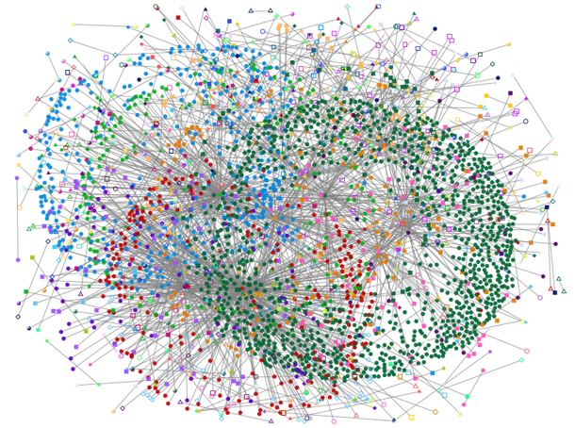
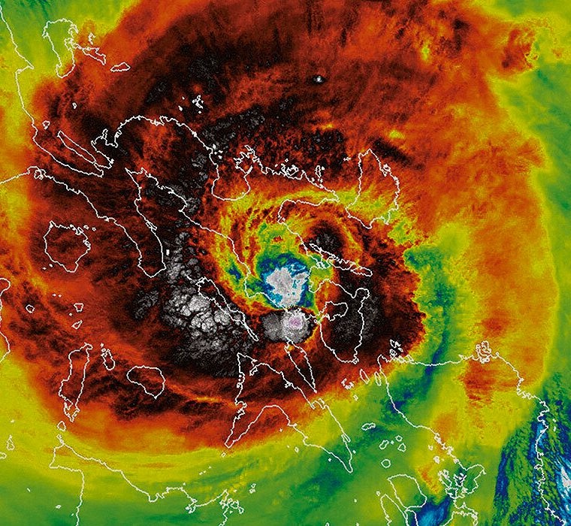
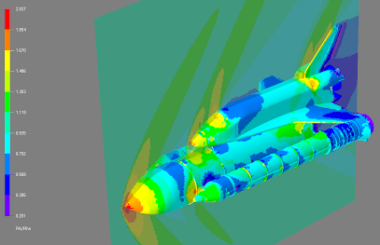
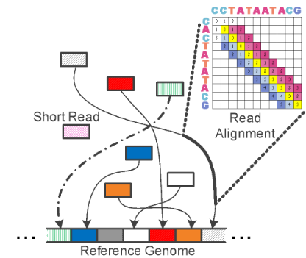




Modern Workloads Exhibit Massive Data Footprints
High-performance computing
Graph analytics
Large-scale artificial intelligence
Genome analysis
Notes:
As we know, many modern workloads from key application domains
such as high-performance computing to genome sequencing exhibit massive data footprints [CLICK]

Slide 3
Modern Workloads Exhibit Massive Data Footprints
Massive data footprints
overwhelm state-of-the-art memory systems
High-performance computing
Graph analytics
Memory is (and likely will be)
the key performance & energy bottleneck
Large-scale artificial intelligence
Genome read mapping
Notes:
Which easily overwhelms the storage and retrieval capabilities of state-of-the-art memory systems
[CLICK] as a result, memory is, and likely will be, the key performance and energy bottleneck of computing systems.

Slide 4
Numerous Microarchitectural Techniques to Address the Memory Bottleneck
Cache management policies
Hit/miss prediction
Dead block prediction
Thread-based precomputation
Cache bypassing
Memory renaming
Runahead execution
Out-of-order execution
Load value prediction
Spatial prefetching
Memoization
Software prefetching
Coarse-grained multithreading
Temporal prefetching
Simultaneous multithreading
Load address speculation
Memory dependence prediction
Load address precomputation
Dead instruction elimination
Notes:
Researchers have proposed numerous microarchitectural techniques to address..
that have constantly pushed the performance and energy efficiency of modern high-performance processors

Slide 5


Key Observation
Even though microarchitectural techniques
observe a large amount of
Application data
(e.g., program counter value, memory addresses, memory values)
System data
(e.g., bandwidth usage,
cache utilization and pollution)
Decisions they make online are often
agnostic to the data they observe
Notes:
However, we observe that:
[CLICK] even though modern microarchitectures observe
a large amount of application data as well as system-generated data during their course of operation
[CLICK] the decisions they make online are often agnostic to the data they observe

Slide 6


Key Observation
Decisions they make online are often
agnostic to the data they observe
Limited adaptation to observed data
Make decisions based on rigid, and often myopic, human-crafted heuristics, disregarding the large volume of data present at runtime
Insufficient exploitation of data characteristics
Do not fully exploit or often disregard diverse properties of
application data (e.g., criticality, value locality, compressibility)
Data-agnostic decision making
limits effectiveness
Notes:
In this thesis, we demonstrate two concrete cases of data-agnostic behavior:
[CLICK] First, we show that many microarchitectural techniques have limited adaptation capability to the observed data
Essentially, they make decision based on ...
[CLICK] Second, we show that many microarchitectural techniques
do not fully exploit or often outright disregard
diverse ... such as ...
We observe that this data-agnostic behavior significantly limit the effectiveness of many state-of-the-art techniques

Slide 7


Thesis Statement
By enabling microarchitecture to
Adapt its policies by continuously learning
from application data and system-generated data
Tailor its decisions by exploiting characteristics
of application data
We can significantly improve performance and
energy efficiency of state-of-the-art processors
Notes:
In this thesis, we posit that, if we enable microarchitecture to
[CLICK] adapt its policies ...
and
[CLICK] tailor its decisions by
[CLICK] we can significantly ...

Slide 8

Our Approach
Exploit lightweight and practical
machine learning methods
Adapt its policies by continuously learning
from application data and system-generated data
Tailor its decisions by exploiting characteristics
of the application data
Study and exploit
underexplored data characteristics
Notes:
To substantiate this hypothesis, we approach in two ways.
[CLICK] First, we exploit lightweight and practical ... to enable microarchitecture to adapt to its policies
[CLICK] Second, we study and exploit previously-underexplored application data characteristics
to enable state-of-the-art microarchitecture to tailor its decisions

Slide 9
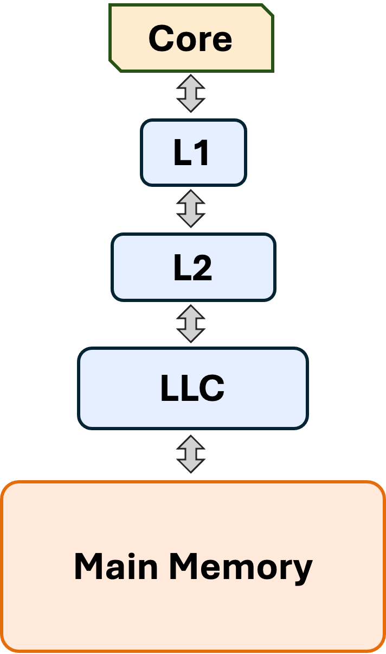
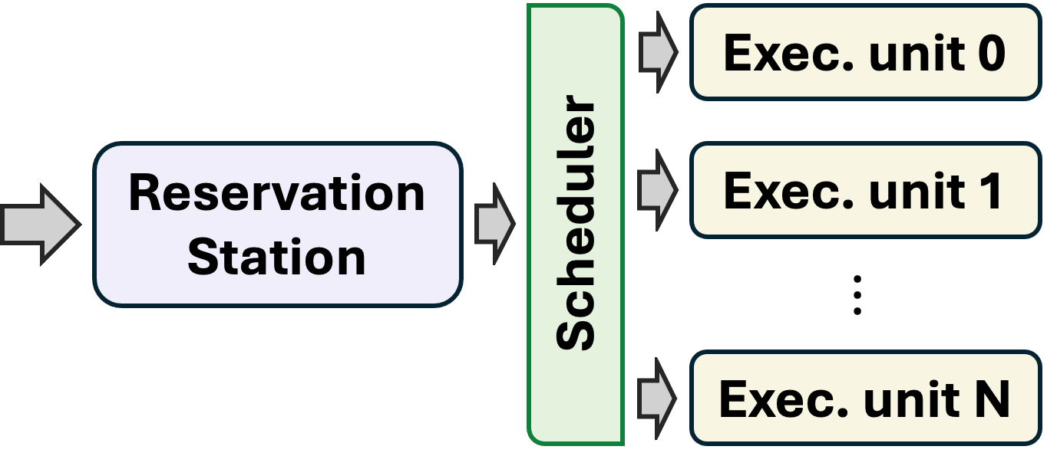
Fetch & Decode
Execute
Access Memory
Commit
Notes:
To this end, this thesis makes four key contributions throughout the processor execution pipeline

Slide 10




Key Contributions
Fetch & Decode
Execute
Access Memory
Commit
Hermes ^{[MICRO’22]}
Off-chip prediction (OCP)
using perceptron learning
Athena ^{[under review]}
Prefetcher-OCP coordination
using reinforcement learning
Constable ^{[ISCA’24]}
Safely eliminating load instruction execution
by exploiting load address-value stability
Pythia ^{[MICRO’21]}
Hardware data prefetching
using reinforcement learning
Notes:
[CLICK] First, we propose Pythia, a RL based hardware data prefetcher
[CLICK] Second, we propose Hermes, a perceptron-learning-based off-chip load prediction mechanism
[CLICK] Third, we propose Athena, a RL-based approach to coordinate prefetching and off-chip prediction
[CLICK] Fourth, we propose Constable, a safe load execution elimination technique by exploiting load instruction characteristics

Slide 11
Key Contributions
Fetch & Decode
Execute
Access Memory
Commit
Hermes ^{[MICRO’22]}
Off-chip prediction (OCP)
using perceptron learning
Athena ^{[under review]}
Prefetcher-OCP coordination
using reinforcement learning
Constable ^{[ISCA’24]}
Safely eliminating load instruction execution
by exploiting load address-value stability
Pythia ^{[MICRO’21]}
Hardware data prefetching
using reinforcement learning
Pythia [MICRO’21]
Hermes [MICRO’22]
Athena [under review]
Constable [ISCA’24]
Notes:
So, now let’s start with Pythia, which is a RL-based hardware data prefetcher.

Slide 12
What is a Hardware Data Prefetcher?
Predicts address of future memory requests and fetches their data before the program needs them
Typically correlates access patterns in past memory requests with program feature
Program feature → access pattern
(e.g., load PC)
When the program feature repeats, the prefetcher anticipates
the repetition of the same access pattern and predicts future addresses
Pythia [MICRO’21]
Hermes [MICRO’22]
Athena [under review]
Constable [ISCA’24]
Notes:
What is data prefetching? It’s a well-explored technique that predicts
A prefetcher typically correlates access patterns ...
The key idea is: when the program feature repeats, the prefetcher ...

Slide 13




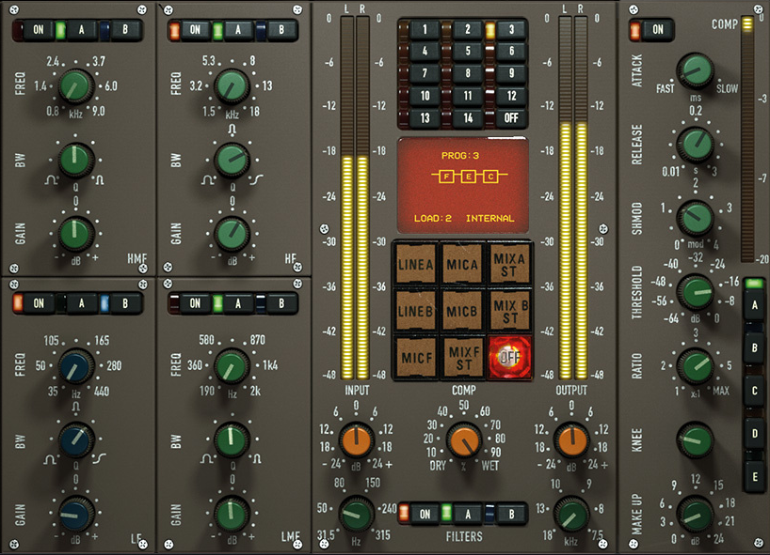
Three Limitations in Prior Prefetchers
Reliance on a single, fixed program feature
for prefetch prediction
Rigidity limits dynamic adaptation in workloads where
the selected feature provides poor correlation with access pattern
Lack of inherent system awareness
Neglecting a prefetcher’s undesirable effects on the system (e.g., bandwidth usage, cache pollution) often harms performance
Lack of in-silicon customizability
Rigid hardware structure provides no customizability to select
new program features and/or prefetching objective at runtime
Pythia [MICRO’21]
Hermes [MICRO’22]
Athena [under review]
Constable [ISCA’24]
Notes:
Even though literature is rich with numerous prefetching techniques,
we observe three key limitations that significantly affects their effectiveness
[CLICK] First, most prior prefetchers rely on single ...
This rigidity limits dynamic adaptation across wide range of workloads
[CLICK] Second, many prior prefetchers lack inherent awareness to system-level feedback
which often harms performance in resource-constrained systems.
[CLICK] Third, they lack in-silicon customizability. Their rigid hardware design provides less opportunity
to customize ...

Slide 14


Our Goal
Design a holistic prefetching framework that can
Learn to prefetch using multiple program features
and inherent system-level feedback information
Be easily customized in silicon to change
program feature and/or prefetching objective on-the-fly
Pythia [MICRO’21]
Hermes [MICRO’22]
Athena [under review]
Constable [ISCA’24]
Notes:
To alleviate these challenges, we aim to design a holistic prefetching framework that can
...

Slide 15




Key Idea: Formulate prefetching as reinforcement learning
RL agent
Pythia
Autonomously learn
what to prefetch
Processor and Memory System
Environment
Pythia [MICRO’21]
Hermes [MICRO’22]
Athena [under review]
Constable [ISCA’24]
Notes:
Towards this, we propose Pythia, whose [CLICK] key idea is to formulate prefetching as a RL problem.
[CLICK] Pythia itself acts as the RL agent, whose goal is to ... by interacting with its environment which is
[CLICK] the processor ...

Slide 16
Key Idea: Formulate prefetching as reinforcement learning
Program features
(e.g., PC, page offset, cacheline delta)
Prefetch offset
(i.e., delta between the prefetch and demand cacheline)
Pythia
State
Reward
Action
Processor and Memory System
Prefetch quality
considering system-level feedback
Pythia [MICRO’21]
Hermes [MICRO’22]
Athena [under review]
Constable [ISCA’24]
Notes:
Pythia extracts a set of program features from the current and past demand requests
and use it as a state information
[CLICK] to take a prefetch action. An action is a prefetch offset that it adds
to the current demand cacheline address to generate prefetch request.
[CLICK] For every generated prefetch request, Pythia gets a numerical reward from the environment
which evaluates the prefetch request under various system-level feedback.
Pythia uses this reward to learn correlation between the state and the action
to autonomously and adaptively generate prefetch requests

Slide 17


Trace-driven simulation
using ChampSim
Two-part evaluation
Hardware prototyping
using Chisel
Pythia [MICRO’21]
Hermes [MICRO’22]
Athena [under review]
Constable [ISCA’24]
Notes:
We evaluate Pythia using both trace-driven simulation and hardware prototyping [NEXT]

Slide 18
Trace-driven simulation
using ChampSim
Wide range of prefetchers
Wide range of workloads
SPP [Kim+, MICRO’16]
Bingo [Bakshalipour+, HPCA’19]
MLOP [Shakerinava+, DPC3’19]
SPP+DSPatch [Bera+, MICRO’19]
SPP+ PPF [Bhatia+, ISCA’20]
150 single-core workloads from SPEC CPU 2006, 2017, PARSEC, and Ligra
270 multi-core workload mixes
Wide range of system-configurations
#cores: 1 – 12 cores
Main memory bandwidth: 150 – 9600 MTPS
LLC size: 256KB – 4 MB
Number of prefetchers at different cache level
Pythia [MICRO’21]
Hermes [MICRO’22]
Athena [under review]
Constable [ISCA’24]
Notes:
using a wide rage of workloads and system configurations

Slide 19



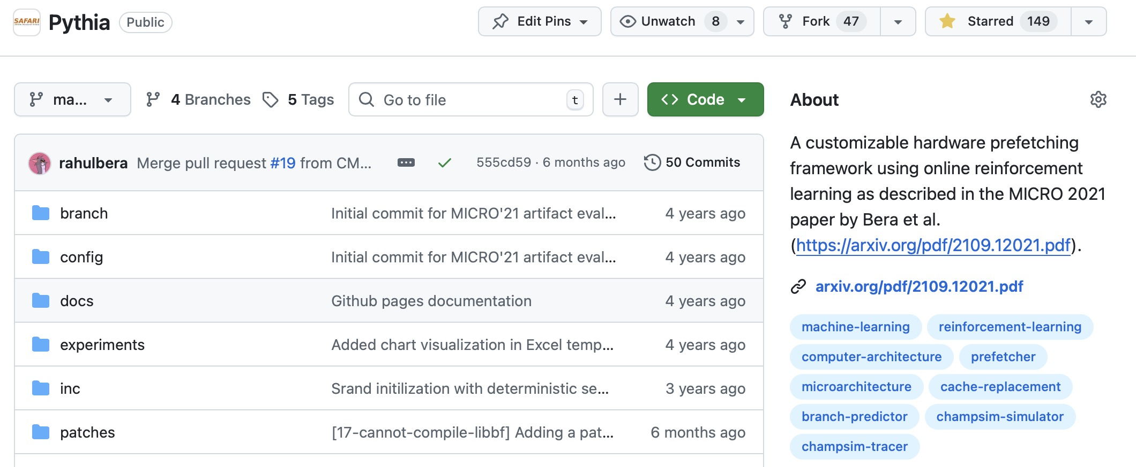
Trace-driven simulation
using ChampSim
Wide range of prefetchers
Wide range of workloads
SPP [Kim+, MICRO’16]
Bingo [Bakshalipour+, HPCA’19]
MLOP [Shakerinava+, DPC3’19]
SPP+DSPatch [Bera+, MICRO’19]
SPP+ PPF [Bhatia+, ISCA’20]
150 single-core workloads from SPEC CPU 2006, 2017, PARSEC, and Ligra
270 multi-core workload mixes
Wide range of system-configurations
#cores: 1 – 12 cores
Main memory bandwidth: 150 – 9600 MTPS
LLC size: 256KB – 4 MB
Number of prefetchers at different cache level
Open-sourced and artifact-evaluated
with all three ACM badges
Pythia [MICRO’21]
Hermes [MICRO’22]
Athena [under review]
Constable [ISCA’24]
Notes:
Our evaluation infrastructure is fully-open sourced and artifact-evaluated

Slide 20
Key Results
Pythia
SPP
MLOP
Bingo
Outperforms prior prefetchers
in wide range of configurations varying core count
Pythia [MICRO’21]
Hermes [MICRO’22]
Athena [under review]
Constable [ISCA’24]
Notes:
Our evaluation shows that Pythia consistently outperforms multiple
prior state-of-the-art prefetchers
both in single-core and numerous multi-core configurations

Slide 21
Key Results
Pythia
Bingo
MLOP
SPP
Outperforms prior prefetchers
in wide range of memory bandwidth configurations
Pythia [MICRO’21]
Hermes [MICRO’22]
Athena [under review]
Constable [ISCA’24]
Notes:
Pythia also outperforms prior prefetchers across
a wide range of memory bandwidth configurations

Slide 22


Key Results
More performance gains
with customization
Uto 7.8% perf. gain than baseline Pythia in Ligra
by reward customization
Low-overhead, low-latency, and high-throughput predictions
1.03% area and 0.4% power overhead
Meets latency and throughput of an L2 prefetcher
Pythia [MICRO’21]
Hermes [MICRO’22]
Athena [under review]
Constable [ISCA’24]
Notes:
Moreover, Pythia can be customized in silicon to provide further performance gains than baseline Pythia
[CLICK] and Pythia’s hardware architecture provides low-overhead ...

Slide 23
Does Pythia Solve the Memory Bottleneck?
~50%
successfully prefetched
by Pythia
~50%
still going off-chip
even with Pythia
# demand loads going to off-chip without Pythia
What to do with these loads
that are still going off-chip?
Pythia [MICRO’21]
Hermes [MICRO’22]
Athena [under review]
Constable [ISCA’24]
Notes:
Does this mean Pythia solve memory bottleneck?
The answer is no.
If we look into the loads that would have gone to off-chip main memory without Pythia,
we see that nearly half of them are successfully prefetched by Pythia.
[CLICK] but the remaining half are still going to off-chip.
[CLICK] So what to do with these loads that are still going off-chip?

Slide 24
Key Contributions
Fetch & Decode
Execute
Access Memory
Commit
Hermes ^{[MICRO’22]}
Off-chip prediction (OCP)
using perceptron learning
Athena ^{[under review]}
Prefetcher-OCP coordination
using reinforcement learning
Constable ^{[ISCA’24]}
Safely eliminating load instruction execution
by exploiting load address-value stability
Pythia ^{[MICRO’21]}
Hardware data prefetching
using reinforcement learning
Pythia [MICRO’21]
Hermes [MICRO’22]
Athena [under review]
Constable [ISCA’24]
Notes:
That brings us to our second contribution -- Hermes.

Slide 25
Key Observation for Off-Chip Loads
On-chip cache access latency
significantly contributes to the off-chip load latency
L1
L2
LLC
Main Memory
L1
L2
LLC
Main Memory
Saved cycles
40% of the stalls can be eliminated by removing
on-chip cache access latency from critical path
Pythia [MICRO’21]
Hermes [MICRO’22]
Athena [under review]
Constable [ISCA’24]
Notes:
In this work, we observe that, on-chip cache access latency ...
[CLICK] 40% of the stalls cycles caused by an off-chip load can be ...

Slide 26
Our Goal
Improve processor performance
by removing on-chip cache access latency
from the critical path of off-chip loads
Pythia [MICRO’21]
Hermes [MICRO’22]
Athena [under review]
Constable [ISCA’24]
Notes:
Thus, our goal in this work is to improve ...

Slide 27



Predicts which loads are likely to go off-chip
L1
L1
L2
L2
LLC
LLC
Main Memory
Main Memory
Starts fetching data directly from main memory
while concurrently accessing the cache hierarchy
Pythia [MICRO’21]
Hermes [MICRO’22]
Athena [under review]
Constable [ISCA’24]
Notes:
Towards this we propose Hermes, which is based on two key ideas...
[CLICK] First, Hermes predicts which ... early in the pipeline
[CLICK] Second, for those predicted off-chip requests, Hermes starts fetching ...
[CLICK] while also concurrently ...
[CLICK] By doing so, Hermes hides the on-chip cache access latency
under the shadow of main memory access latency
[CLICK] which in turn provides significant performance improvement

Slide 28


Predicts which loads are likely to go off-chip
The first perceptron-based off-chip load predictor
Adaptively learns to identify off-chip loads from multiple program features
Trainable weights
Feature
(e.g., PC)
Load Request
Σ
Off-chip
prediction
Pythia [MICRO’21]
Hermes [MICRO’22]
Athena [under review]
Constable [ISCA’24]
Notes:
To predict which loads are likely to go off-chip, Hermes employs the
first perceptron-based off-chip load predictor that adaptively learns ....
From a given demand request, Hermes extracts a set of program features to retrive

Slide 29
Trace-Driven Simulation Methodology
Prefetchers
Off-chip Predictors
Pythia [Bera+, MICRO’21]
Bingo [Bakshalipour+, HPCA’19]
MLOP [Shakerinava+, DPC3’19]
SPP+ PPF [Bhatia+, ISCA’20]
SMS [Somogyi+, ISCA’06]
History-based predictor [Yoaz+, ISCA’99]
Address Tag-Tracking based predictor
Ideal off-chip predictor
Workloads
System Configurations
110 single-core workloads from SPEC CPU 2006, 2017, PARSEC, and Ligra, and more
220 four-core and eight-core workload mixes
# cores: 1- 8 cores
Main memory bandwidth: 200-12800 MTPS
Cache access latency
Interconnect latency
...
Pythia [MICRO’21]
Hermes [MICRO’22]
Athena [under review]
Constable [ISCA’24]

Slide 30
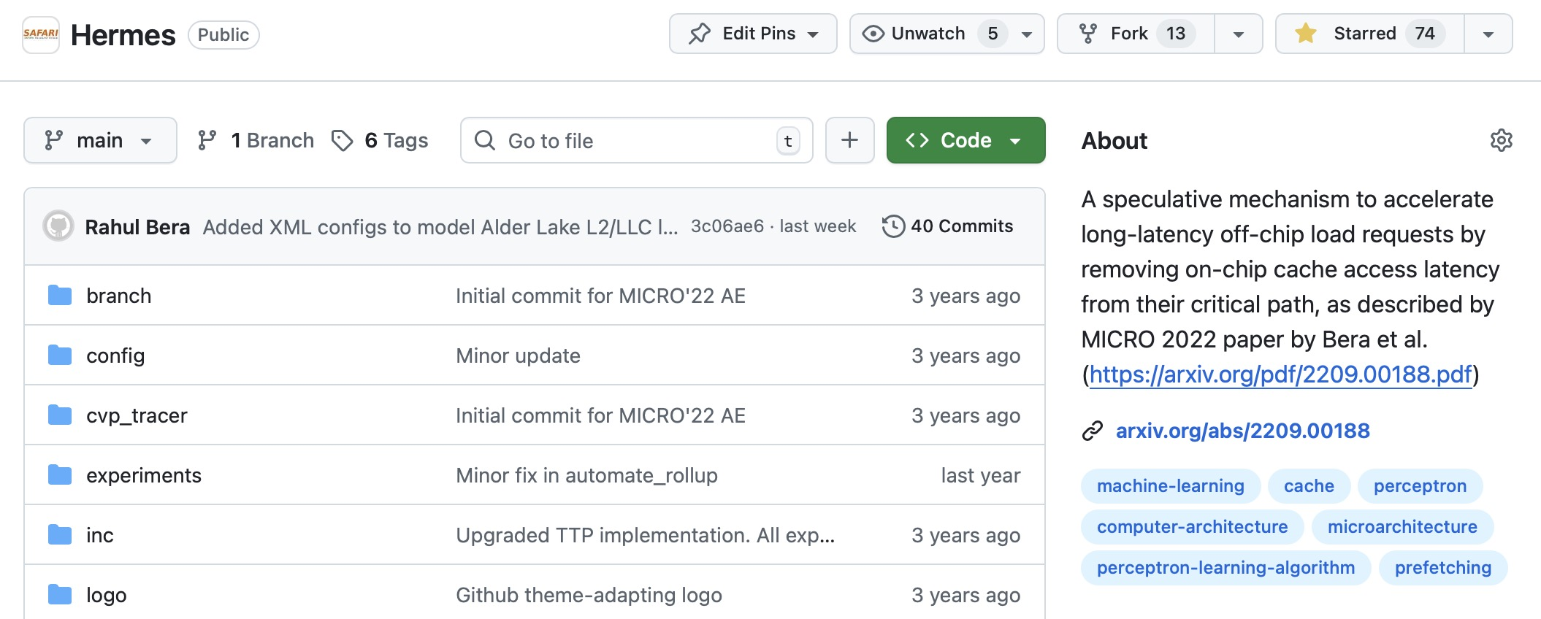
Trace-Driven Simulation Methodology
Prefetchers
Off-chip Predictors
Pythia [Bera+, MICRO’21]
Bingo [Bakshalipour+, HPCA’19]
MLOP [Shakerinava+, DPC3’19]
SPP+ PPF [Bhatia+, ISCA’20]
SMS [Somogyi+, ISCA’06]
History-based predictor [Yoaz+, ISCA’99]
Address Tag-Tracking based predictor
Ideal off-chip predictor
Workloads
System Configurations
110 single-core workloads from SPEC CPU 2006, 2017, PARSEC, and Ligra, and more
220 four-core and eight-core workload mixes
# cores: 1- 8 cores
Main memory bandwidth: 200-12800 MTPS
Cache access latency
Interconnect latency
...
Open-sourced and artifact-evaluated
with all three ACM badges
Pythia [MICRO’21]
Hermes [MICRO’22]
Athena [under review]
Constable [ISCA’24]

Slide 31
Key Results
5.4%
11.5%
Provides performance gains by itself
and when added on top of sophisticated prefetchers
Pythia [MICRO’21]
Hermes [MICRO’22]
Athena [under review]
Constable [ISCA’24]

Slide 32

Key Results
High-accuracy and high-coverage
Off-chip prediction with 77% accuracy & 74% coverage
Low storage and
low power overhead
Only 4 KB storage per core
1.5% increase in power over Pythia
Pythia [MICRO’21]
Hermes [MICRO’22]
Athena [under review]
Constable [ISCA’24]
Notes:
Our simulation-based evaluation shows that Hermes provides ...
[CLICK] Hermes improves performance by itself, and also when added on top of ...
[CLICK] And Hermes’s performance benefits come at a modest overhead in storage and power consumption

Slide 33
One Problem:
Two Fundamentally-Different Approaches
Data prefetcher
Off-chip predictor
Predicts address
of future memory requests
Predicts whether or not a given memory request would go off-chip
How do they behave together?
Pythia [MICRO’21]
Hermes [MICRO’22]
Athena [under review]
Constable [ISCA’24]
Notes:
With that, we proposed two fundamentally-different speculative mechanisms
targeted towards the same memory bottleneck problem:
[CLICK] Pythia addresses memory bottleneck by predicting future memory addresses
[CLICK] whereas, Hermes addresses memory bottleneck by predicting which memory requests would go off-chip
Technically, these two techniques can be applied together in a system.
But then the question is [CLICK] how do they ...

Slide 34
Key Contributions
Fetch & Decode
Execute
Access Memory
Commit
Hermes ^{[MICRO’22]}
Off-chip prediction (OCP)
using perceptron learning
Athena ^{[under review]}
Prefetcher-OCP coordination
using reinforcement learning
Constable ^{[ISCA’24]}
Safely eliminating load instruction execution
by exploiting load address-value stability
Pythia ^{[MICRO’21]}
Hardware data prefetching
using reinforcement learning
Pythia [MICRO’21]
Hermes [MICRO’22]
Athena [under review]
Constable [ISCA’24]
Notes:
This brings us to the third contribution of this thesis – Athena.

Slide 35



Key Observations
Off-chip prediction (OCP) and data prefetching individually provide complementary performance gains
Especially in memory bandwidth-constrained systems, where prefetcher
often degrades performance, but an OCP improves performance
Naively combination is not beneficial
Enabling both mechanisms often negates performance benefits of OCP
Existing mechanisms lack flexibility or have significant performance headroom
TLP [Jamet+, HPCA’24] lacks flexibility.
HPAC [Ebrahimi+, MICRO’09] and MAB [Gerogiannis+, MICRO’23] are not optimal
Pythia [MICRO’21]
Hermes [MICRO’22]
Athena [under review]
Constable [ISCA’24]
Notes:
In this work, we observe that ...
[CLICK] off-chip prediction is a viable alternative ...
especially in memory ...
[CLICK] Yet, naively combining both of these mechanisms is not beneficial,
especially in bandwidth-constrained systems, where enabling both mechanism often negates ...
[CLICK] and existing coordination mechanism either lack flexibility
in a sense that they cannot coordinate an off-chip predictor
in presence of multiple prefetchers scattered throughout the cache hierarchy,
or they leave a substantial room for performance improvement behind

Slide 36


Our Goal
Design a holistic framework that
Autonomously synergizes OCP with
multiple prefetchers throughout the cache hierarchy
To deliver consistent performance benefits,
regardless of workloads and system configuration
Pythia [MICRO’21]
Hermes [MICRO’22]
Athena [under review]
Constable [ISCA’24]
Notes:
Thus, our goal in this work is to design ...
autonomously ...
to deliver ...

Slide 37

Key Idea: Formulate OCP-prefetcher coordination
as a reinforcement learning problem
Pythia [MICRO’21]
Hermes [MICRO’22]
Athena [under review]
Constable [ISCA’24]
Notes:
Towards this, we propose Athena, whose key idea is to ...

Slide 38
RL agent
Athena
Autonomously learn
how to coordinate
Processor and Memory System
Environment
Pythia [MICRO’21]
Hermes [MICRO’22]
Athena [under review]
Constable [ISCA’24]
Notes:
Athena itself acts as the RL agent whose
[CLICK] goal is to autonomously ...
[CLICK] by interacting with the environment which is ...

Slide 39
System features
(e.g., b/w usage, prefetcher accuracy)
Coordination action
(i.e., what to enable
& how much to enable)
Athena
State_{t}
Reward_{t}
Action_{t}
Processor and Memory System
Change in telemetry
(e.g., IPC, #LLC miss, #load instructions)
t = N committed instructions
Pythia [MICRO’21]
Hermes [MICRO’22]
Athena [under review]
Constable [ISCA’24]
Notes:
At the end of every epoch, which is a fixed number of committed instructions ...
[CLICK] Athena extracts a set of system-level features such as ..
and use it as a state information
[CLICK] to take a coordination action. An action in this case is
not only to determine which mechanism to enable, but also how much aggressiveness a mechanism should be enabled with.
[CLICK] At the end of the epoch, the environment provides a numerical reward to Athena
that incorporates the change in system-level telemetry, that are directly affected by Athena’s actions (such as change in IPC),
but also, telemetry that are seemingly uncorrelated to Athena’s action (such as change in number of load instructions).
[This is to ensure that Athena not only learns from the impact of its own actions,
but also from the change in the program phase behavior.]

Slide 40
Trace-Driven Simulation Methodology
Prefetchers
Off-chip Predictors
Stride [Baer, SC’91]
IPCP [Pakalapati+, ISCA’20]
Pythia [Bera+, MICRO’21]
SPP+ PPF [Bhatia+, ISCA’20]
SMS [Somogyi+, ISCA’06]
MLOP [Shakerinava+, DPC3’19]
Hermes [Bera+, MICRO’22]
HMP [Yoaz+, ISCA’99]
TTP [Jalili+, HPCA’22]
Coordination Policies
HPAC [Ebrahimi+, MICRO’09]
MAB [Yoaz+, ISCA’99]
TLP [Jamet+, HPCA’24]
System Configurations
# cores: 1- 8 cores
Main memory bandwidth: 200 - 1600 MTPS
4 cache designs with various prefetchers at different cache levels
Workloads
100 single-core workloads
180 four-core and eight-core workload mixes
Pythia [MICRO’21]
Hermes [MICRO’22]
Athena [under review]
Constable [ISCA’24]
Notes:
We evaluate Athena in coordinating multiple types of prefetcher and off-chip predictors
under a wide range of workloads and system configurations

Slide 41
Key Results
OCP + 1 prefetcher @ L2
OCP + 1 prefetcher @ L1
OCP + 2 prefetchers @ L2
OCP + 1 prefetcher @ L1 & L2
Pythia [MICRO’21]
Hermes [MICRO’22]
Athena [under review]
Constable [ISCA’24]
Notes:
Our evaluation shows that, across a wide range of system configuration
with different number of prefetchers at different cache levels
[CLICK] Consistently outperforms [CLICK] in all system configurations

Slide 42

Key Results
Consistent performance benefit
In coordinating four types of prefetchers
and three types of off-chip predictors
Low storage overhead
Only 3 KB per core
Pythia [MICRO’21]
Hermes [MICRO’22]
Athena [under review]
Constable [ISCA’24]
Notes:
Moreover, Athena provides consistent performance benefit ...
[CLICK] all while incurring a modest storage overhead.

Slide 43
Key Contributions: Recap
Fetch & Decode
Execute
Access Memory
Commit
Hermes ^{[MICRO’22]}
Off-chip prediction (OCP)
using perceptron learning
Athena ^{[under review]}
Prefetcher-OCP coordination
using reinforcement learning
Constable ^{[ISCA’24]}
Safely eliminating load instruction execution
by exploiting load address-value stability
Pythia ^{[MICRO’21]}
Hardware data prefetching
using reinforcement learning
Pythia [MICRO’21]
Hermes [MICRO’22]
Athena [under review]
Constable [ISCA’24]
Notes:
With that, we look three proposals in this thesis,
[CLICK] Pythia, Hermes, and Athena - all of which aim to alleviate memory bottleneck
[CLICK] by finding inefficiencies at the memory hierarchy level

Slide 44
Key Contributions
Fetch & Decode
Execute
Access Memory
Commit
Hermes ^{[MICRO’22]}
Off-chip prediction (OCP)
using perceptron learning
Athena ^{[under review]}
Prefetcher-OCP coordination
using reinforcement learning
Constable ^{[ISCA’24]}
Safely eliminating load instruction execution
by exploiting load address-value stability
Pythia ^{[MICRO’21]}
Hardware data prefetching
using reinforcement learning
Pythia [MICRO’21]
Hermes [MICRO’22]
Athena [under review]
Constable [ISCA’24]
Notes:
But inefficiencies also arise inside the core’s execution.
Addressing these inefficiencies can also help in alleviating memory bottleneck.
That brings us to our fourth contribution – Constable

Slide 45

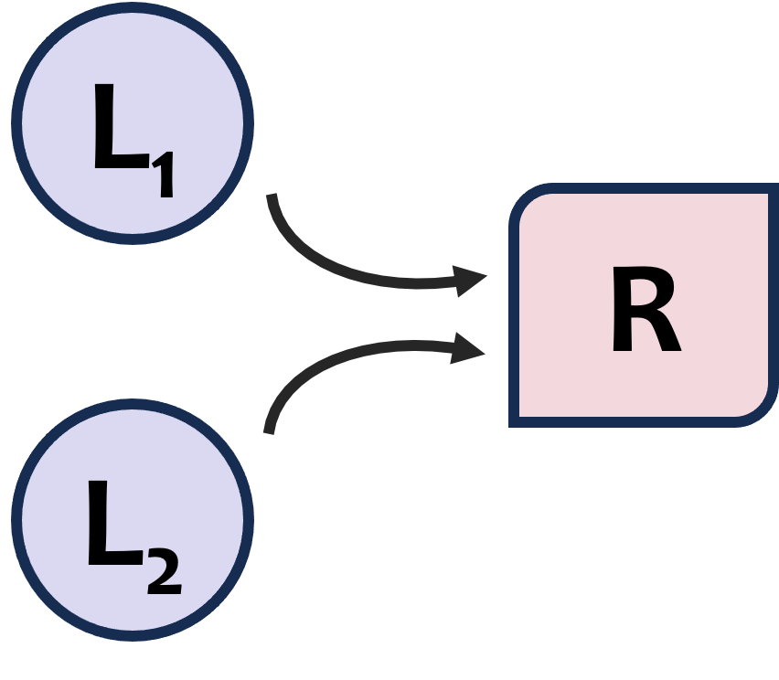
Key Observations
A large fraction (34%) of dynamic loads fetch
the same data from the same address
throughout the entire workload
Techniques like load value prediction (LVP) and memory renaming (MRN)
do not fully exploit this data characteristic
These loads cause instruction-level parallelism loss due to resource dependence
i.e., blocking other loads from getting executed due to limited resources.
LVP and MRN fail to mitigate resource dependence
Mitigating both data and resource dependence has higher potential performance improvement
Eliminating execution of such loads provides more than 2X potential performance benefit than just breaking their data dependence
2X
Pythia [MICRO’21]
Hermes [MICRO’22]
Athena [under review]
Constable [ISCA’24]
Notes:
In this work we observe that
[CLICK] a large fraction of load instructions executed by the processor infact fetches ...
prior techniques like ... do not fully exploit this data characteristics ...
[CLICK] We show that these loads cause significant loss in instruction-level parallelism
due to sheer resource dependence even in presence of sophisticated techniques like LVP and MRN
[CLICK] Mitigating both the data and resource dependence on these loads ...
has double potential performance benefit than just breaking their data dependence.

Slide 46
Our Goal
Improve instruction-level parallelism by
mitigating both load data and resource dependence
Pythia [MICRO’21]
Hermes [MICRO’22]
Athena [under review]
Constable [ISCA’24]
Notes:
Thus our goal in this work is to ...

Slide 47
Constable: Key Insight
LD₁
add rax, 0x10
mov r8, [rbp+0x8]
sub rax, r8
cmp rsi, rax
Two successive dynamic instances
of the same static load instruction
jle 0x40230e
Dynamic instruction stream
add rax, 0x10
mov r8, [rbp+0x8]
sub rax, r8
LD₂
cmp rsi, rax
jle 0x40230e
add rax, 0x10
Pythia [MICRO’21]
Hermes [MICRO’22]
Athena [under review]
Constable [ISCA’24]
Notes:
Towards this we propose Constable,
which is based on a simple key insight that if there are two successive dynamic instances
X1 and X2 of a load instruction,
[CLICK] then X2 will fetch... if:
[CLICK] None of the ...
[CLICK] No store or snoop ...

Slide 48


Constable: Key Insight
If the source register (rbp)
has not been modified
LD₁
add rax, 0x10
mov r8, [rbp+0x8]
sub rax, r8
LD₂ would have the same address as LD₁
cmp rsi, rax
jle 0x40230e
Address generation of LD₂
can be eliminated
Dynamic instruction stream
add rax, 0x10
mov r8, [rbp+0x8]
If no store or snoop request
to address [rbp+0x8]
sub rax, r8
LD₂
cmp rsi, rax
jle 0x40230e
LD₂ would fetch the same data as LD₁
add rax, 0x10
Data fetching of LD₂
can be eliminated
Pythia [MICRO’21]
Hermes [MICRO’22]
Athena [under review]
Constable [ISCA’24]
Notes:
Constable is based on a simple key insight that if there are two successive dynamic instances
X1 and X2 of a load instruction,
[CLICK] then X2 will fetch... if:
[CLICK] None of the ...
[CLICK] No store or snoop ...

Slide 49



Constable: Key Steps
Dynamically identify load instructions
that have historically fetched
the same data from the same load address
(i.e., likely-stable)
Eliminate execution of likely-stable loads
by tracking modifications to
their source registers and their load addresses
Pythia [MICRO’21]
Hermes [MICRO’22]
Athena [under review]
Constable [ISCA’24]
Notes:
Based on this insight, Constable works on two key steps:
[CLICK] First, Constable dynamically identifies ...
[CLICK] For every likely-stable load, Constable tracks modifications ...
[CLICK] and eliminates their execution until there is a write ...

Slide 50
Evaluation with Industry-Grade Simulator
Strong Baseline
Compared Against
Aggressive OoO processor
With memory renaming, zero/constant/move elimination, branch folding
Five data prefetchers
EVES, the state-of-the-art load value predictor [Seznec+, CVP’18]
Early load address resolution [Berkerman+, ISCA’00]
Register file prefetching [Shukla+, ISCA’22]
Workloads
System Configurations
90 workloads from variety of application domains
  SPEC CPU 2017
  Client
  Enterprise
  Server
Without simultaneous multithreading
With 2-way simultaneous multithreading
Pythia [MICRO’21]
Hermes [MICRO’22]
Athena [under review]
Constable [ISCA’24]

Slide 51
Key Results – Without SMT
5.1%
3.4%
Provides performance gains by itself
and when added on top of load value predictor
Pythia [MICRO’21]
Hermes [MICRO’22]
Athena [under review]
Constable [ISCA’24]

Slide 52
Key Results – With 2-way SMT
11.3%
8.8%
Higher performance benefits
in a 2-way SMT processor
Pythia [MICRO’21]
Hermes [MICRO’22]
Athena [under review]
Constable [ISCA’24]

Slide 53


Key Results
Improved resource efficiency
26% L1-D access reduction,
8.8% RS allocation reduction
Reduction in dynamic power
9.1% L1-D power reduction, 5.1% RS power reduction
Low storage and area overhead
12.4 KB per core, 0.232 mm2 area overhead
Pythia [MICRO’21]
Hermes [MICRO’22]
Athena [under review]
Constable [ISCA’24]
Notes:
Our extensive evaluation with an industry-grade simulator shows that:
[CLICK] Constable provides ... over a SOTA processor that already employs
the SOTA LVP and memory renaming ... both in no SMT ...
[CLICK] On top of improving performance, Constable also improves ...
which in turn reduces the dynamic power consumption of the system...
[CLICK] all while incurring a modest storage and area overhead ...

Slide 54
Putting It All Together
Notes:
To put together everything that we have discussed till now...

Slide 55
Recall: Thesis Statement
By enabling microarchitecture to
Adapt its policies by continuously learning
from application data and system-generated data
Tailor its decisions by exploiting characteristics
of application data
We can significantly improve performance and
energy efficiency of state-of-the-art processors
Notes:
We started with a hypothesis that by enabling microarchitecture ...

Slide 56
Key Contributions
Fetch & Decode
Execute
Access Memory
Commit
Hermes ^{[MICRO’22]}
Off-chip prediction (OCP)
using perceptron learning
Athena ^{[under review]}
Prefetcher-OCP coordination
using reinforcement learning
Constable ^{[ISCA’24]}
Safely eliminating load instruction execution
by exploiting load address-value stability
Pythia ^{[MICRO’21]}
Hardware data prefetching
using reinforcement learning
Notes:
[CLICK] First, we propose Pythia, a RL based hardware data prefetcher
[CLICK] Second, we propose Hermes, a perceptron-learning-based off-chip load prediction mechanism
[CLICK] Third, we propose Athena, a RL-based approach to coordinate prefetching and off-chip prediction
[CLICK] Fourth, we propose Constable, a safe load execution elimination technique by exploiting load instruction characteristics

Slide 57
Putting it All Together
ML-driven techniques
Pythia ^{[MICRO’21]}
Hardware data prefetching
using reinforcement learning
Hermes ^{[MICRO’22]}
Off-chip prediction (OCP)
using perceptron learning
Athena ^{[under review]}
Prefetcher-OCP coordination
using reinforcement learning
Adapt their policies by continuously learning
from application data and system-generated data
Tailor its decisions by exploiting characteristics
of the application data
Constable ^{[ISCA’24]}
Safely eliminating load instruction execution
by exploiting load address-value stability
Data-aware technique
Notes:
where Pythia, Hermes, and Athena in unison exemplifies techniques
that uses machine learning to adapt ...
whereas Constable exemplifies technique that exploits
new data characteristics to tailor microarchitectural decisions

Slide 58
Putting it All Together
Pythia ^{[MICRO’21]}
Hardware data prefetching
using reinforcement learning
Hermes ^{[MICRO’22]}
Off-chip prediction (OCP)
using perceptron learning
Athena ^{[under review]}
Prefetcher-OCP coordination
using reinforcement learning
Constable ^{[ISCA’24]}
Safely eliminating load instruction execution
by exploiting load address-value stability
Significantly improve
performance and/or energy efficiency
over best-prior mechanisms
Notes:
All four techniques significantly improve
the performance and/or energy efficiency over their respective SOTA mechanisms,
thus, quantitatively substantiating the central statement of the thesis.

Slide 59
Recall: Thesis Statement
By enabling microarchitecture to
Adapt its policies by continuously learning
from application data and system-generated data
Tailor its decisions by exploiting characteristics
of application data
We can significantly improve performance and
energy efficiency of state-of-the-art processors
Notes:
We started with a hypothesis that by enabling microarchitecture ...

Slide 60
Future Directions
RL-driven online instruction criticality prediction
RL-driven shared resource partitioning in multi-core systems
Multi-agent RL for coordinated caching, prefetching & memory scheduling
Compiler-microarchitecture co-design to eliminate redundant loads
Near-accurate speculation-aware lazy instruction execution
Extend
Off-chip prediction in GPUs/accelerators
Accurate memory location prediction for disaggregated memory systems
Off-chip prediction for transparent identification of PIM regions
Learning-based data partitioning/placement for PIM
Learning-based self-adaptive prefetcher for PIM
Expand
Notes:
That said, the ML-driven and data-aware design principles advocated in this thesis
can be extended to many other microarchitectural decision making beyond what we have demonstrated.
[CLICK] We can extend these principles to other mechanisms employed in general-purpose processors, such as ...
[CLICK] The same design principles can also be expanded beyond general-purpose processors, such as ...

Slide 61
My Involvements During Ph.D.
Thesis
publications
Bera+
MICRO’21
Bera+
MICRO’22
Bera+
ISCA’24
Lang & Bera+
under review
Other major
contributions
Bera+
MICRO’19
Nori+
ISCA’21
ML-driven
storage system
Singh+
ISCA’22
Nadig+
arXiv’25
Kanellopoulos+
MICRO’23
Kanellopoulos+
ASPLOS’25
Address
translation system
Kanellopoulos+
MICRO’23
Kanellopoulos+
arXiv’25
Near data
processing
Denzler+
IEEE Access’23
Kabra+
ASPLOS’25
Energy-efficient
architecture
Haj-Yahya+
MICRO’21
Olgun+
TACO’24
2019
2020
2021
2022
2023
2024
2025
Notes:
This brings me to the last part of the presentation...
I am thankful to contribute to many other interesting projects beyond what contribute to my thesis

Slide 62
Acknowledgements
Onur Mutlu
Anant V. Nori, Sree Subramoney
Aamer Jaleel, Boris Grot, Chris Wilkerson, Daniel Jiménez, Pradip Bose
Kaveh Razavi
Amazingly-talented mentees: Zhenrong, Sgouras, Clément, and Liana
All SAFARI group members (especially Big K., Nika, Rakesh, and Mohammad)
Industrial partners & sponsors
Friends and colleagues all over the world
My mother, my wife, and my aunt
Notes:
This thesis won’t be possible without the help from numerous people, ....

Slide 63

Acknowledgements
My beloved baba,
Mr. R. R. Bera
(1960 - 2020)
Notes:
This thesis won’t be possible without the help from numerous people, ....

Slide 64
Mitigating the Memory Bottleneck with
Machine Learning-Driven and Data-Aware
Microarchitectural Techniques
Rahul Bera
Doctoral Examination
01.10.2025
Advisor:
Onur Mutlu (ETH Zurich)
Co-Examiners:
Aamer Jaleel (Nvidia Research)
Boris Grot (University of Edinburgh)
Chris Wilkerson (Intel)
Daniel Jiménez (Texas A&M University)
Pradip Bose (IBM T. J. Watson Research Center)
Notes:
This concludes my talk...
I will be happy to take questions...

Slide 65
Influence on the Community

Slide 66
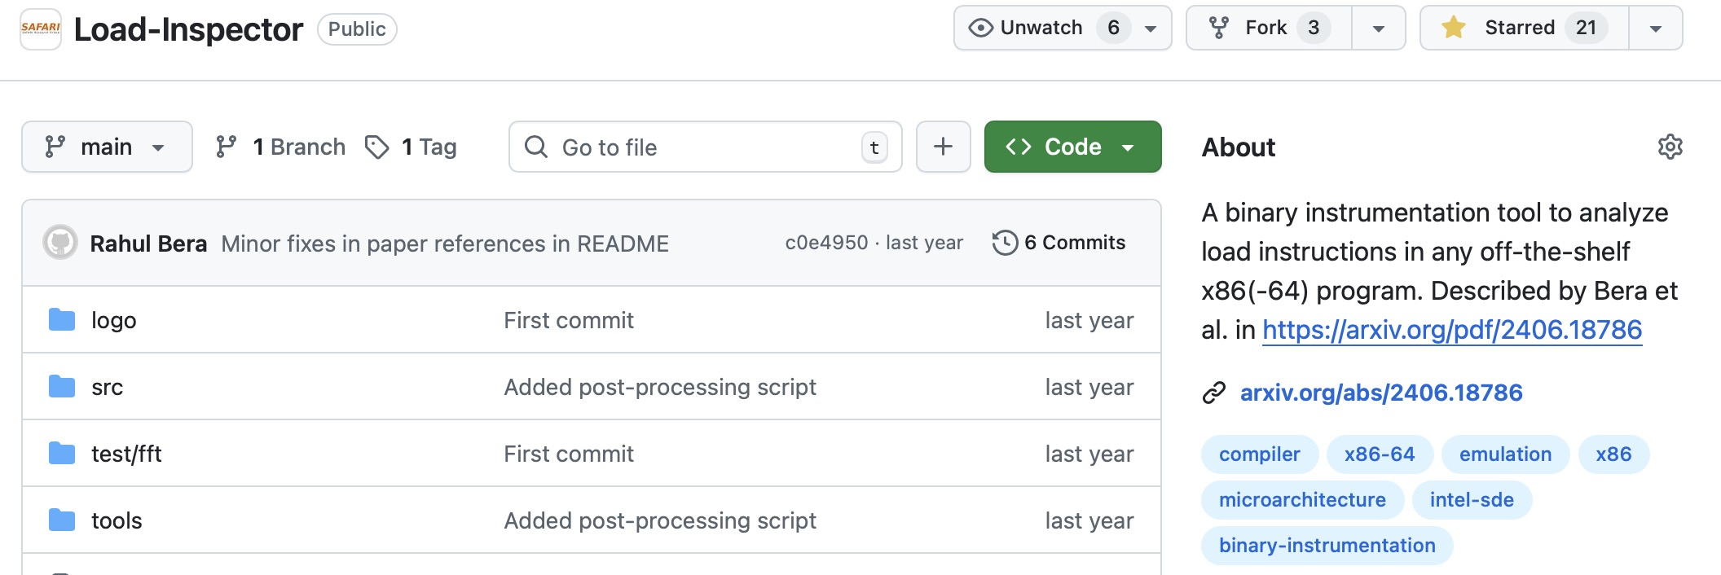
Open-Sourced Artifacts

Slide 67
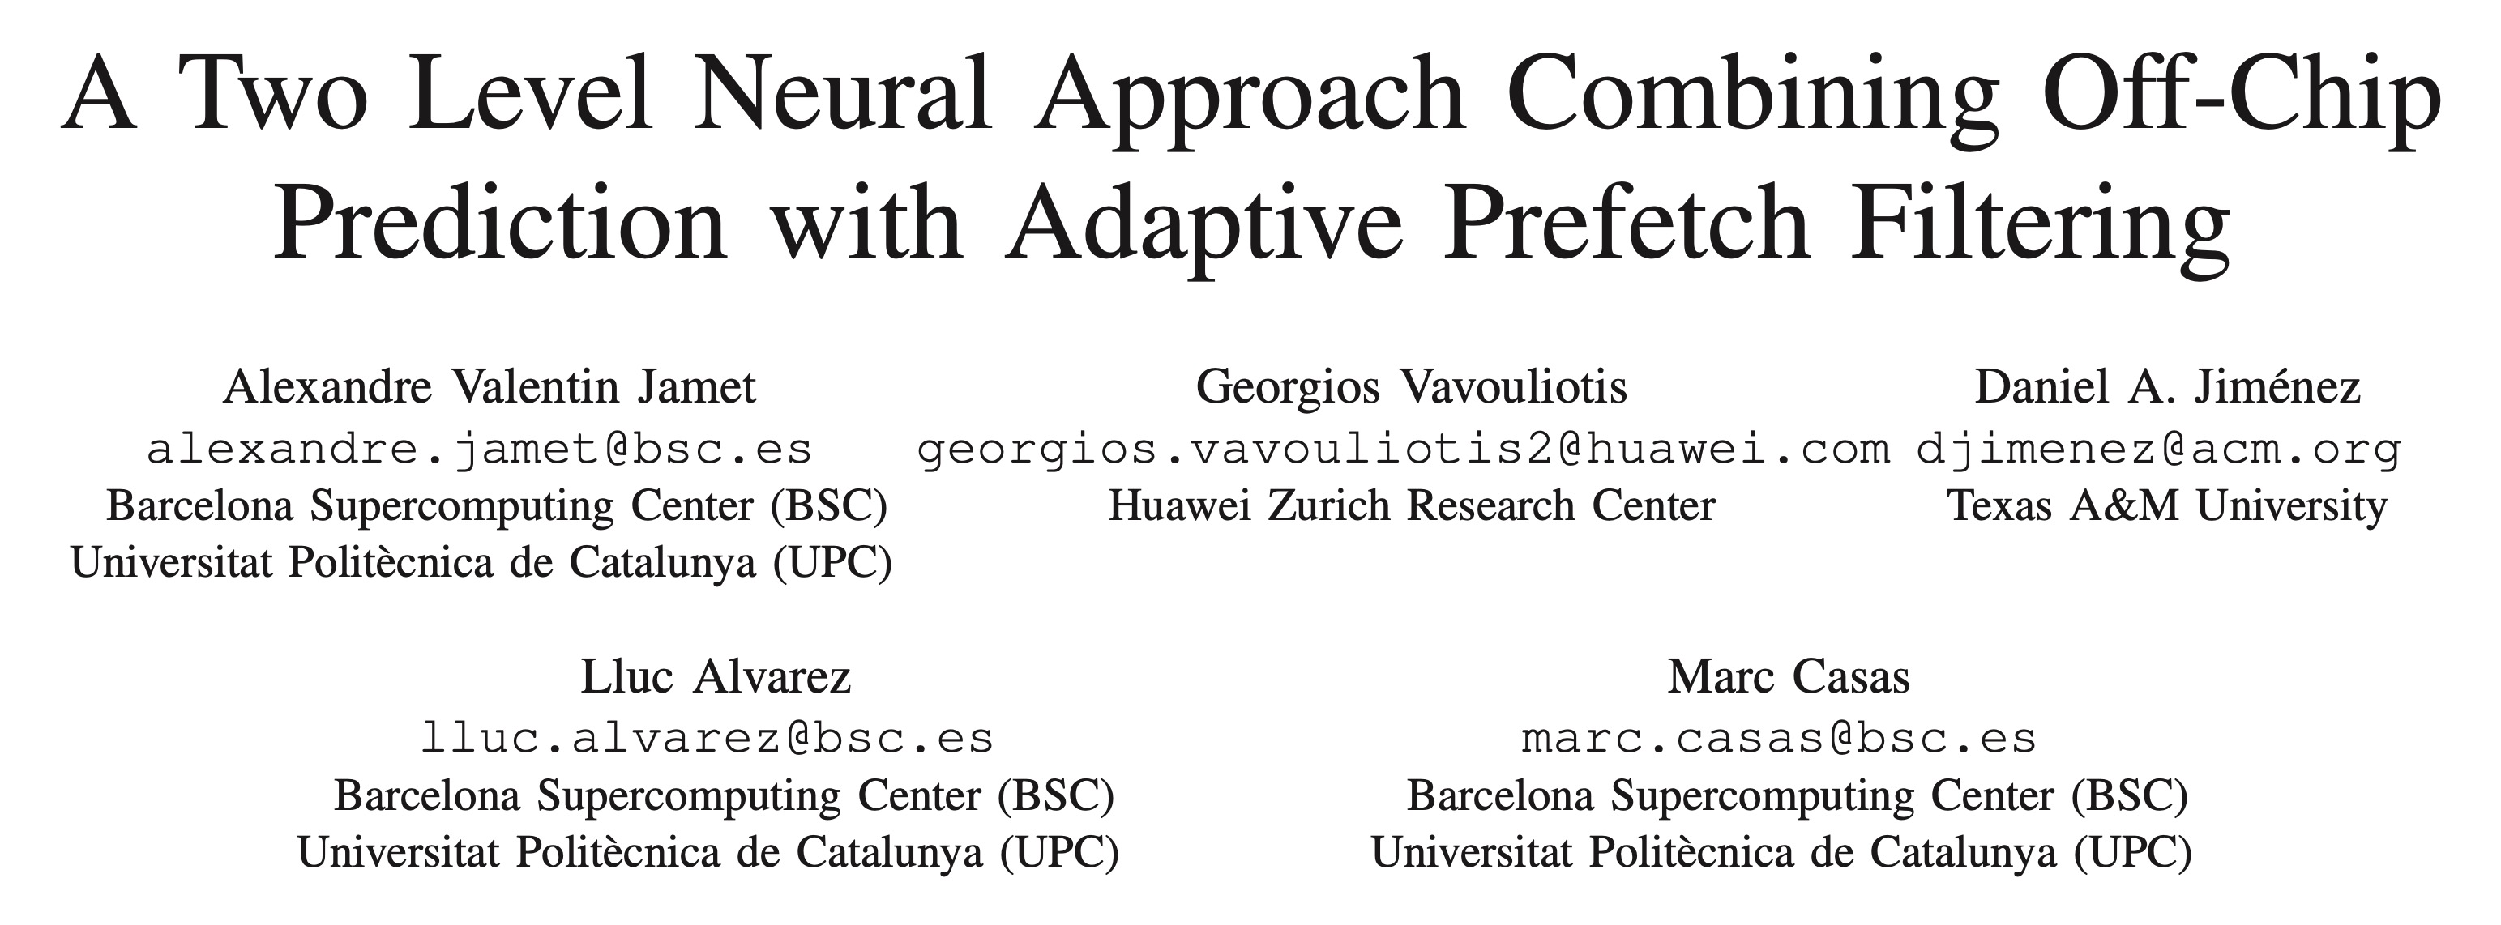


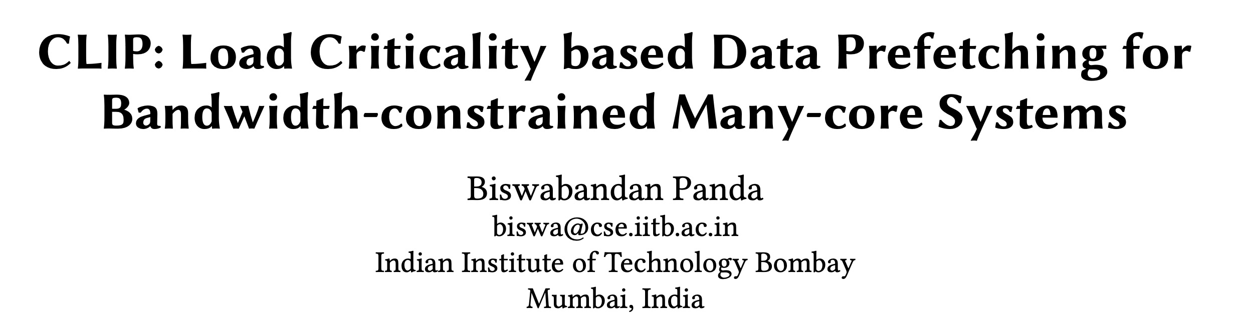


Impact on the Community
Pythia, Hermes, and Constable – all have served as the state-of-the-art in many subsequent works
MICRO’25
HPCA’24
MICRO’23
MICRO’23
MICRO’22
IISWC’25

Slide 68
Backup

Slide 69
Pythia
Hermes
Athena
Constable

Slide 70
Pythia Discussion

Slide 71
Pythia Discussions
FAQs
  Why RL?
  What about large page?
  What’s the prefetch degree?
  Can customization happen during workload execution?
  Can runtime mixing create problem?
Simulation and Methodology
  Basic Pythia configuration
  System parameters
  Configuration of prefetchers
  Evaluated workloads
  Feature selection
Detailed Design
  Reward structure
  Design overview
  QVStore Organization
More Results
  Comparison against other adaptive prefetchers
  Comparison against Context prefetcher
  Feature combination sensitivity
  Hyperparameter sensitivity
  Comparison with multi-level prefetchers
  Performance in unseen workloads
  Single-core s-curve
  Four-core s-curve
  Detailed performance analysis
  Benefit of bandwidth awareness
  Case study
  Customizing rewards
  Customizing features

Slide 72

(1) Single-Feature Prefetch Prediction
Provides good performance gains mainly on workloads where the feature-to-pattern correlation exists
15.4%
4.6%
5.5%
3.5%
Bingo [1] performs better
SPP [2] performs better
[1] Bakshalipour et al., HPCA’19
[2] Kim et al., MICRO’16
Notes:
Due to the use of a single program feature for prefetch prediction, a prefetcher typically provides performance benefits …
In other types of workloads, the same prefetcher fails to provide performance gains.
To illustrate this [CLICK], we show the coverage, overprediction, and performance improvement of two prior prefetchers SPP and Bingo for six sample workloads.
The top figure shows …
The bottom figure shows …
As we can see, for workloads like [CLICK], … Bingo performs better than SPP, as the program feature exploited by Bingo has stronger correlation with the access pattern than SPP.
On the other hand, for workloads like … [CLICK], SPP’s program feature provides better correlation, and thus performs better than Bingo.

Slide 73
(2) Lack of Inherent System Awareness
Little understanding of undesirable effects (e.g., memory bandwidth usage, cache pollution, …)
  Performance loss in resource-constrained configurations
368%
574%
Similar coverage
Lower overpredictions
Yet, lower performance
Notes:
The second shortcoming is that, all prior prefetchers have …, which often leads to …
To illustrate this, let revisit the previous figure and focus on Bingo’s performance in PARSEC-Canneal and Ligra-CC.
Bingo in Ligra-CC has similar coverage to PARSEC-Canneal with significantly …
The reason is that, in baseline without prefetching, Ligra-CC consumes much higher main memory …
As a result, even a smaller amount of overprediction hurts more performance in Ligra-CC than in PARSEC-Canneal.
This is only happening as Bingo does not take its undesirable effects into account while prefetching.
Thus the key takeaway is that, [CLICK] …

Slide 74



(3) Lack of In-silicon Customizability
Feature statically selected at design time
  Rigid hardware designed specifically to exploit that feature
No way to change program feature and/or change prefetcher’s objective in silicon
  Cannot adapt to a wide range of workload demands
Design from scratch
Verify
Fabricate
Notes:
The third key shortcoming is that, all prior prefetcher lack in-silicon customizability.
These prefetchers statically selects the feature to exploit at design time and design a rigid hardware to specifically …
[CLICK] There is no way …
In order to exploit a new program feature, architects need to design a prefetcher from scratch …
[CLICK] and this cycle goes on for every new prefetcher. This wastes precious design time and human resource.

Slide 75
Why RL? Why Not Supervised Learning?
Determining the benefits of prefetching (i.e., whether a decision was good for performance or not) is not easy
  Depends on a complex set of metrics
    Coverage, accuracy, timeliness
    Effects on system: b/w usage, pollution, cross-application interference, …
  Dynamically-changing environmental conditions change the benefit
  Delayed feedback due to long latency (might not receive feedback at all for inaccurate prefetches!)
Differs from classification tasks (e.g., branch prediction)
  Performance strongly correlates mainly to accuracy
  Does not typically depend on environment
  Bounded feedback delay

Slide 76
What About Large Pages?
Pythia’s framework can be easily extended to incorporate additional prefetch actions (i.e., possible prefetch offsets for the page size)
To decrease the storage overhead
  Prune action space via automatic design-space exploration
  Hash action values to retrieve Q-values

Slide 77
What is the Prefetch Degree? Is It Managed by the RL Agent?
Pythia employs a simple degree selector, separate from the RL agent
  If the agent has selected the same prefetch action (O) multiple times in a row, Pythia increases the degree (A+2O, A+3O, …)
  At most degree 4
Future works on managing degree by the RL agent

Slide 78
Can the Customization Be Done While the Workload is Running?
Certainly.
Pythia, being an online learning technique, will autonomously adapt (and optimize) its policy to use the new program features or the modified reward values

Slide 79
Can Runtime Workload Mix Create an Issue?
We implement the bandwidth usage feedback using a counter in the memory controller. Thus Pythia already has a global view of the memory bandwidth usage that incorporates all workloads running on a multi-core system
We evaluate a diverse set (300 of each category) of four-core, eight-core, twelve-core random workload mixes
Based on our evaluation, we observe that Pythia dynamically adapts itself to varying workload demands

Slide 80
How does Pythia Compare Against Other Adaptive Prefetching Solutions?
We compare Pythia against IBM POWER7[5] prefetcher
  Adaptively selects prefetcher degree/configuration by monitoring program IPC
4.5%
(a) single-core
6.4%
(b) four-core
[5] Jimenez et al., TOPC’14

Slide 81
How Does Pythia Compare Against the Context Prefetcher?
Pythia widely differs from the Context Prefetcher (CP)[6] in all three aspects: state, action, and reward. The key differences are:
  CP does not consider system-level feedback
  CP models the agent as a contextual bandit which takes myopic prefetch decisions as compared to Pythia
  CP requires compiler support to extract software-level features
Pythia outperforms CP-HW by 5.3% in single-core and 7.6% in four-core system
[6] Leeor et al., ISCA’15

Slide 82
How Pythia’s Performance Changes With Various State Definitions You Have Swept?
In total we evaluate state defined as any-one, any-two, and any-three combinations of 32 features
Performance gain ranges from 20.7% to 22.4%
Coverage ranges from 66.2% to 71.5%
Overprediction ranges from 26.7% to 32.2%

Slide 83
Is Pythia Sensitive to Hyperparameter?
Not setting hyperparameters can significantly impact the overall performance improvement
Changing 𝜀 from 0.002 to 1.0 drops perf. by 16%
Changing 𝛼 from 0.0065 to 1.0 drops perf. by 5.4%

Slide 84
How Does Pythia Compare Against Commercial Multi-level Prefetchers?
Pythia outperforms IPCP [7] by 14.2% on average in 150-MTPS
[6] Prakalapati et al., ISCA’20

Slide 85
Does Pythia Perform Equally Well for Unseen Workloads also?
Evaluated with 500 traces from value prediction championship
  No prefetcher has been trained on these traces
Pythia outperforms MLOP and Bingo by
8.3% and 3.5% in single-core
And 9.7% and 5.4% in four-core

Slide 86
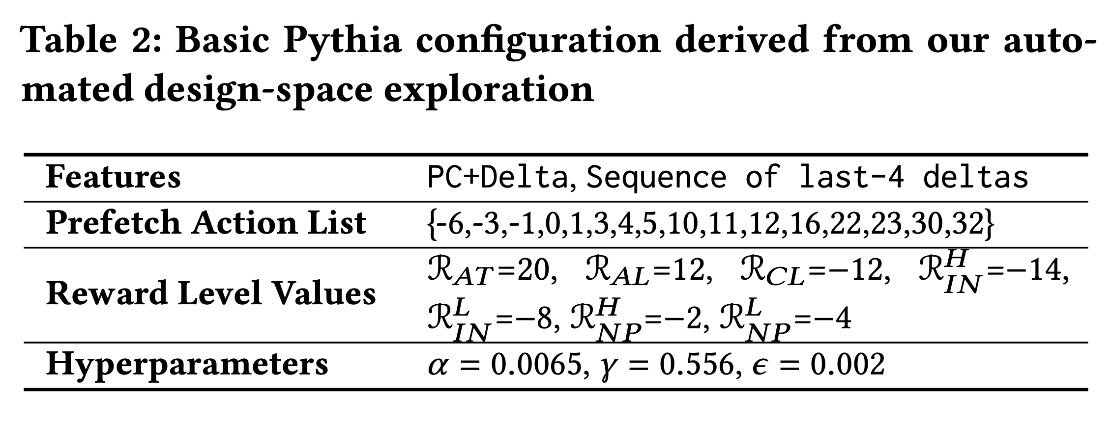
Basic Pythia Configuration

Slide 87
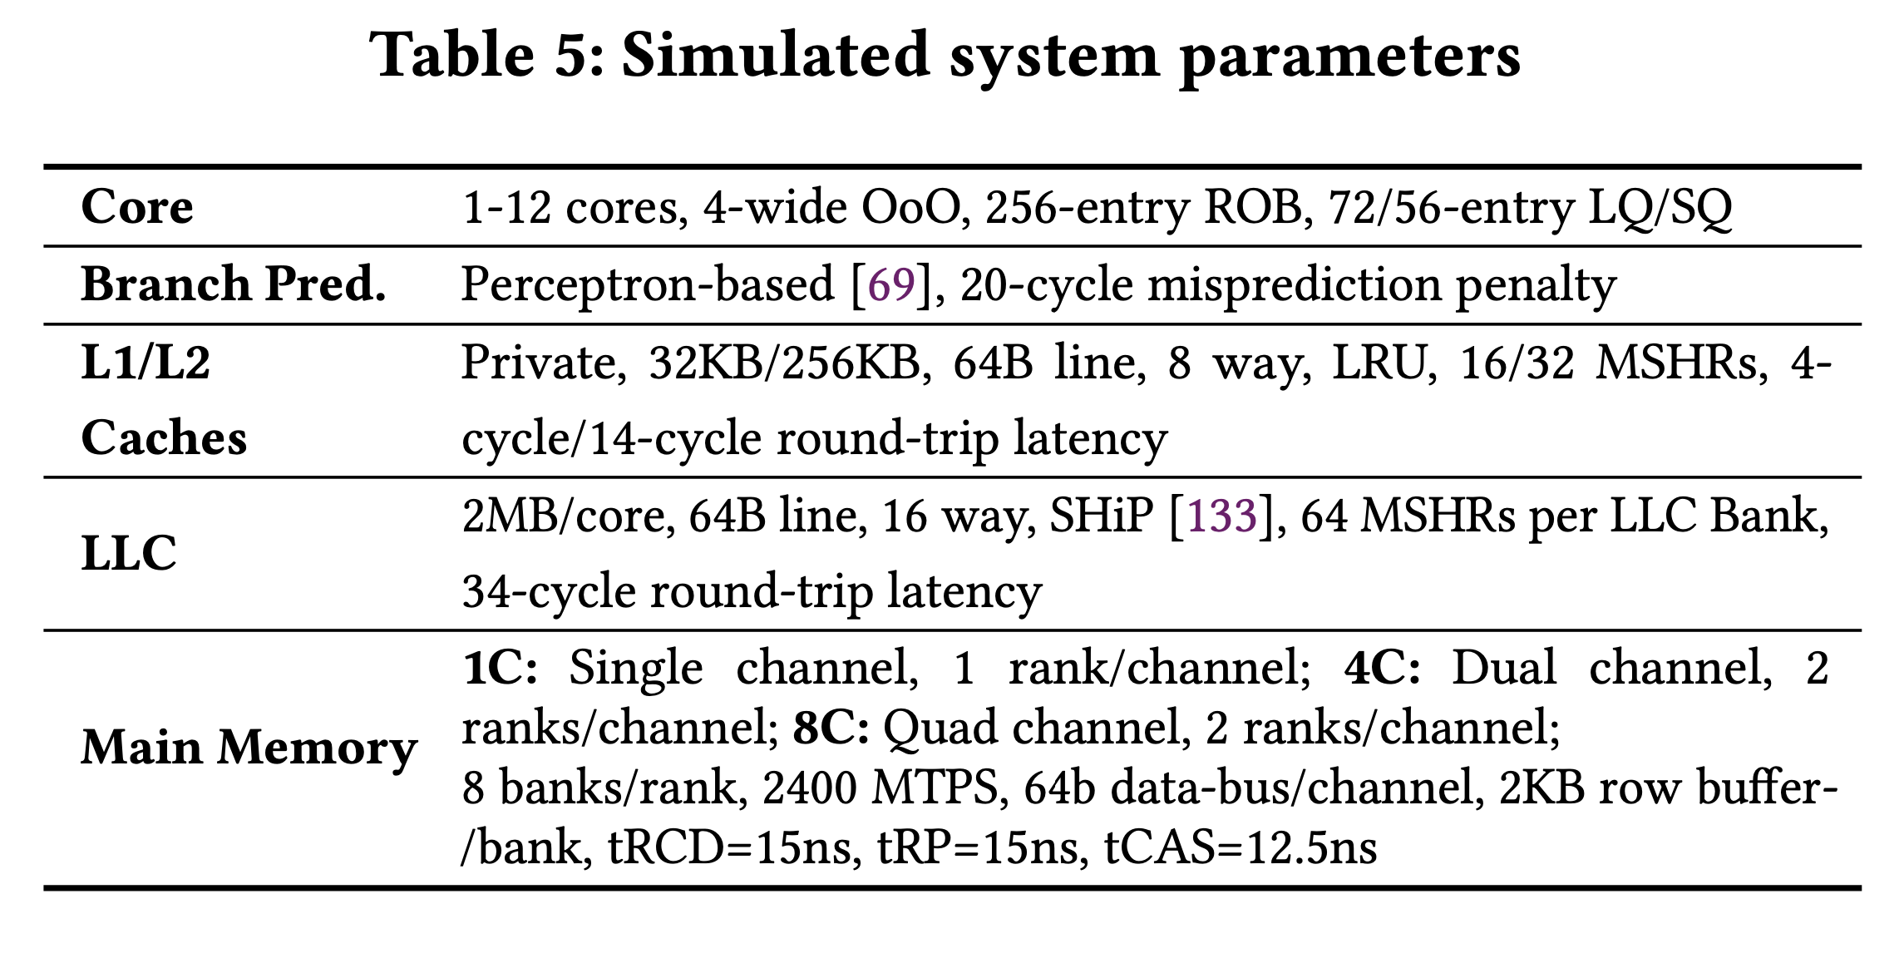
System Parameters

Slide 88
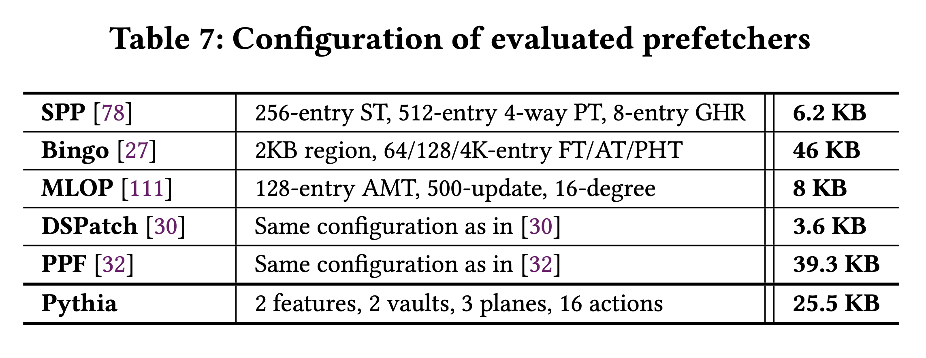
Configuration of Prefetchers

Slide 89
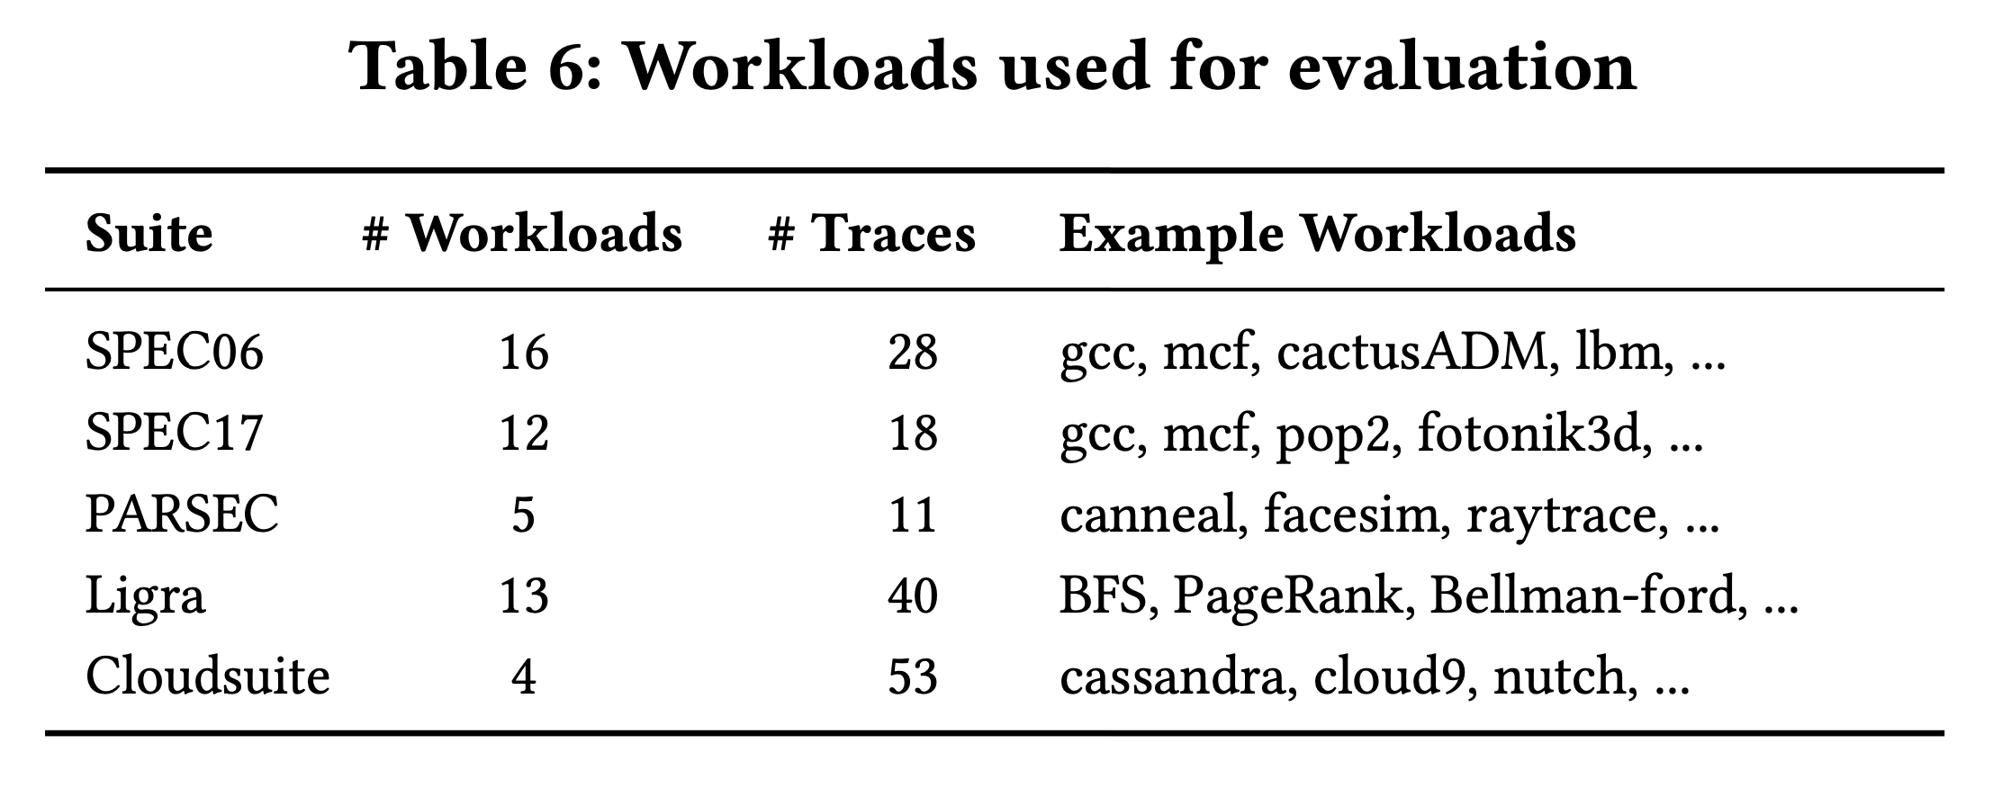
Evaluated Workloads

Slide 90
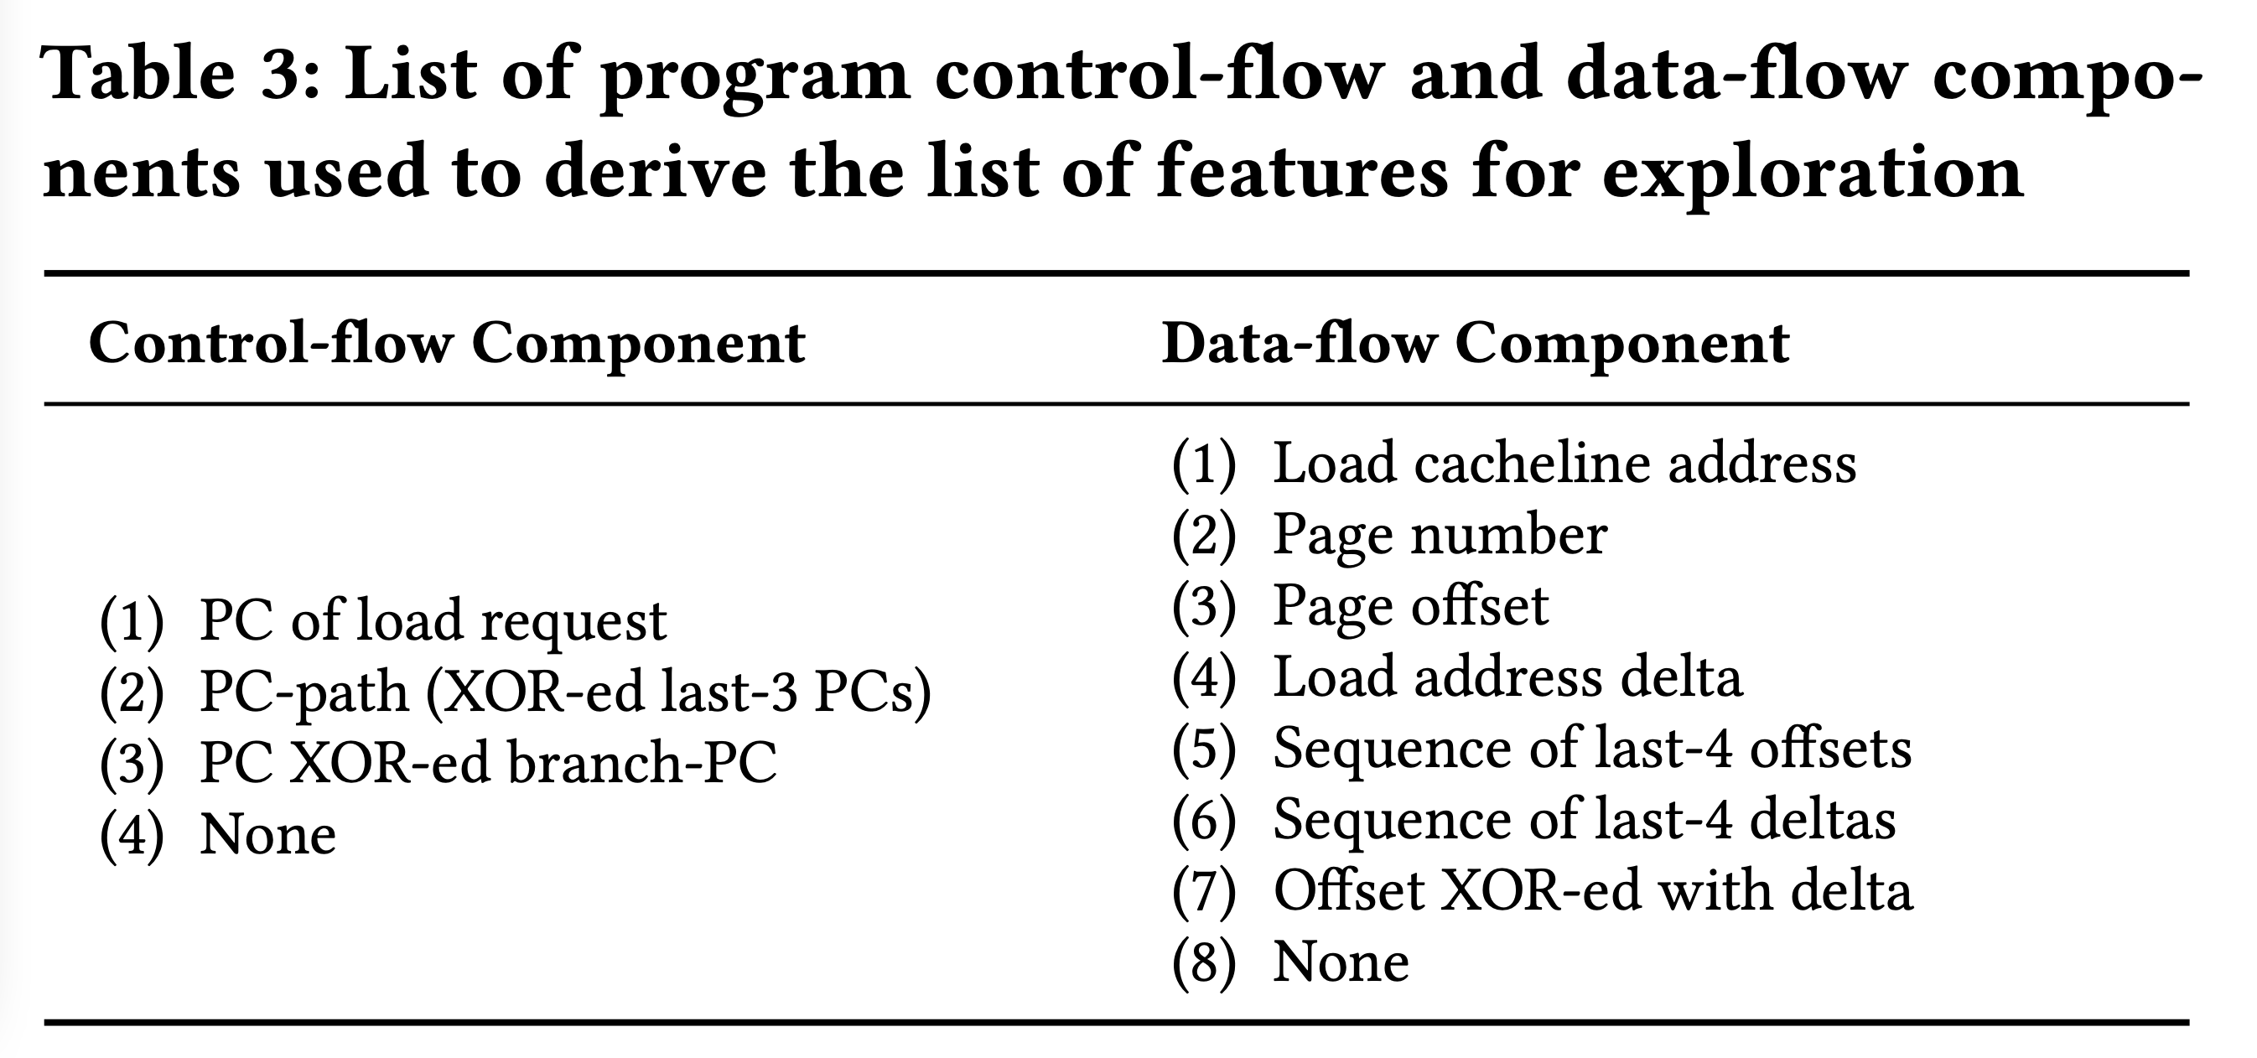
List of Evaluated Features

Slide 91
Performance S-curve: Single-core
603.bwaves_s-2931B
462.libquantum
streamcluster
fluidanimate-9500M
623.xalancbmk_s-592B
BFSCC-22B
pagerank-51B
429.mcf

Slide 92
Performance S-curve: Four-core
437.leslie3d-271B
462.libquantum-1343B
raytrace-23.75B
429.mcf-184B
Mix-59
pagerank
Mix-240

Slide 93
Single-core Coverage & Overprediction

Slide 94
Detailed Performance

Slide 95
Benefit of Bandwidth Awareness

Slide 96
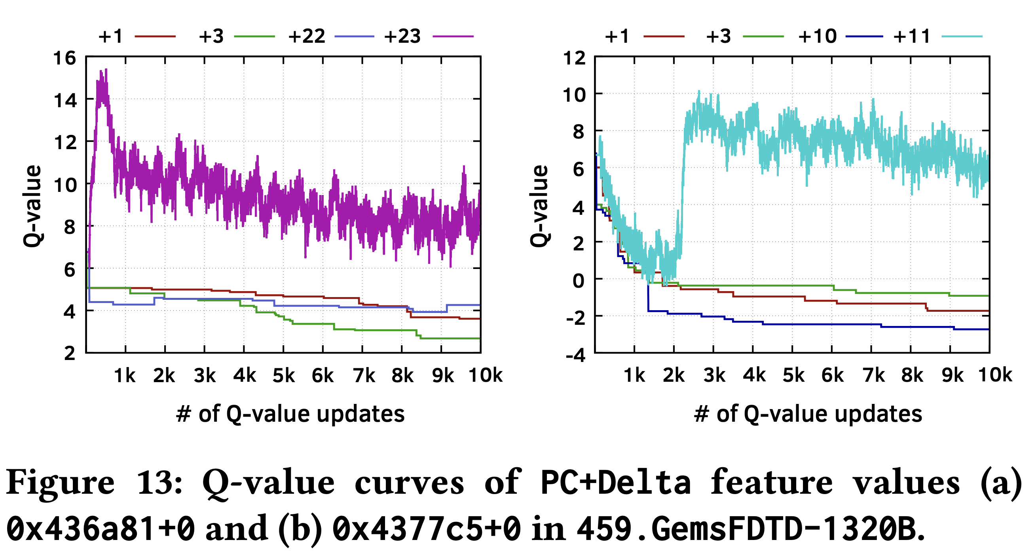
Case Study

Slide 97
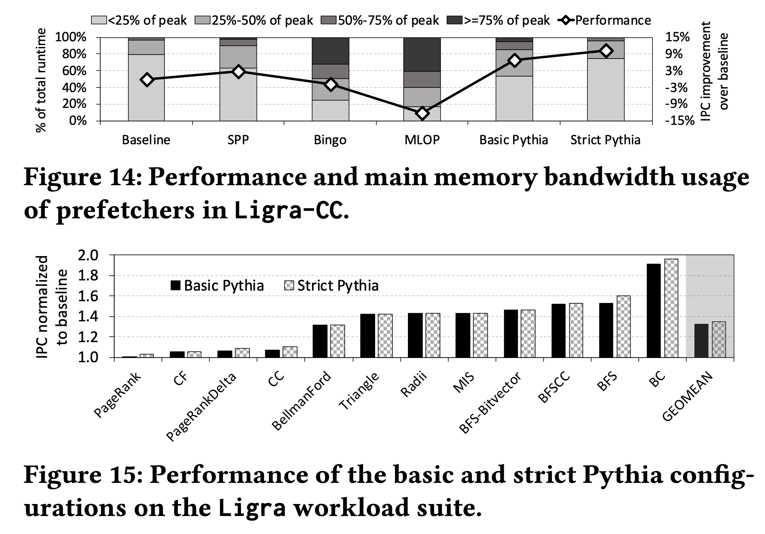
Customizing Rewards

Slide 98
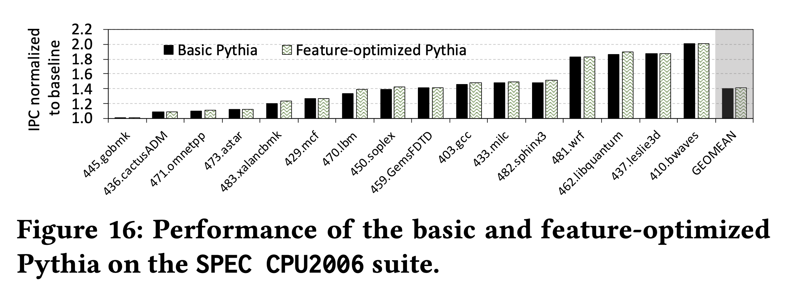
Customizing Features

Slide 99
Hermes Discussions

Slide 100
Hermes Discussions
FAQs
  What are the selected set of program features?
  Can you provide some intuition on why these features work?
  What happens in case of a misprediction?
  What’s the performance headroom for off-chip prediction?
  Do you see a variance of different features in final prediction accuracy?
Simulation Methodology
  System parameters
  Evaluated workloads
More Results
  Percentage of off-chip requests
  Reduction in stall cycles by reducing the critical path
  Fraction of off-chip load requests
  Accuracy and coverage of POPET
  Effect of different features
  Are all features required?
  1C performance
  1C performance line graph
  1C performance against prior predictors
  Effect on stall cycles
  8C performance
  Sensitivity:
    Hermes request issue latency
    Cache hierarchy access latency
    Activation threshold
    ROB size
    LLC size
  Power overhead
  Accuracy without prefetcher
  Main memory request overhead with different prefetchers

Slide 101
Hermes Overview
Core
Latency tolerance limit of ROB
L1-D
Baseline
Processor is stalled
L2
L1
L2
LLC
Main Memory
LLC
MC
Off-Chip
Main Memory
Notes:
Now let me give you a brief overview of Hermes.
This is how a traditional cache hierarchy looks like in today’s processor.
[CLICK] And this is how the memory latency timeline looks like for an off-chip load in the baseline system
[CLICK] If the ROB has a latency tolerance limit up till here, the processor stalls for the remaining cycles

Slide 102




Hermes Overview
Perceptron-based
off-chip load predictor
Predict
Core
POPET
Train
Latency tolerance limit of ROB
L1-D
Issue a Hermes request
Baseline
Processor is stalled
L2
L1
L2
LLC
Main Memory
LLC
Hermes
L1
L2
LLC
Wait
Saved stall cycles
MC
Main Memory
Off-Chip
Main Memory
Notes:
Now Hermes employs an off-chip predictor named POPET.
[CLICK] For every load generated in the core, Hermes consults POPET to predict whether this load would go off-chip or not
[CLICK] If the load is predicted to go off-chip, Hermes waits for the address translation to finish, which happens in parallel with L1 cache access
[CLICK] And then issues a speculative memory request, which we call a Hermes request,
directly to the main memory controller to start fetching the data from the main memory,
While also concurrently accessing the cache hierarchy for such a load.
[CLICK] If the off-chip prediction is correct, the load would eventually miss the LLC and arrive at the memory controller
Where it will simply wait for the ongoing Hermes request to finish, thus hiding the entire cache access latency from its critical path.
Once the data returns from the main memory, Hermes returns the data to the core [CLICK],
Thus, saving the precious stall cycles induced by the off-chip load [CLICK], which in turn provides performance benefit.
[CLICK] Hermes trains POPET when the data finally returns to the core, closing the feedback loop.

Slide 103

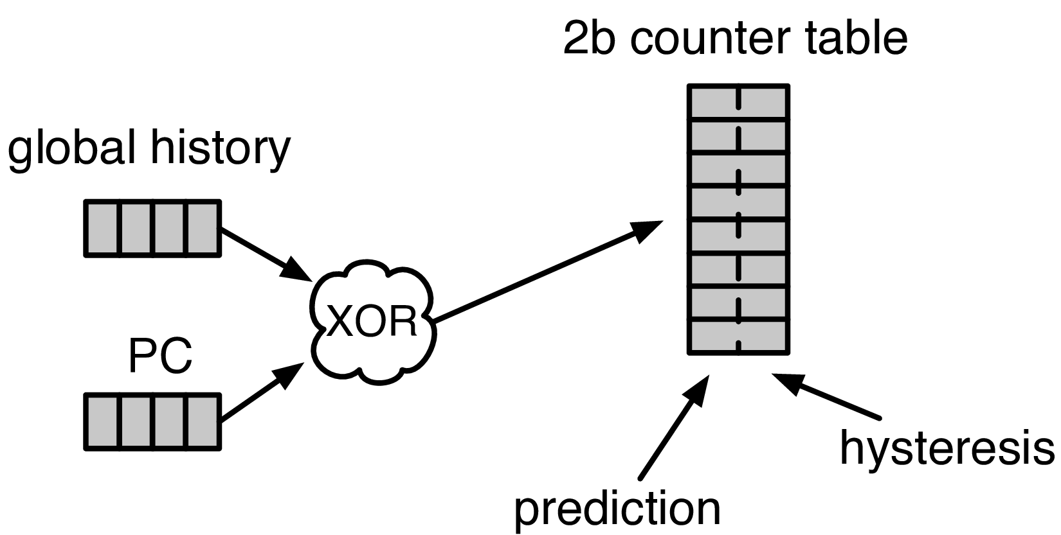


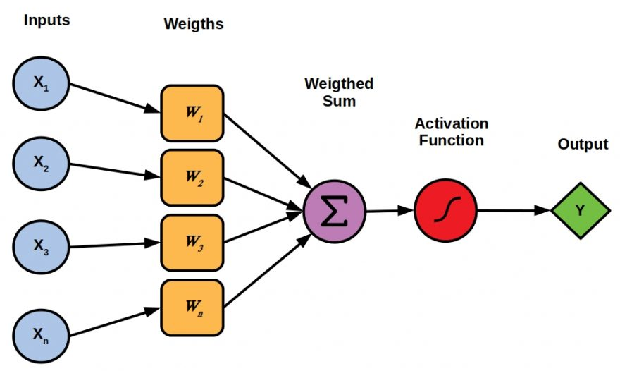

Designing the Off-Chip Load Predictor
History-based prediction
HMP [Yoaz+, ISCA’99] for the L1-D cache
Using branch-predictor-like hybrid predictor:
Global, Gshare, and GSkew
POPET provides
both higher accuracy and higher performance
than predictors inspired from these previous works
Tracking cache contents
MissMap [Loh+, MICRO’11] for the DRAM cache,
D2D [Sembrant+, ISCA’14], D2M [Sembrant+, HPCA’17], LP [Jalili+, HPCA’22] for the cache hierarchy
  Large metadata
  Metadata size increases with cache hierarchy size
  May need to track all cache operations
  Gets complex depending on the cache hierarchy configuration (e.g., inclusivity, bypassing,…)
Learning from program behavior
  Correlate different program features with off-chip loads
Low storage overhead
Low design complexity
Notes:
Now let’s discuss how to design this off-chip predictor.
So, there are multiple prior works that can be used either directly or with small modifications for off-chip load prediction.
These works can be broadly categorized into two classes.
[CLICK] History-based predictor introduced by HMP, uses a branch-predictor like hybrid predictor design
to identify which requests are going to miss L1 cache.
We can easily extend HMP’s design to predict loads that are going to miss the entire cache hierarchy.
[CLICK] Tracking-based methods, on the other hand, explicitly track cache contents
to predict which load requests are going to miss the cache hierarchy.
[CLICK] These tracking-based methods poses two key challenges…
[CLICK] First,…
[CLICK] Second,…
[CLICK] POPET takes a completely different approach to predict off-chip load requests by learning from program behavior.
[CLICK] It aims to correlate multiple different types of program features with off-chip load requests
to provide accurate predictions with much lower storage overhead and design complexity.
[CLICK] In our paper, we compare POPET against predictors inspired from these prior works and show that
[CLICK] POPET provides both higher accuracy and performance than them.

Slide 104

POPET: Perceptron-Based Off-Chip Predictor
Multi-feature hashed perceptron model^{[1]}
  Each feature has its own weight table
    Stores correlation between feature value and off-chip prediction
[1] D. Tarjan and K. Skadron, “Merging Path and Gshare Indexing in Perceptron Branch Prediction,” TACO, 2005
Notes:
Now let’s deep dive into our off-chip predictor design.
Our predictor, named as POPET, is designed using hashed-perceptron model.
[CLICK] where each feature has its own weight table
That stores the correlation between feature value and the off-chip prediction

Slide 105

Predicting using POPET
Uses simple table lookups, addition, and comparison
42
-4
0x7ffe0+12
3
3 >= -2
Predict that the load would go off-chip
Extract features from the load request
12
-5
Notes:
Hermes predicts using POPET using simple operations like table lookup, addition, and comparison.
Let me give you an example on how POPET’s prediction works.
POPET’s prediction works in three stages.
[CLICK] In the first stage, POPET extracts the features from the load request
[CLICK] In the second stage, each feature value is hashed and used as an index to retrieve the weights from each individual weight tables
[CLICK] In the third stage, the retrieved weights are accumulated and the cumulative weight is used to compute the activation function.
[CLICK] If the cumulative weight is higher than the activation threshold, POPET predicts that the load would go off-chip.

Slide 106
Training POPET
Uses simple increment or decrement of feature weights
42
-1
-4
0x7ffe0+12
3
3 >= -2
Predict that the load would go off-chip
-1
12
Shouldn’t be activated
-5
Cumulative weight < 𝜏_{act}
-1
Notes:
Now let’s understand how to train POPET.
For this let’s assume the previous example where the load is predicted to go off-chip.
[CLICK] But in reality, the load didn’t go off-chip
[CLICK] this means the activation which have triggered before, shouldn’t have triggered
Which means, the cumulative weight should be lower than the activation threshold
[CLICK] Now to adjust the feature weights, POPET again indexes each weight table using the hashed feature values
[CLICK] And simply decrement each weight from the individual weight tables.
Thus, by using simple increment and decrement operations, POPET continuously learns from program behavior to accurately predict off-chip loads.

Slide 107

Latency Configuration
Cache round-trip latency
  L1-D: 5 cycles
  L2: 15 cycles
  LLC: 55 cycles
Hermes request issue latency (incurred after address translation)
Depends on
  Interconnect between POPET and MC
0 cycles
24 cycles
6 cycles
Notes:
For our evaluation, we consider
[CLICK] a 5 cycle L1-D
[CLICK] 15 cycle L2
[CLICK] and 55 cycle LLC round-trip latency.
[CLICK] The latency for Hermes to issue a request directly to the main memory controller (after the address translation) depends on …
[CLICK] For this reason we sweep this latency from 0-cycles to 24-cycles in our paper.
[CLICK] But in this presentation, I am going to show you results considering a 6-cycle latency.

Slide 108
Single-Core Performance Improvement
5.4%
20.3%
11.5%
Hermes alone provides nearly
50% performance benefits of Pythia
with only 1/5th storage overhead
Hermes provides nearly 90% performance benefit of Ideal Hermes that has an ideal off-chip load predictor
Hermes on top of Pythia
outperforms Pythia alone in every workload category
Notes:
Let’s first analyze the single-core performance improvement.
[CLICK] This is how Hermes and a state-of-the-art prefetcher Pythia improves performance on top of a no-prefetching system.
[CLICK] The first takeaway is that Hermes alone provides nearly 50%...
[CLICK] Now if we combine Hermes with Pythia, that provides an additional 5.4% performance improvement on top of a strong baseline that has Pythia.
[CLICK] And finally, if we compare Hermes’s performance benefit with the Ideal Hermes that has an ideal off-chip predictor,
We see that Hermes provides nearly 90% performance benefit of the Ideal Hermes

Slide 109
Increase in Main Memory Requests
20.3%
5.4%
11.5%
For every 1% performance benefit,
increase in main memory requests
Pythia
2%
5.9%
Hermes on top of Pythia
1%
38.5%
Hermes alone
0.5%
5.5%
Hermes is more bandwidth-efficient
than even an efficient prefetcher like Pythia
Notes:
This performance improvement comes at a cost of increase in main memory requests.
This graph shows the increase in the main memory request over the no-prefetching system provided by the three configurations.
[CLICK] As we can see, Hermes increases the main memory requests by 5.5% on average on top of the no-prefetching system..
Whereas Pythia increases …
If we combine two together, then it increases the main memory request by an additional 5.9%.
[CLICK] Now, if we compare this increase in the main memory request with the performance improvement each of these configurations are providing,
We see that
[CLICK] For every 1% performance benefit, Pythia …
[CLICK] This basically shows that Hermes is much more bandwidth efficient than a traditional data prefetcher like Pythia.
And for this reason [NEXT]

Slide 110
Performance with Varying Memory Bandwidth
Pythia+Hermes
Pythia
Hermes
Baseline
~Intel Xeon 6258R
(Cascade Lake, 28C/6ch, 2020)
~AMD EPYC Rome 7702P (Zen 2, 64C/8ch, 2019)
~AMD Threadripper 3990x (Zen 2, 64C/4ch, 2020)
In bandwidth-constrained configurations,
Hermes alone outperforms Pythia
Hermes+Pythia outperforms Pythia
across all bandwidth configurations
Notes:
If we evaluate Pythia and Hermes over a wide range of memory bandwidth configurations, we see that,
[CLICK] In these extremely-bandwidth constrained configurations, which are in fact roughly modeling per-core main memory bandwidth of commercial processors,
Hermes even outperforms Pythia.
[CLICK] And if we combine both of them, the combination of Hermes and Pythia outperforms Pythia in every bandwidth configurations.

Slide 111
Performance with Varying Baseline Prefetcher
5.4%
6.2%
7.6%
5.1%
Hermes consistently improves performance
on top of a wide range of baseline prefetchers
7.7%
Notes:
And these observations are not only true for Pythia.
We evaluate Hermes combined with multiple prior baseline state-of-the-art prefetchers and find that
Hermes consistently improves performance on top of a wide range of baseline prefetchers.

Slide 112

Overhead of Hermes
4 KB storage overhead
1.5% power overhead*
*On top of an Intel Alder Lake-like performance-core ^{[2]} configuration
[2] https://www.anandtech.com/show/16881/a-deep-dive-into-intels-alder-lake-microarchitectures/3
Notes:
All of these performance benefit comes at a
[CLICK] modest 4KB storage overhead per core and
[CLICK] 1.5% power overhead on top an Intel Alder Lake-like performance-core configuration

Slide 113
More in the Paper
Performance sensitivity to:
  Cache hierarchy access latency
  Hermes request issue latency
  Activation threshold
  ROB size (in extended version on arXiv)
  LLC size (in extended version on arXiv)
Accuracy, coverage, and performance analysis against HMP and TTP
Understanding usefulness of each program feature
Effect on stall cycle reduction
Performance analysis on an eight-core system
Notes:
We have many more evaluation results:
For example, a wide range of performance sensitivity study by varying…in the paper.

Slide 114
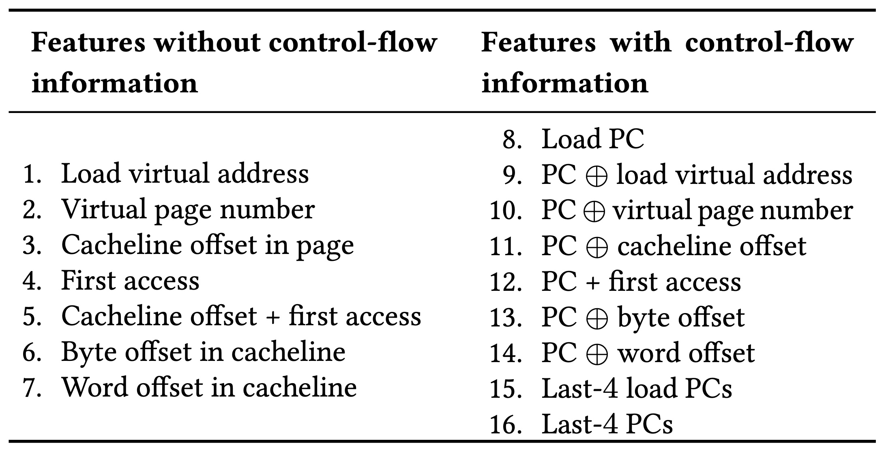
Initial Set of Program Features

Slide 115
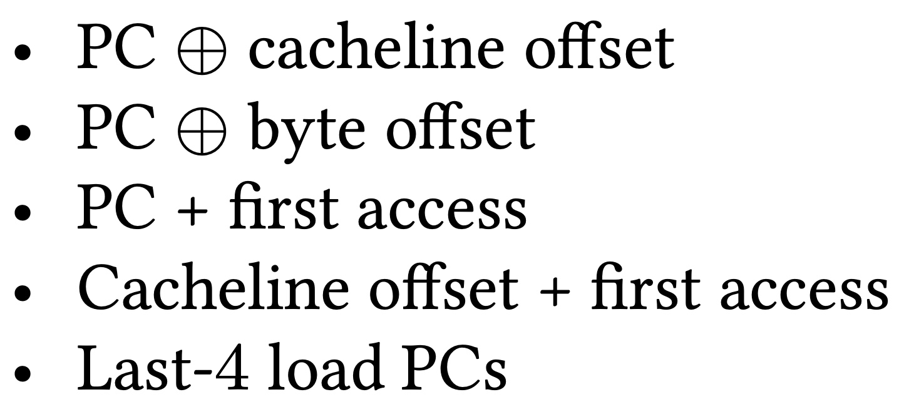
Selected Set of Program Features
A binary hint that represents whether or not a cacheblock has been recently touched
Five features

Slide 116
When A Feature Works/Does Not Work?
Trace: 462.libquantum-1343B
PC: 0x401442
…
Cacheline #42
Cacheline #43
…
Without prefetcher
With a simple stride prefetcher
PC + first access
Cacheline offset + first access
Cacheline offset + first access

Slide 117
What Happens in case of a Misprediction?
Two cases of mispredictions:
Predicted on-chip but actually goes off-chip
  Loss of performance improvement opportunity
Predicted off-chip but actually is on-chip
  Memory controller forwards the data to LLC if and only if a load to the same address have already missed LLC and arrived at the memory controller
No need for misprediction detection and recovery
No need for misprediction detection and recovery

Slide 118
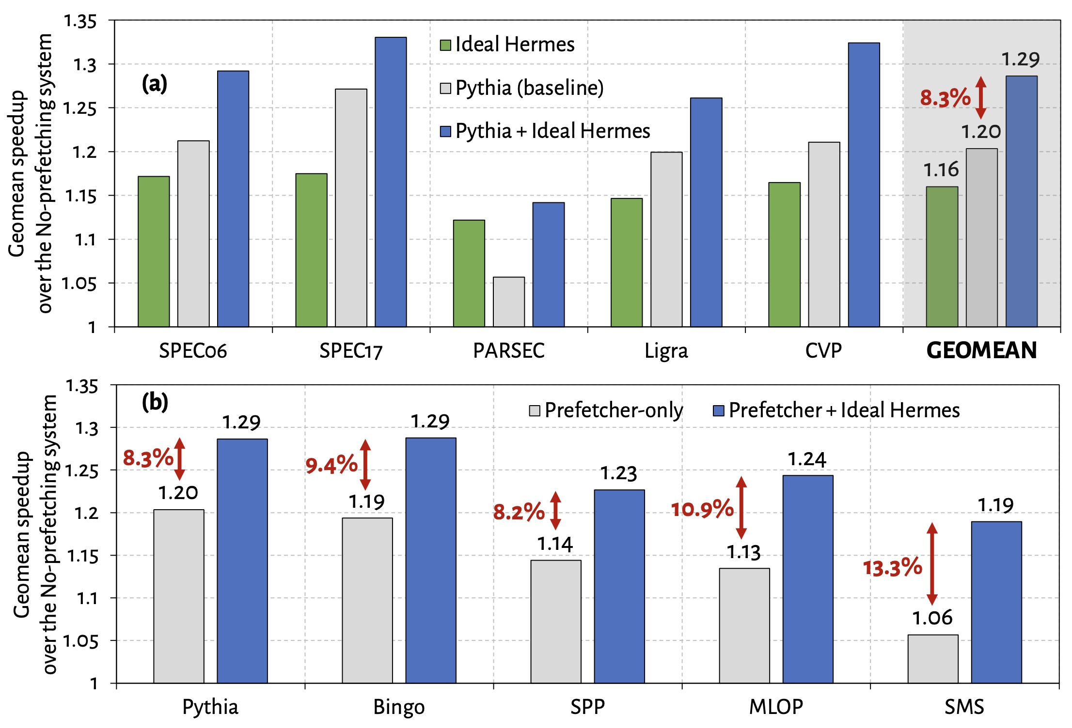
Performance Headroom of Off-Chip Prediction

Slide 119
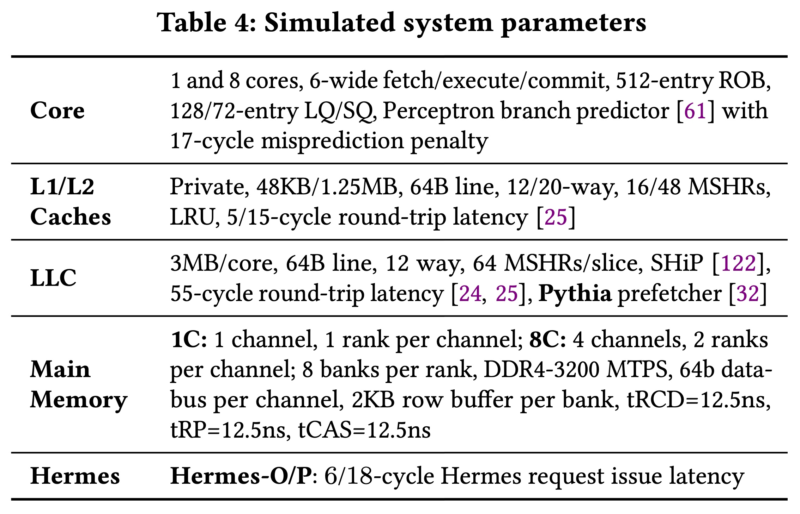
System Parameters

Slide 120
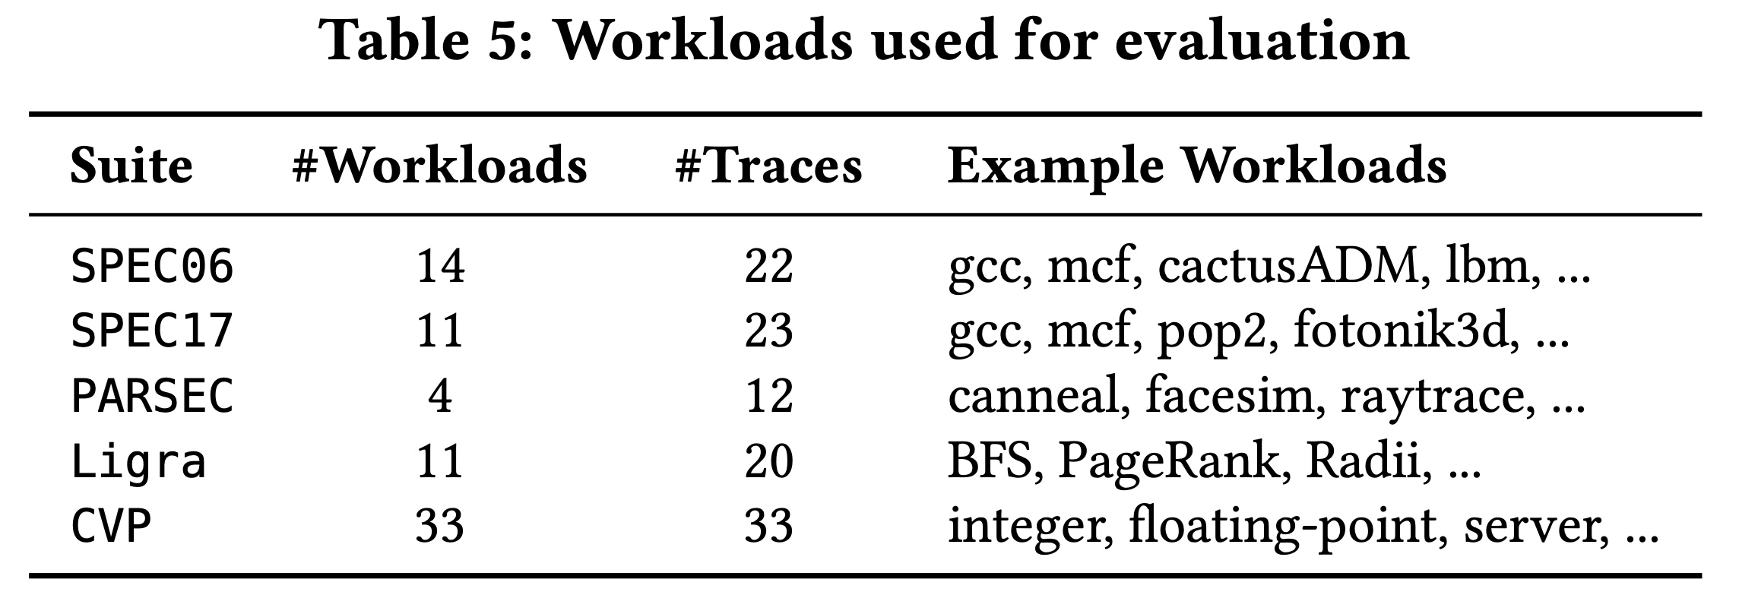
Evaluated Workloads

Slide 121
Observation: Not All Off-Chip Loads are Prefetched
50%
1
Nearly 50% of the loads are still not prefetched

Slide 122
Observation: Not All Off-Chip Loads are Prefetched
2
70% of these off-chip loads blocks ROB

Slide 123
Observation: With Large Cache Comes Longer Latency
On-chip cache access latency significantly contributes to the latency of an off-chip load
On-chip cache hierarchy access latency
58

Slide 124
Observation: With Large Cache Comes Longer Latency
On-chip cache access latency significantly contributes to the latency of an off-chip load
On-chip cache hierarchy access latency
40% of stall cycles caused by an off-chip load can be eliminated
by removing on-chip cache access latency from its critical path
58

Slide 125
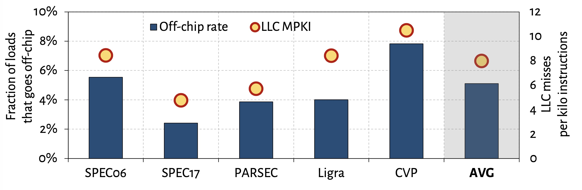
What Fraction of Load Requests Goes Off-Chip?

Slide 126
Off-Chip Prediction Quality: Defining Metrics
Accuracy
Coverage
Predicted off-chip
Actual off-chip
Predicted and actual off-chip

Slide 127
Off-Chip Prediction Quality: Analysis
Accuracy
77%
47%
16%
Coverage
95%
74%
22%

Slide 128
Off-Chip Prediction Quality: Analysis
Accuracy
77%
47%
16%
POPET provides off-chip predictions with high-accuracy and high-coverage
Coverage
95%
74%
22%

Slide 129
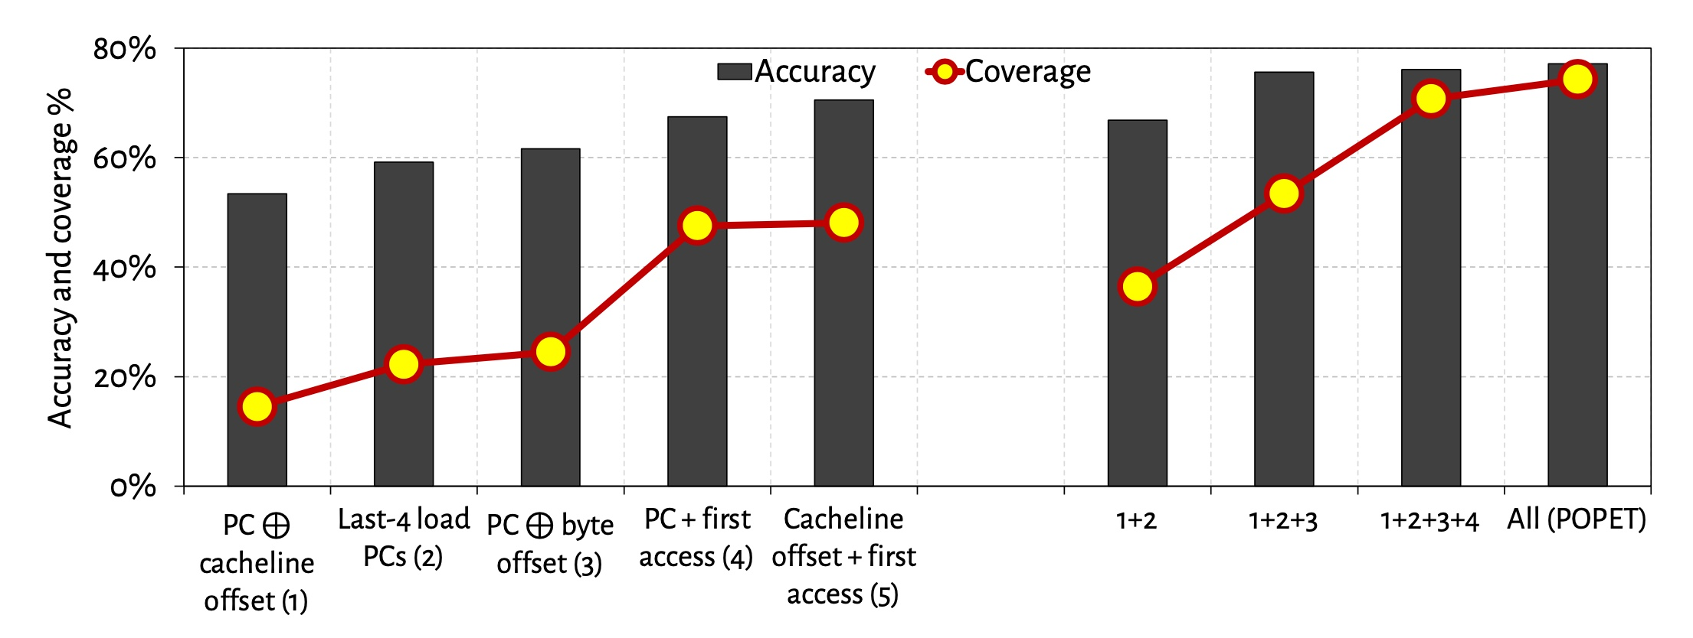
Effect of Different Features
Combination of features provides both higher accuracy and higher coverage than any individual feature

Slide 130
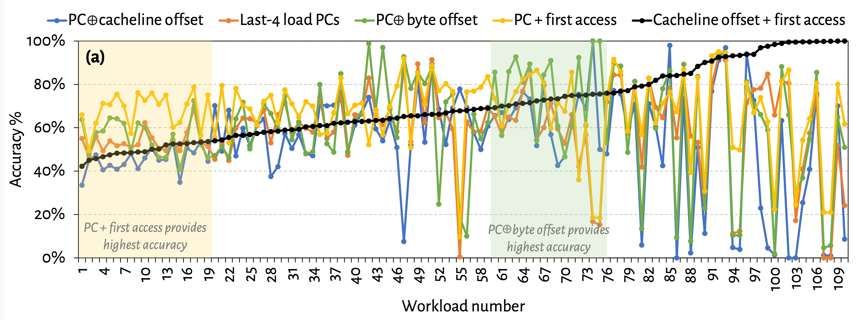
Are All Features Required? (1)
No single feature individually provides
highest prediction accuracy across all workloads

Slide 131
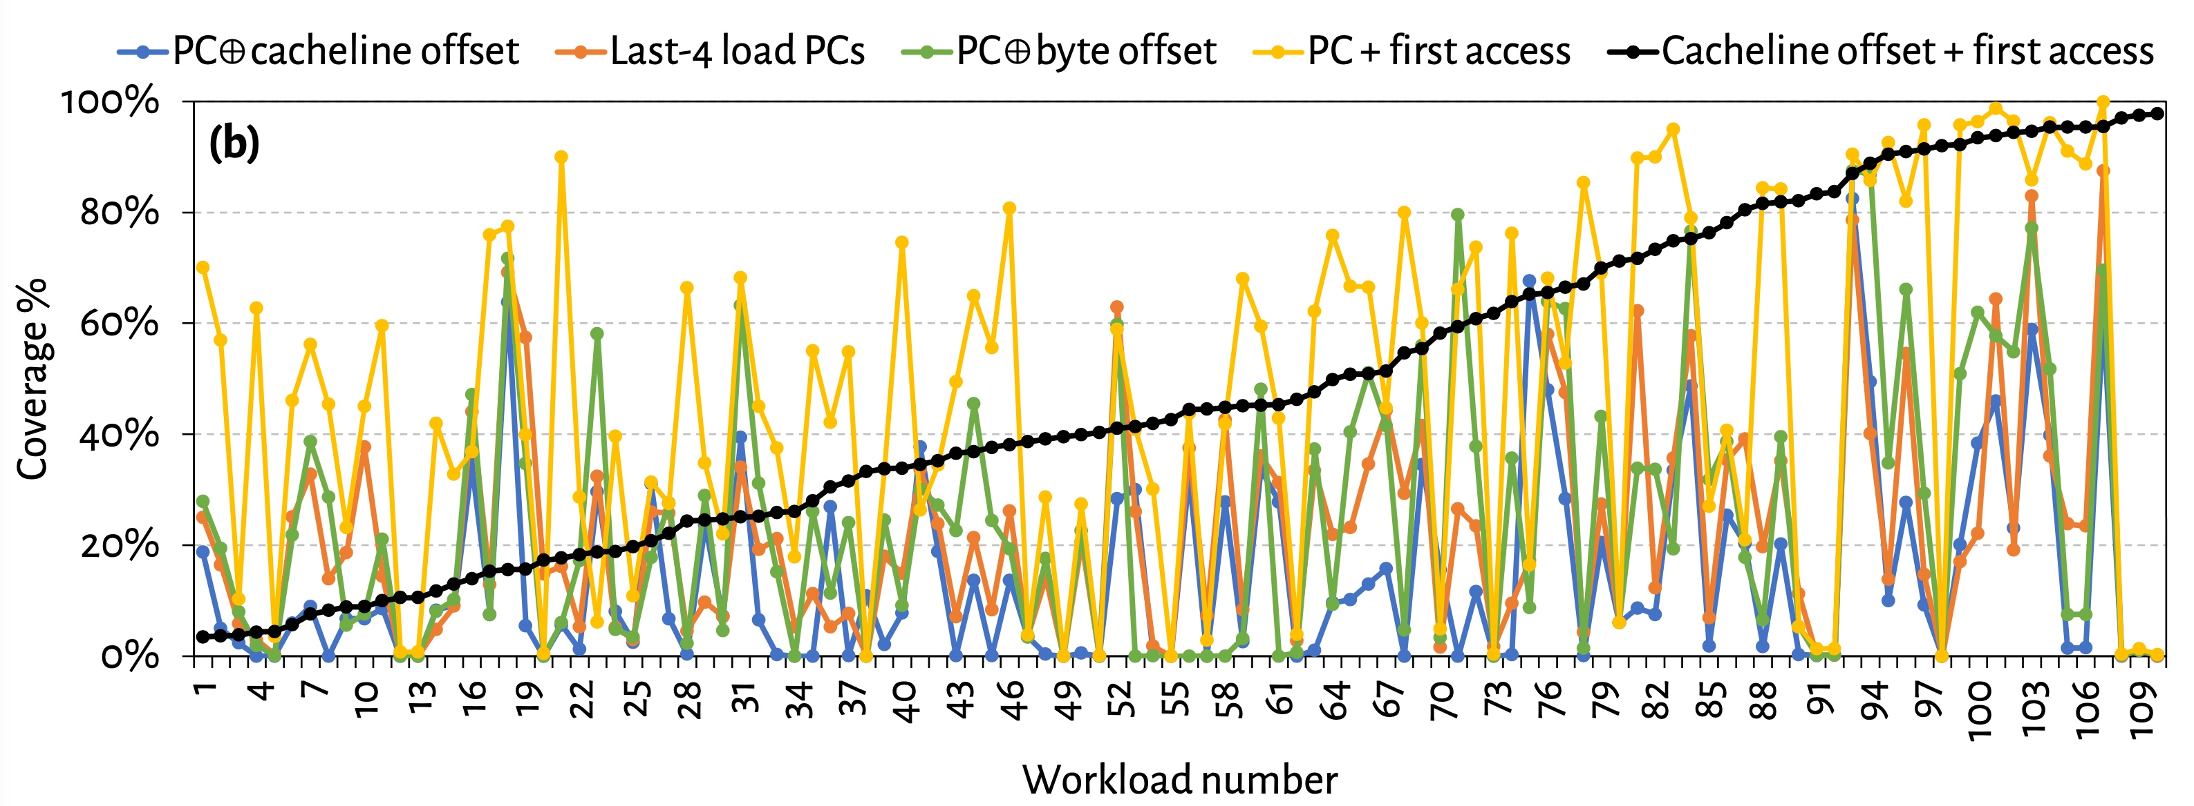
Are All Features Required? (2)
No single feature individually provides
highest prediction coverage also across all workloads

Slide 132
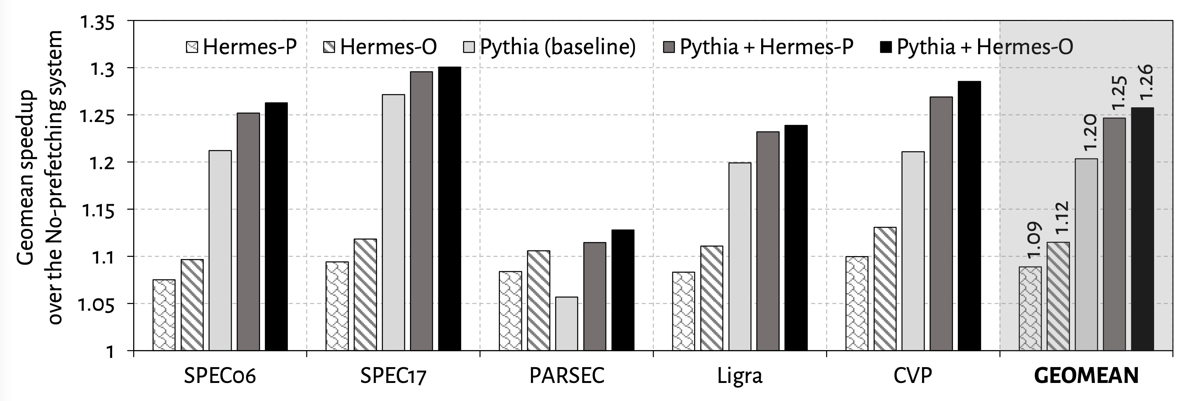
Single-Core Performance
Hermes in combination with Pythia
outperforms Pythia alone in every workload category

Slide 133
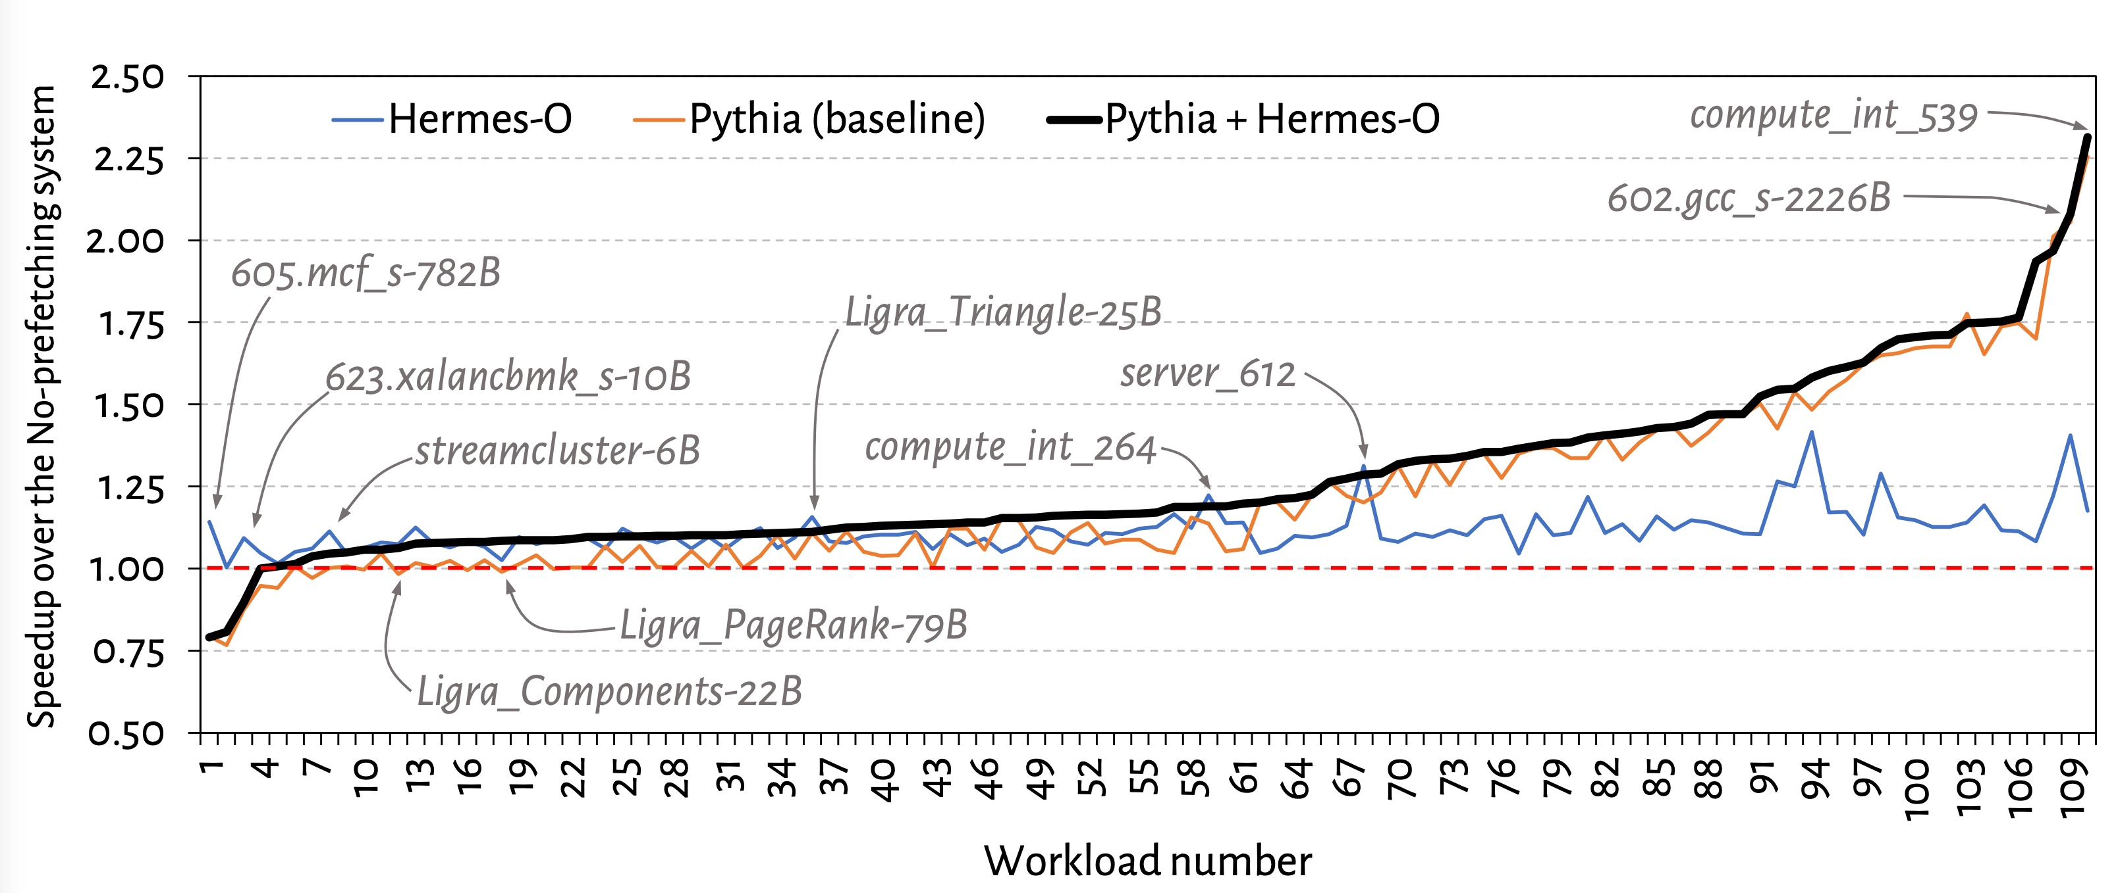
Single-Core Performance Line Graph

Slide 134
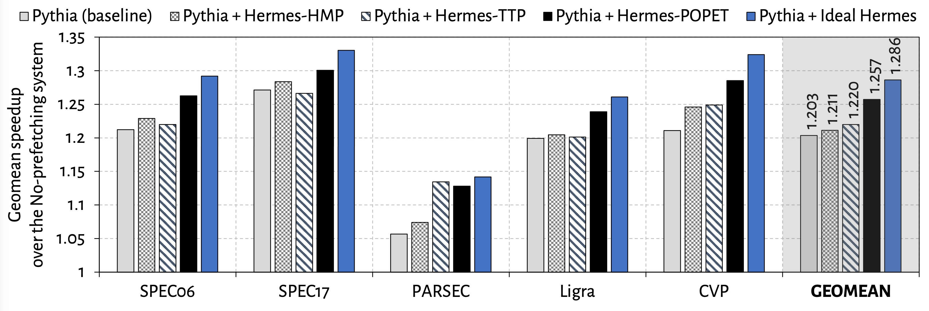
Single-Core Performance Against Prior Predictors
POPET provides higher performance benefit
than prior predictors
Hermes with POPET achieves nearly 90% performance improvement of the Ideal Hermes

Slide 135
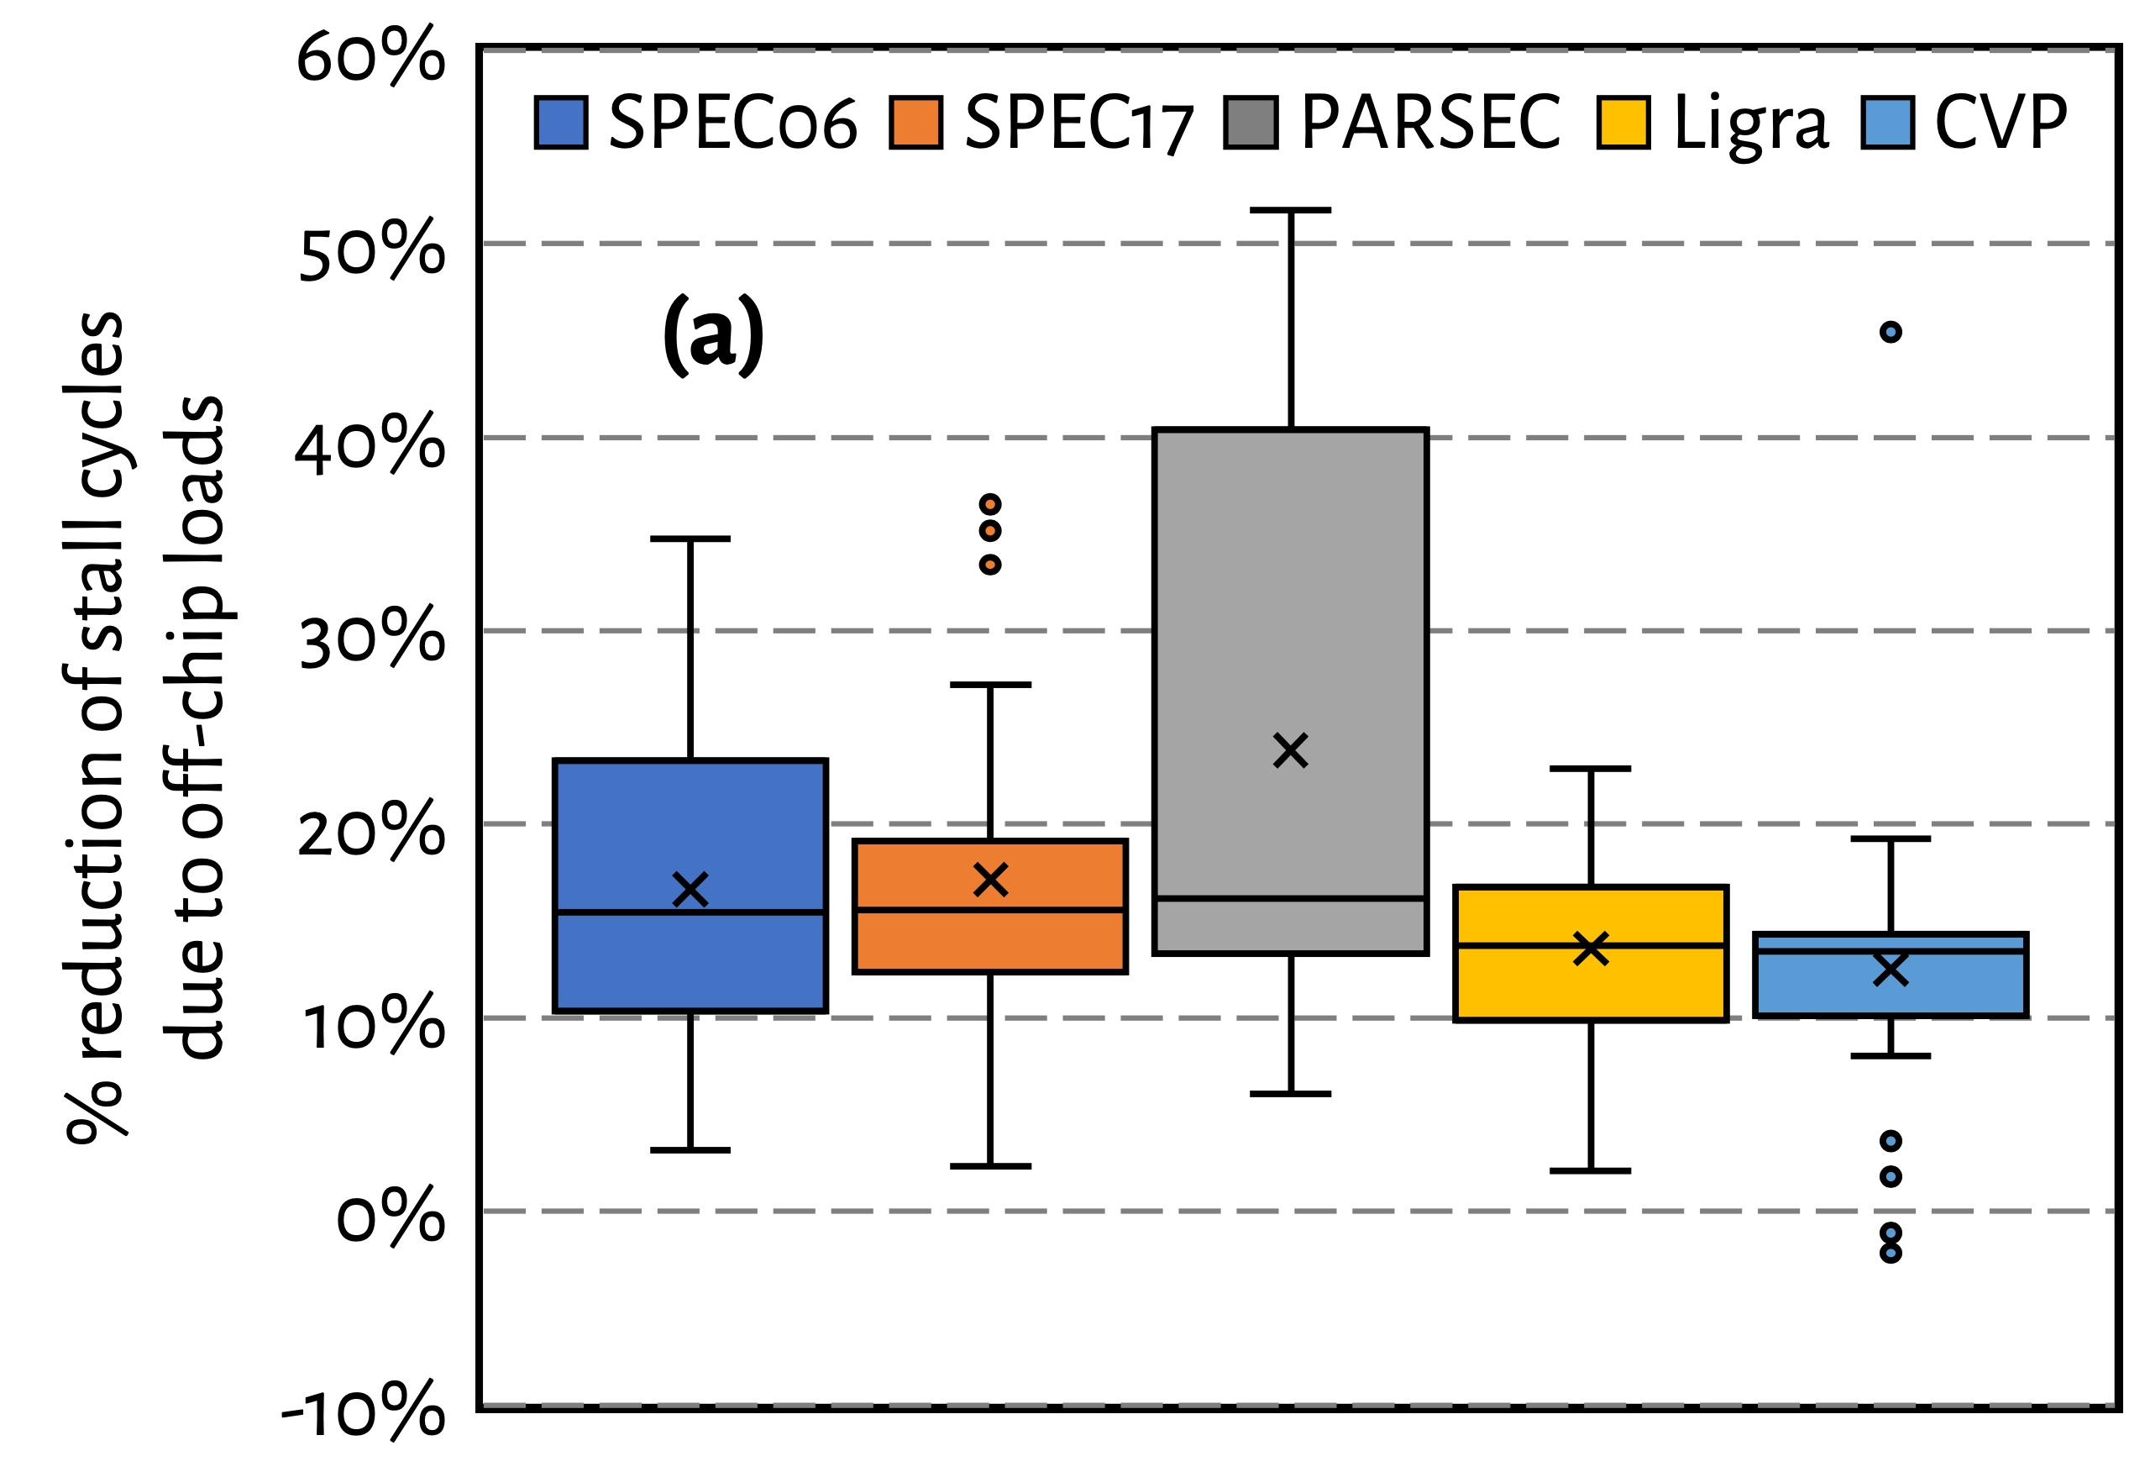
Effect on Stall Cycles
Hermes reduces off-chip load induced stall cycles
on average by 16.2% (up-to 51.8%)

Slide 136
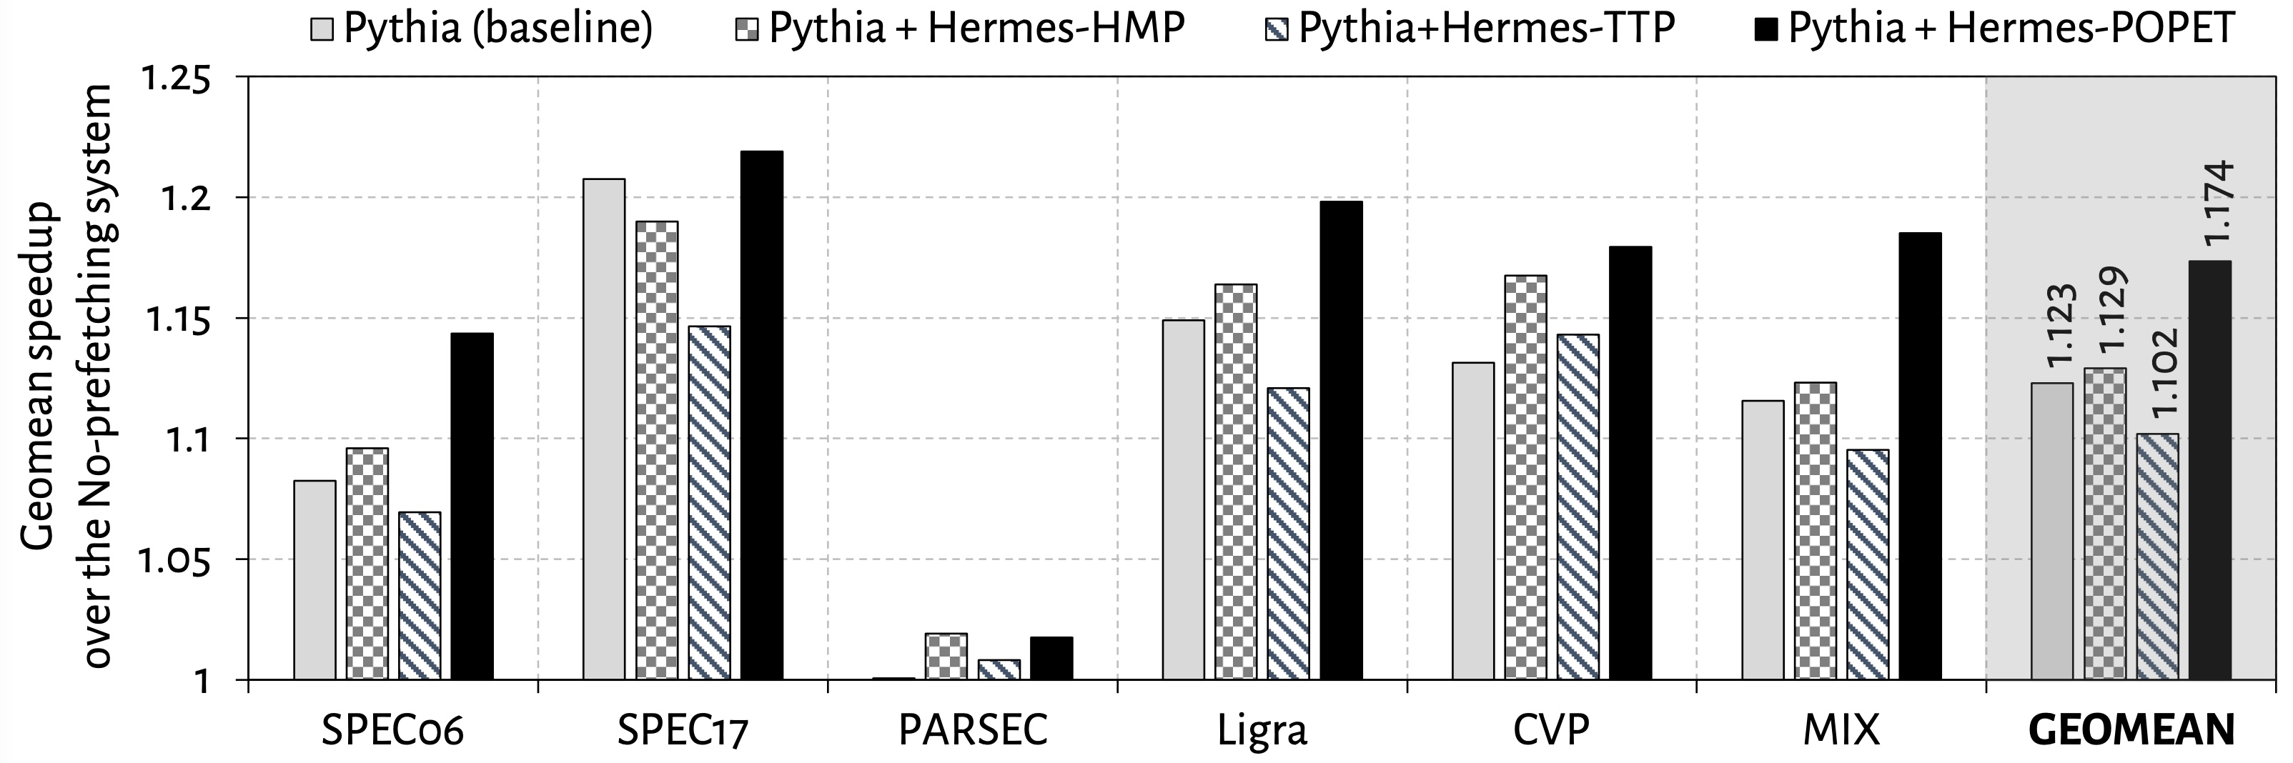
Eight-Core Performance
Hermes in combination with Pythia
outperforms Pythia alone by 5.1% on average

Slide 137
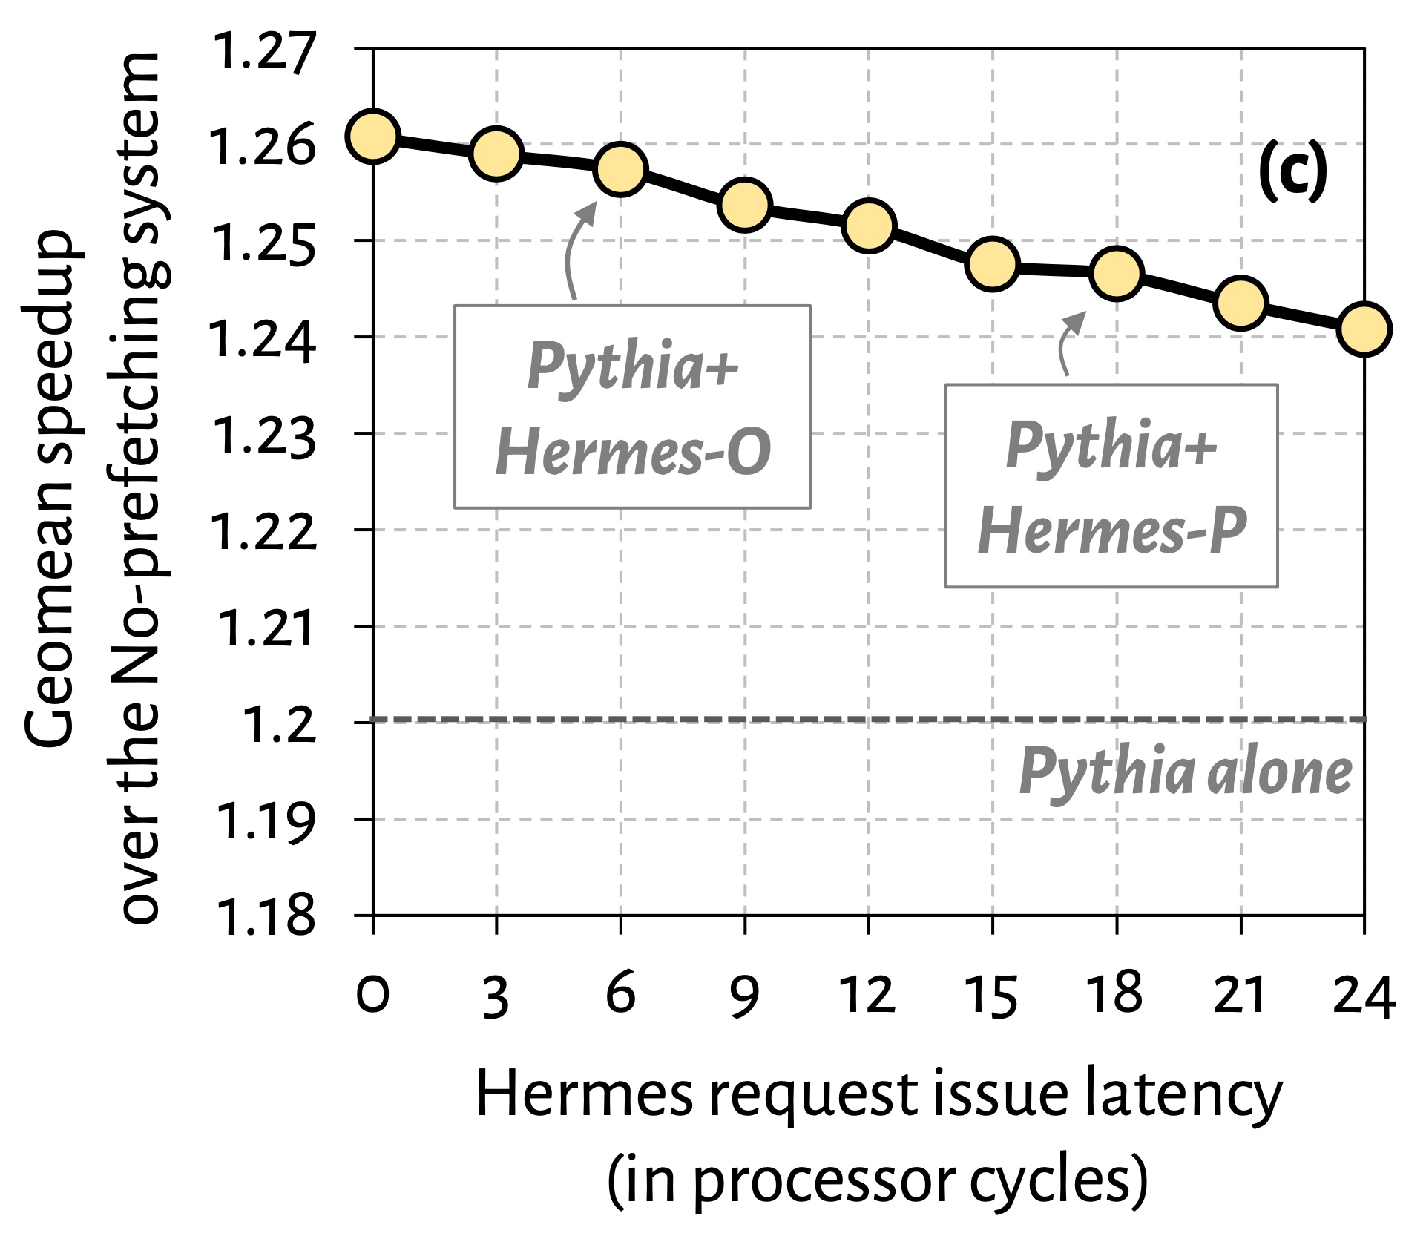

Effect of Hermes Request Issue Latency
3.6%
5.7%
Hermes in combination with Pythia outperforms Pythia alone even with a 24-cycle Hermes request issue latency

Slide 138
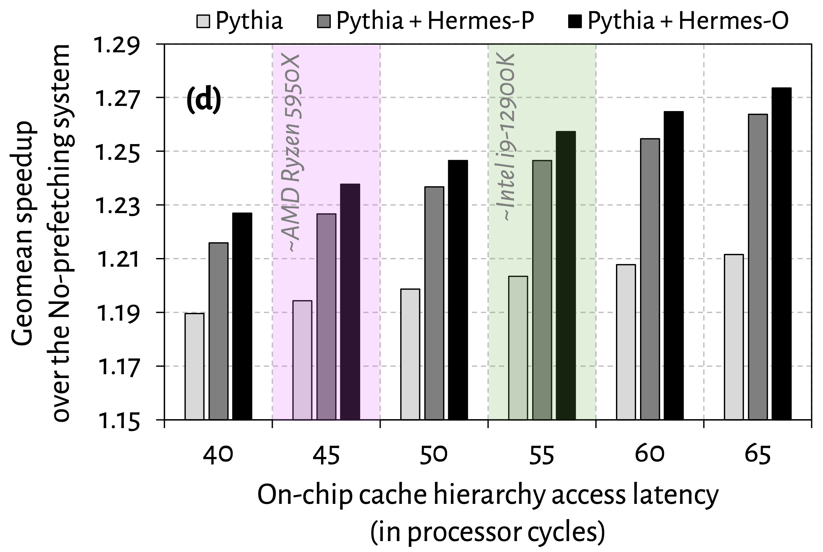
Effect of Cache Hierarchy Access Latency
6.2%
3.6%
Hermes can provide even higher performance benefit in
future processors with bigger and slower on-chip caches

Slide 139
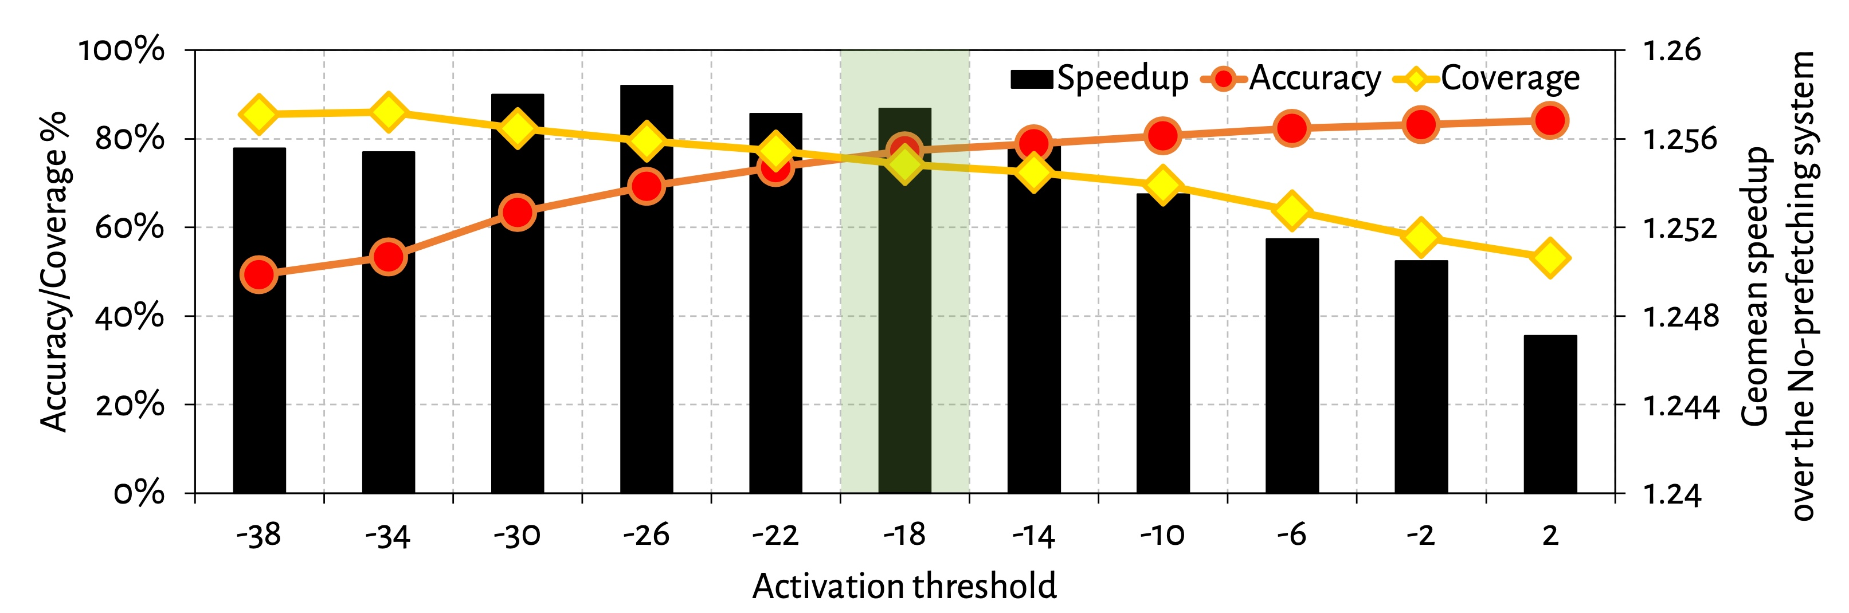
Effect of Activation Threshold
With increase in activation threshold
Accuracy increases
Coverage decreases

Slide 140
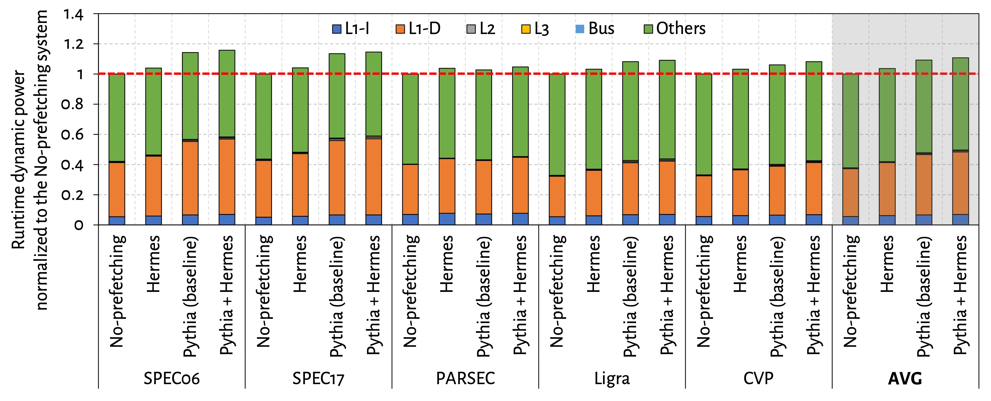
Power Overhead

Slide 141
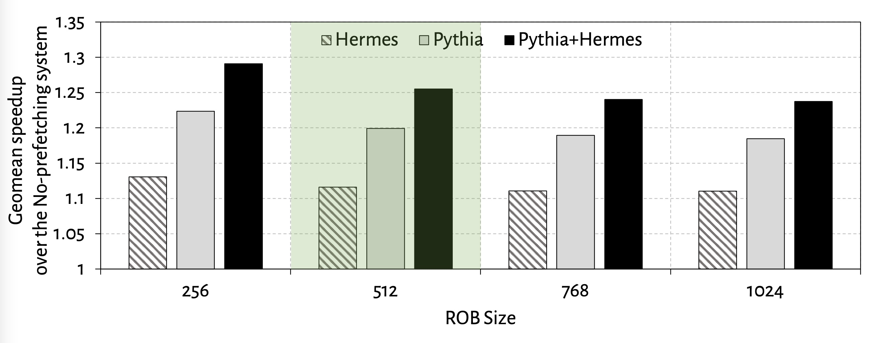
Effect of ROB Size
6.7%
5.3%

Slide 142
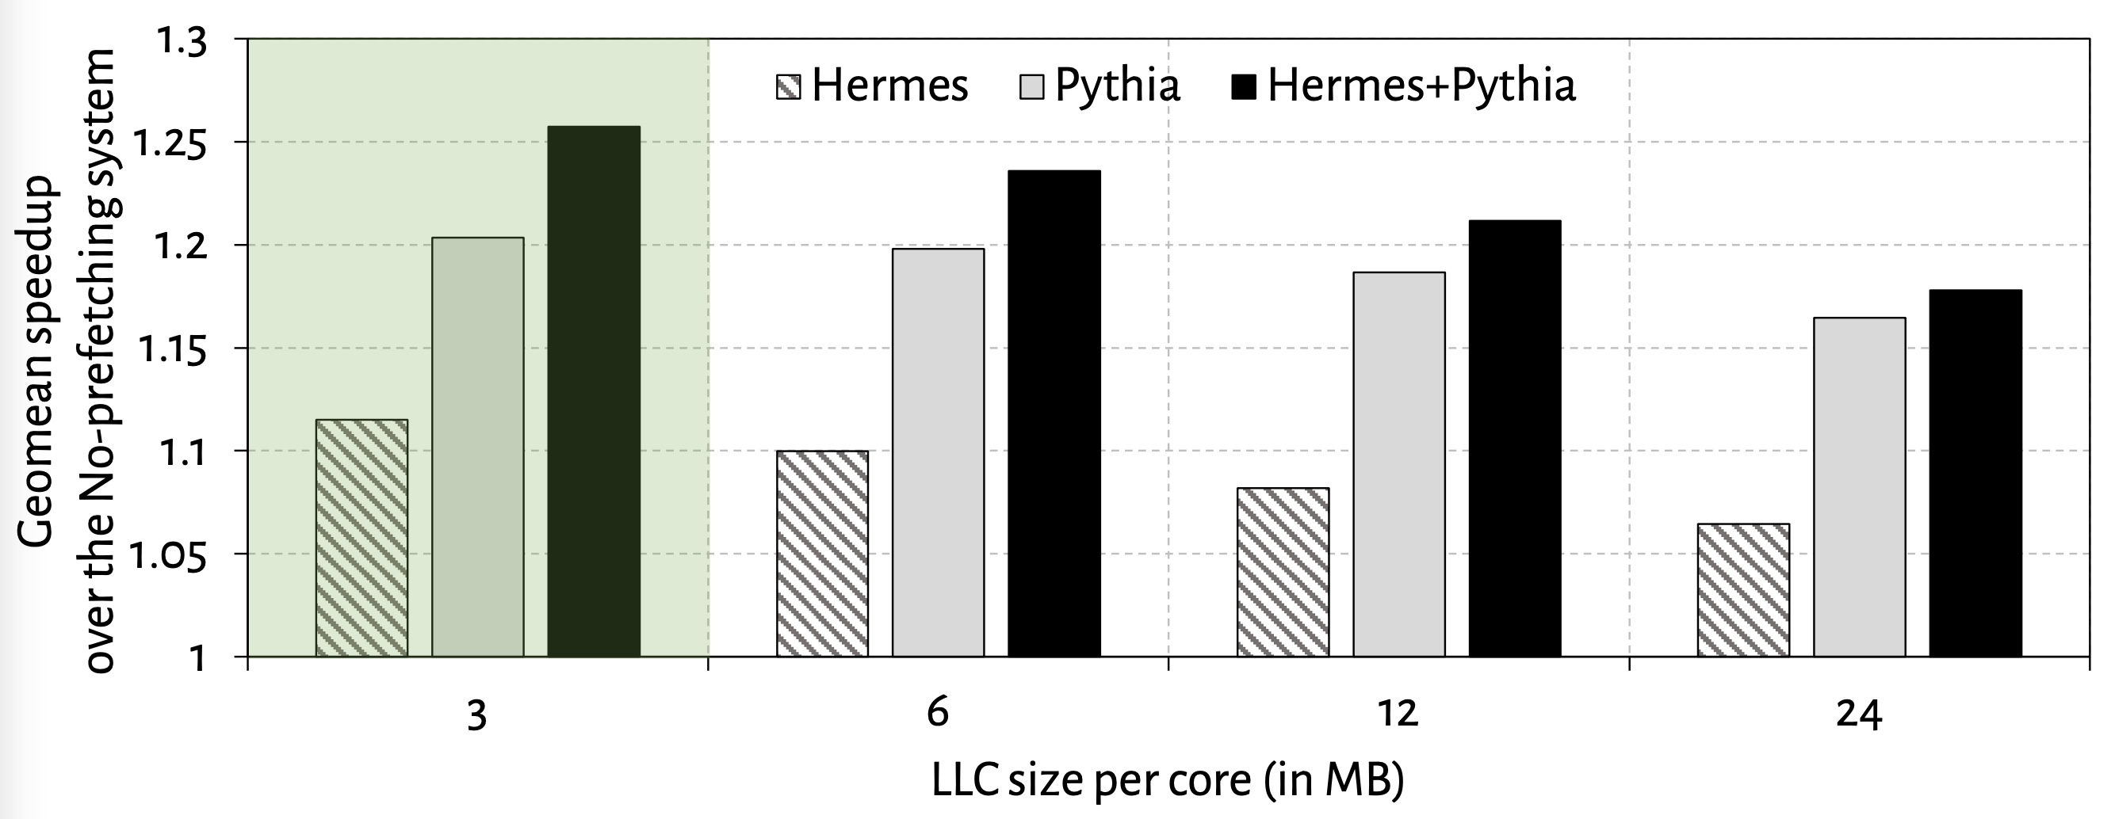
Effect of LLC Size
2.5%
1.3%

Slide 143
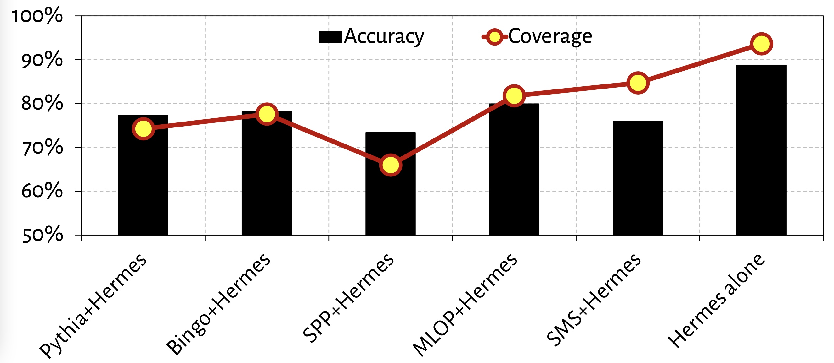
Accuracy and Coverage with Different Prefetchers
POPET’s accuracy and coverage increases significantly
in absence of a data prefetcher

Slide 144
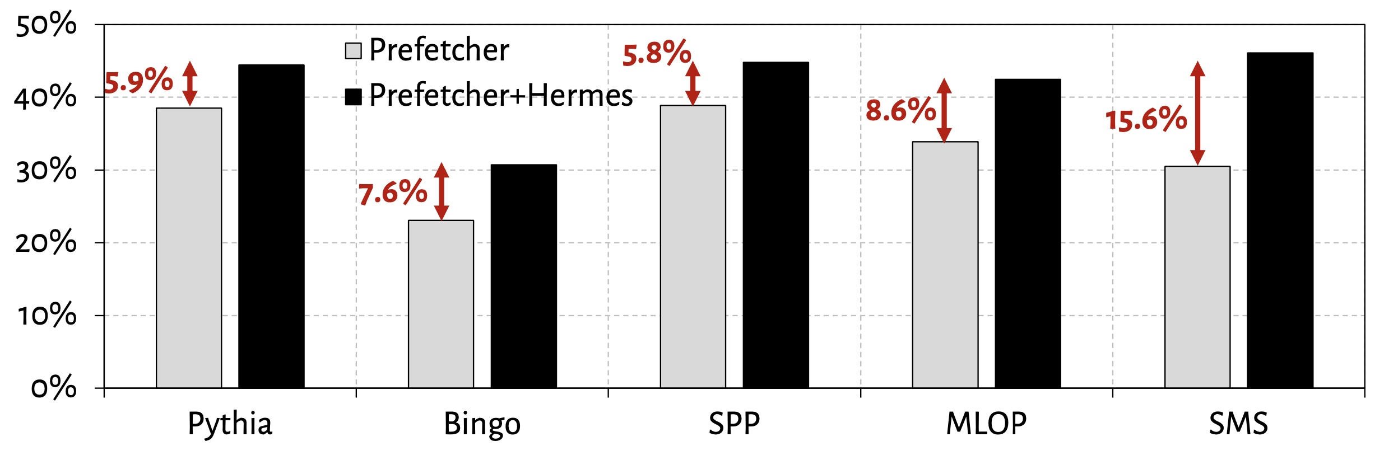
Increase in Main Memory Requests

Slide 145
Increase in Main Memory Requests

Slide 146
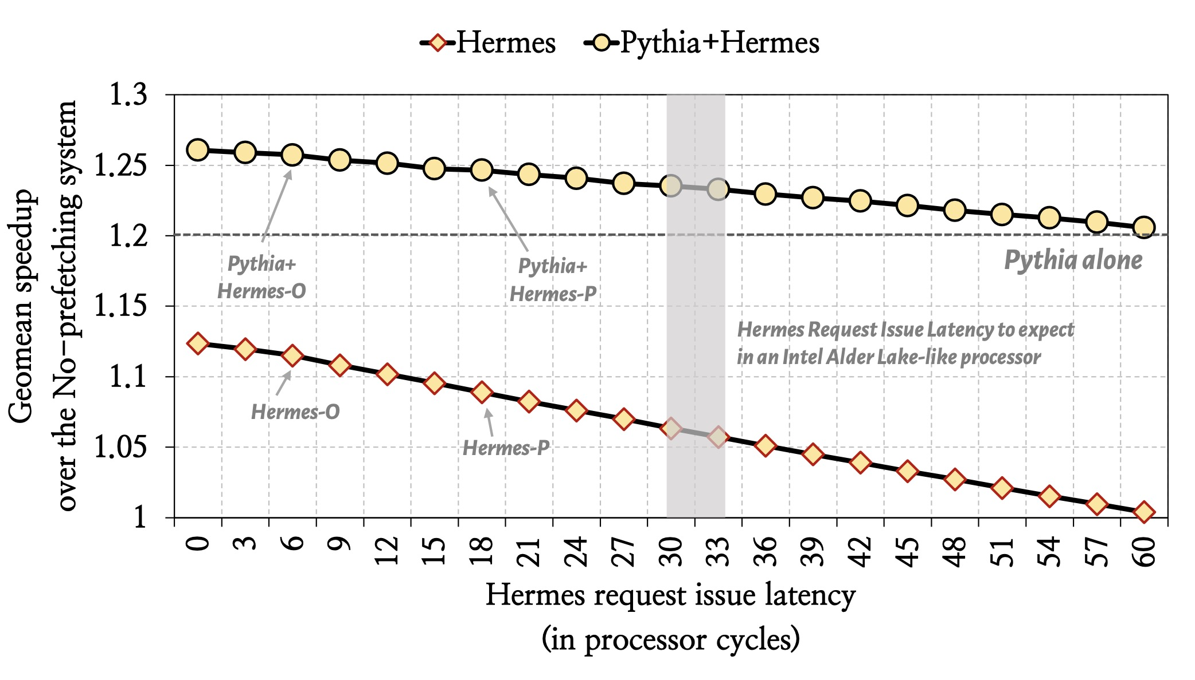
Hermes Limit Study

Slide 147
Athena Discussions

Slide 148
Athena Discussions
Motivational data
Features considered
Q-Value table organization
Final configuration
Overhead analysis
Simulation parameters
Evaluated workloads
Evaluated mechanisms
Perf in CD1
Perf in CD2
Perf in CD3
Perf in CD4
Prefetcher sensitivity
OCP sensitivity
Bandwidth sensitivity
Four-core perf
Eight-core perf
Impact of uncorrelated reward
Understanding Athena

Slide 149
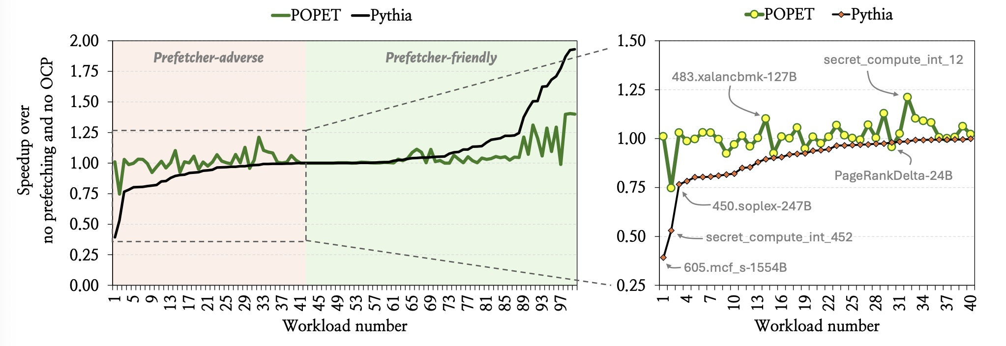
Motivational Data

Slide 150
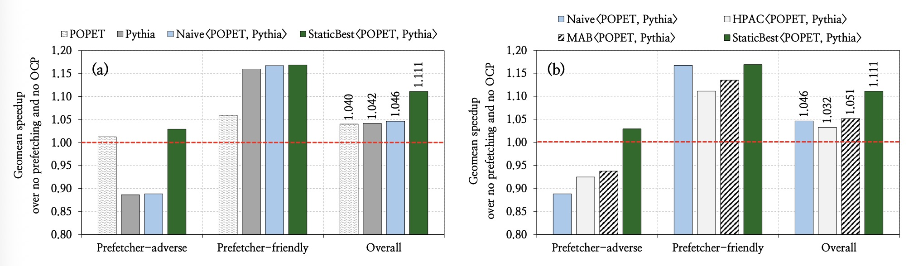
Motivational Data

Slide 151
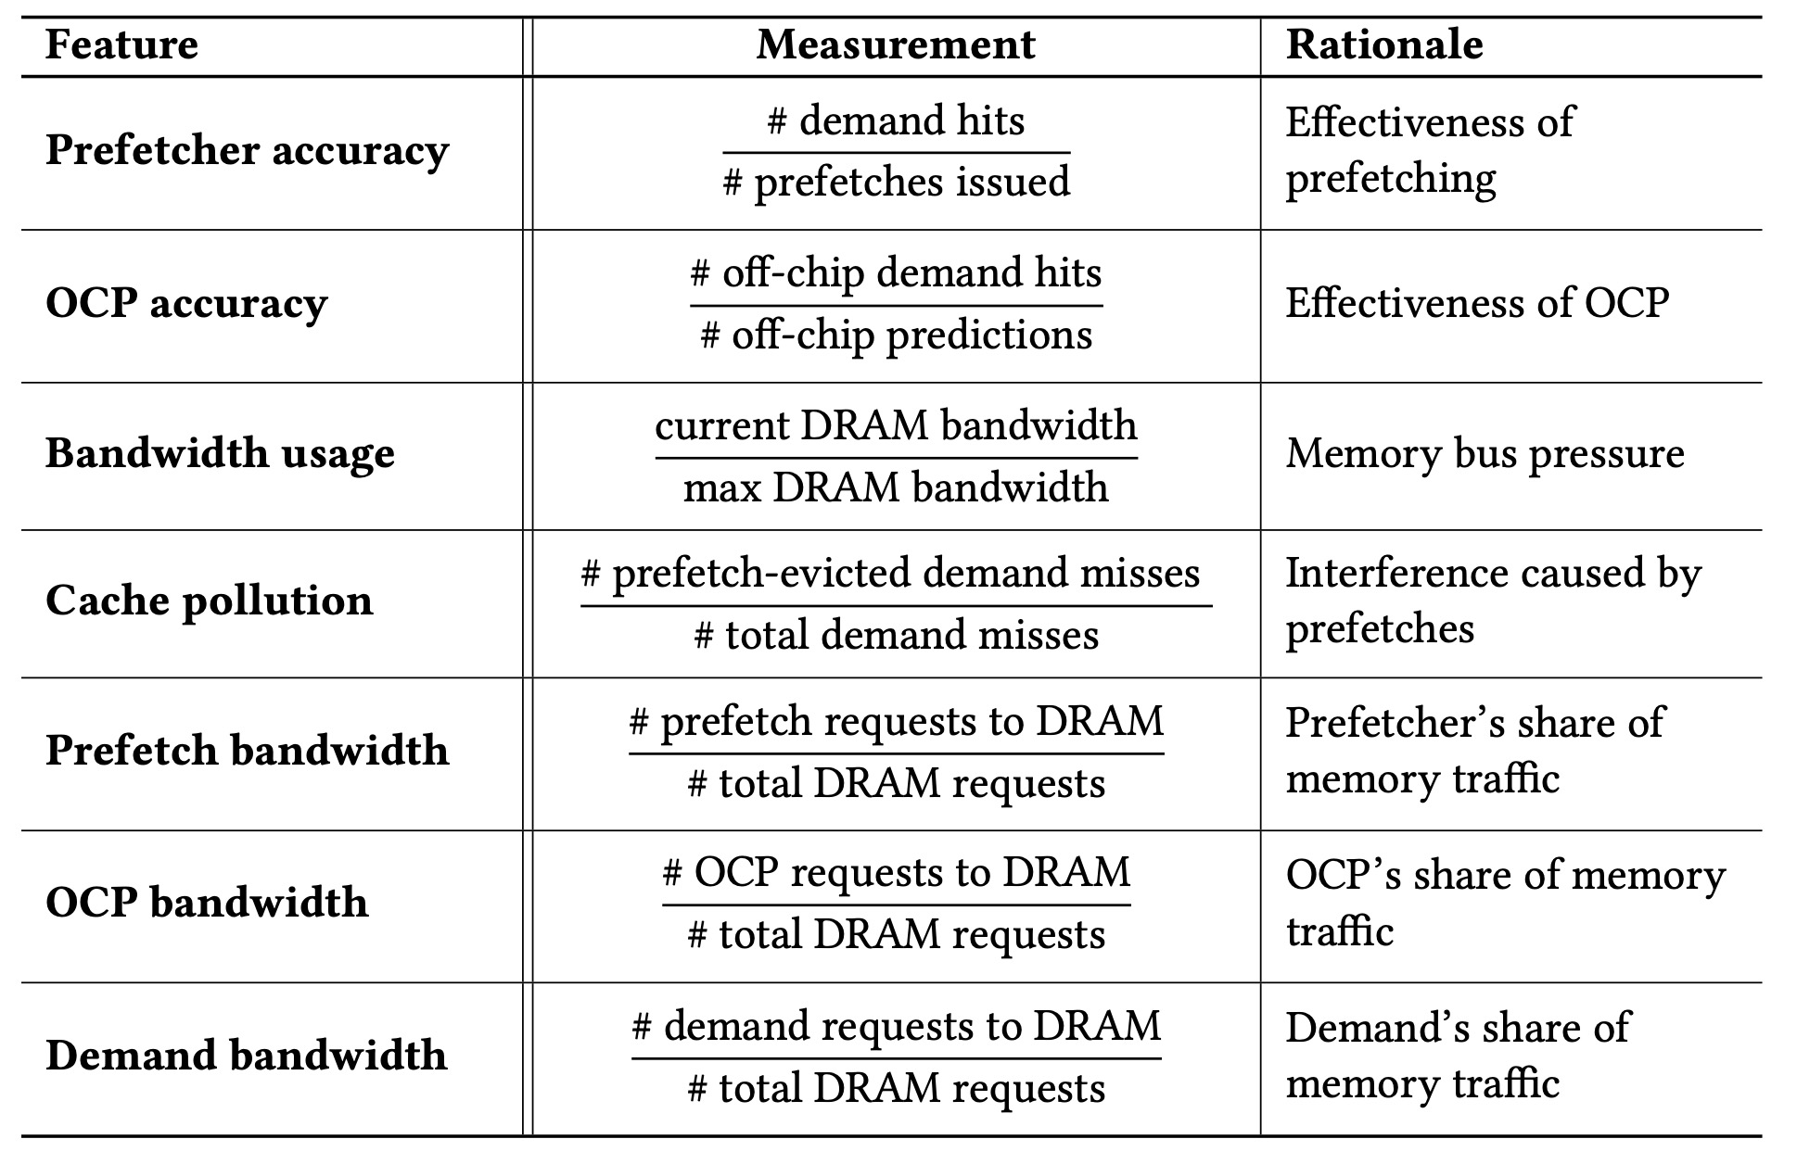
Features Considered

Slide 152
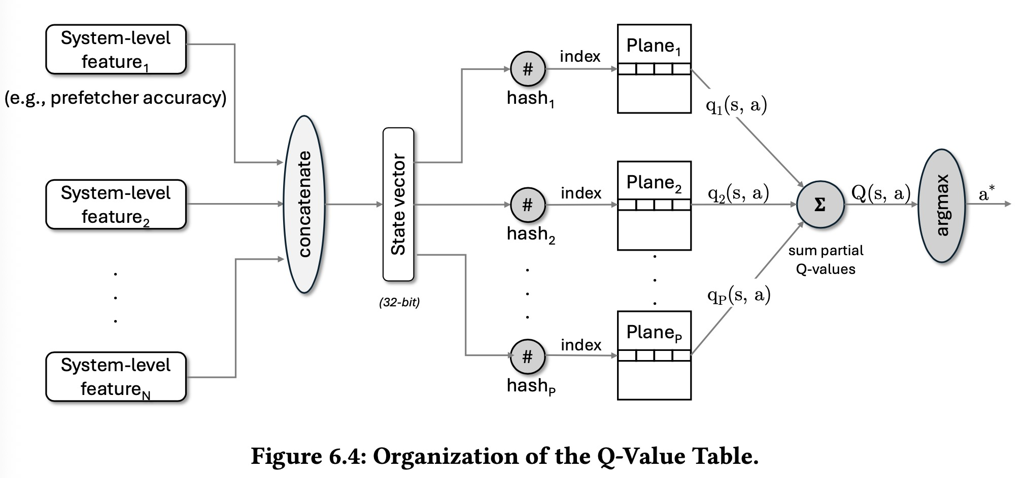
Q-Value Table Organization

Slide 153

Final Configuration

Slide 154

Overhead Analysis

Slide 155

Simulation Parameters

Slide 156

Evaluated Workloads

Slide 157

Evaluated Cache Designs

Slide 158

Evaluated Mechanisms

Slide 159

Performance Gain in CD1

Slide 160

Performance Gain in CD2

Slide 161

Performance Gain in CD3

Slide 162

Performance Gain in CD4

Slide 163

Sensitivity to Prefetcher Type

Slide 164

Sensitivity to OCP Type

Slide 165

Sensitivity to Main Memory Bandwidth

Slide 166

Performance Improvement in Four-Core

Slide 167

Performance Improvement in Eight-Core

Slide 168

Impact of Uncorrelated Reward

Slide 169

Understanding Athena

Slide 170
Constable Discussions

Slide 171
Constable Discussions
Motivation & Design
Why do global-stable loads exist?
Effect of increasing registers
Characterization of global-stable loads
Resource dependence by global-stable loads
Performance headroom
Constable overview
Architecting elimination table
Effect of wrong-path update
Example of Constable’s operation
Ensuring coherence
Storage overhead
Area/energy overhead
Methodology & Evaluation
Simulation parameters
Evaluated workloads
Workload-wise performance
Load-category-wise performance
Comparison with prior works
Elimination coverage
Coverage of global-stable loads
Reduction in power
Scaling width
Scaling depth
Violating memory ordering

Slide 172

Why Do Global-Stable Loads Exist?
Random* Random::s_rng = 0;
Random* Random::get_Rng(void)
{
if (s_rng == 0)
s_rng = new Random();
return s_rng;
}
Global scope variable
Function to access the variable
Example code from 541.leela_r
Notes:
To answer that, here is an example code from a SPEC CPU workload.
[CLICK] The code declares a global-scope variable and
[CLICK] its access function.

Slide 173
Why Do Global-Stable Loads Exist?
Random* Random::s_rng = 0;
Random* Random::get_Rng(void)
{
if (s_rng == 0)
s_rng = new Random();
return s_rng;
}
624: mov rax, [rip+0x1f4ac5]
62b: test rax,rax
62e: je 0x638
630: ret
631: nop
638: sub rsp,0x8
63c: mov edi,0xc
641: call 0x460
Example code from 541.leela_r
Disassembly (compiled by GCC* with –O3)
*GNU GCC 13.2
Notes:
Here is the disassembly of the code compiled by latest GCC with full optimization.

Slide 174
Why Do Global-Stable Loads Exist?
Gets initialized only once
and never changes
Global-stable load
Random* Random::s_rng = 0;
Random* Random::get_Rng(void)
{
if (s_rng == 0)
s_rng = new Random();
return s_rng;
}
624: mov rax, [rip+0x1f4ac5]
62b: test rax,rax
62e: je 0x638
630: ret
631: nop
638: sub rsp,0x8
63c: mov edi,0xc
641: call 0x460
Example code from 541.leela_r
Disassembly (compiled by GCC* with –O3)
*GNU GCC 13.2
Notes:
If we focus on the highlighted “if” instruction, it gets converted to a load instruction to read the global variable, followed by a branch.
[CLICK] Now, as the variable gets initialized only once and never gets changed,
[CLICK] the corresponding load instruction naturally becomes a global-stable load
that always fetches the same data from the same address.

Slide 175


Why Do Global-Stable Loads Exist?

Slide 176
Why Do Global-Stable Loads Exist?
Global-stable loads exist for many reasons:
Accessing global variables
Accessing local variables of an inline function
Limited architectural registers
...

Slide 177

Effects of Increasing Architectural Registers
Fraction of global-stable loads
are nearly same without or with APX
Compiled with Clang 18.1.3 with and without -mapxf

Slide 178
Effects of Increasing Architectural Registers
Fraction of global-stable loads (i.e., Constable’s opportunities)
are much higher than reduction in loads by APX
Compiled with Clang 18.1.3 with and without -mapxf

Slide 179

Effects of Increasing Architectural Registers
The profile of global-stable loads stays largely unchanged
after doubling registers using APX

Slide 180

Characterization of Global-Stable Loads (I)

Slide 181

Characterization of Global-Stable Loads (II)

Slide 182

Characterization of Global-Stable Loads (III)

Slide 183

Resource Dependence by Global-Stable Loads
Global-stable loads cause significant resource dependence

Slide 184

Performance Headroom Analysis

Slide 185

Constable Overview

Slide 186

Architecting SLD

Slide 187

Effect of Wrong-Path Update

Slide 188

An Example of Constable’s Operation

Slide 189

Ensuring Coherence
Constable relies on snoop requests to observe modifications to a memory address by other cores

Slide 190
Ensuring Coherence
Constable relies on snoop requests to observe modifications to a memory address by other cores
Evicting a cacheline from core-private cache resets the core-valid bit in directory
  What if a clean eviction?
    Unnecessary elimination opportunity loss
Constable pins the CV-bit of an eliminated load’s cacheline
  Even if the cacheline gets evicted from core-private cache, snoop request gets delivered

Slide 191

Constable’s Storage Overhead

Slide 192

Area and Power Overhead of Constable’s Structures

Slide 193

Simulated System Parameters

Slide 194

Evaluated Workloads

Slide 195

Workload-Wise Performance

Slide 196

Load Category-Wise Performance

Slide 197

Performance Comparison with Prior Works

Slide 198

Elimination Coverage

Slide 199

Coverage of Global-Stable Loads

Slide 200

Reduction in Dynamic Power

Slide 201

Performance Sensitivity to Load Execution Width Scaling

Slide 202

Performance Sensitivity to Pipeline Depth Scaling

Slide 203

Eliminated Loads that Violates Memory Ordering
Only 0.09% of all eliminated loads
violate memory ordering

Slide 204
Eliminated Loads that Violates Memory Ordering
Eliminated loads that violate memory ordering
increase number of allocated instructions only by 0.3%

