Slide 1







Accelerating Long-Latency Load Requests
via Perceptron-Based Off-Chip Load Prediction
Rahul Bera, Konstantinos Kanellopoulos, Shankar Balachandran,
David Novo, Ataberk Olgun, Mohammad Sadrosadati, Onur Mutlu
Notes:
Hi everyone, I am Rahul. Today, I am going to introduce our work Hermes,
which is done at SAFARI research group in ETH Zurich,
with our academic and industrial collaborators.

Slide 2
The Key Problem
Long-latency off-chip load requests
Often block instruction retirement from
Reorder Buffer (ROB)
Limits performance
Notes:
The key problem that we are trying to address in this work is stemming from Off-chip load request
[CLICK] As we know, these off-chip load requests often block…,
[CLICK] which severely limits the performance of a core.

Slide 3

Traditional Solutions
1
Employ sophisticated prefetchers
2
Increase size of on-chip caches
Notes:
Architects have primarily relied on two key techniques to reduce latency of such loads:
[CLICK] By employing sophisticated data prefetchers
[CLICK] And Increasing size of the on-chip cache hierarchy

Slide 4

Key Observations
Observation 1
Nearly 50% of the off-chip requests
in a no-prefetching system
still go to the main memory
even in presence of state-of-the-art prefetcher
70% of these off-chip loads block the ROB
Notes:
In this work we show that, nearly 50% …
[CLICK] And 70% of these off-chip loads are still blocking the ROB

Slide 5
Key Observations
Observation 2
On-chip cache access latency significantly contributes to total off-chip load latency
40% of the stalls caused by an off-chip load
can be reduced by removing on-chip cache access latency from its critical path
L1
L2
LLC
Main Memory
L1
L2
LLC
Saved cycles
Main Memory
Notes:
Our second observation is that, on-chip cache access…
[CLICK] 40% of the stalls …

Slide 6
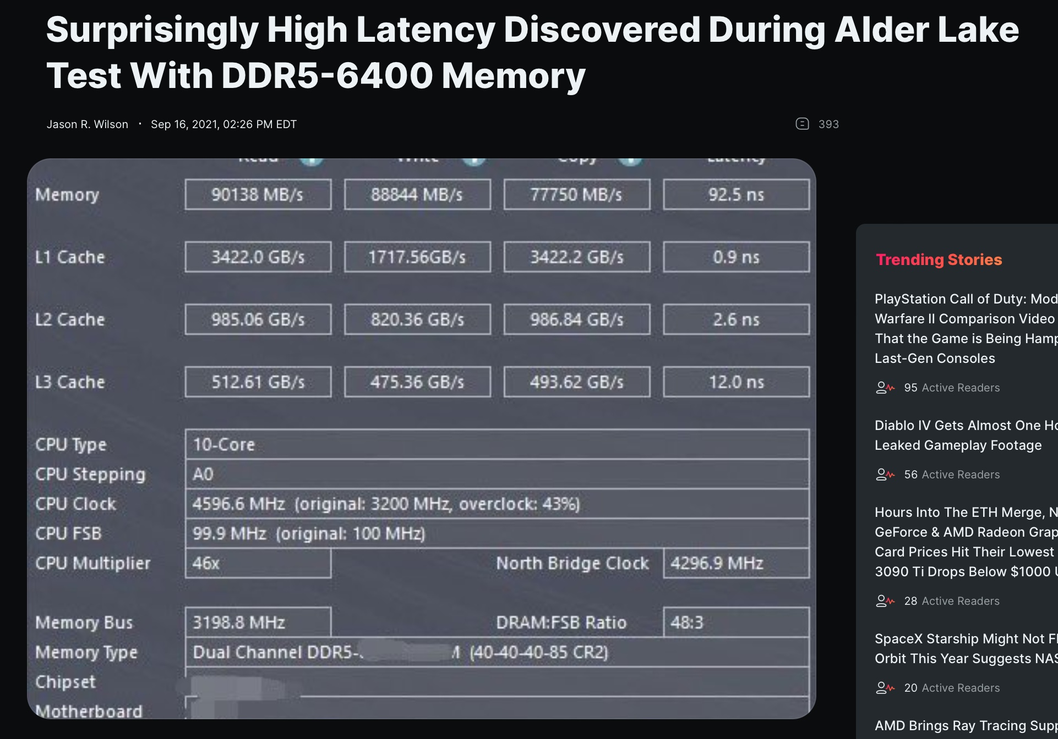
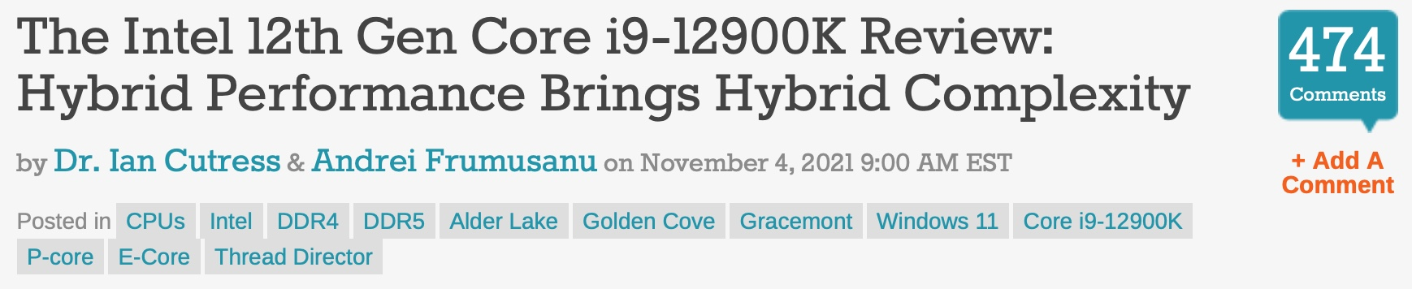
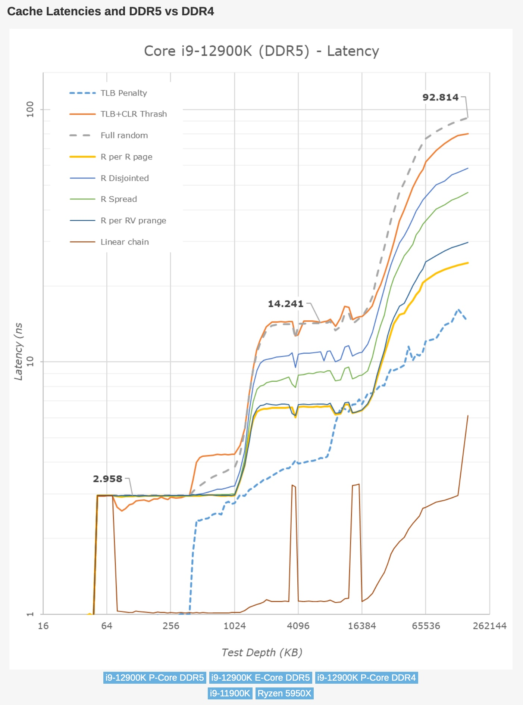
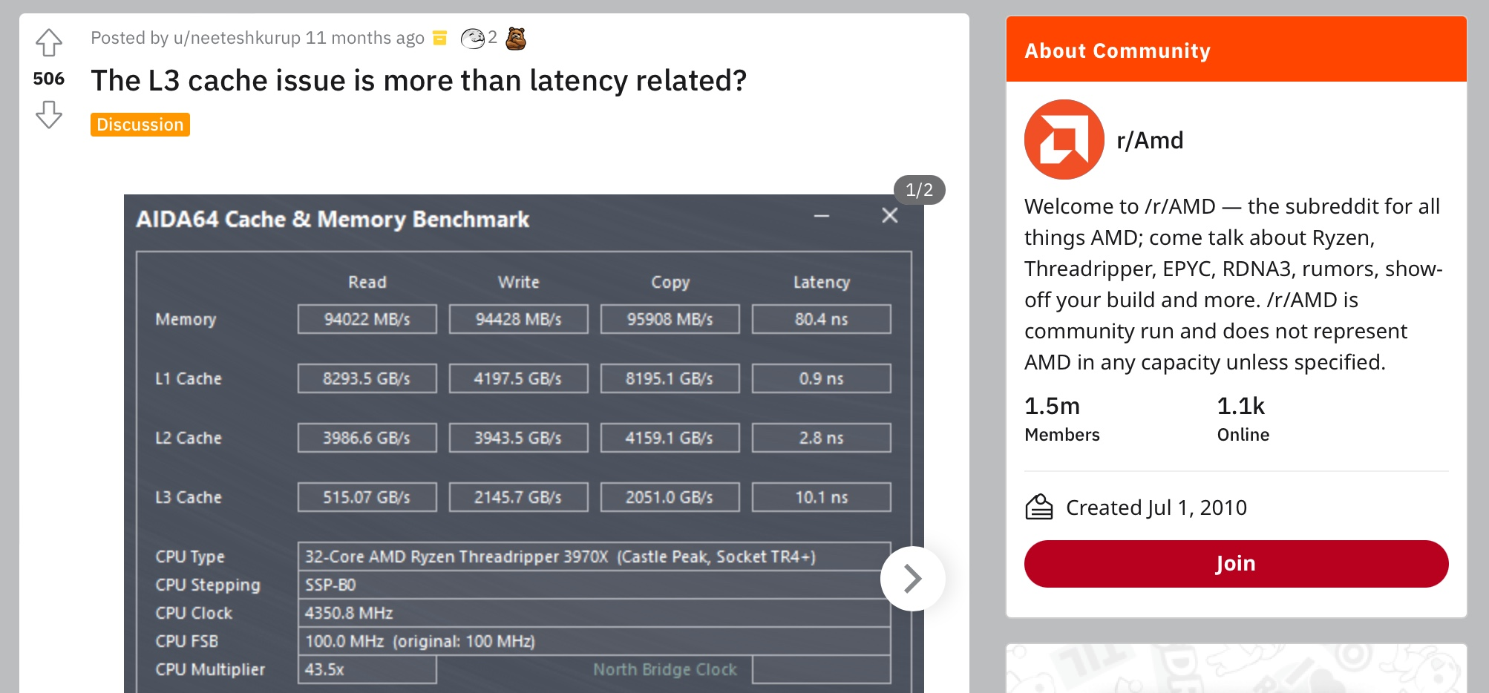
And Things are Getting Worse…
https://wccftech.com/surprisingly-high-latency-discovered-during-alder-lake-test-with-ddr5-6400-memory
https://www.anandtech.com/show/17047/the-intel-12th-gen-core-i912900k-review-hybrid-performance-brings-hybrid-complexity/6
https://www.reddit.com/r/Amd/comments/q8k3u7/the_l3_cache_issue_is_more_than_latency_related
Notes:
[CLICK] As the on-chip hierarchy is steadily growing in size and complexity,
[CLICK] the problems stemming from long on-chip cache access latency
[CLICK] are aggravating the performance of recent processors.

Slide 7
Our Goal
Improve processor performance
by removing on-chip cache access latency
from the critical path of off-chip loads
Notes:
To alleviate this problem, the goal of our work is to improve…

Slide 8
Predicts which load requests might go off-chip
Starts fetching data directly from main memory while concurrently accessing the cache hierarchy
Notes:
Towards this we propose Hermes, which is based on two key ideas.
[CLICK] Hermes predicts which…
[CLICK] Hermes starts fetching …

Slide 9
Hermes Overview
Core
Latency tolerance limit of ROB
L1-D
Baseline
Processor is stalled
L2
L1
L2
LLC
Main Memory
LLC
MC
Off-Chip
Main Memory
Notes:
Now let me give you a brief overview of Hermes.
This is how a traditional cache hierarchy looks like in today’s processor.
[CLICK] And this is how the memory latency timeline looks like for an off-chip load in the baseline system
[CLICK] If the ROB has a latency tolerance limit up till here, the processor stalls for the remaining cycles

Slide 10




Hermes Overview
Off-chip predictor
Predict @ LQ alloc
Core
POPET
Train@ LQ release
Latency tolerance limit of ROB
L1-D
Baseline
Processor is stalled
Issue Hermes request
L2
L1
L2
LLC
Main Memory
LLC
Hermes
L1
L2
LLC
Saved stall cycles
Wait
Main Memory
MC
Off-Chip
Main Memory
Notes:
Now Hermes employs an off-chip predictor named POPET.
[CLICK] For every load generated in the core, Hermes consults POPET to predict whether this load would go off-chip or not
[CLICK] If the load is predicted to go off-chip, Hermes waits for the address translation to finish
[CLICK] And then issues a speculative memory request, which we call a Hermes request,
directly to the main memory controller to start fetching the data from the main memory,
While also concurrently accessing the cache hierarchy for such a load.
[CLICK] If the off-chip prediction is correct, the load would eventually miss the LLC and arrive at the memory controller
Where it will simply wait for the ongoing Hermes request to finish, thus hiding the entire cache access latency from its critical path.
Once the data returns from the main memory, Hermes returns the data to the core [CLICK],
Thus, saving the precious stall cycles induced by the off-chip load [CLICK], which in turn provides performance benefit.
[CLICK] Hermes trains POPET when the data finally returns to the core, closing the feedback loop.

Slide 11



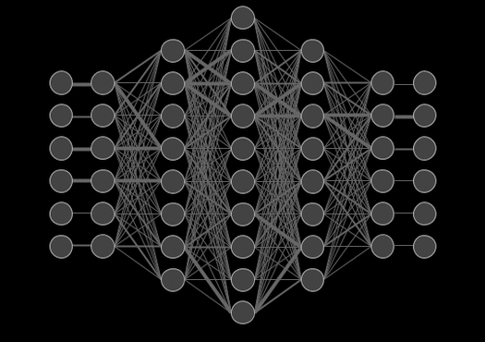

Designing The Off-Chip Predictor
  Large metadata
    Metadata size increases with cache hierarchy size
  Track every cache operations
    Gets tricky based on the cache hierarchy configuration
    (e.g., inclusivity, bypassing,…)
  Correlate different program features with off-chip loads
  Lower storage overhead
  Lower design complexity
Tracking cache contents
Learning from program behavior
Notes:
Now let’s discuss how to design this off-chip predictor.
[CLICK] There are two major ways to design an off-chip predictor.
First, by explicitly tracking the cache contents and
Second, by learning from the program behavior.
[CLICK] Now tracking the cache content poses two key challenges
First, it requires a large metadata structure. And the size of this metadata also increases with the increase in the cache hierarchy size.
And second, we need to track every cache operation going on in the entire cache hierarchy. This can get tricky based on the cache hierarchy configuration.
[CLICK] Learning method, on the other hand, aims to correlate different program feature values with the off-chip load to accurately predict with much lower storage and design complexity.
[CLICK] Hermes adopts the learning method and proposes… [NEXT]

Slide 12
POPET: Perceptron-Based Off-Chip Predictor
Multi-feature hashed perceptron model^{[1]}
  Each feature has its own weight table
    Stores correlation between feature value and off-chip prediction
[1] D. Tarjan and K. Skadron, “Merging Path and Gshare Indexing in Perceptron Branch Prediction,” TACO, 2005
Notes:
…the perceptron-based off-chip predictor, called POPET.
POPET is designed using hashed-perceptron model.
[CLICK] where each feature has its own weight table
That stores the correlation between feature value and the off-chip prediction

Slide 13

Predicting using POPET
Using simple table lookups, addition, and comparison
42
-4
0x7ffe0+12
3
3 >= -2
12
-5
Notes:
Hermes predicts using POPET using simple operations like table lookup, addition, and comparison.
Let me give you an example on how POPET’s prediction works.
POPET’s prediction works in three stages.
[CLICK] In the first stage, POPET extracts the features from the load request
[CLICK] In the second stage, each feature value is hashed and used as an index to retrieve the weights from each individual weight tables
[CLICK] In the third stage, the retrieved weights are accumulated and the cumulative weight is used to compute the activation function.
[CLICK] If the cumulative weight is higher than the activation threshold, POPET predicts that the load would go off-chip.

Slide 14
Training POPET
Using simple increment or decrement of feature weights
42
-4
0x7ffe0+12
3
3 >= -2
12
-5
Notes:
Now let’s understand how to train POPET.
For this let’s assume the previous example where the load is predicted to go off-chip.
[CLICK] But in reality, the load didn’t go off-chip
[CLICK] this means the activation which have triggered before, shouldn’t have triggered
Which means, the cumulative weight should be lower than the activation threshold
[CLICK] Now to adjust the feature weights, POPET again indexes each weight table using the hashed feature values
[CLICK] And simply decrement each weight from the individual weight tables.
Thus, by using simple increment and decrement operations, POPET continuously learns from program behavior to accurately predict off-chip loads.

Slide 15
Evaluation
Notes:
Now let’s evaluate Hermes.

Slide 16
Simulation Methodology
ChampSim trace driven simulator
110 single-core memory-intensive traces
  SPEC CPU 2006 and 2017
  PARSEC 2.1
  Ligra
  Real-world applications
220 eight-core homogeneous and heterogeneous trace mixes
LLC Prefetchers
Off-Chip Predictors
Pythia [Bera+, MICRO’22]
Bingo [Bakshalipour+, HPCA’19]
MLOP [Shakerinava+, 3rd Prefetching Championship’19]
SPP + Perceptron filter [Bhatia+, ISCA’20]
SMS [Somogyi+, ISCA’06]
HMP [Yoaz+, ISCA’99]
Address Tag-Tracking based Predictor (TTP)
Notes:
We evaluate Hermes using ChampSim simulator,
[CLICK] using a wide range of memory-intensive traces spanning across SPEC CPU, PARSEC, Ligra, and real-world applications
[CLICK] We compare Hermes with five LLC prefetchers
[CLICK] and two off-chip predictors extended from prior works

Slide 17
Simulation Methodology
6 cycles
18 cycles
Hermes-Optimistic
Hermes-Pessimistic

Slide 18
Performance with Varying Memory Bandwidth
Pythia+Hermes
5.4%
Pythia
20.3%
11.5%
Hermes
~Intel Xeon 6258R (Cascade Lake, 28C/6ch)
~AMD EPYC Rome 7702P (Zen 2, 64C/8ch)
6.2%
~AMD Threadripper 3990x (Zen 2, 64C/4ch)
In extremely bandwidth-constrained configurations,
Hermes alone outperforms Pythia
Hermes+Pythia outperforms Pythia
in a wide range of bandwidth configurations
Hermes alone provides nearly 50% performance of Pythia

Slide 19
Bandwidth Efficiency
5%
20%
11%
For every 1% performance benefit,
the increase in main memory request by
Pythia
2%
5.9%
38.5%
Hermes on top of Pythia
1%
5.5%
Hermes alone
0.5%

Slide 20
Performance with Varying Baseline Prefetcher
5.4%
6.2%
7.6%
5.1%
Hermes consistently improves performance
on top of a wide range of baseline prefetchers
7.7%
Notes:
And this observation is not only true for Pythia.
We evaluate Hermes combined with multiple prior baseline state-of-the-art prefetchers and find that
Hermes consistently improves performance on top of a wide range of baseline prefetchers.

Slide 21

Overhead of Hermes
4 KB storage overhead
1.5% power overhead
On top of an Intel Alder Lake-like performance-core ^{[2]} configuration
[2] https://www.anandtech.com/show/16881/a-deep-dive-into-intels-alder-lake-microarchitectures/3
Notes:
All of these performance benefit comes at a
[CLICK] modest 4KB storage overhead per core and
[CLICK] 1.5% power overhead on top an Intel Alder Lake-like performance-core configuration

Slide 22
More in the Paper
Wide range of sensitivity studies by varying
  Cache hierarchy access latency
  Hermes request issue latency
  Activation threshold
Comparison of POPET’s accuracy and coverage against HMP and TTP
Understanding usefulness of each program feature
Hermes’s effect on stall cycle reduction
Performance analysis in eight-core system
Notes:
We have many more evaluation results:
For example, a wide range of performance sensitivity study by varying…in the paper.

Slide 23
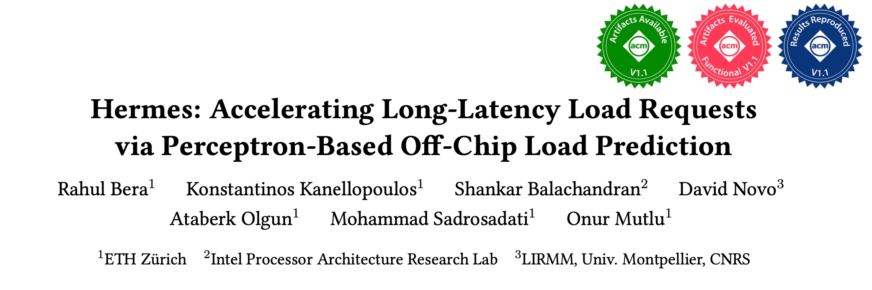
More in the Paper
Wide range of sensitivity studies by varying
  Cache hierarchy access latency
  Hermes request issue latency
  Activation threshold
Comparison of POPET’s accuracy and coverage against HMP and TTP
Understanding usefulness of each program feature
Hermes’s effect on stall cycle reduction
Performance analysis in eight-core system
https://arxiv.org/pdf/2209.00188.pdf
Notes:
[CLICK] We are encouraging everyone to read it.

Slide 24
To Summarize…
Notes:
Thus to summarize…

Slide 25
Summary
Hermes advocates off-chip load prediction,
a different form of speculation than
load address predictions by prefetchers
Off-chip load prediction can be applied by itself
or combined with load address prediction
to provide performance improvement
Notes:
Hermes advocates …
[CLICK] We show that off-chip load prediction…

Slide 26




Summary
Hermes…
Identifies 74% off-chip loads,
that misses a 4.5 MB cache hierarchy
using only 4 KB storage overhead,
with 77% accuracy,
and provides 5.4% performance gain
Notes:
In a nutshell, Hermes
[CLICK] identifies …
[CLICK] that misses …
[CLICK] with 77% …
[CLICK] and this in turn provides …
But we believe Hermes’s off-chip prediction can be made even better…

Slide 27
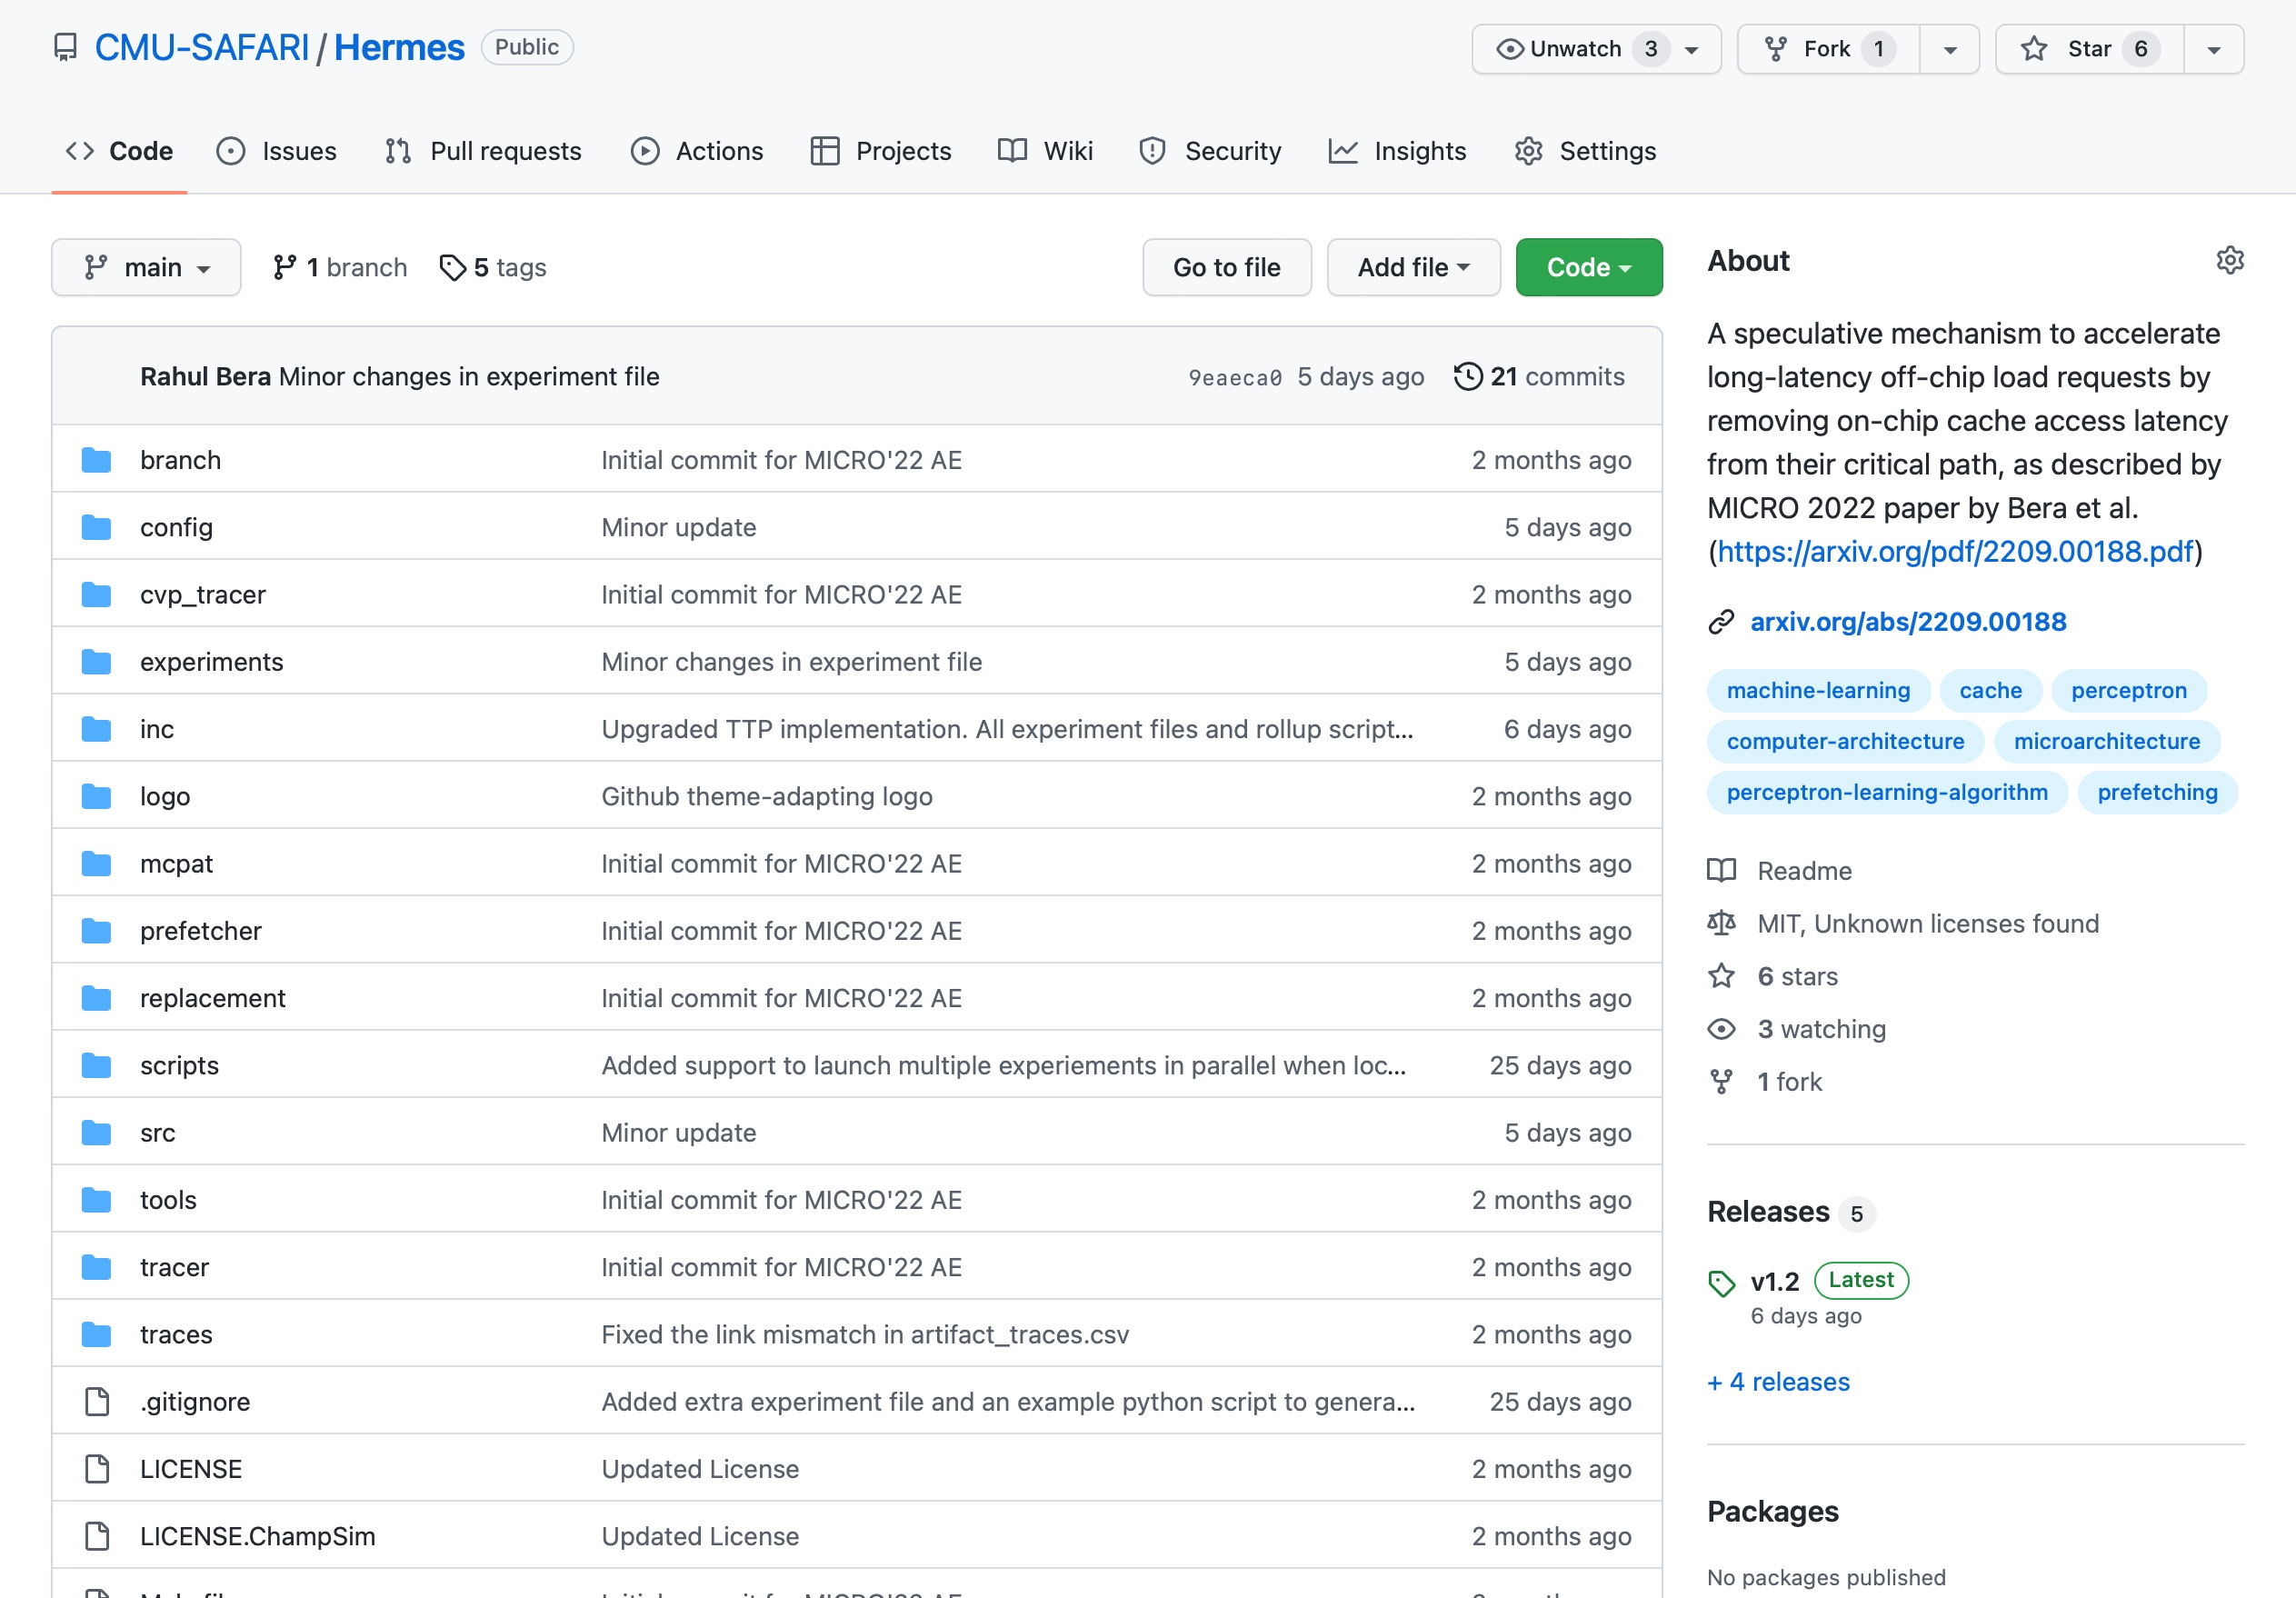
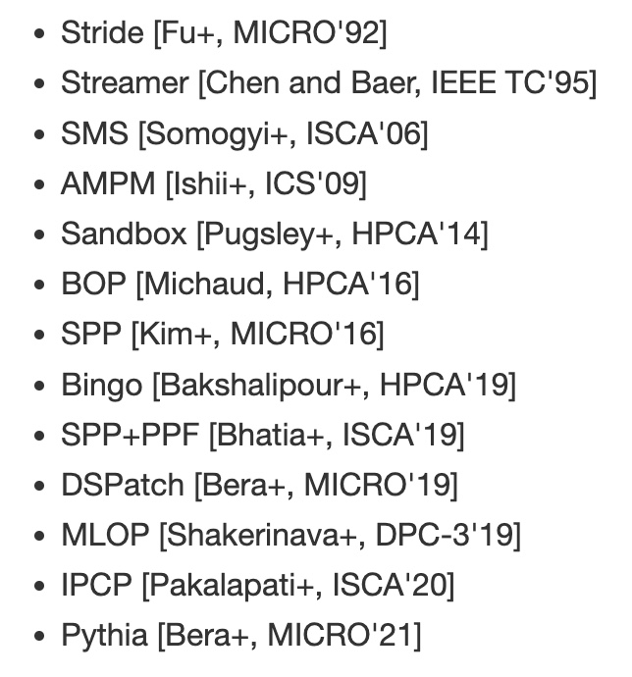
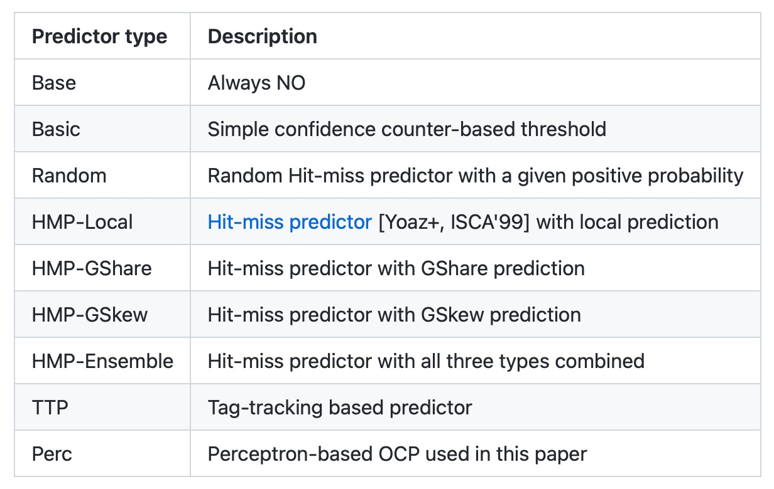
Hermes is Open Sourced
All workload traces
13 prefetchers
9 off-chip predictors
https://github.com/CMU-SAFARI/Hermes
Notes:
That’s why we open-source our artifact.
It can be freely downloaded from our GitHub repository.
In this artifact, [CLICK] you will get all the workload traces we have used to evaluate Hermes,
[CLICK] 13 types of data prefetchers proposed in the past and
[CLICK] 9 types of off-chip predictors out of the box

Slide 28
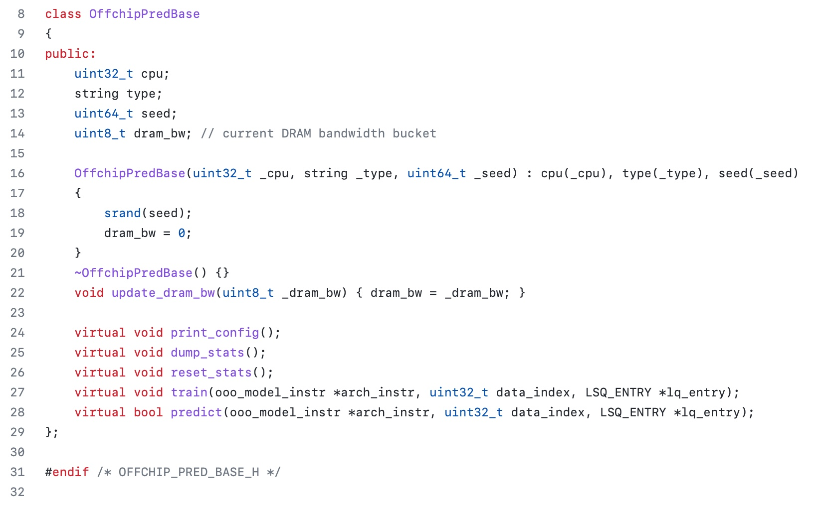
Easy To Define Your Own Off-Chip Predictor
Just extend the OffchipPredBase class
Notes:
But if you want to impalement your own off-chip predictor, that’s also very easy.
All you have to do is to extend the OffchipPred base class…

Slide 29
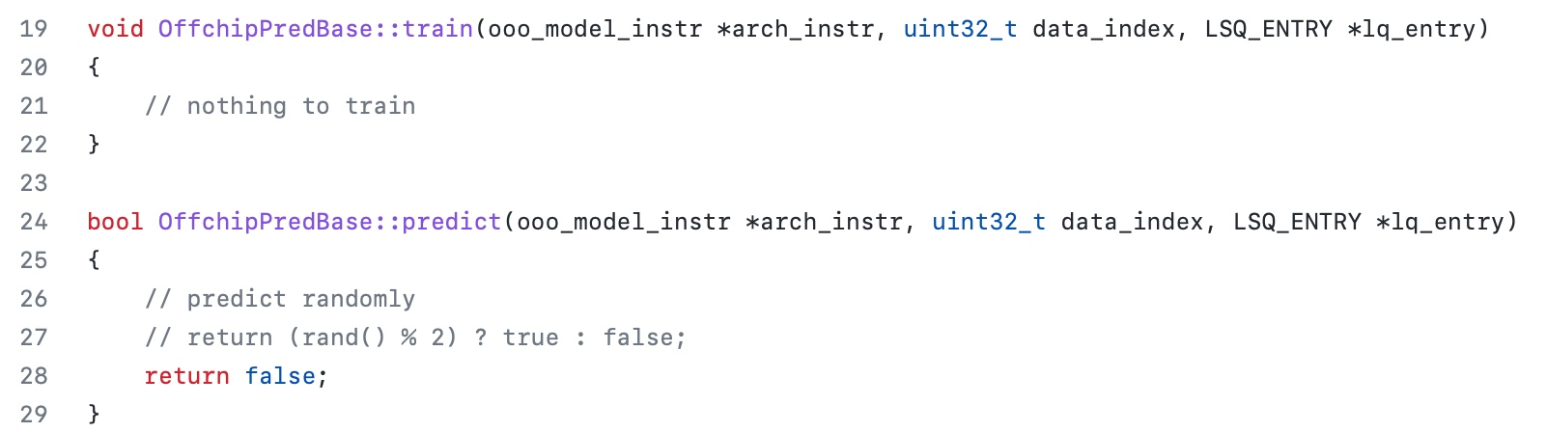
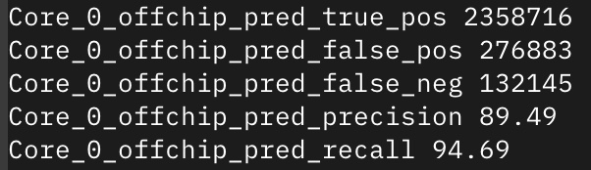
Easy To Define Your Own Off-Chip Predictor
Define your own train() and predict() functions
Get statistics like precision (aka accuracy) and recall (aka coverage) out of the box
Notes:
And define your own train() and predict() functions
[CLICK] the infrastructure will automatically provide statistics like precision and recall out of the box

Slide 30
Off-Chip Prediction Can Further Enable…
Prioritizing loads that are likely go off-chip
in cache queues and on-chip network routing
Better instruction scheduling
of data-dependent instructions
and many more…
Notes:
We hope that high-accuracy off-chip prediction can further enable a multitude of optimization possibilities, for example:
[CLICK] prioritizing loads … to improve performance and fairness in extreme core processors
[CLICK] better instruction scheduling for data dependent loads
[CLICK] and many more…

Slide 31
Accelerating Long-Latency Load Requests
via Perceptron-Based Off-Chip Load Prediction
Rahul Bera, Konstantinos Kanellopoulos, Shankar Balachandran,
David Novo, Ataberk Olgun, Mohammad Sadrosadati, Onur Mutlu
Notes:
With that hope, I will conclude my talk.
I will be very happy to take any question from the audience.

Slide 32
BACKUP

Slide 33
Key Observations
Observation 2
On-chip cache access latency significantly contributes to total off-chip load latency
40% of the stalls caused by
an off-chip load can be reduced by removing on-chip cache access latency from its critical path
Notes:
Our second observation is that, on-chip cache access…
[CLICK] 40% of the stalls …

Slide 34
The Problem and Its Traditional Solutions
Key Problem
Long-latency off-chip load requests
significantly limits performance by stalling the processor
Traditional Solutions
Employ sophisticated data prefetchers
Increase size of on-chip cache hierarchy

Slide 35
Observation: Not All Off-Chip Loads are Prefetched
50%
1
Nearly 50% of the loads are still not prefetched

Slide 36
Observation: Not All Off-Chip Loads are Prefetched
2
70% of these off-chip loads blocks ROB

Slide 37
Observation: With Large Cache Comes Longer Latency
On-chip cache access latency significantly contributes to the latency of an off-chip load
On-chip cache hierarchy access latency
58

Slide 38
Observation: With Large Cache Comes Longer Latency
On-chip cache access latency significantly contributes to the latency of an off-chip load
On-chip cache hierarchy access latency
40% of stall cycles caused by an off-chip load can be eliminated
by removing on-chip cache access latency from its critical path
58

Slide 39
Bandwidth Efficiency
5%
20%
11%
For every 1% performance benefit
Pythia increases
main memory requests by 2%
5.9%
Hermes on top of Pythia increases main memory requests by 1%
38.5%
5.5%
Hermes alone increases
main memory requests by 0.5%

Slide 40

Core
L1-D
L2
Key Problem
Long-latency load requests
that go off-chip significantly limits
a processor’s performance
LLC
MC
Off-Chip
Main Memory

Slide 41
Key Problem
Core
L1-D
L2
LLC
Long-latency load requests that go off-chip significantly limits processor’s performance
MC
Off-Chip
Main Memory

Slide 42
Executive Summary
The problem
Long-latency off-chip load requests limits processor’s performance
by stalling the core
How it is addressed today?
Employ sophisticated data prefetchers
Increase size of on-chip cache hierarchy
Key observations
Nearly 50% of the off-chip loads are not prefetched even by a sophisticated state-of-the-art prefetcher
40% of the stall cycles caused by an off-chip load can be eliminated by removing on-chip cache access latency from its critical path
Our goal
Improve processor performance by removing on-chip cache access latency from the critical path of an off-chip load

Slide 43
Executive Summary
Hermes: Key idea
Predict which load request would go off-chip
Start fetching data directly from main memory, while also concurrently accessing the cache hierarchy
Key mechanism
POPET – A perceptron-based off-chip load predictor
Learns to accurately predict off-chip loads using multiple program features
Key results
Evaluated using a wide range of workloads from SPEC CPU, PARSEC, Ligra, and real-world applications
Identifies 74% off-chip loads with 77% accuracy
Improves performance by 5.4%, 5.1%, and 6.2% in 1/8/bw-limited cores
Incurs only 4KB storage and 1.5% power overhead per-core
https://github.com/CMU-SAFARI/Hermes

