Slide 1



Improving Performance and Power Efficiency
by Safely Eliminating Load Instruction Execution
Rahul Bera* Adithya Ranganathan* Joydeep Rakshit Sujit Mahto
Anant V. Nori Jayesh Gaur Ataberk Olgun Konstantinos Kanellopoulos
Mohammad Sadrosadati Sreenivas Subramoney Onur Mutlu
Notes:
Hi everyone, I am Rahul. Today I am going to discuss our work Constable...
[CLICK]

Slide 2

Key Problem
Load instructions are a key limiter of
instruction-level parallelism (ILP)
Data Dependence
Resource Dependence
Stall load-dependent instructions
due to long load execution latency
Stall other loads due to contention
in load execution resources
L₁
L
I
R
L₂
(e.g., address generation unit,
load port, ...)
Notes:
As the name suggests, this work targets load instructions
which are the key limiters of instruction-level parallelism due to two reasons:
[CLICK] data dependence, meaning stalling data-dependent instructions due to ...
[CLICK] and resource dependence, meaning stalling of ...

Slide 3

Prior Works on Tolerating Load Latency
Load value prediction (LVP) [Lipasti+, ASPLOS’96; Sazeides+, MICRO’96; ...]
Memory renaming (MRN) [Moshovos+, ISCA’97; Tyson+, MICRO’97; ...]
Mitigate
Data Dependence
Do Not Mitigate
Resource Dependence
By speculatively executing
load-dependent instructions
using a predicted load value
Predicted load still gets executed
to verify speculation,
consuming execution resources
L₁
L
I
R
L₂
Notes:
Researchers have proposed multiple techniques to tolerate long load execution latency.
[CLICK] Load Value Prediction and Memory Renaming are two such key techniques.
[CLICK] These techniques successfully mitigates data dependence by speculatively ...
[CLICK] However, they fail to mitigate resource dependence as the predicted loads ...

Slide 4

Motivation
Safely breaking load data dependency
without executing a load instruction
may provide additional performance benefits
How do we start?
By finding load instructions that repeatedly produce
identical results across dynamic instances
Notes:
If we can safely mitigate load data dependency
without executing a load instruction,
it may provide higher performance benefits than prior techniques
But the question is [CLICK] how can we do it?
and [CLICK] how much performance benefit to even expect?

Slide 5
Key Finding I: Global-Stable Loads
Some loads repeatedly fetch the same data value from same load address across entire workload
  Both operations, address generation & data fetch, produce identical results across all dynamic instances
  Prime targets for breaking data dependency without execution
Global-Stable Load
Notes:
To answer these questions, we start by investigating load instructions
that repeatedly fetch the same data value from the same load address across the entire workload.
[CLICK] In other words, both the address generation and data fetch operations of these instructions
produce identical results.
[CLICK] Thus, they are the prime candidates for breaking ...
[CLICK] We call such loads global-stable.
[CLICK] We found out that, across a wide variety of workloads, a surprising [CLICK] 34.2% of all dynamic loads on average are global-stable!

Slide 6
Key Finding I: Global-Stable Loads
Global-Stable Loads
34.2%
Fraction of dynamic loads
Nearly 1 in every 3 dynamic loads
is a global-stable load
Across a wide range of 90 workloads

Slide 7
In the Paper: Analysis of Global-Stable Loads
Why do these loads even exist in well-optimized real-world workloads?
  Accessing global-scope variables
  Accessing local variables of inline functions
  Limited set of architectural registers
Can increasing architectural registers help?
  Very small change even after doubling x64 registers
Deeper characterization of global-stable loads
  Which addressing mode do they use?
  How far away do they appear in a workload?
Notes:
[CLICK] In the paper we have shown why do these loads even exist in real-world well-optimized workloads using examples.
[CLICK] We have also shown that even doubling the architectural registers have very negligible impact on these loads at compile time.
[CLICK] And we have done a deeper characterization of these loads,

Slide 8
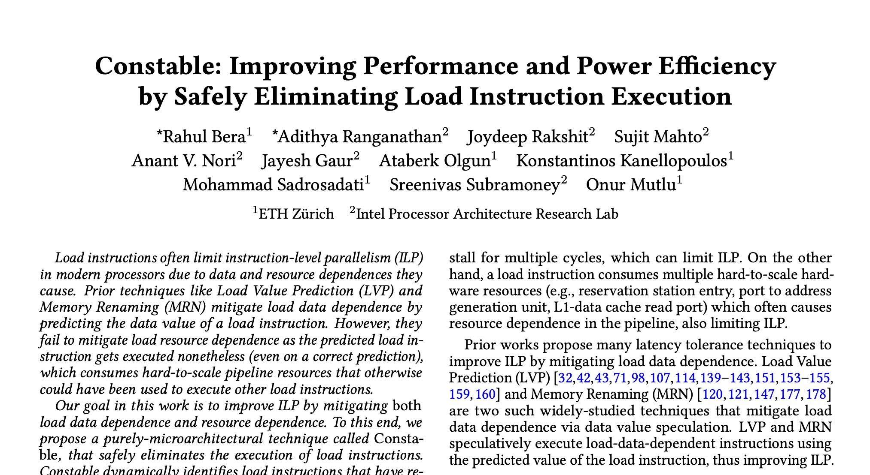
In the Paper: Analysis of Global-Stable Loads
Why do these loads even exist in well-optimized real-world workloads?
  Accessing global-scope variables
  Accessing local variables of inline functions
  Limited set of architectural registers
Can increasing architectural registers help?
  Very small change even after doubling x64 registers
Deeper characterization of global-stable loads
  Which addressing mode do they use?
  How far away do they appear in a workload?
https://arxiv.org/pdf/2406.18786
Notes:
[CLICK] In the paper we have shown why do these loads even exist in real-world well-optimized workloads using examples.
[CLICK] We have also shown that even doubling the architectural registers have very negligible impact on these loads at compile time.
[CLICK] And we have done a deeper characterization of these loads,

Slide 9

A significant fraction of loads are global-stable
But do they limit ILP even when using
load value prediction and memory renaming?
Notes:
So we saw that a significant fraction of loads are global-stable.
[CLICK] but do they limit ILP even in presence of ...?

Slide 10
Key Finding II: Global-Stable Loads Cause
Resource Dependence
All execution cycles where
at least one load port is utilized
In an aggressive OoO processor with 6-wide issue, 3 load ports,
a load value predictor (EVES [Seznec, CVP’18]), and memory renaming enabled

Slide 11
Key Finding II: Global-Stable Loads Cause
Resource Dependence
All execution cycles where
at least one load port is utilized
23%
A global-stable load utilizes a load port
blocking a non-global-stable load
In an aggressive OoO processor with 6-wide issue, 3 load ports,
a load value predictor (EVES [Seznec, CVP’18]), and memory renaming enabled

Slide 12
Key Finding II: Global-Stable Loads Cause
Resource Dependence
All execution cycles where
at least one load port is utilized
Even when using load value prediction and memory renaming,
global-stable loads limit ILP due to resource dependence
23%
A global-stable load utilizes a load port
blocking a non-global-stable load
What’s the performance headroom of mitigating the resource dependence?
In an aggressive OoO processor with 6-wide issue, 3 load ports,
a load value predictor (EVES [Seznec, CVP’18]), and memory renaming enabled

Slide 13
Key Finding III: High Performance Headroom
Ideally value-predicting all global-stable loads
(mitigating only load data dependence)
Ideally eliminating all global-stable loads
(mitigating load data + resource dependence)
2x load execution width
9.1%
8.8%
Mitigating both data and resource dependence has
more than 2x the performance benefit
of mitigating only data dependence of global-stable loads
4.3%
Ideal elimination of global-stable loads exceeds performance
of a processor with 2x wider load execution

Slide 14
Load Execution Resources Lag Behind
3.4x
3x
1.5x
Notes:
As scaling of load execution resources has traditionally lagged behind than
[CLICK] scaling of other pipeline resources over generations due to its area and power limitations,

Slide 15
Load Execution Resources Lag Behind
3.4x
3x
Mitigating load resource dependence has
high performance potential
in recent and future generation processors
1.5x
Notes:
We believe that mitigating load resource dependence would have even higher performance potential
in future generation processors.

Slide 16
Our Goal
To improve instruction-level parallelism by mitigating
both load data dependence and resource dependence
Notes:
Thus our goal is ...

Slide 17
A purely-microarchitectural technique
Mitigates both load data dependence
and load resource dependence
By safely eliminating
the entire execution of a load instruction
Notes:
Towards this, we propose Constable, a purely-microarchitectural technique ...

Slide 18
Constable: Key Insight
LD₁
add rax, 0x10
mov r8, [rbp+0x8]
sub rax, r8
cmp rsi, rax
Two successive dynamic instances
of the same static load instruction
jle 0x40230e
Dynamic instruction stream
add rax, 0x10
mov r8, [rbp+0x8]
sub rax, r8
LD₂
cmp rsi, rax
jle 0x40230e
add rax, 0x10
Notes:
Constable is based on a simple key insight that if there are two successive dynamic instances
X1 and X2 of a load instruction,
[CLICK] then X2 will fetch... if:
[CLICK] None of the ...
[CLICK] No store or snoop ...

Slide 19


Constable: Key Insight
If the source register rbp
has not been modified
LD₁
add rax, 0x10
mov r8, [rbp+0x8]
sub rax, r8
LD₂ would have the same address as LD₁
cmp rsi, rax
jle 0x40230e
Address generation of LD₂
can be eliminated
Dynamic instruction stream
add rax, 0x10
mov r8, [rbp+0x8]
If no store or snoop request
to address [rbp+0x8]
sub rax, r8
LD₂
cmp rsi, rax
jle 0x40230e
LD₂ would fetch the same data as LD₁
add rax, 0x10
Data fetching of LD₂
can be eliminated
Notes:
Constable is based on a simple key insight that if there are two successive dynamic instances
X1 and X2 of a load instruction,
[CLICK] then X2 will fetch... if:
[CLICK] None of the ...
[CLICK] No store or snoop ...

Slide 20



Constable: Key Steps
Dynamically identify load instructions
that have historically fetched
the same data from the same load address
(i.e., likely-stable)
Eliminate execution of likely-stable loads
by tracking modifications to
their source registers and their load addresses
Notes:
Based on this insight, Constable works on three key steps:
[CLICK] First, Constable dynamically identifies ...
[CLICK] For every likely-stable load, Constable tracks modifications ...
[CLICK] and eliminates their execution until there is a write ...

Slide 21


Prior Related Literature
Rich literature on skipping redundant computations
by memoizing previously-computed results
[Michie, Nature’68; Harbison+, ASPLOS’82; Richardson, SCA’93; Sodani+, ISCA’97; González+, ICPP’99; ...]
Aim to memoize every instruction
including multiple dynamic instances of each instruction
Require large memoization buffer
Often bigger than the size of L1 data cache
Notes:
Unlike prior works that aim to memoize multiple dynamic instances of every possible instructions,
Constable focuses on loads and only those loads that indeed found to be likely-stable.
This significantly reduces Constable’s storage overhead as well as design complexity.

Slide 22





Key Improvements over Literature
Rich literature on skipping redundant computations
by memoizing previously-computed results
[Michie, Nature’68; Harbison+, ASPLOS’82; Richardson, SCA’93; Sodani+, ISCA’97; González+, ICPP’99; ...]
Focus only on loads that are likely stable
Lower storage overhead
with high load elimination coverage
Lower design complexity
Fewer port requirements, lower power
Notes:
Unlike prior works that aim to memoize multiple dynamic instances of every possible instructions,
Constable focuses on loads and only those loads that indeed found to be likely-stable.
This significantly reduces Constable’s storage overhead as well as design complexity.

Slide 23



Key Improvements over Literature
Rich literature on skipping redundant computations
by memoizing previously-computed results
[Michie, Nature’68; Harbison+, ASPLOS’82; Richardson, SCA’93; Sodani+, ISCA’97; González+, ICPP’99; ...]
Focus only on loads that are likely stable
Eliminate loads early in the pipeline
Elimination at rename stage
by explicitly monitoring changes to the source registers
and load address of a likely-stable load
Notes:
Second, unlike many prior works that waits for the source registers of an instruction to be available before elimination,
Constable eliminates a load way early in the pipeline at the rename stage by explicitly monitoring changes to its source registers.

Slide 24

Key Improvements over Literature
Rich literature on skipping redundant computations
by memoizing previously-computed results
[Michie, Nature’68; Harbison+, ASPLOS’82; Richardson, SCA’93; Sodani+, ISCA’97; González+, ICPP’99; ...]
Focus only on loads that are likely stable
Eliminate loads early in the pipeline
Ensure correctness in today’s processors
Maintain correctness in presence of out-of-order load issue
Maintain coherence in multi-threaded & multi-core execution
Notes:
And third, unlike prior works, Constable ensure correctness in today’s high-performance processors
with techniques like out-of-order load issue and multi-core execution.
In fact, we have extensively verified Constable’s correctness over a wide range of workloads and system configurations
as shown in the paper.

Slide 25
Design Overview
Notes:
Now let me give you a very brief overview of Constable’s design.

Slide 26
Constable: Key Steps
Identify
likely-stable loads
Eliminate
by tracking modifications
Notes:
As I said, Constable first identify likely-stable loads
and then eliminate them.

Slide 27


Identify a Likely-Stable Load
add rax, 0x10
Using a stability confidence counter per load instruction
mov r8, [rbp+0x8]
5
sub rax, r8
cmp rsi, rax
Same data & address
as last dynamic instance
add rax, 0x10
+1
mov r8, [rbp+0x8]
6
sub rax, r8
Stability Confidence
cmp rsi, rax
ret
/2
mov r8, [rbp+0x8]
3
sub rax, r8
Different data or
different address
cmp rsi, rax
jle 0x40230e
Notes:
Let’s first see how Constable identifies likely-stable loads.
[CLICK] Constable uses a stability confidence counter per load instruction
to measure how frequently a load has fetched the same data from the same address.
[CLICK] Once a load completes its execution, if it has found to fetch the same data from the same load address
as the last dynamic instance, its stability confidence counter gets incremented.
[CLICK] Otherwise, the counter gets halved.

Slide 28

Eliminate a Likely-Stable Load
jle 0x40230e
Stability confidence crosses threshold
add rax, 0x10
mov r8, [rbp+0x8]
Register Monitor
Address Monitor
30
sub rax, r8
Insert
rbp
PC_{x}
Insert
0x4200e0
PC_{x}
cmp rsi, rax
add rax, 0x10
mov r8, [rbp+0x8]
Elimination Table
30
Lookup
sub rax, r8
Insert
PC_{x}
0x2ae
last value
cmp rsi, rax
eliminate flag
add rax, 0x10
mov r8, [rbp+0x8]
No reservation station
No address generation unit
No load port
Still takes ROB and load buffer
30
sub rax, r8
cmp rsi, rax
to handle correct elimination of in-flight loads
Notes:
[CLICK] Once the counter reaches a confidence threshold,
[CLICK] Constable starts tracking the source registers and the last executed load address
of this instruction in two separate structures.
[CLICK] saves the last executed load value, and sets an eliminate flag, which signifies that
any subsequent instances of this instruction can be eliminated from now on.
[CLICK] Once a new instance of this instructions arrives, Constable eliminates its execution,
meaning no reservation station, address generation unit, and load port will be assigned for this instruction
and its data-dependency would be broken using the last executed value.
[CLICK] However, an eliminated load would still take a reorder buffer and a load buffer entry
to rectify any rare incorrectly-eliminated in-flight loads, as we describe in the paper.
[CLICK] Constable keeps on eliminating any subsequent instances of this instruction till the eliminate flag stays on.

Slide 29

Stop Elimination of a Likely-Stable Load
jle 0x40230e
add rax, 0x10
mov r8, [rbp+0x8]
Register Monitor
Address Monitor
30
sub rax, r8
rbp
PC_{x}
0x4200e0
PC_{x}
cmp rsi, rax
pop rbx
add rbp, 0xd8
Elimination Table
.
PC_{x}
0x2ae
.
.
add rax, 0x10
mov r8, [rbp+0x8]
15
30
sub rax, r8
Elimination flag not set.
Gets executed
cmp rsi, rax
jle 0x40230e
Notes:
[CLICK] Now once an instruction arrives that modifies either any tracked registers or addresses,
[CLICK] Constable looks up the corresponding monitor table, and
[CLICK] resets the eliminate flag of the respective load instruction.
[CLICK] Resetting the flag essentially means that a future instance of this instruction needs to be executed.
[CLICK] After the execution completes, the stability confidence gets updated, which needs to be regained
before this instruction can be eligible for elimination.

Slide 30
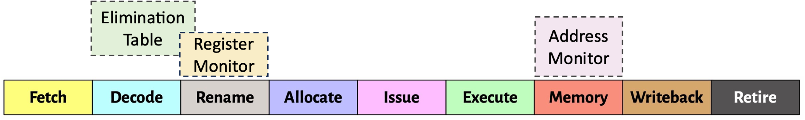
More in the Paper
Ensuring safe and correct elimination in presence of
  Out-of-order load issue
  Multi-threaded & multi-core execution
  Wrong-path execution
Integration of Constable into the processor pipeline
Microarchitecture for breaking data dependence on the eliminated loads
Microarchitecture of Constable’s own structures
  Read and write port requirements
Notes:
In the paper, we have many more details in Constable’s design, for example,
[CLICK] How Constable ensures correct elimination in presence of out-of-order load issue, multi-core execution, ...
[CLICK] Microarchitecture for ...
[CLICK] Microarchitecture of Constable’s own structures ...

Slide 31
More in the Paper
Ensuring safe and correct elimination in presence of
  Out-of-order load issue
  Multi-core execution
  Wrong-path execution
Integration of Constable into the processor pipeline
Microarchitecture for breaking data dependence on the eliminated loads
Microarchitecture of Constable’s own structures
  Read and write port requirements
https://arxiv.org/pdf/2406.18786
Notes:
In the paper, we have many more details in Constable’s design, for example,
[CLICK] How Constable ensures correct elimination in presence of out-of-order load issue, multi-core execution, ...
[CLICK] Microarchitecture for ...
[CLICK] Microarchitecture of Constable’s own structures ...

Slide 32
Evaluation
Notes:
Now let’s evaluate Constable.

Slide 33
Methodology
Industry-grade x86-64 simulator modeling aggressive OoO processor
  8-wide fetch, 6-wide issue to 3 load ports, 512-entry ROB
  With memory renaming, zero/constant/move elimination, branch folding
  Five prefetchers throughout cache hierarchy
90 workloads of wide variety
  All from SPEC CPU 2017
  Client (SYSMark, DaCapo, ...)
  Enterprise (SPECjbb, SPECjEnterprise, ...)
  Server (BigBench, Hadoop, ...)
Mechanisms compared against
Configurations
EVES, the state-of-the-art load value predictor [Seznec, CVP’18]
Early Load Address Resolution [Bekerman+, ISCA’00]
Register File Prefetching [Shukla+, ISCA’22]
No simultaneous multi-threading (SMT)
2-way SMT
Notes:
We evaluate Constable using the in-house, industry-grade simulator modeling a fairly aggressive out-of-order processor
that already has memory renaming and multiple dynamic non-memory instruction elimination techniques implemented.
[CLICK] We use 90 workloads from wide variety of SPEC CPU, Client, Enterprise, and Server applications.
[CLICK] We compare Constable against the state-of-the-art load value predictor EVES, and two other related techniques,
[CLICK] in both no SMT and 2-way SMT configurations.

Slide 34
Performance Improvement in noSMT
EVES (the state-of-the-art load value predictor)
Constable
EVES + Constable
3.4%
5.1%
4.7%
Constable alone provides similar performance as EVES
with only ½ of EVES’ storage overhead
Constable on top of EVES outperforms EVES alone
Notes:
Let’s first analyze the performance improvement in noSMT configuration.
[CLICK] This is how Constable and EVES improves performance on top of the baseline system.
[CLICK] The first takeaway is that Constable alone provides the same performance benefit as the state-of-the-art load value predictor EVES
while consuming only half of its storage overhead.
[CLICK] Now, if we combine Constable and EVES together, it provides 3.4% more performance benefit on top of EVES.

Slide 35
Performance Improvement in 2-way SMT
EVES (the state-of-the-art load value predictor)
Constable
EVES + Constable
11.3%
8.8%
3.6%
Notes:
In 2-way SMT configuration where resource contention is more severe,
Constable’s performance benefit increases even further.
[CLICK] While EVES improves performance by only 3.6% over the baseline,
Constable alone improves performance by 8.8%.
[CLICK] Combining Constable with EVES improves performance by 11.3%.

Slide 36
Performance Improvement in 2-way SMT
EVES (the state-of-the-art load value predictor)
Constable
EVES + Constable
11.3%
8.8%
3.6%
Constable provides higher performance benefits
in a 2-way SMT processor
Notes:
In 2-way SMT configuration where resource contention is more severe,
Constable’s performance benefit increases even further.
[CLICK] While EVES improves performance by only 3.6% over the baseline,
Constable alone improves performance by 8.8%.
[CLICK] Combining Constable with EVES improves performance by 11.3%.

Slide 37
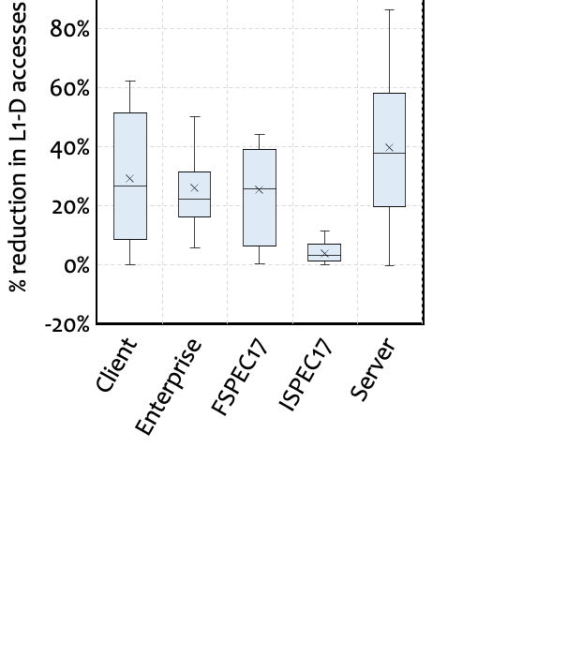
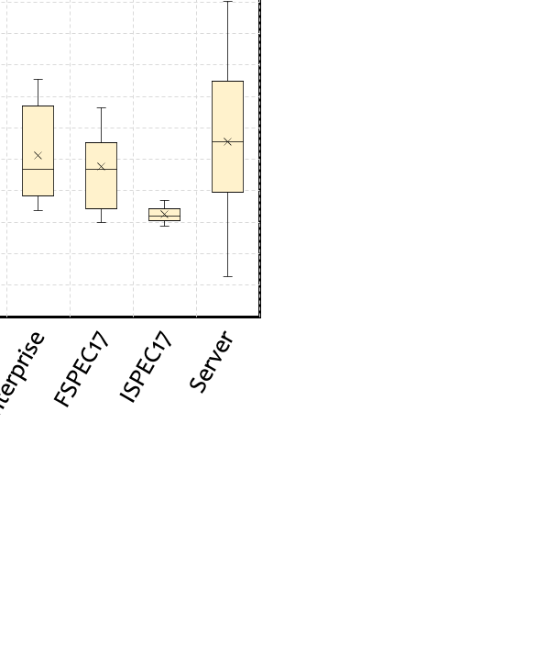
Improvement in Resource Efficiency
Reduction in
L1 Data Cache Accesses
Reduction in Reservation Station Allocation
26% average
8.8% average
Notes:
Now let’s analyze the reduction in resource utilization by Constable.
[CLICK] Since the eliminated loads do not take the reservation station,
Constable reduces RS allocation, as shown here as a box and whisker plot.
[CLICK] We observe an average of 8.8% reduction in RS allocations by Constable.
[CLICK] Similar to RS allocations, Constable also reduces L1 data cache accesses.
[CLICK] We observe a 26% L1 data cache access reduction on average.

Slide 38

Improvement in Resource Efficiency
Reduction in
L1 Data Cache Accesses
Reduction in Reservation Station Allocation
26% average
8.8% average
Constable significantly improves resource efficiency
by eliminating load instruction execution
Notes:
Now let’s analyze the reduction in resource utilization by Constable.
[CLICK] Since the eliminated loads do not take the reservation station,
Constable reduces RS allocation, as shown here as a box and whisker plot.
[CLICK] We observe an average of 8.8% reduction in RS allocations by Constable.
[CLICK] Similar to RS allocations, Constable also reduces L1 data cache accesses.
[CLICK] We observe a 26% L1 data cache access reduction on average.

Slide 39
Reduction in Dynamic Power
Memory Execution Unit Power
OoO Unit Power
9.1% average reduction
5.1% average reduction
Notes:
The reduction in resource utilization directly translates to power reduction.
[CLICK] Here’s the power consumption by the out-of-order unit,
broken down into key microarchitectural components like reservation station, register alias table, and reorder buffer,
for Baseline, EVES, Constable, and EVES+Constable configuration.
[CLICK] As we can see, unlike EVES, Constable provides a 5.1% reduction in power consumes by RS.
[CLICK] Here’s the power consumption by memory execution unit,
broken down into key microarchitectural components like L1 data cache, and data TLB.
[CLICK] As we can see, Constable also provides a 9.1% reduction in power consumed by L1 data cache.

Slide 40
Reduction in Dynamic Power
Memory Execution Unit Power
OoO Unit Power
By eliminating load instruction execution,
Constable reduces dynamic power consumption
9.1% reduction
5.1% reduction
Notes:
The reduction in resource utilization directly translates to power reduction.
[CLICK] Here’s the power consumption by the out-of-order unit,
broken down into key microarchitectural components like reservation station, register alias table, and reorder buffer,
for Baseline, EVES, Constable, and EVES+Constable configuration.
[CLICK] As we can see, unlike EVES, Constable provides a 5.1% reduction in power consumes by RS.
[CLICK] Here’s the power consumption by memory execution unit,
broken down into key microarchitectural components like L1 data cache, and data TLB.
[CLICK] As we can see, Constable also provides a 9.1% reduction in power consumed by L1 data cache.

Slide 41



Area and Power Overhead of Constable’s Own Structures
12.4 KB
Storage overhead per core
0.232 mm²
0.0061% area of Intel Alderlake-S processor
Low Energy
Up to 10.8 pJ/read and 16.7 pJ/write

Slide 42
More in the Paper
Load elimination coverage of Constable
  23.5% of all dynamic loads are eliminated
Per-workload performance analysis
  Up to 31.2% over baseline
  60/90 workloads outperforms EVES by more than 5%
Performance contribution per load category
  Stack loads contribute the highest
Performance improvement over prior works
  4.7% over Early load address resolution
  3.6% over Register file prefetching
Performance sensitivity:
  Higher performance in every configuration up to 2X load execution width
  Higher performance in every configuration up to 2X pipeline depth
Notes:
There are many more results in the paper which I did not go through today.

Slide 43
More in the Paper
Load elimination coverage of Constable
  23.5% of all dynamic loads are eliminated
Per-workload performance analysis
  Up to 31.2% over baseline
  60/90 workloads outperforms EVES by more than 5%
Performance contribution per load category
  Stack loads contributes the highest
Performance improvement over prior works
  4.7% over Early load address resolution
  3.6% over Register file prefetching
Performance sensitivity:
  Higher performance in every configuration up to 2X load execution width
  Higher performance in every configuration up to 2X pipeline depth
https://arxiv.org/pdf/2406.18786
Notes:
There are many more results in the paper which I did not go through today.

Slide 44
To Summarize...
Notes:
Thus to summarize..

Slide 45
Our Key Findings
A large fraction (34%) of dynamic loads fetch
the same data from the same address
throughout the entire workload
These global-stable loads cause significant ILP loss due to resource dependence
Eliminating global-stable load execution provides
more than 2x the performance benefit
of just breaking their load data dependency
Notes:
[CLICK] We show that ...
[CLICK] These global-stable ...
[CLICK] Eliminating these global-stable ...

Slide 46


Our Proposal
Constable
Identifies and eliminates loads
that repeatedly fetch same data from same address
High performance benefit
over a strong baseline system
without (5.1%) and with SMT (8.8%)
Improves resource efficiency
L1-D access reduction by 26%
RS allocation reduction by 8.8%
Reduces dynamic power
L1-D power by 9.1%
RS power by 5.1%
Low storage overhead
Only 12.4 KB/core,
0.232 mm² in 14-nm technology
Notes:
This motivated us to design Constable that identifies ...
[CLICK] Constable provides high performance benefit ...
[CLICK] while reducing resource utilization
[CLICK] and dynamic power
[CLICK] All these benefits comes at a modest storage overhead

Slide 47
There’s Still Headroom...
Constable successfully eliminates
57% of all global-stable loads at runtime
43% of global-stable loads
do not get eliminated
We need to understand more
software primitives that generate global-stable loads

Slide 48

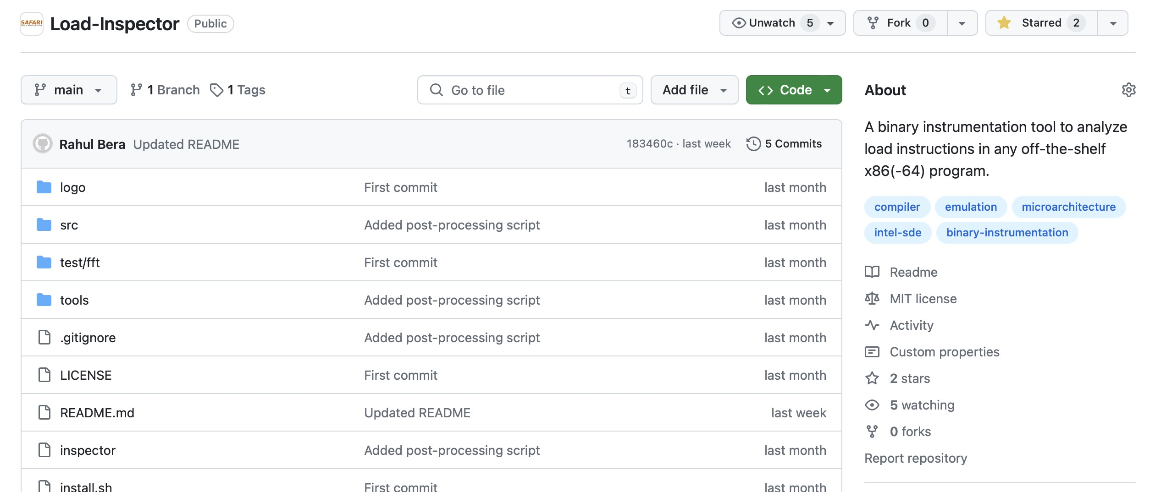
Open-Source Tool
A tool to analyze load instructions in any off-the-shelf x86(-64) program
https://github.com/CMU-SAFARI/Load-Inspector

Slide 49
Open-Source Tool
A tool to analyze load instructions in any off-the-shelf x86(-64) program
Study global-stable loads
Study the effects of increasing architectural registers
using APX extension to x64 ISA
https://github.com/CMU-SAFARI/Load-Inspector

Slide 50


Improving Performance and Power Efficiency
by Safely Eliminating Load Instruction Execution
arXiv
Load Inspector
Notes:
Hi everyone, I am Rahul. Today I am going to discuss our work Constable...
[CLICK]

Slide 51
BACKUP

Slide 52
Index
Motivation & Design
Why do global-stable loads exist?
Effect of increasing registers
Characterization of global-stable loads
Resource dependence by global-stable loads
Performance headroom
Constable overview
Architecting elimination table
Effect of wrong-path update
Example of Constable’s operation
Ensuring coherence
Storage overhead
Area/energy overhead
Methodology & Evaluation
Simulation parameters
Evaluated workloads
Workload-wise performance
Load-category-wise performance
Comparison with prior works
Elimination coverage
Coverage of global-stable loads
Reduction in power
Scaling width
Scaling depth
Violating memory ordering

Slide 53

Why Do Global-Stable Loads Exist?
Random* Random::s_rng = 0;
Random* Random::get_Rng(void)
{
if (s_rng == 0)
s_rng = new Random();
return s_rng;
}
Global scope variable
Function to access the variable
Example code from 541.leela_r
Notes:
To answer that, here is an example code from a SPEC CPU workload.
[CLICK] The code declares a global-scope variable and
[CLICK] its access function.

Slide 54
Why Do Global-Stable Loads Exist?
Random* Random::s_rng = 0;
Random* Random::get_Rng(void)
{
if (s_rng == 0)
s_rng = new Random();
return s_rng;
}
624: mov rax, [rip+0x1f4ac5]
62b: test rax,rax
62e: je 0x638
630: ret
631: nop
638: sub rsp,0x8
63c: mov edi,0xc
641: call 0x460
Example code from 541.leela_r
Disassembly (compiled by GCC* with –O3)
*GNU GCC 13.2
Notes:
Here is the disassembly of the code compiled by latest GCC with full optimization.

Slide 55
Why Do Global-Stable Loads Exist?
Gets initialized only once
and never changes
Global-stable load
Random* Random::s_rng = 0;
Random* Random::get_Rng(void)
{
if (s_rng == 0)
s_rng = new Random();
return s_rng;
}
624: mov rax, [rip+0x1f4ac5]
62b: test rax,rax
62e: je 0x638
630: ret
631: nop
638: sub rsp,0x8
63c: mov edi,0xc
641: call 0x460
Example code from 541.leela_r
Disassembly (compiled by GCC* with –O3)
*GNU GCC 13.2
Notes:
If we focus on the highlighted “if” instruction, it gets converted to a load instruction to read the global variable, followed by a branch.
[CLICK] Now, as the variable gets initialized only once and never gets changed,
[CLICK] the corresponding load instruction naturally becomes a global-stable load
that always fetches the same data from the same address.

Slide 56
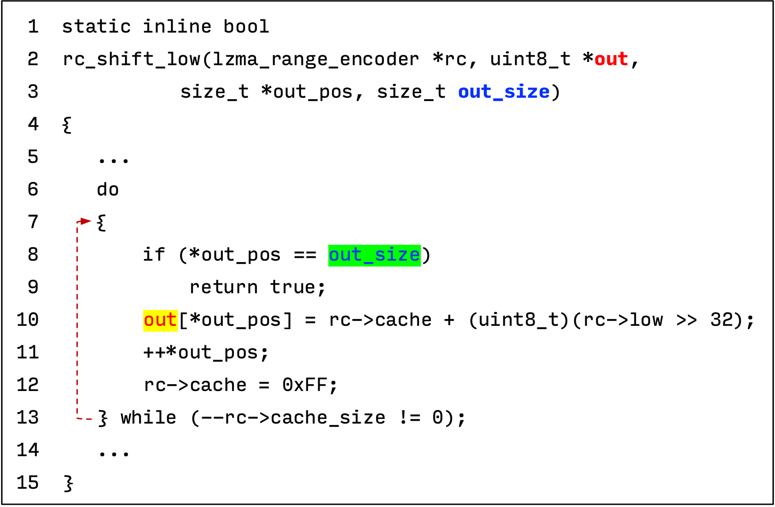
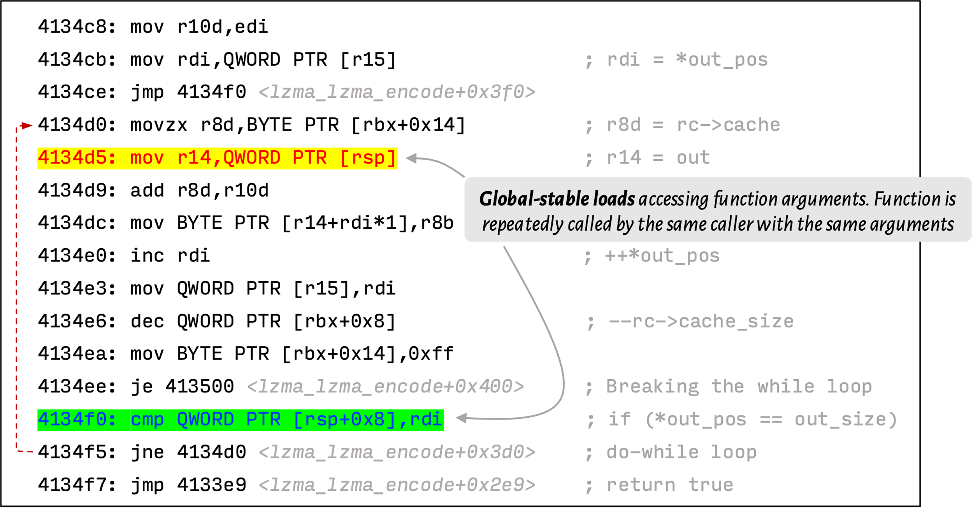
Why Do Global-Stable Loads Exist?

Slide 57
Why Do Global-Stable Loads Exist?
Global-stable loads exist for many reasons:
Accessing global variables
Accessing local variables of an inline function
Limited architectural registers
...

Slide 58
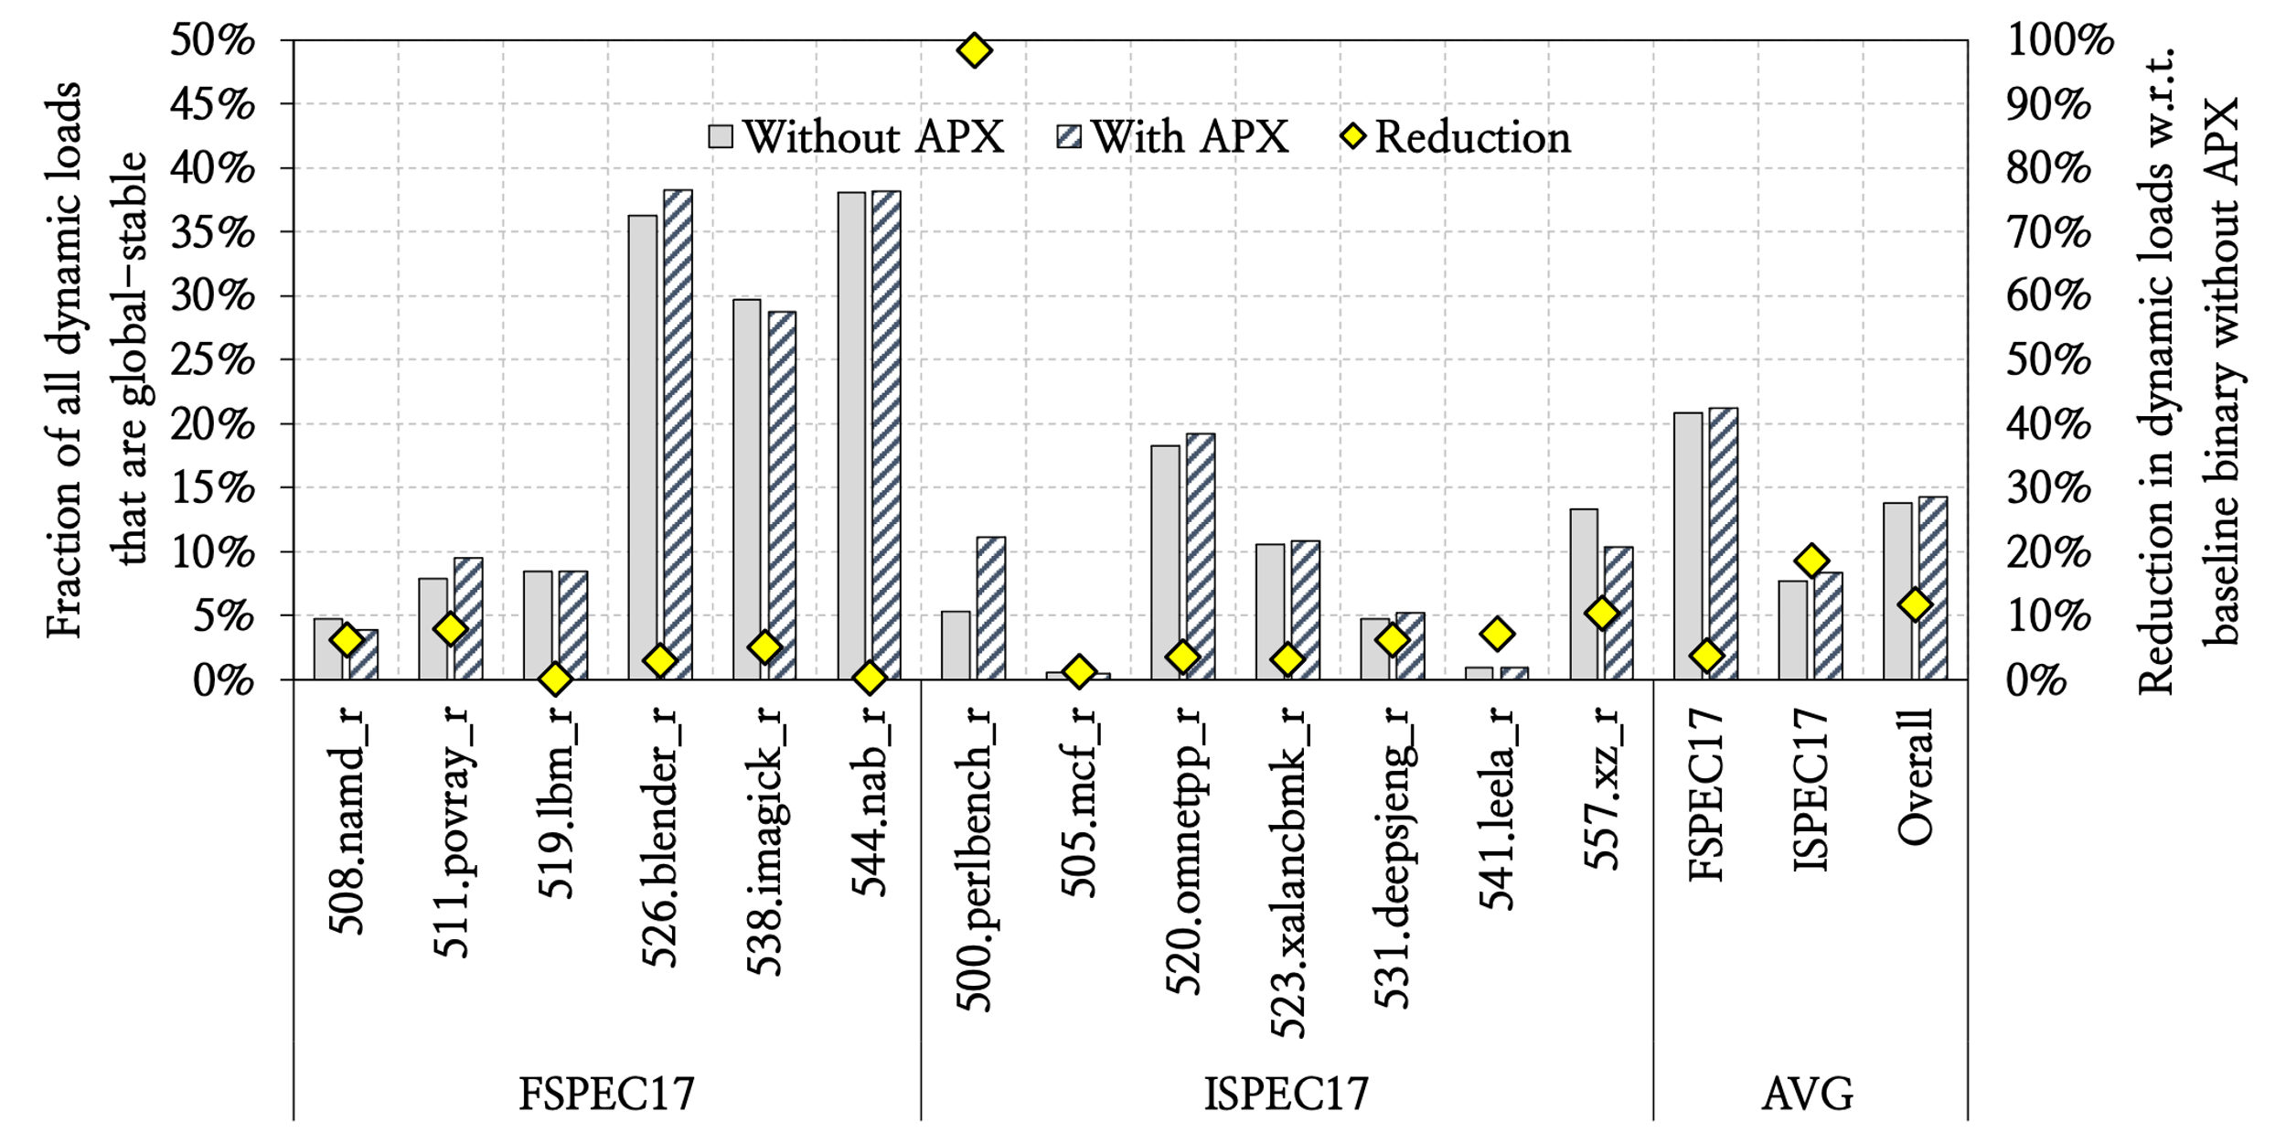
Effects of Increasing Architectural Registers
Fraction of global-stable loads
are nearly same without or with APX
Compiled with Clang 18.1.3 with and without -mapxf

Slide 59
Effects of Increasing Architectural Registers
Fraction of global-stable loads (i.e., Constable’s opportunities)
are much higher than reduction in loads by APX
Compiled with Clang 18.1.3 with and without -mapxf

Slide 60
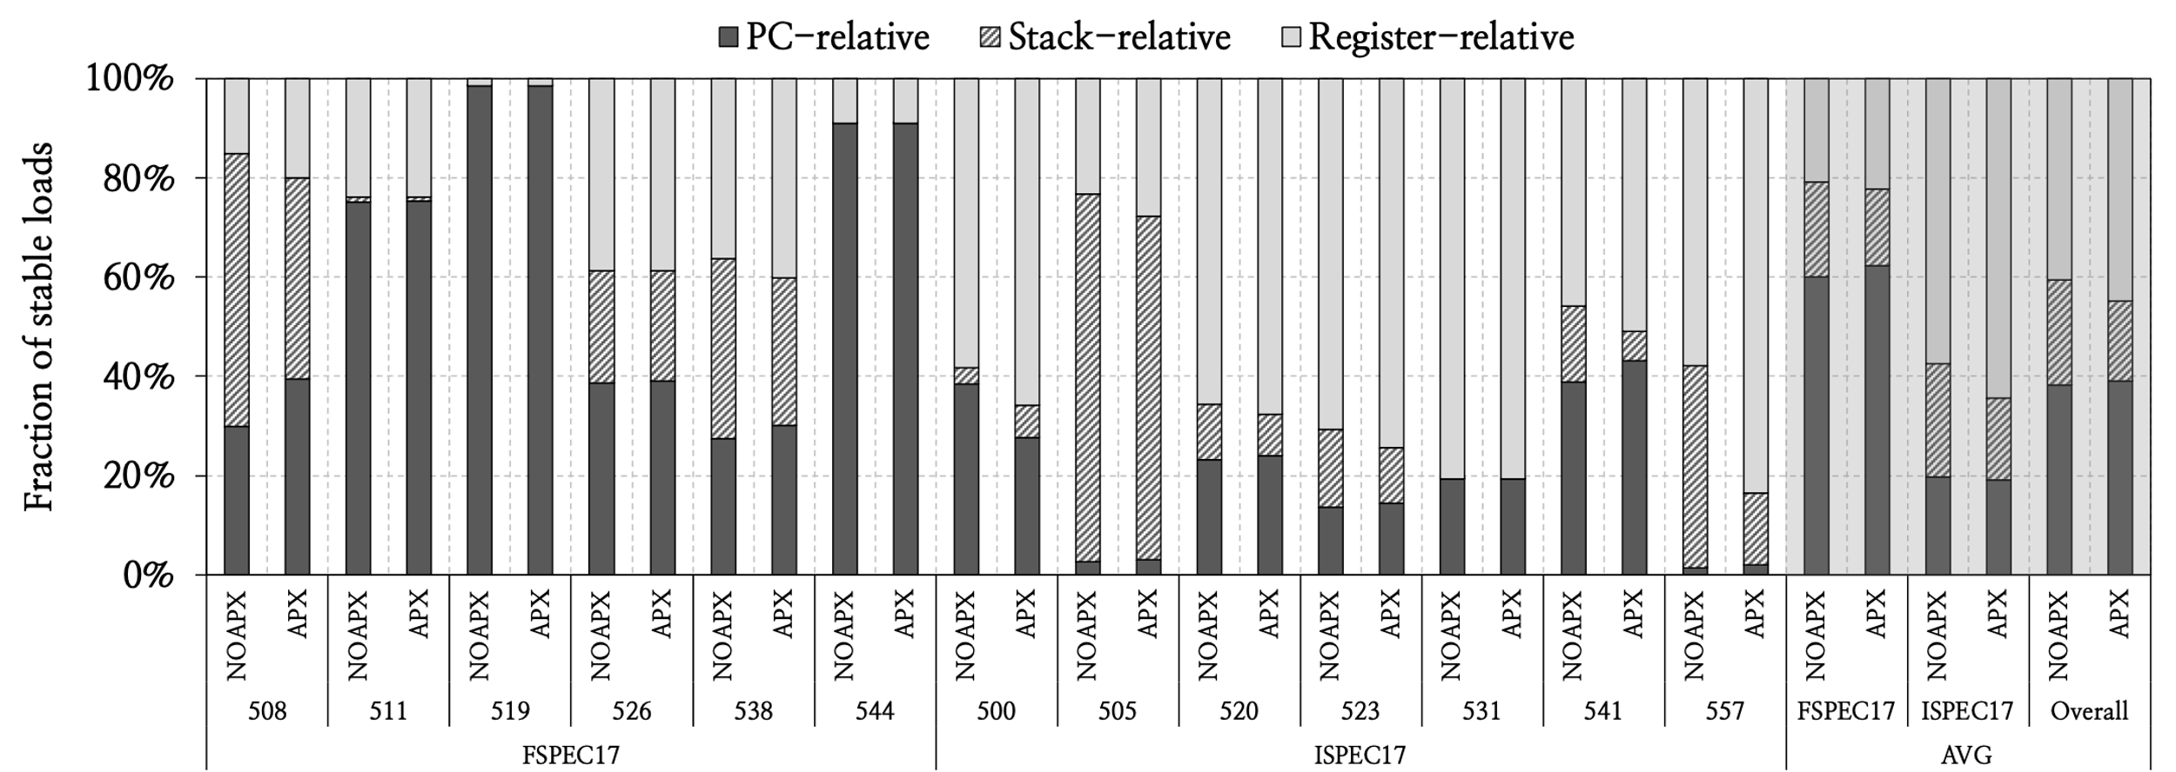
Effects of Increasing Architectural Registers
The profile of global-stable loads stays largely unchanged
after doubling registers using APX

Slide 61
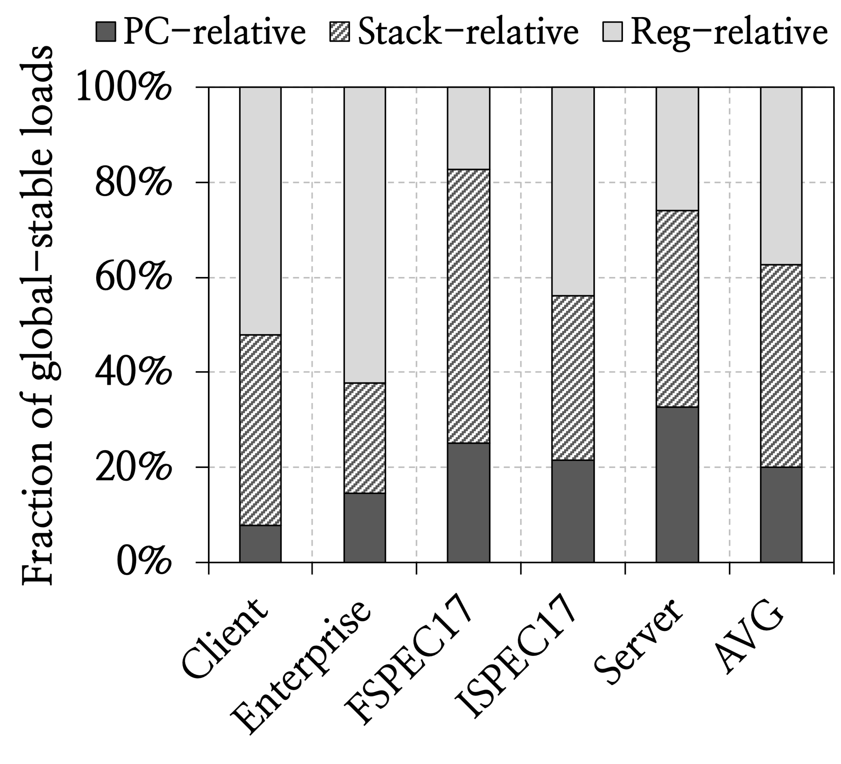
Characterization of Global-Stable Loads (I)

Slide 62
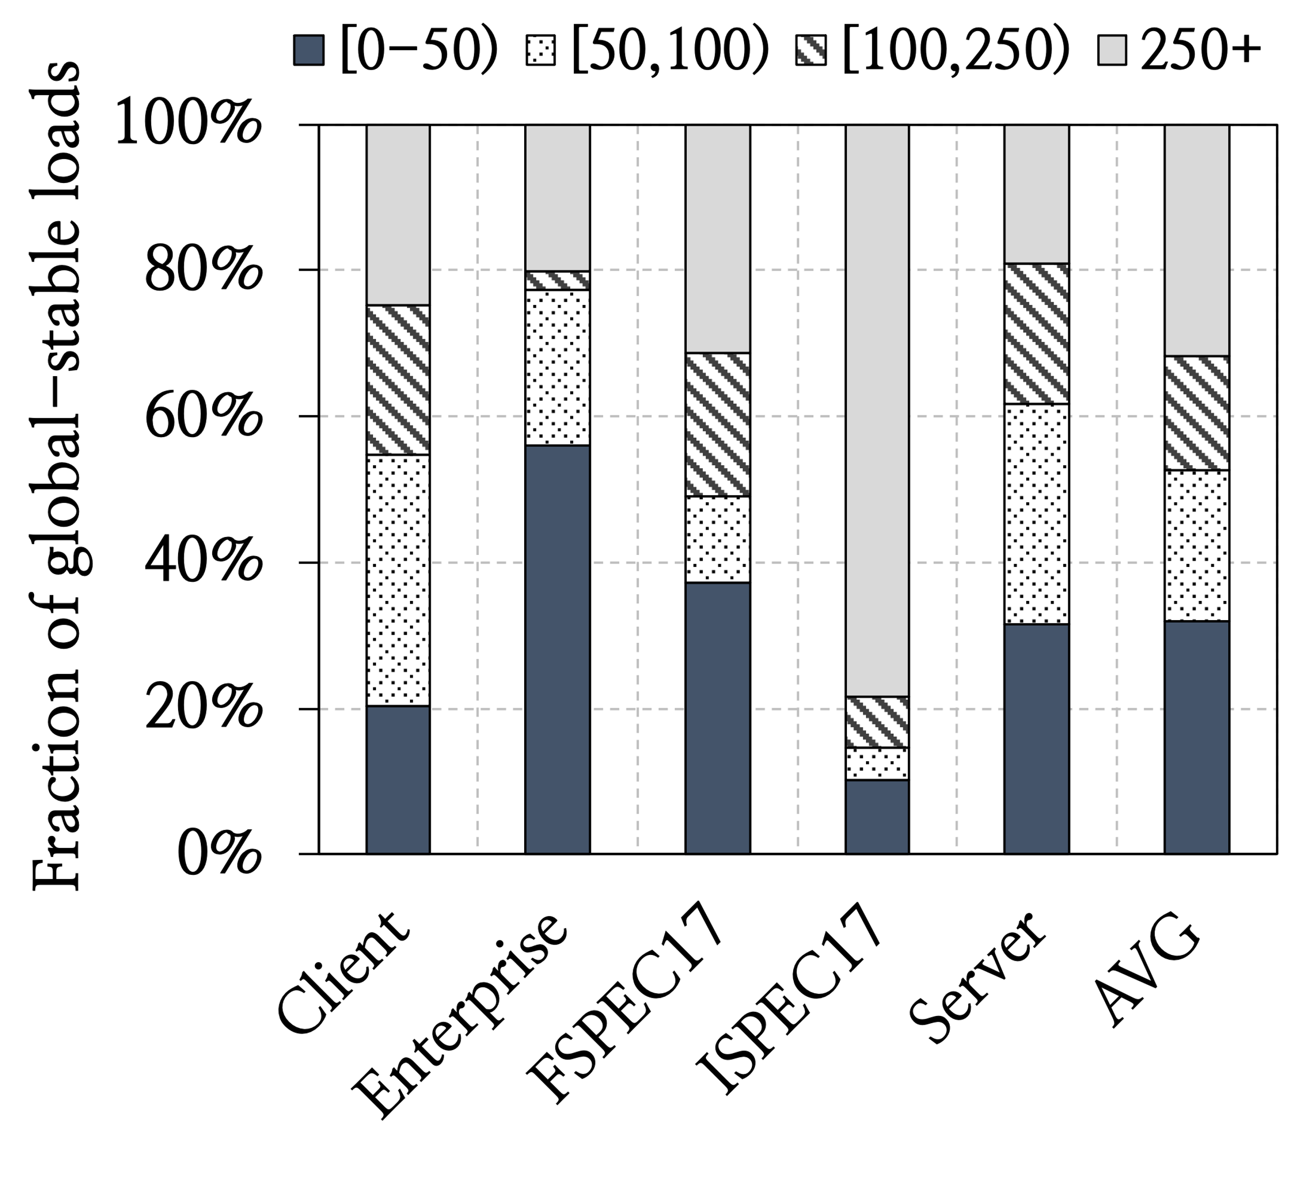
Characterization of Global-Stable Loads (II)

Slide 63
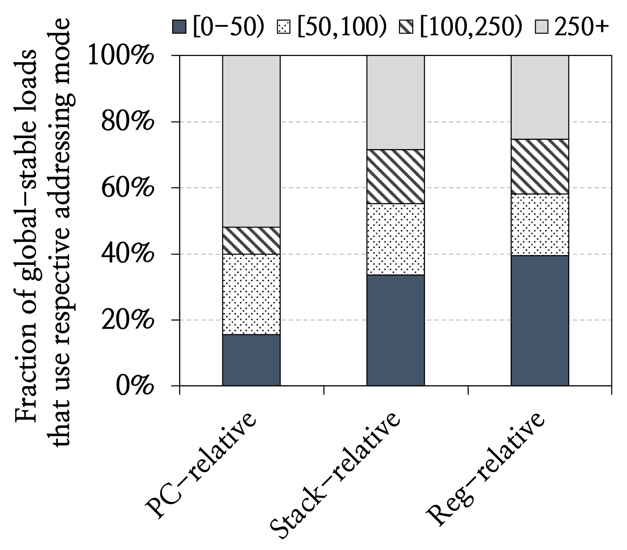
Characterization of Global-Stable Loads (III)

Slide 64
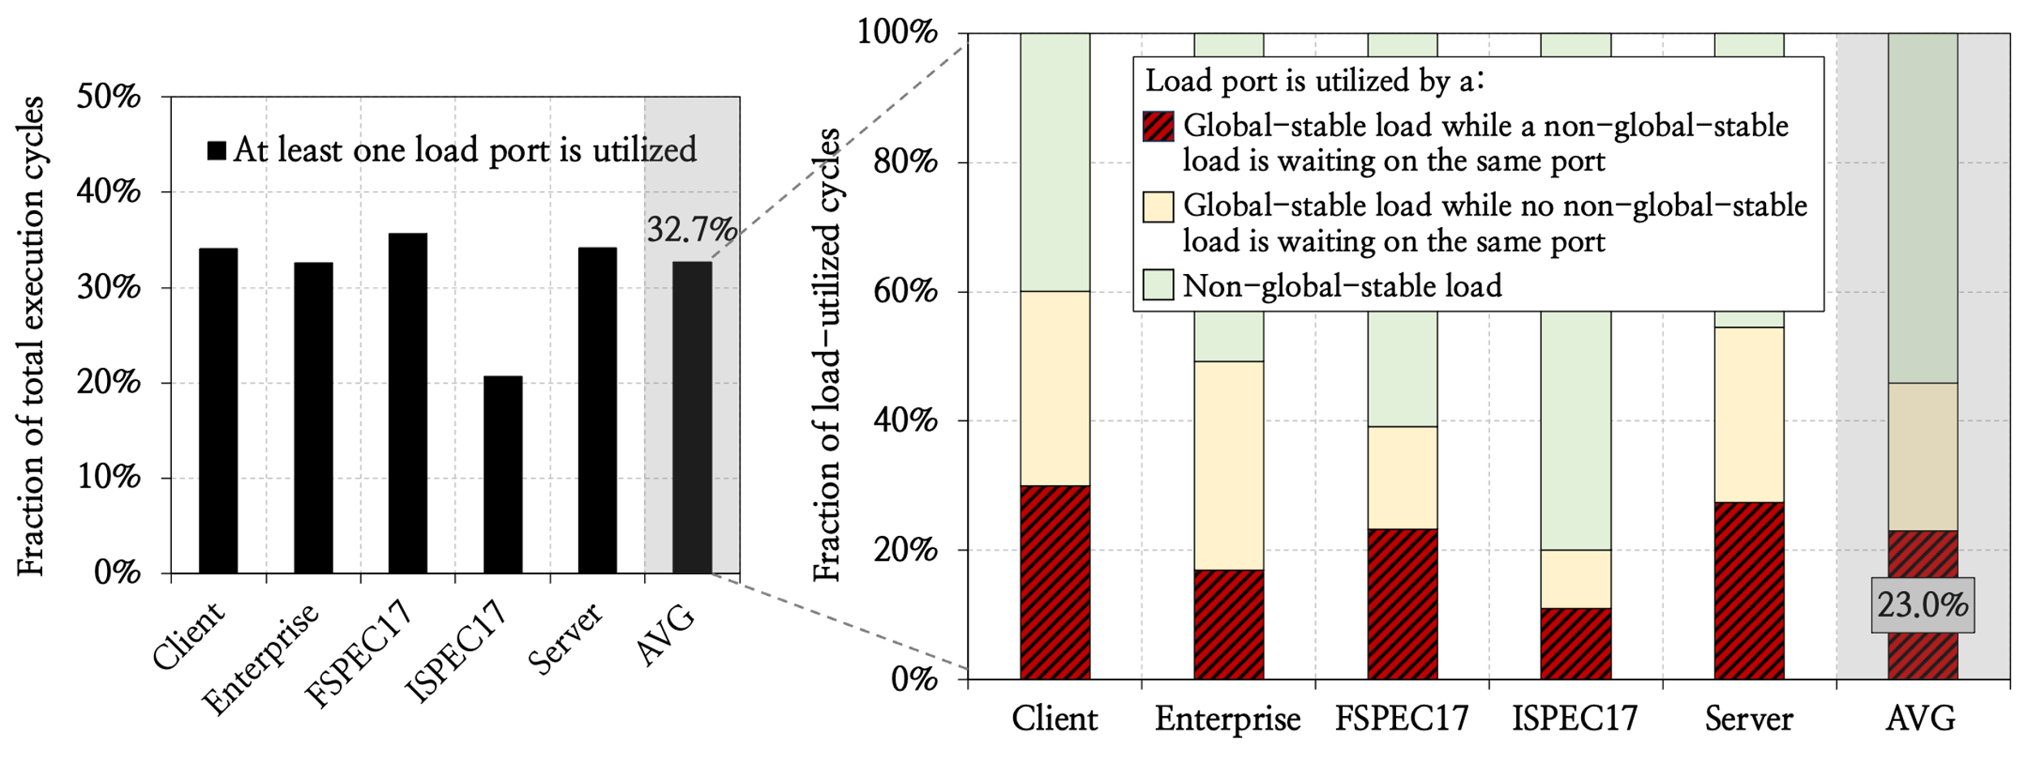
Resource Dependence by Global-Stable Loads
Global-stable loads cause significant resource dependence

Slide 65
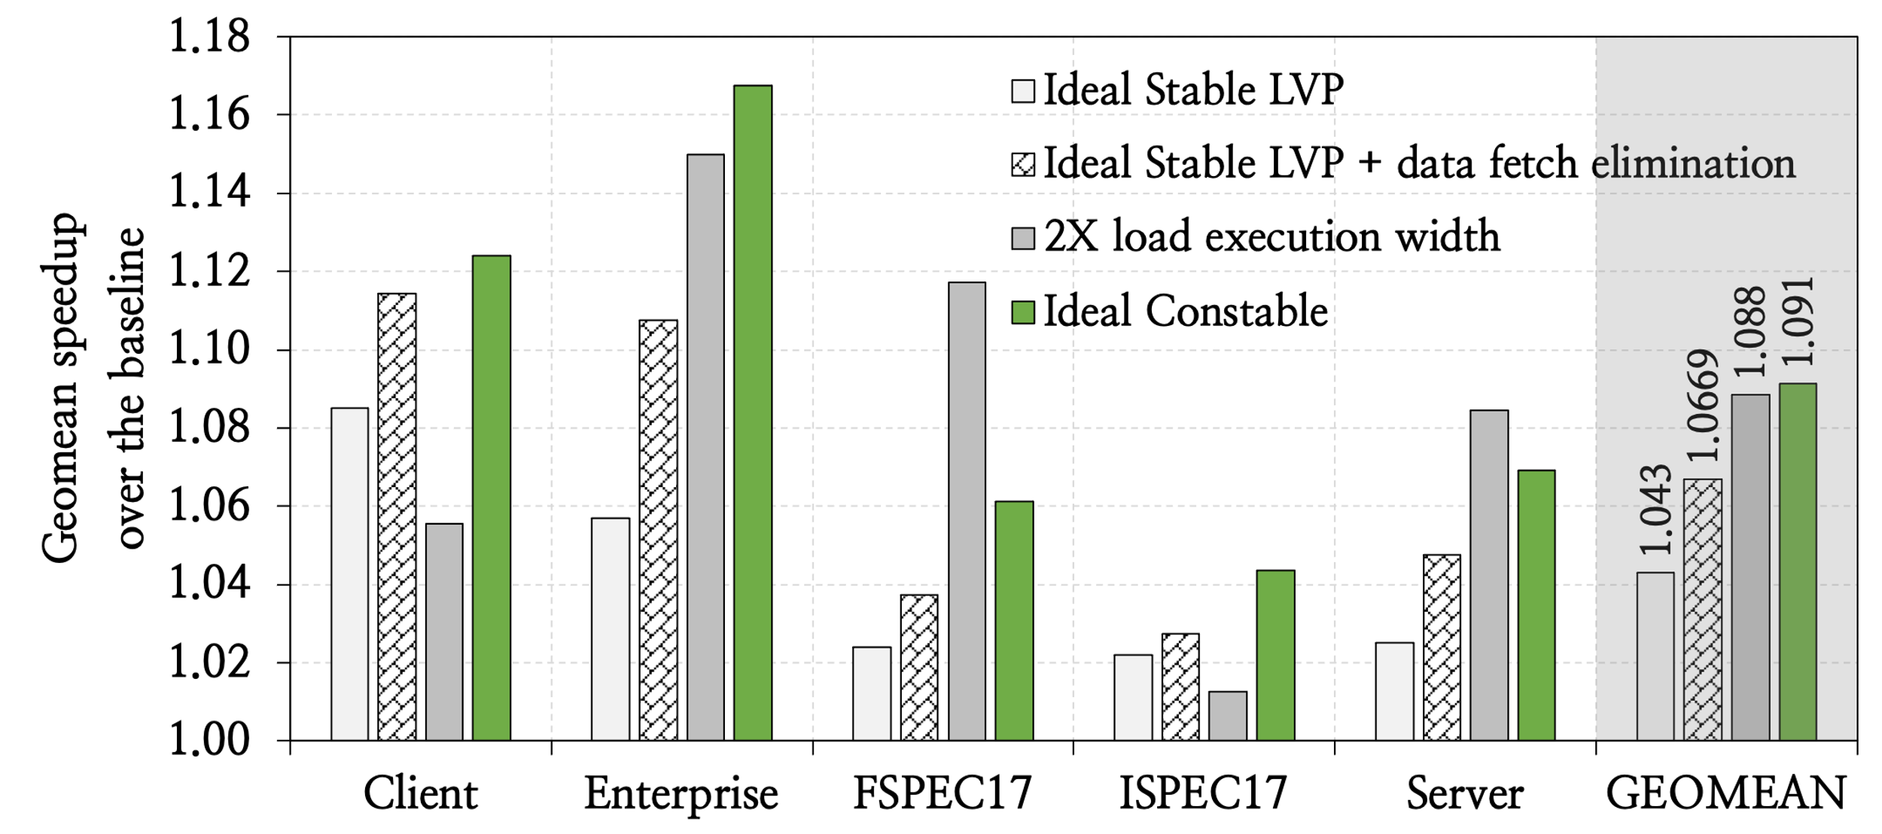
Performance Headroom Analysis

Slide 66
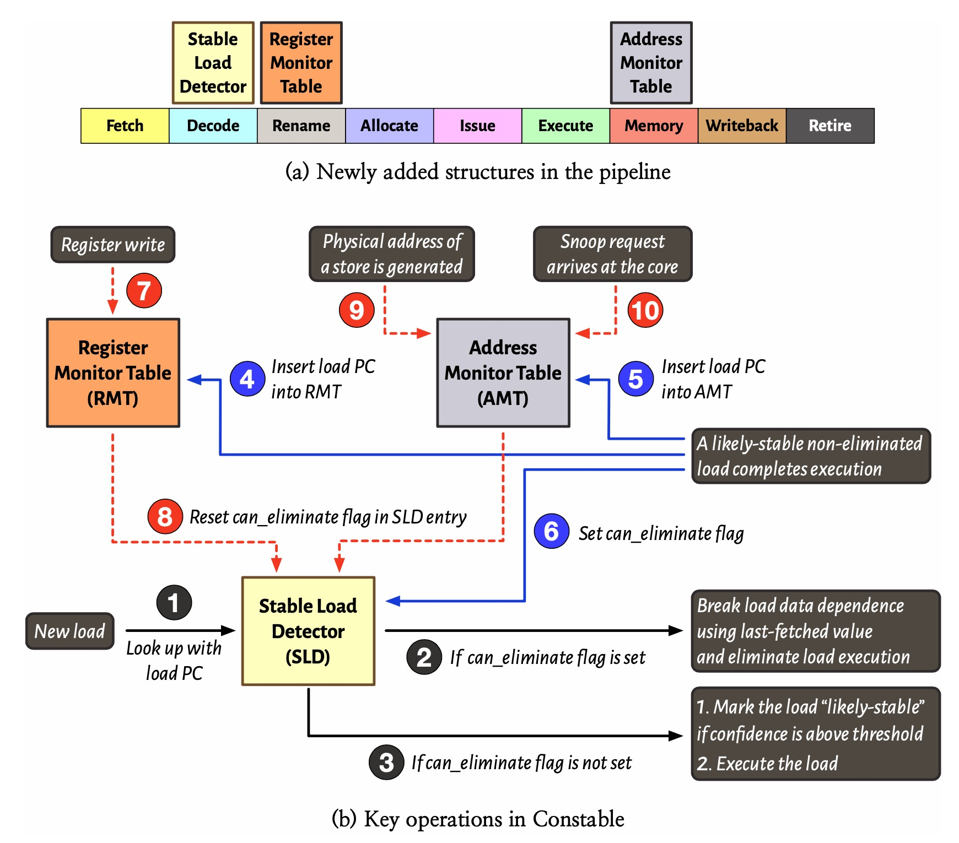
Constable Overview

Slide 67
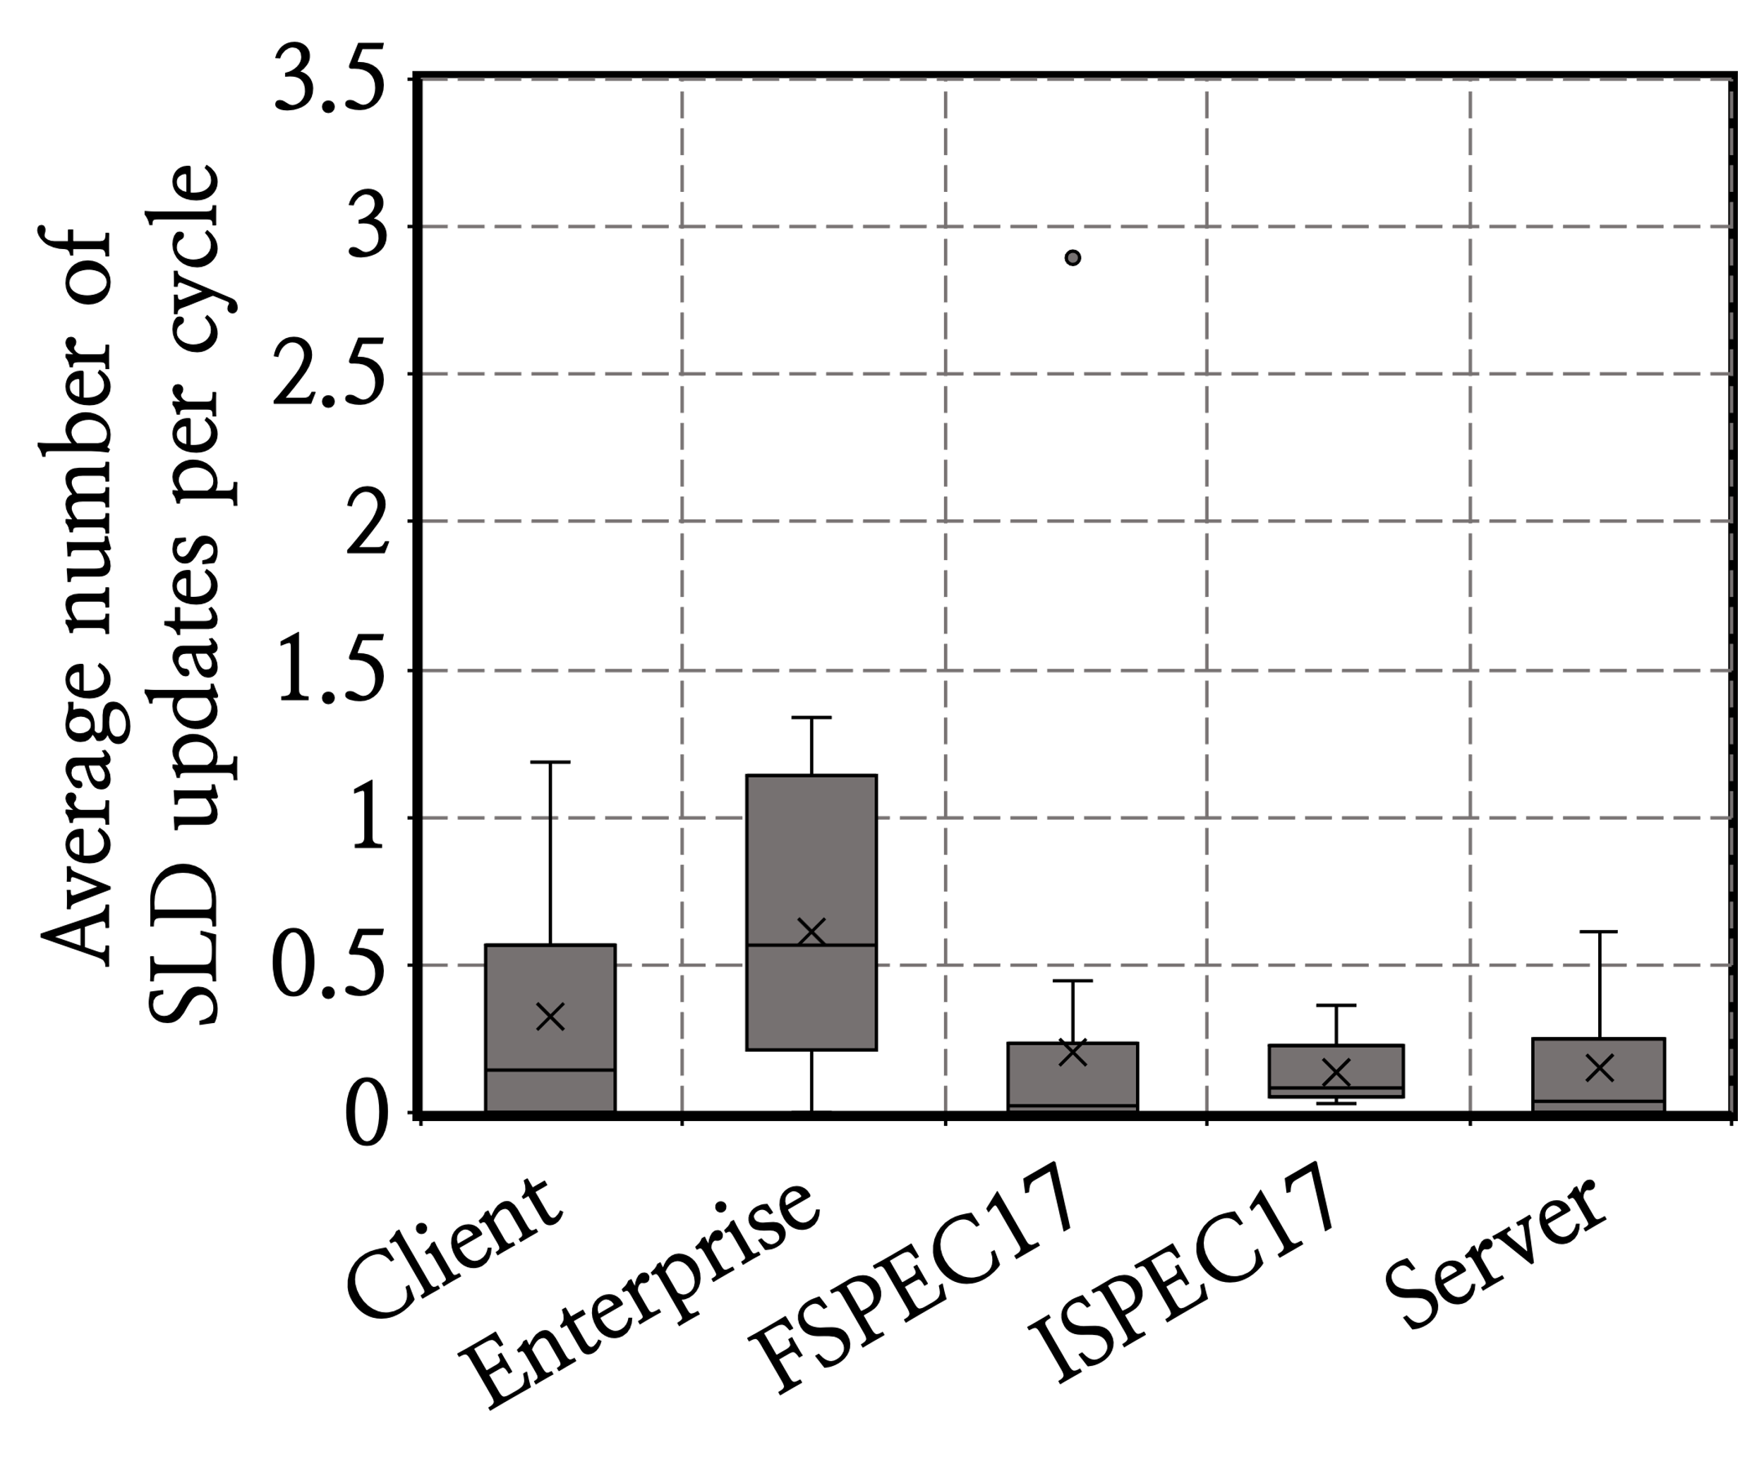
Architecting SLD

Slide 68
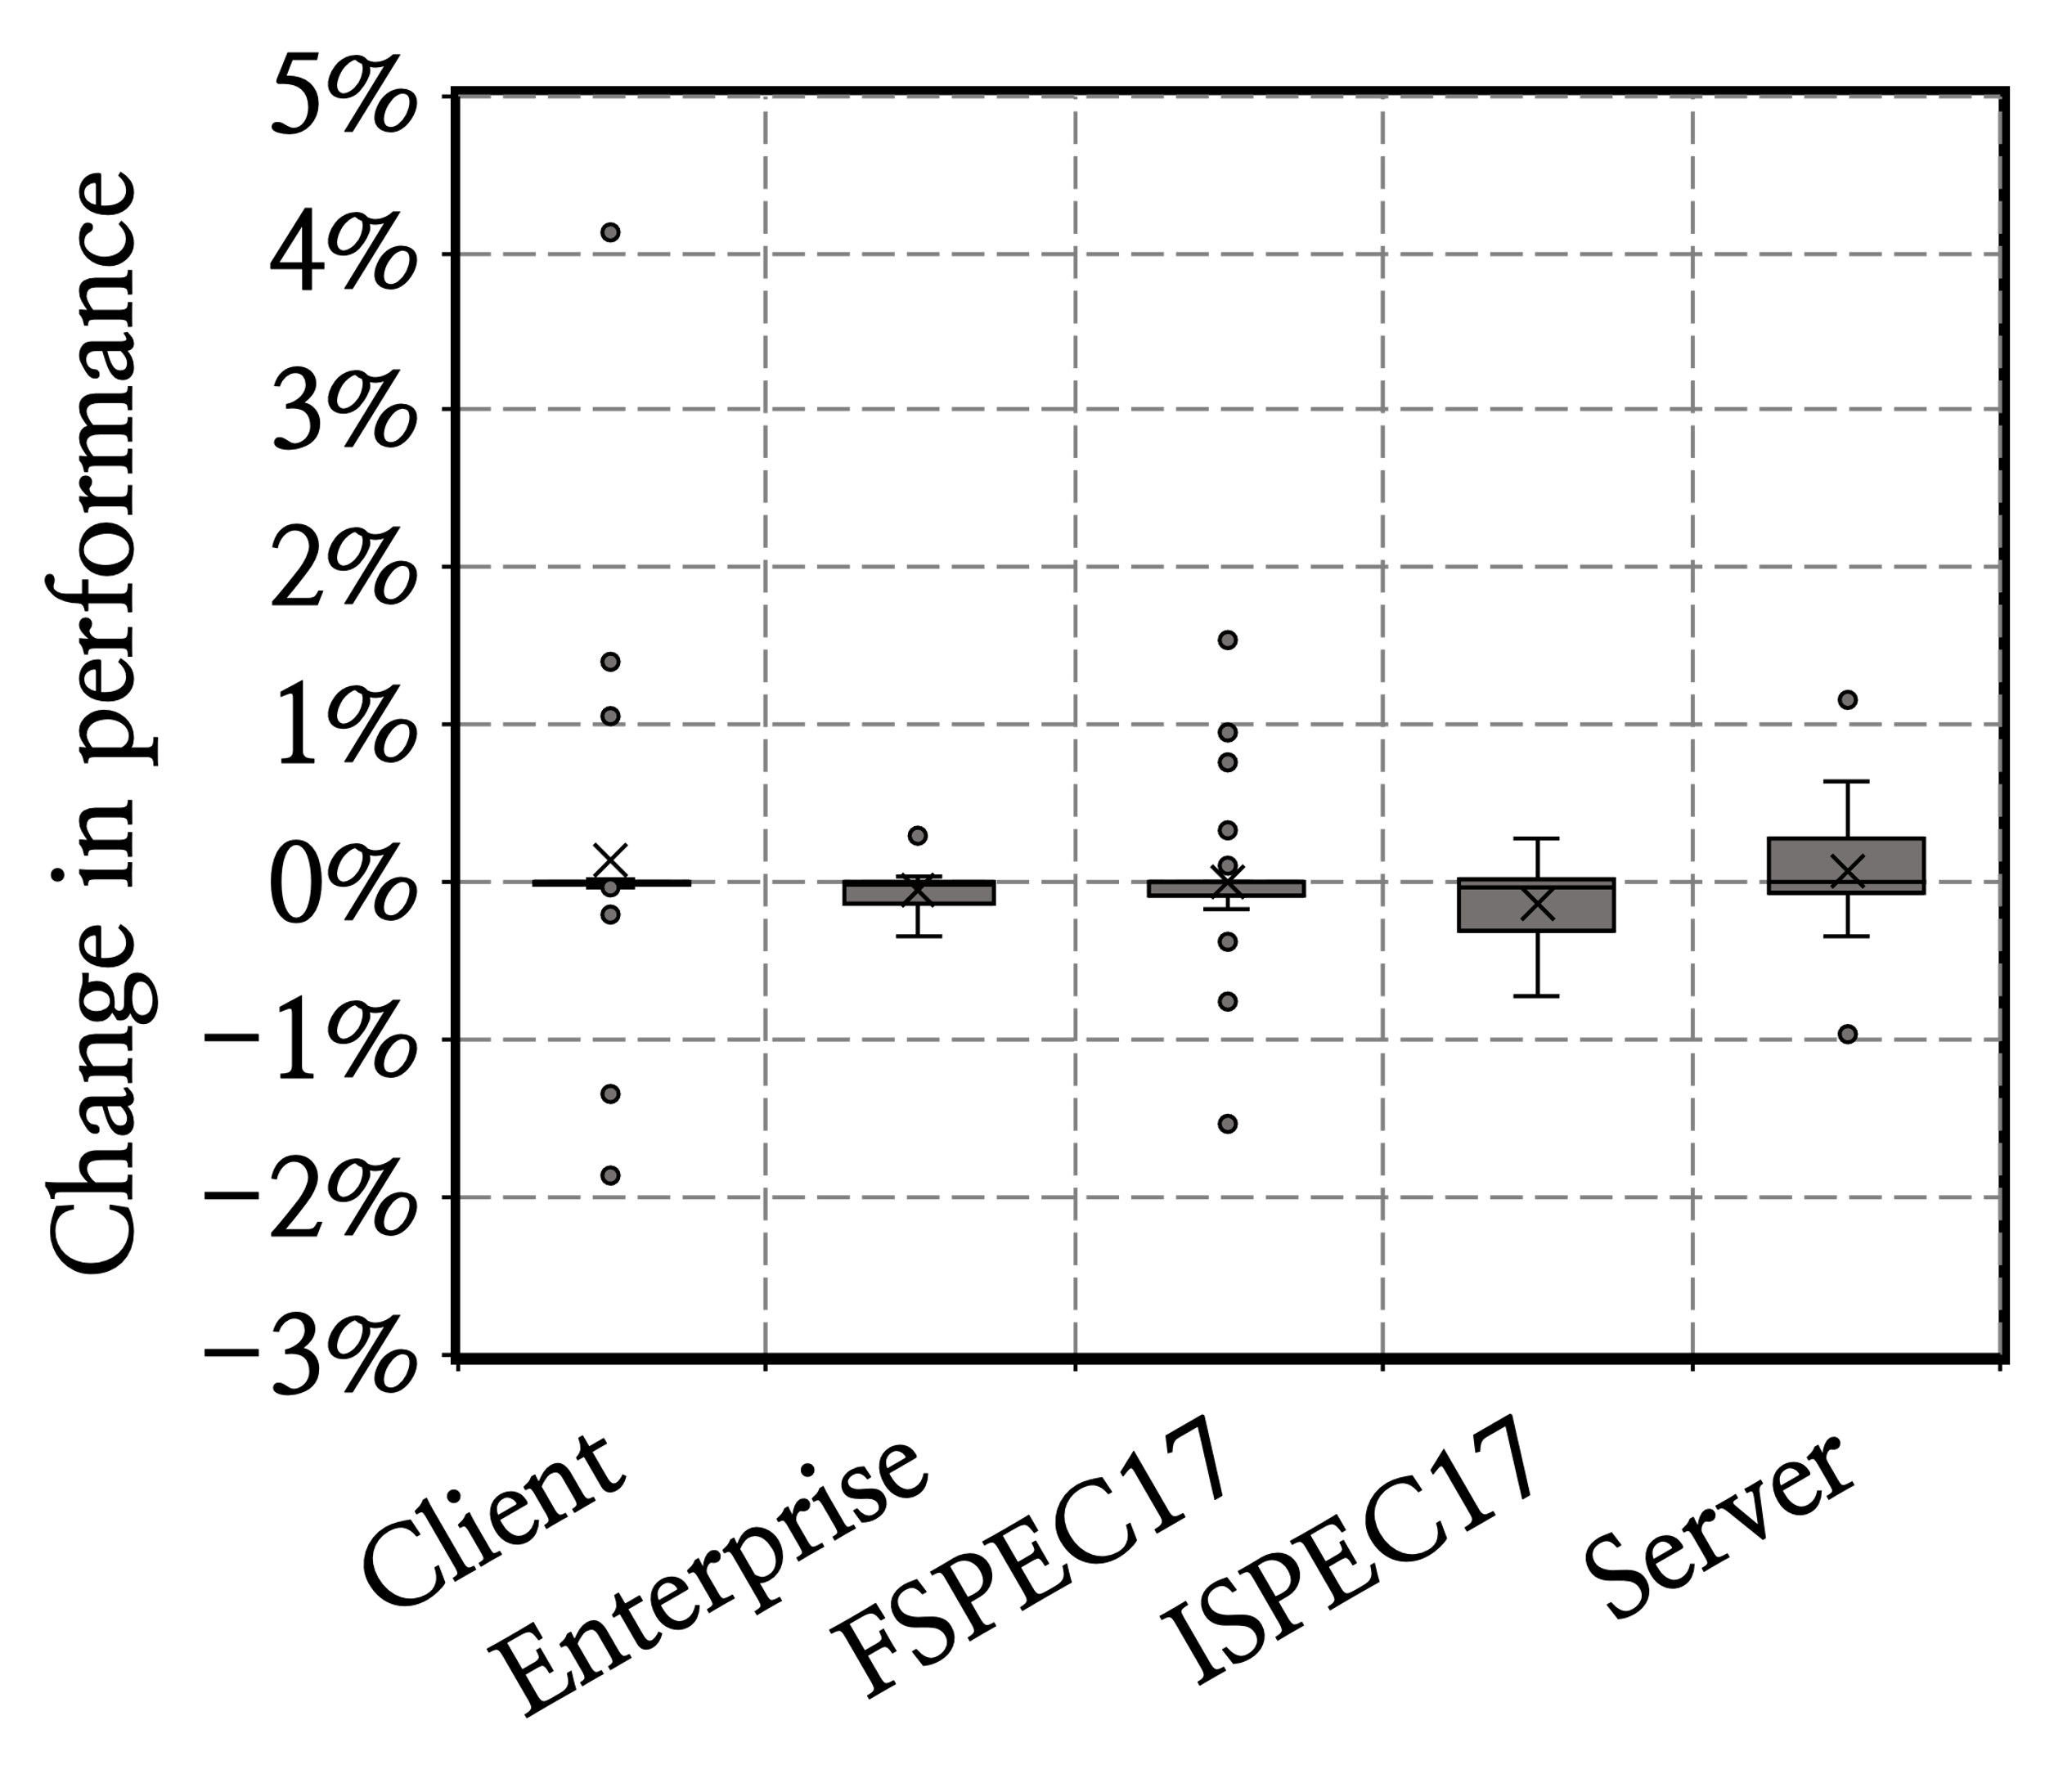
Effect of Wrong-Path Update

Slide 69
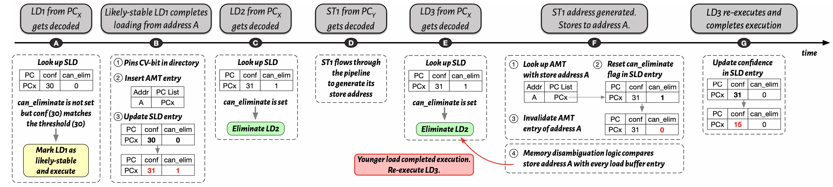
An Example of Constable’s Operation

Slide 70
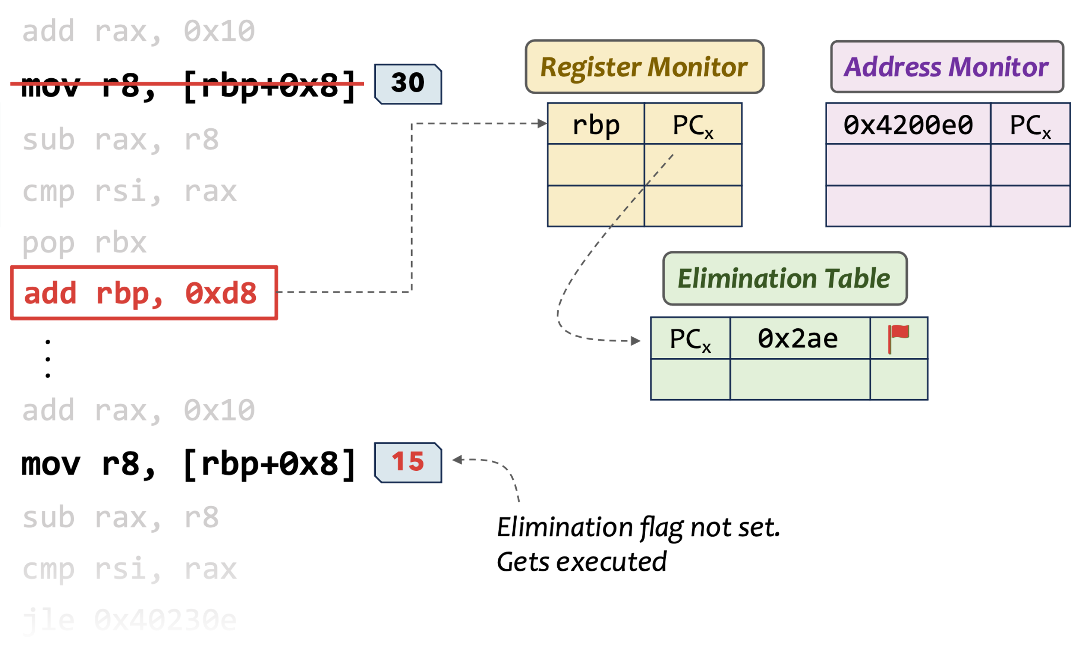
Ensuring Coherence
Constable relies on snoop requests to observe modifications to a memory address by other cores

Slide 71
Ensuring Coherence
Constable relies on snoop requests to observe modifications to a memory address by other cores
Evicting a cacheline from core-private cache resets the core-valid bit in directory
  What if a clean eviction?
    Unnecessary elimination opportunity loss
Constable pins the CV-bit of an eliminated load’s cacheline
  Even if the cacheline gets evicted from core-private cache, snoop request gets delivered

Slide 72
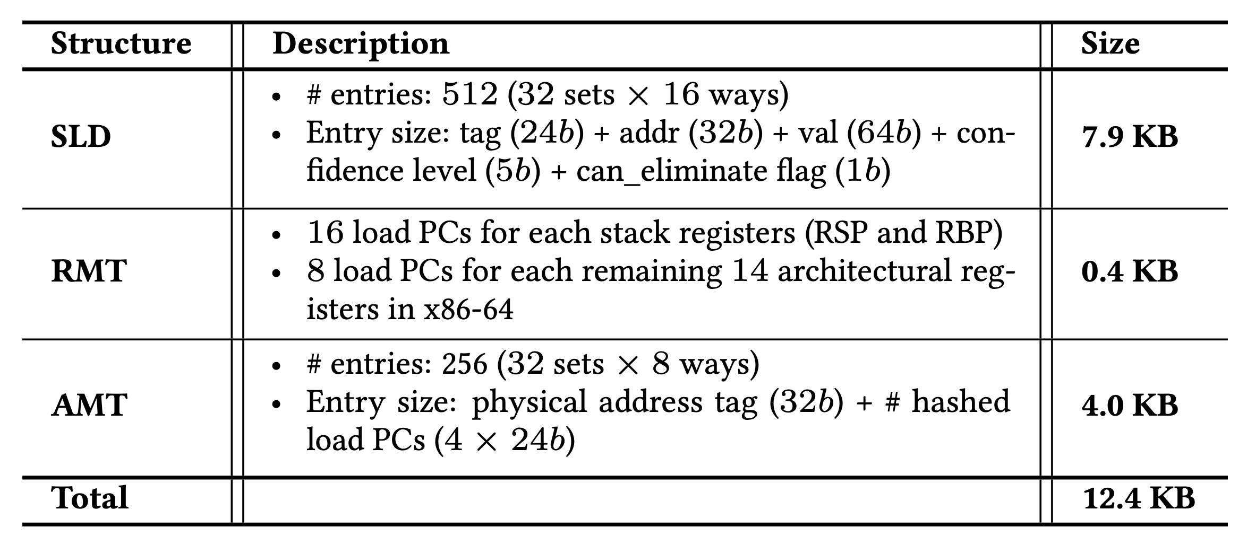
Constable’s Storage Overhead

Slide 73
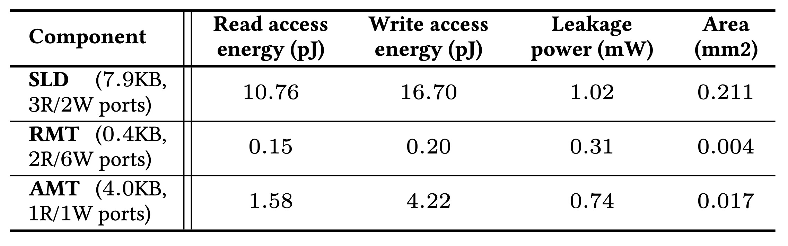
Area and Power Overhead of Constable’s Structures

Slide 74
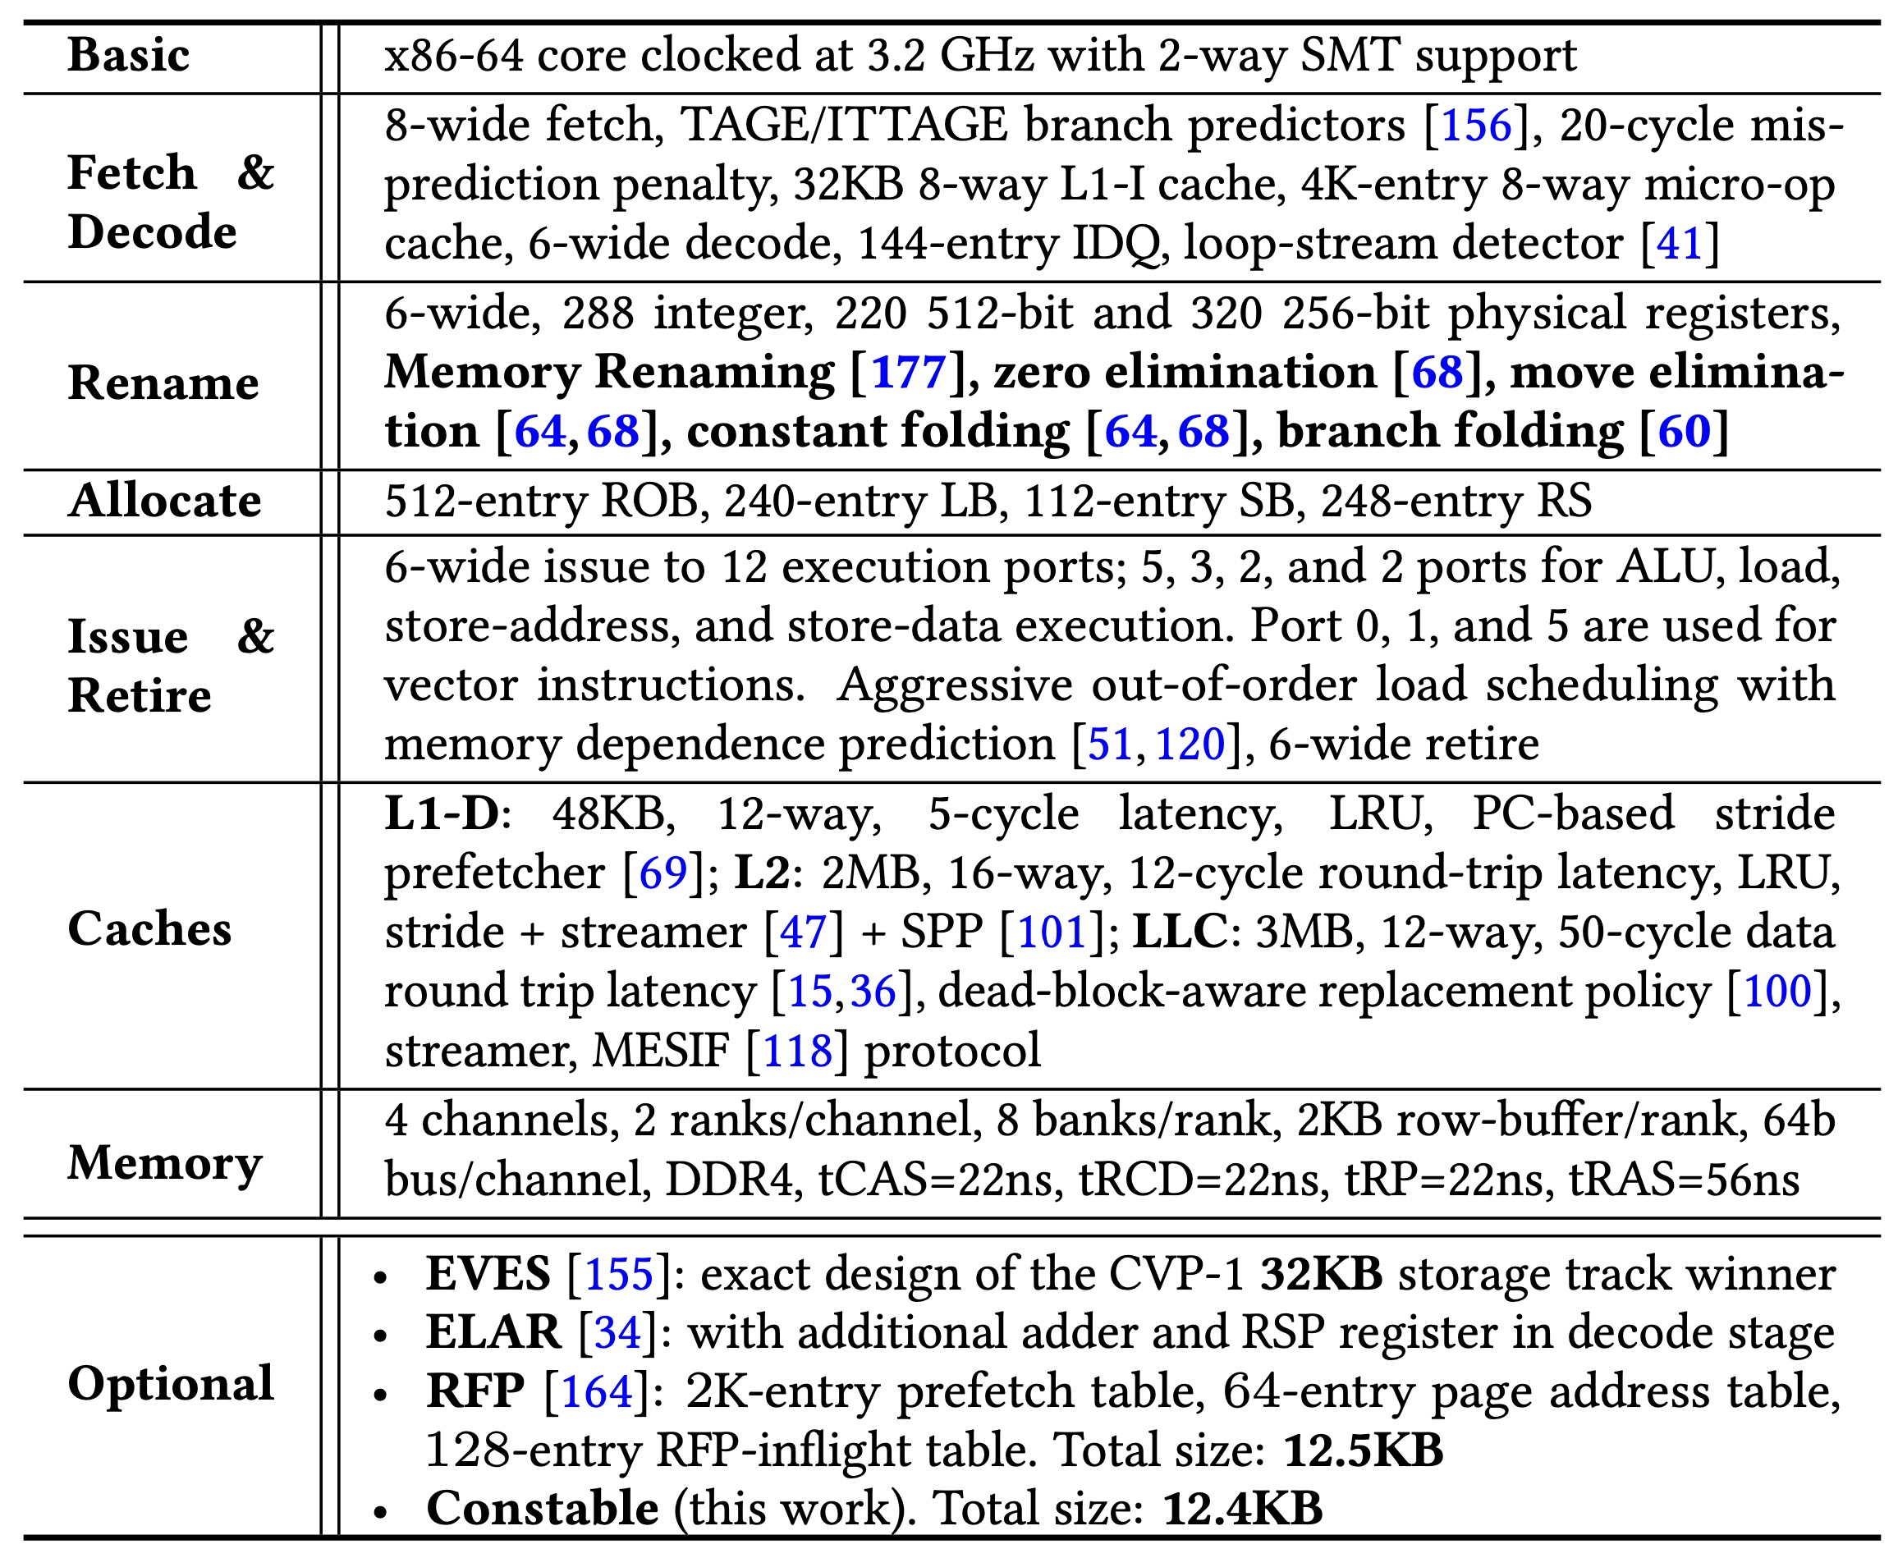
Simulated System Parameters

Slide 75
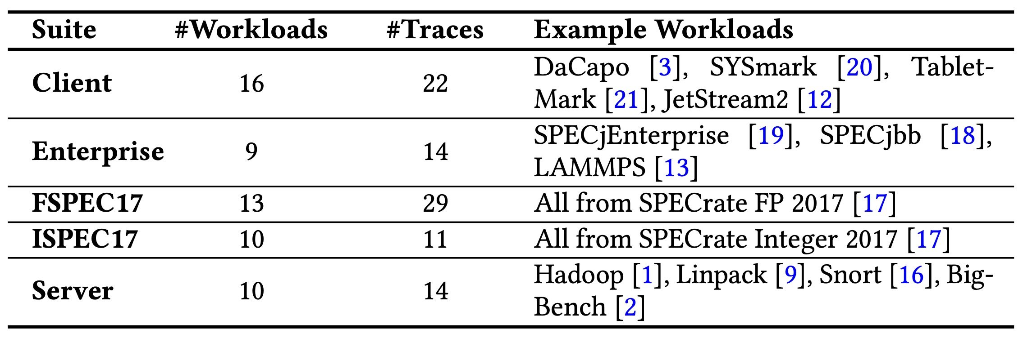
Evaluated Workloads

Slide 76
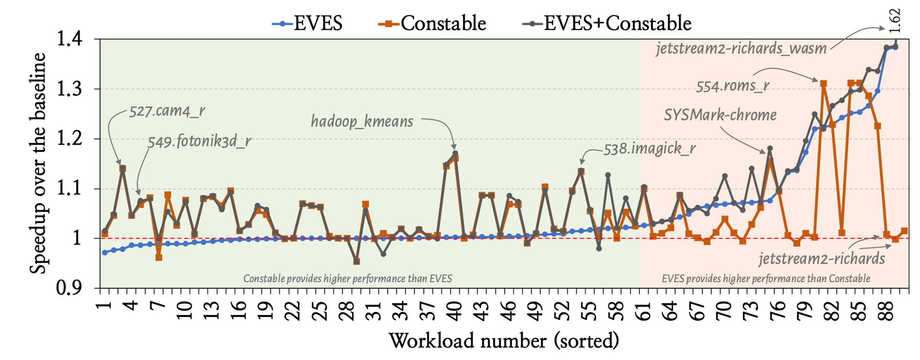
Workload-Wise Performance

Slide 77
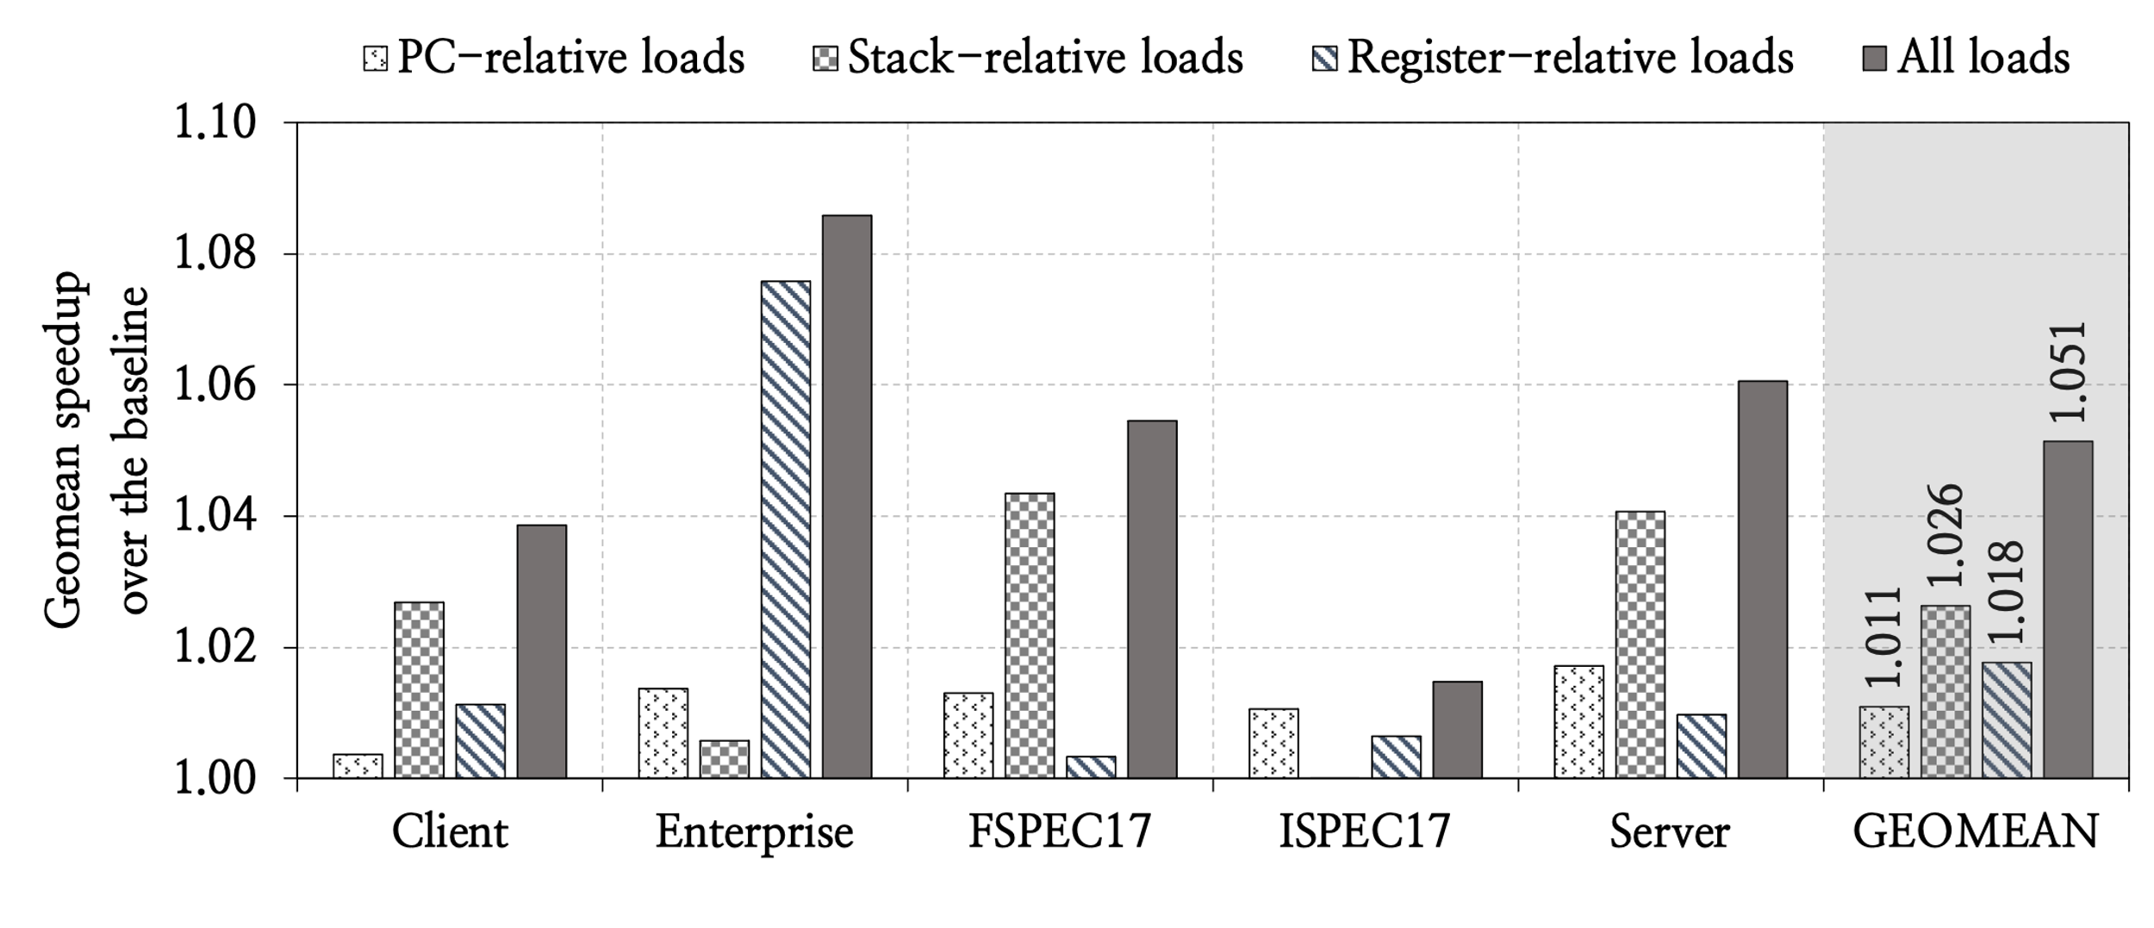
Load Category-Wise Performance

Slide 78
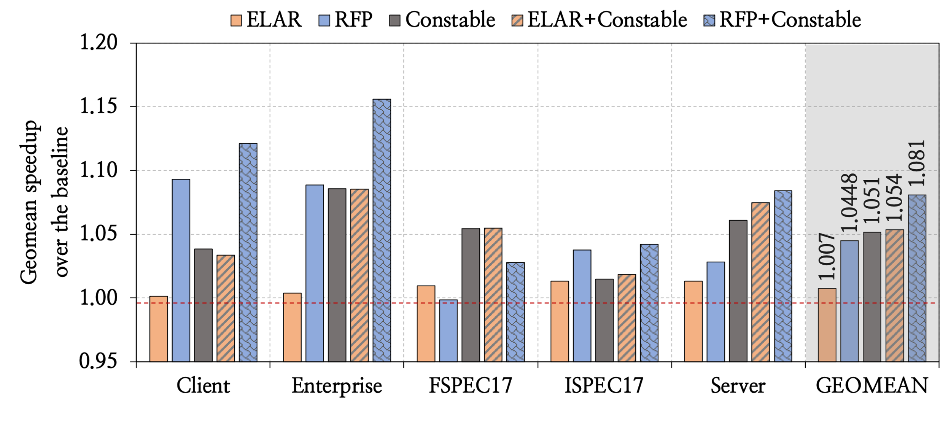
Performance Comparison with Prior Works

Slide 79
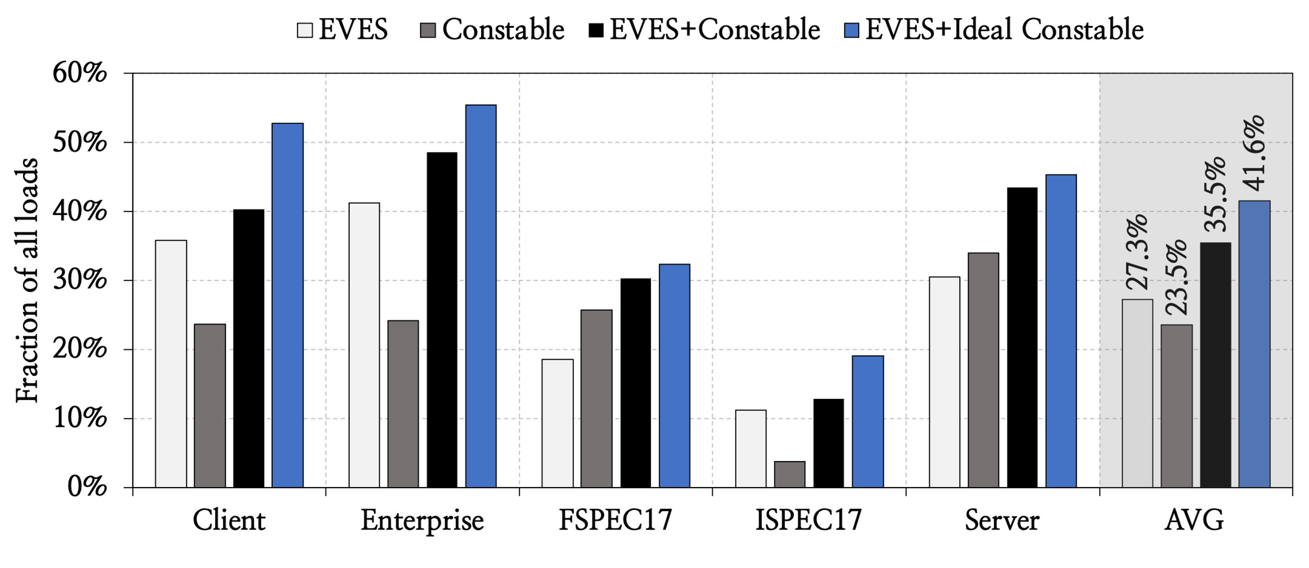
Elimination Coverage

Slide 80
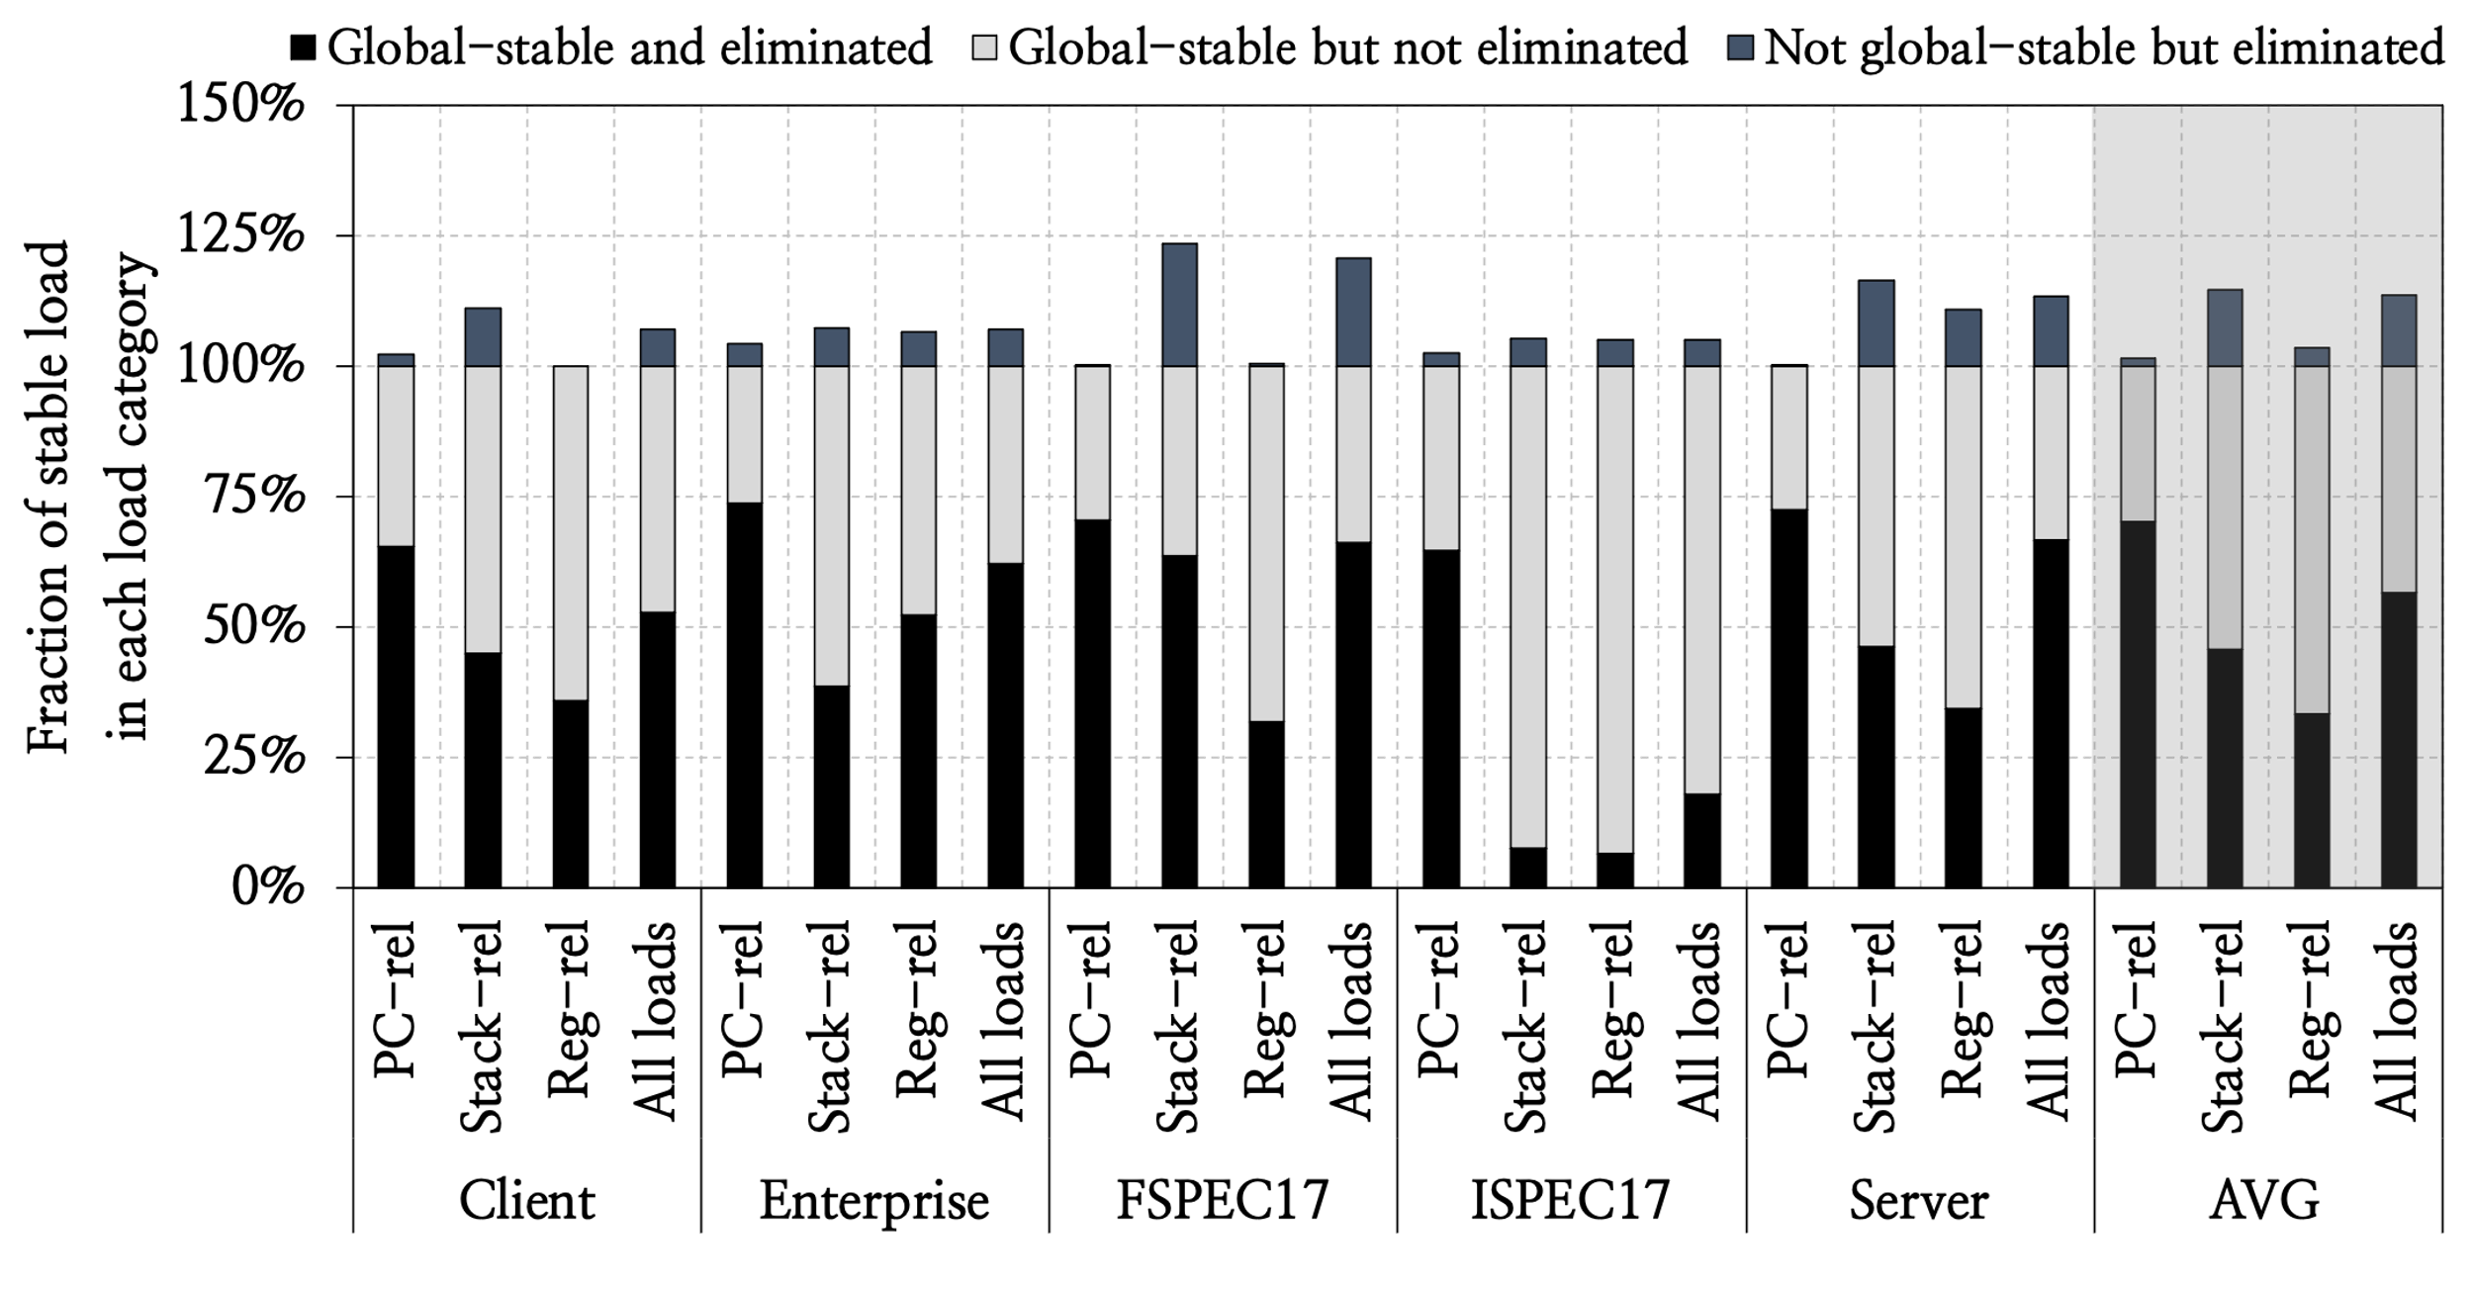
Coverage of Global-Stable Loads

Slide 81
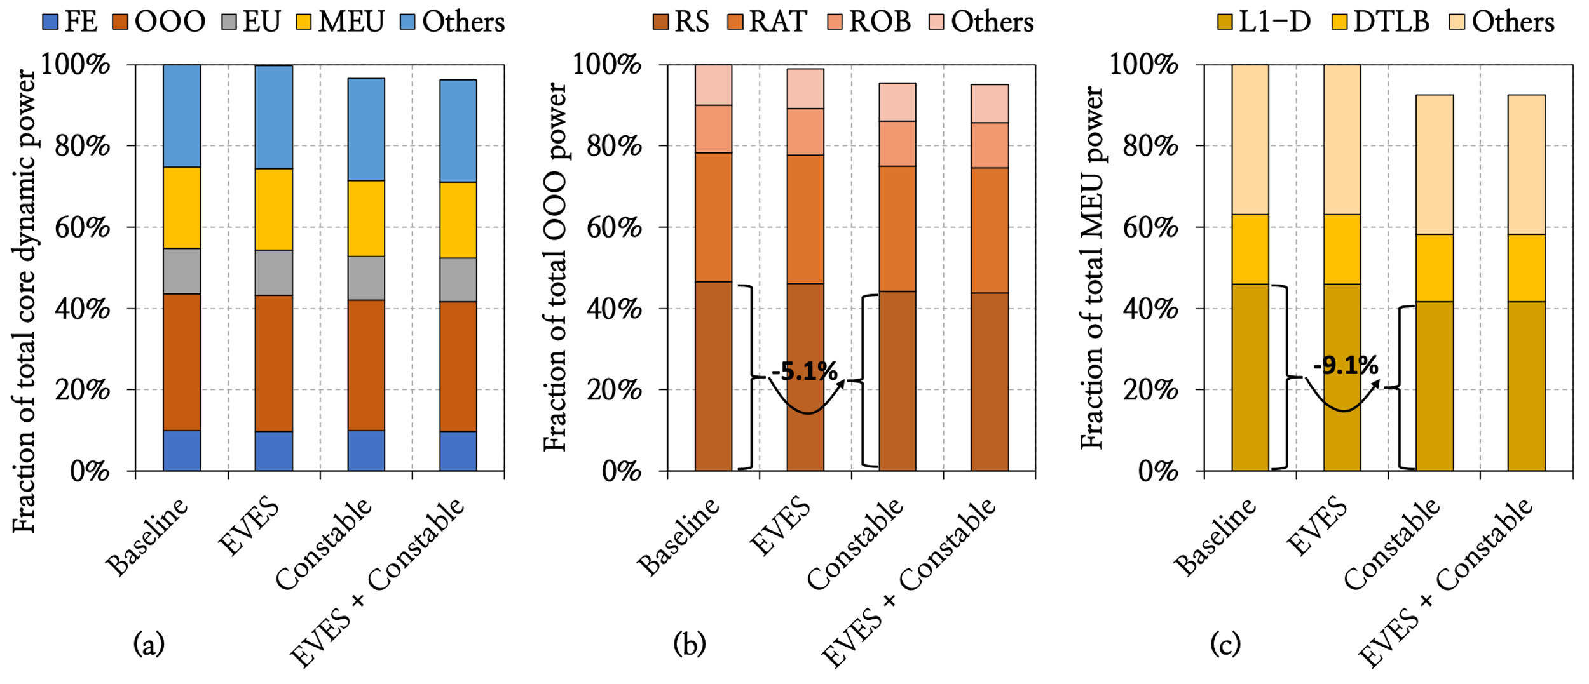
Reduction in Dynamic Power

Slide 82
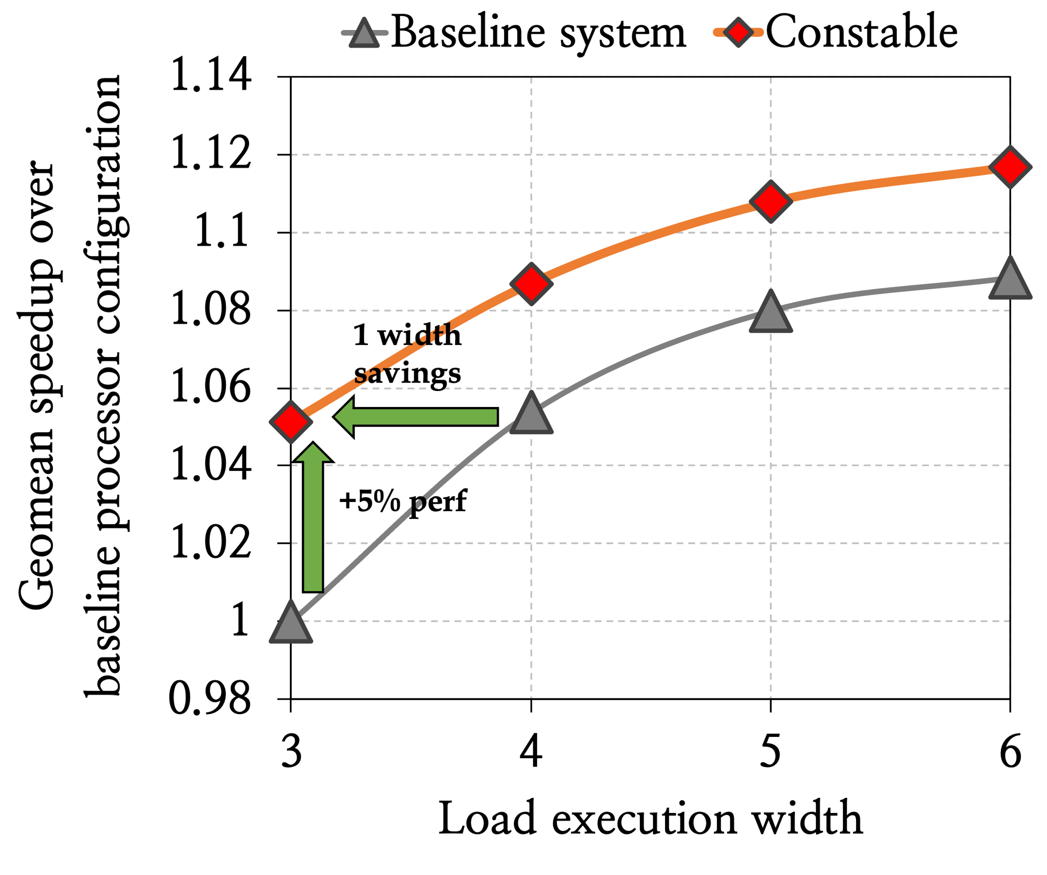
Performance Sensitivity to Load Execution Width Scaling

Slide 83
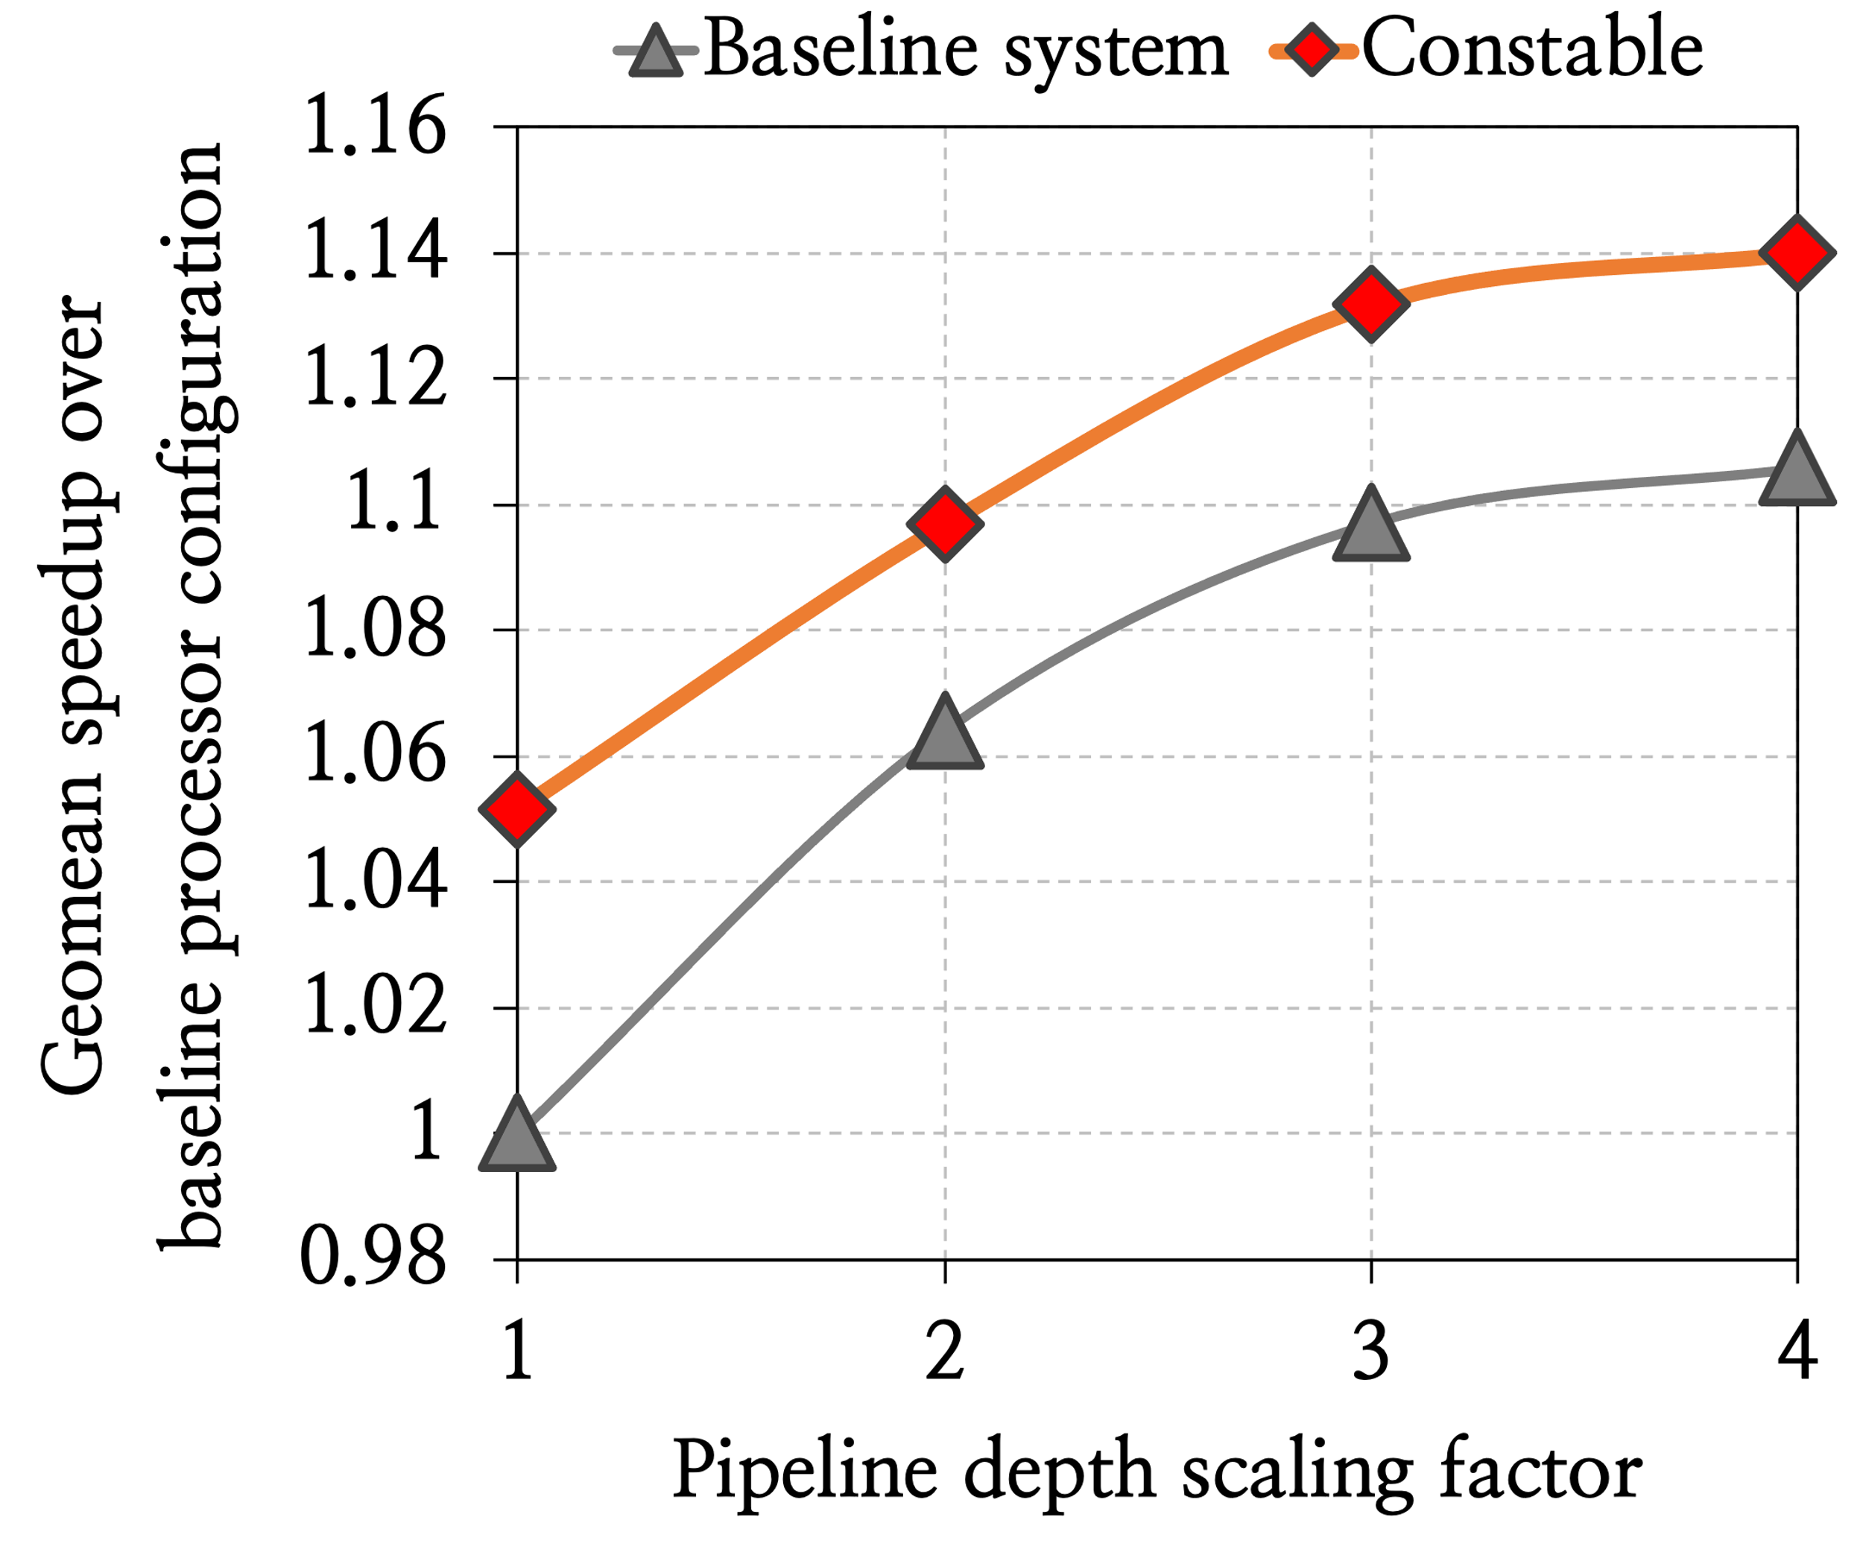
Performance Sensitivity to Pipeline Depth Scaling

Slide 84
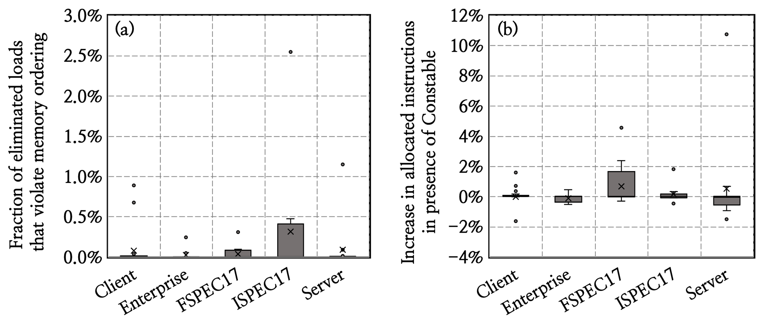
Eliminated Loads that Violates Memory Ordering
Only 0.09% of all eliminated loads
violate memory ordering

Slide 85
Eliminated Loads that Violates Memory Ordering
Eliminated loads that violate memory ordering
increase number of allocated instructions only by 0.3%

Slide 86



Executive Summary
A significant fraction of loads always fetch the same data
from same address throughout the entire workload
These loads cause significant resource dependence
even when using value prediction and memory renaming
Mitigating their resource dependence has significant performance headroom
Key Findings
Constable
Key Idea: To mitigate both load data and load resource dependence by safely eliminating the entire execution of a load
  Key Result: Simultaneously improves performance and power efficiency of a strong baseline OoO processor
Key Mechanism

