Slide 1




Synergizing Data Prefetching and Off-Chip Prediction via Online Reinforcement Learning
Rahul Bera, Zhenrong Lang
Caroline Hengartner, Konstantinos Kanellopoulos, Rakesh Kumar,
Mohammad Sadrosadati, Onur Mutlu
https://github.com/CMU-SAFARI/Athena
Notes:
Hi everyone, I am Rahul, a recently-graduated PHD ...
and together we will present our work ...

Slide 2



Executive Summary (I)
Long memory access latency significantly limits performance of modern high-performance processors
Prefetching and off-chip prediction (OCP) are two orthogonal techniques proposed to hide long memory access latency
Background
OCP and prefetching provide complementary performance benefits
Key Insights
Naively combining OCP with prefetching often fails to realize their full
performance potential
Existing coordination policies leave a large performance potential behind
Autonomously coordinates off-chip prediction with multiple prefetchers
Provides consistent performance benefits, regardless of workloads and system configurations
Goal
Notes:
So, let’s get started with the executive summary
As, we know, long memory access latency ...
Prefetching and off-chip prediction are two key orthogonal techniques proposed to hide the long memory access latency
[CLICK] In this work, we make three key observations regarding the combined usage of data prefetching and off-chip prediction...
First, we show that off-chip prediction and prefetching provides complementary performance benefits, especially in memory bandwidth constrained processors
[CLICK] Yet, naively combining these two techniques often fails ...
[CLICK] and, existing policies to coordinate these two mechanisms leave a ...
[CLICK] Thus, to address these issues, our goal in this work is to design a holistic framework that ...

Slide 3

Executive Summary (II)
Athena
Models the coordination between prefetchers and off-chip predictor (OCP) as a reinforcement learning (RL) problem
Observes multiple system-level features over an epoch of program execution
Takes a coordination action (i.e., enabling the prefetcher and/or OCP, and adjusting prefetcher aggressiveness)
Receives a numerical reward to autonomously and continuously learn
Our Proposal
Introduces a composite reward framework that isolates the true impact of Athena’s own action from inherent variations in workload behavior
Contributions
Works as a prefetcher-OCP coordinator and a prefetcher throttler, at the same time, without any additional hardware
Evaluated with 100 workloads, 6 prefetchers, 3 OCPs, 4 cache designs, and a wide range of main memory bandwidth configurations
Consistently outperforms both heuristic- and learning-based policies in every prefetcher/OCP/bandwidth configurations on average by 3.6% - 10.3%
Evaluation
https://github.com/CMU-SAFARI/Athena
Notes:
To this end, we propose Athena which models ...
[CLICK] Athena works in epochs of workload execution.
At the end of every epoch, Athena extracts a set of system-level features,
such as memory bandwidth usage, prefetcher or OCP’s accuracy, cache pollution
and use it as a state information to take a coordination action.
[CLICK] An action in this case, is to not only enable or disable each mechanism,
but also to dictate the aggressiveness of the prefetcher
[CLICK] For every action, Athena receives a numerical reward, that measures
the change in multiple system-level metrics. Athena uses this reward to
autonomously and continuously learn the coordination policy.
[CLICK] Athena improves upon prior learning-based coordination mechanisms
in two key ways.
[CLICK] First, Athena introduces a composite reward framework that ...
and
[CLICK] Athena works both as a ...
[CLICK] Our extensive evaluation using a wide range of workloads, prefetchers, off-chip predictors
and system configuration shows that
Athena consistently outperforms both best-prior heuristics-based and learning-based coordination policies.
[CLICK] Athena is open-sourced and fully artifact evaluated, which you can download from our GitHub repo

Slide 4
Outline
Background
Motivation
Athena
Evaluation
Conclusion
Notes:
This is going to be the outline of today’s talk.
Let’s start with the background.

Slide 5

Key Problem and Its Potential Solutions
Long memory access latency
remains a key performance bottleneck in modern processors
Key latency hiding techniques:
1
Data prefetching
2
Off-chip prediction
Notes:
As we all know, long memory access latency remains the key ...
[CLICK] Now, researchers have proposed numerous techniques to hide memory access latency
[CLICK] Data prefetching and off-chip prediction are two such key techniques..

Slide 6
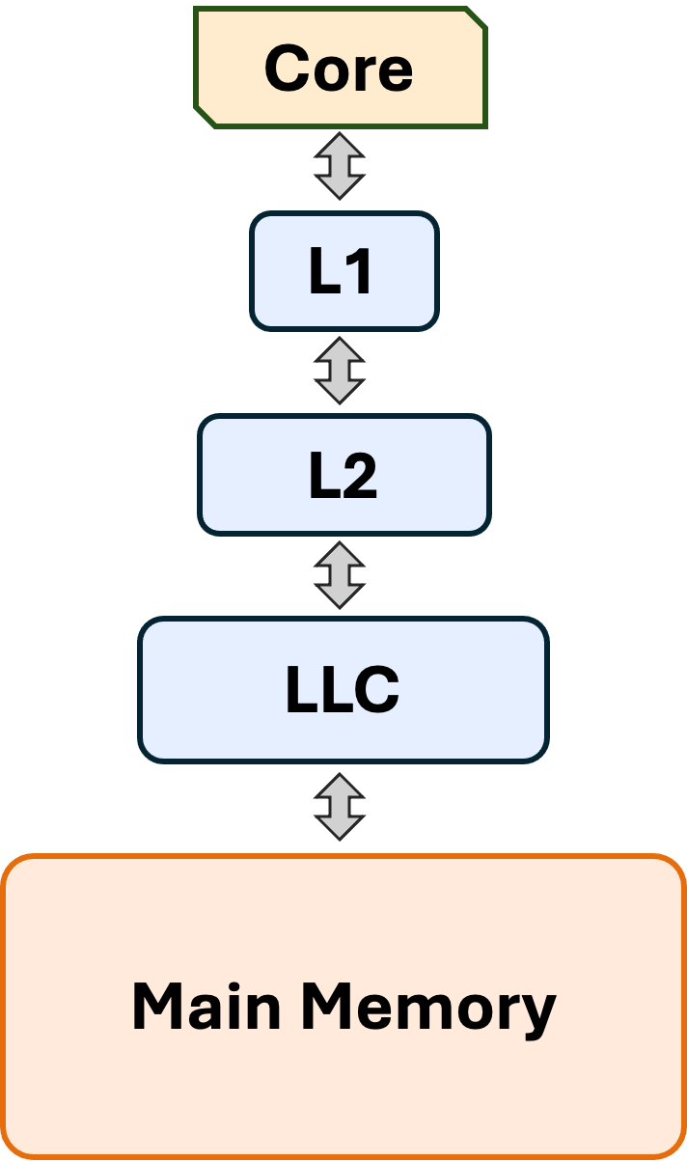


Data Prefetching and Off-Chip Prediction
Data prefetcher
Off-chip predictor
Predicts address of future memory requests
Hides the memory
access latency
Bandwidth overhead
and cache pollution
Predicts whether a given memory request would go off-chip
Often more accurate
predictions
Lower timeliness than a
prefetcher
How do they behave together?
Notes:
[CLICK] Data prefetching is a widely-explored speculation technique that predicts the address ....
and fetches the corresponding data to the on-chip caches before the program demands it
[CLICK] If the prediction is correct, a prefetcher can partially or fully hide the long memory access latency
[CLICK] However, incorrect speculation can cause severe memory bandwidth overhead and cache pollution
[CLICK] Off-chip predictor, on the other hand, is a recently-proposed technique that predicts whether or not ...
and starts fetching their data directly from the main memory ...
An off-chip predictor often produce more accurate speculation compared to traditional prefetchers
However, it also provides less timeliness than a prefetcher.
Now, technically, both of these mechanisms can be orthogonally applied in a processor.
[CLICK] But the question is: how do they behave in presence of each other?

Slide 7
Outline
Background
Motivation
Athena
Evaluation
Conclusion
Notes:
In this work we make three observations regarding the combined usage of data prefetching and off-chip prediction

Slide 8
Ob. 1: Data Prefetching and Off-Chip Prediction Provide Complementary Performance Benefits
(OCP)
(Prefetcher)
Prefetcher-adverse
Prefetcher-friendly
In bandwidth-constrained processor with 3.2 GB/s of main memory bandwidth
Notes:
First, we observe that prefetcher and off-chip predictor often provides complementary performance benefit,
especially in memory bandwidth-constrained processors.
To illustrate this, here I am showing the performance improvement of a state-of-the-art prefetcher Pythia
employed in the L2 cache of a bandwidth-constrained single-core processor.
On the x-axis, we have different workloads, and the y-axis, we have the speedup.
[CLICK] As we can see, Pythia improves performance for the majority of the workloads even in this bandwidth-constrained configuration.
[CLICK] We call such workloads – prefetcher friendly.
[CLICK] However, for a significant number of workloads, Pythia significantly degrades performance,
even with its built-in bandwidth-aware throttling mechanism
[CLICK] In many of these prefetcher-adverse workloads, the state-of-the-art off-chip predictor POPET provides performance benefit.
However, in prefetcher-friendly workloads, POPET significantly underperforms Pythia.

Slide 9
Ob. 1: Data Prefetching and Off-Chip Prediction Provide Complementary Performance Benefits
(OCP)
(Prefetcher)
Prefetcher-adverse
Prefetcher-friendly
Data prefetching and off-chip prediction provide complementary performance benefits
In bandwidth-constrained processor with 3.2 GB/s of main memory bandwidth
Notes:
First, we observe that prefetcher and off-chip predictor often provides complementary performance benefit,
especially in memory bandwidth-constrained processors.
To illustrate this, here I am showing the performance improvement of a state-of-the-art prefetcher Pythia
employed in the L2 cache of a bandwidth-constrained single-core processor.
On the x-axis, we have different workloads, and the y-axis, we have the speedup.
[CLICK] As we can see, Pythia improves performance for the majority of the workloads even in this bandwidth-constrained configuration.
[CLICK] We call such workloads – prefetcher friendly.
[CLICK] However, for a significant number of workloads, Pythia significantly degrades performance,
even with its built-in bandwidth-aware throttling mechanism
[CLICK] In many of these prefetcher-adverse workloads, the state-of-the-art off-chip predictor POPET provides performance benefit.
However, in prefetcher-friendly workloads, POPET significantly underperforms Pythia.

Slide 10
Ob. 2: Naively Combining OCP with Prefetching Fails to Realize their Full Performance Potential
StaticBest <POPET, Pythia>
6.5%
14.1%
Notes:
Let’s now take a look what happens when we enable both techniques without coordination.
[CLICK] In prefetcher-adverse workloads, we have already seen that
POPET improve performance, whereas Pythia severely degrades performance.
[CLICK] If we naively combine Pythia and POPET, it completely masks out
the performance improvement that POPET alone could have delivered.
[CLICK] However, if we could have controlled these two mechanisms
based on the oracular understanding of their effectiveness,
which we show here as the StaticBest combination,
it could have provided a 14.1% performance improvement over the naive combination.
[CLICK] In prefetcher-friendly workloads, we have already seen that
Pythia provides more performance benefits than POPET.
The naive and StaticBest combination closely follows the trend of Pythia.
[CLICK] Overall across all workloads, the naive combination underperforms the StaticBest combination
by 6.5% on average

Slide 11
Ob. 2: Naively Combining OCP with Prefetching Fails to Realize their Full Performance Potential
StaticBest <POPET, Pythia>
6.5%
14.1%
Naively combining OCP with prefetching often
fails to realize their full performance potential
Notes:
Let’s now take a look what happens when we enable both techniques without coordination.
[CLICK] In prefetcher-adverse workloads, we have already seen that
POPET improve performance, whereas Pythia severely degrades performance.
[CLICK] If we naively combine Pythia and POPET, it completely masks out
the performance improvement that POPET alone could have delivered.
[CLICK] However, if we could have controlled these two mechanisms
based on the oracular understanding of their effectiveness,
which we show here as the StaticBest combination,
it could have provided a 14.1% performance improvement over the naive combination.
[CLICK] In prefetcher-friendly workloads, we have already seen that
Pythia provides more performance benefits than POPET.
The naive and StaticBest combination closely follows the trend of Pythia.
[CLICK] Overall across all workloads, the naive combination underperforms the StaticBest combination
by 6.5% on average

Slide 12
Ob. 3: Existing Coordination Policies Fall Short
TLP [Jamet+, HPCA’24] is the only technique proposed
to combine OCP with a prefetcher
Notes:
Now, while researchers have proposed numerous techniques control multiple prefetchers present in a system
TLP is the only technique proposed to ..

Slide 13

Ob. 3: Existing Coordination Policies Fall Short
TLP [Jamet+, HPCA’24] is the only technique proposed
to combine OCP with a prefetcher
Can coordinate OCP with prefetcher employed only at the L1 data cache
Notes:
However, TLP is significantly limited by its ability to
coordinate off-chip predictor with prefetcher employed only at the L1 data cache

Slide 14
Ob. 3: Existing Coordination Policies Fall Short
3.4%
5.9%
9.2%
Notes:
That said, we still extend two best-prior prefetcher coordination policies: [CLICK] the heuristic-based HPAC and [CLICK] learning-based policy MAB,
both of which have been originally proposed to control only prefetchers
to coordinate prefetchers with off-chip predictors in our case.
[CLICK] We observe that while HPAC and MAB improve performance over the naive combination
in prefetcher-adverse workloads
they still leave a significant performance potential behind than the StaticBest combination.

Slide 15
Ob. 3: Existing Coordination Policies Fall Short
3.4%
5.9%
9.2%
Existing coordination policies
leave a large performance potential behind
Notes:
That said, we still extend two best-prior prefetcher coordination policies: [CLICK] the heuristic-based HPAC and [CLICK] learning-based policy MAB,
both of which have been originally proposed to control only prefetchers
to coordinate prefetchers with off-chip predictors in our case.
[CLICK] We observe that while HPAC and MAB improve performance over the naive combination
in prefetcher-adverse workloads
they still leave a significant performance potential behind than the StaticBest combination.

Slide 16


Our Goal
Design a holistic framework that
Autonomously synergizes OCP with
multiple prefetchers throughout the cache hierarchy
To deliver consistent performance benefits,
regardless of workloads and system configuration
Notes:
Our goal in this work is to design a holistic framework that can autonomously coordinate off-chip prediction with multiple
prefetching techniques employed at various levels of the cache
hierarchy by taking multiple system-level features into account,
thereby delivering consistent performance benefits, regardless
of the underlying prefetcher-OCP combination, workload, and
system configuration.

Slide 17
Our Proposal
Formulates the coordination between prefetchers and OCP
as a reinforcement learning problem
Notes:
To this end, we propose Athena, which formulates the dy-
namic coordination between prefetchers and OCP as a rein-
forcement learning problem.

Slide 18
Outline
Background
Motivation
Athena
Evaluation
Conclusion

Slide 19
Basics of Reinforcement Learning (RL)
An algorithmic approach to learn to take an action in a given state to maximize a numerical reward
Agent stores Q-values for every state-action pair
  Expected reward for taking an action in a state
Given a state, the agent selects the action that provides the highest Q-value
State (s_{t})
Environment
Reward (R_{t+1})
Agent
Action (a_{t})
Notes:
A typical RL system consists of two key components: the agent and the environment.
At each timestep t, the agent observes the current state of the environment St, selects an action At, and receives a numerical reward Rt+1 based on the outcome of the action.
The agent’s goal is to find the optimal policy that maximizes the cumulative reward collected over time.

Slide 20
Formulating Coordination as RL
State (s_{t})
Environment
Reward (R_{t+1})
Agent
Action (a_{t})
State
(e.g., bandwidth usage, prefetcher/OCP accuracy)
Processor & Memory Subsystem
Reward
Athena
Action
1) enable/disable prefetcher and OCP
2) set prefetcher aggressiveness
Notes:
Athena formulates the coordination of data prefetchers and the off-chip predictor as an RL problem,
Athena acts as the RL agent
And the Processor and Memory Subsystem acts as the Environment
At every timestep
Let's dive deeper into the three components

Slide 21

What is State?
Vector of system-level features
State := [Feature 1, Feature 2, …]
Captures runtime behavior of the memory subsystem
Example Features
Prefetcher accuracy
OCP accuracy
Bandwidth usage
Cache pollution
Prefetch bandwidth
OCP bandwidth
Demand bandwidth
Automated Design-Space Exploration
Perform offline feature selection to determine the final subset
of features that Athena uses to construct the state vector
Notes:
Let's take a closer look into the three key components of the RL framework
We define the state as a vector of system-level features, where each feature encapsulates a distinct behavior of the memory subsystem
[CLICK]
Collectively, these features represent the runtime conditions relevant to making a prefetcher-OCP coordination decision.
We start with these example features, such as ...
Later, we perform offline feature selection using automated design-space exploration to determine the final subset of features that Athena uses to construct the state vector.

Slide 22


What is Action?
Prefetcher /
OCP /
Adjust the aggressiveness of prefetcher
Notes:
At a high level, Athena decides whether to enable or disable the prefetcher and off-chip predictor.

Slide 23


What is Action?
28
9
2
4
State vector
Prefetcher Only
OCP Only
Both Enabled
Neither Enabled
The magnitude of the selected action’s Q-value implicitly encodes Athena’s confidence in taking that action
>> avg( , , )
Notes:
Given the state vector, Athena looks up the Q-values for each of the four actions, prefetcher only, OCP only, both enabled and both disabled.
Athena selects the action with the highest Q-value.
In this example, Athena selects prefetcher-only.
Can we do better than soley selecting the actions at a coarse granularity?
In this case, the Q-Value of prefetcher-only is much larger than
We exploit this observation to enable ...

Slide 24



Q-Value-Driven Prefetcher Aggressiveness Control
Key Idea: Use the Q-value difference to control prefetcher aggressiveness
Calculate Q-value difference
∆Q ← Q(a*) − avg (Q(remaining actions))
Drive prefetcher aggressiveness using ∆Q
Low ∆Q
→ Low aggressiveness
High ∆Q → High aggressiveness
Notes:
Use the q-value difference to control prefetcher aggressivness
If Athena enables prefetching, Athena

Slide 25
Q-Value-Driven Prefetcher Aggressiveness Control
Key Idea: Use the Q-value difference to control prefetcher aggressiveness
Calculate Q-value difference
∆Q ← Q(a*) − avg (remaining actions)
Drive prefetcher aggressiveness using ∆Q
Low ∆Q
→ Low aggressiveness
High ∆Q → High aggressiveness
Athena works as a prefetcher-OCP coordinator and a prefetcher throttler, at the same time, using the same hardware
Notes:
Use the q-value difference to control prefetcher aggressivness
If Athena enables prefetching, Athena

Slide 26
What is Reward?
Defines the objective of Athena
Intuitive reward: instructions committed per cycle (IPC)
Change in IPC
Coordination actions taken by Athena
Inherent variation in workload behavior
Using IPC as the sole reward can be unreliable and may mislead the learned policy
Notes:
Reward defines the
Intuitive
However, a change in IPC may originate from two different sources: (1) the coordination actions taken by the agent, and (2) the inherent variations in workload behavior, that are independent of the agent’s actions.
As such, using IPC as the sole reward can be unreliable and may mislead the learned policy.

Slide 27
Athena's Composite Reward Framework
Athena’s overall reward
Correlated reward
Reflects the effect of
Athena’s action
- Cycles
- LLC misses
- LLC miss latency
Uncorrelated reward
Reflects inherent
workload variation
Load instructions
Mispredicted branches
Allows Athena to autonomously learn a coordination policy
by isolating the true impact of its actions
from inherent variations in workload behavior
Notes:
To address this limitation, Athena introduces a composite reward framework
(1) correlated reward, which encapsulates the effect of Athena’s
action on the system,
and (2) uncorrelated reward, which encapsulates the inherent change in program behavior.
By

Slide 28
Athena's Composite Reward Framework
Athena’s overall reward
Correlated reward
Reflects the effect of
Athena’s action
- Cycles
- LLC misses
- LLC miss latency
Uncorrelated reward
Reflects inherent
workload variation
Load instructions
Mispredicted branches
Allows Athena to autonomously learn a coordination policy
by isolating the true impact of its actions
from inherent variations in workload behavior
Potentially broadly applicable to many other
microarchitectural decision-making processes
Notes:
To address this limitation, Athena introduces a composite reward framework
(1) correlated reward, which encapsulates the effect of Athena’s
action on the system,
and (2) uncorrelated reward, which encapsulates the inherent change in program behavior.
By

Slide 29
Final Configuration of Athena
State
Action
Reward
Four features
Prefetcher accuracy
OCP accuracy
Bandwidth usage
Prefetcher-induced cache pollution
Coarse-grained action
Enable prefetcher
Enable OCP
Enable both
Enable none
Fine-grained action
Q-value driven prefetcher aggressiveness control
Correlated reward
Cycles
LLC misses
LLC miss latency
Uncorrelated reward
Load instructions
Mispredicted branches

Slide 30
More in the Paper
Detailed design of Athena
  Architecture to store and retrieve Q-values
Automated design space exploration
  Feature selection
  Reward tuning
  Hyperparameter tuning
Mechanism to measure system state
  Prefetcher accuracy
  OCP accuracy
  Cache pollution
  Main memory bandwidth usage
Storage and latency overhead analysis

Slide 31
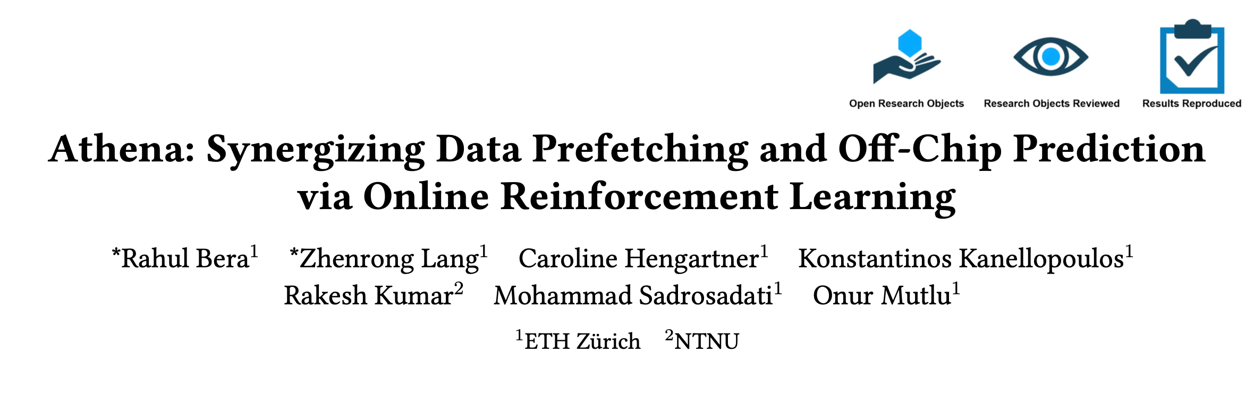
More in the Paper
https://www.arxiv.org/pdf/2601.17615

Slide 32
Outline
Background
Motivation
Athena
Evaluation
Conclusion

Slide 33
ChampSim Trace-Driven Simulation Methodology
Prefetchers
Off-Chip Predictors
IPCP [Pakalapati+, ISCA’20]
Berti [Navarro-Torres+, MICRO’22]
Pythia [Bera+, MICRO’21]
SPP+ PPF [Bhatia+, ISCA’20]
SMS [Somogyi+, ISCA’06]
MLOP [Shakerinava+, DPC3’19]
Hermes [Bera+, MICRO’22]
HMP [Yoaz+, ISCA’99]
TTP [Jalili+, HPCA’22]
Coordination Policies
HPAC [Ebrahimi+, MICRO’09]
MAB [Yoaz+, ISCA’99]
TLP [Jamet+, HPCA’24]
System Configurations
# cores: 1- 8 cores
Main memory bandwidth:
1.6 GB/s – 12.8 GB/s
4 cache designs with various prefetchers at different cache levels
Workloads
100 single-core workloads
180 four-core and eight-core workload mixes
Notes:
We use ChampSim to evaluate Athena in coordinating multiple types of prefetcher and off-chip predictors, and compare it against multiple prior coordination policies under a wide range of workloads and system configurations

Slide 34
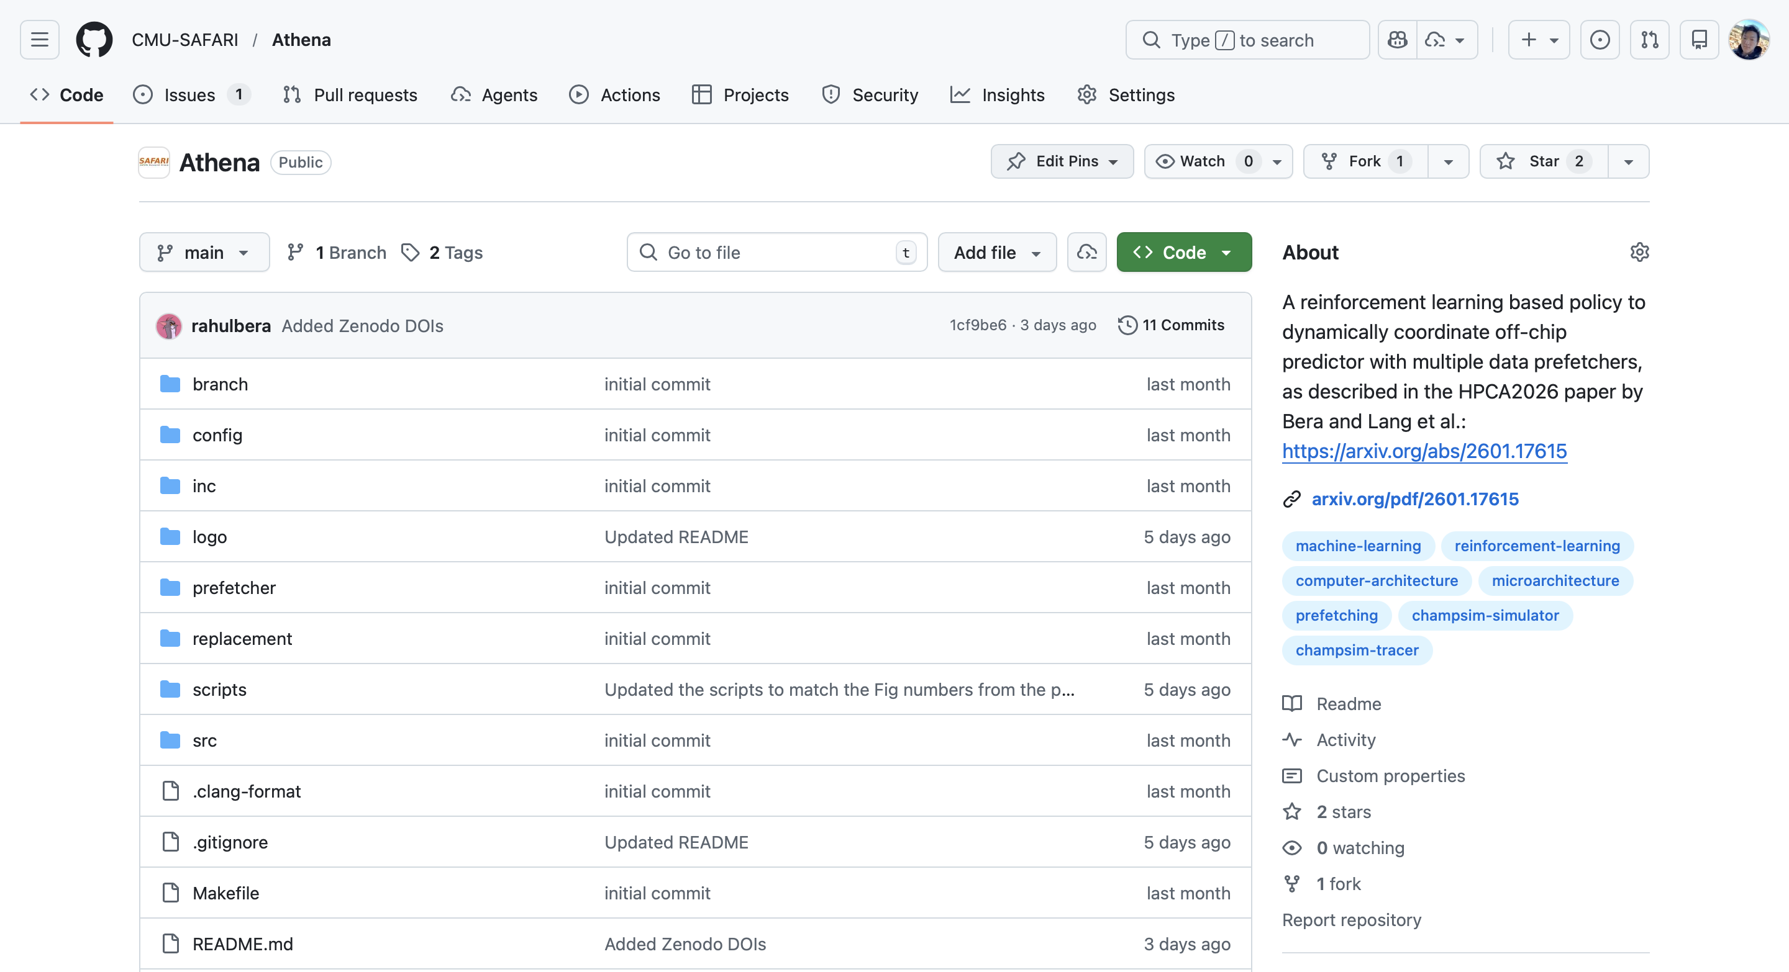
Trace-Driven Simulation Methodology
Prefetchers
Off-chip Predictors
IPCP [Pakalapati+, ISCA’20]
Berti [Navarro-Torres+, MICRO’22]
Pythia [Bera+, MICRO’21]
SPP+ PPF [Bhatia+, ISCA’20]
SMS [Somogyi+, ISCA’06]
MLOP [Shakerinava+, DPC3’19]
Hermes [Bera+, MICRO’22]
HMP [Yoaz+, ISCA’99]
TTP [Jalili+, HPCA’22]
Coordination Policies
HPAC [Ebrahimi+, MICRO’09]
MAB [Yoaz+, ISCA’99]
TLP [Jamet+, HPCA’24]
System Configurations
# cores: 1- 8 cores
Main memory bandwidth:
1.6 GB/s – 12.8 GB/s
4 cache designs with various prefetchers at different cache levels
Workloads
https://github.com/CMU-SAFARI/Athena
100 single-core workloads
180 four-core and eight-core workload mixes
Open-sourced and artifact-evaluated
with all three badges
Notes:
All of our implementations are fully open-sourced

Slide 35
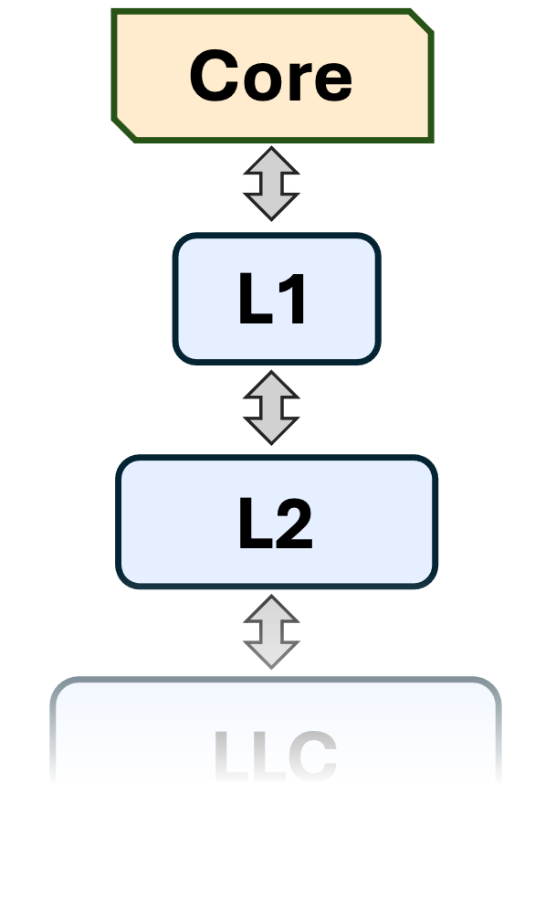
Evaluated Cache Designs
OCP
OCP
PF
Cache Design 1
Cache Design 2
PF
OCP
OCP
PF₁
Cache Design 3
Cache Design 4
PF₁
PF₂
PF₂
Notes:
We evaluate Athena using four cache designs, which differ in the number of prefetchers deployed at various levels of the cache hirarchy

Slide 36

Evaluated Cache Designs
OCP
OCP
PF
Cache Design 1
Cache Design 2
PF
OCP
OCP
PF₁
Cache Design 3
Cache Design 4
PF₁
PF₂
PF₂

Slide 37
Speedup in Cache Design 1
6.2%
5.0%
7.5%
4.8%
1.5%

Slide 38
Speedup in Cache Design 1
6.2%
5.0%
7.5%
4.8%
1.5%
Athena outperforms the best-prior coordination policy MAB
by 5% on average
Athena consistently outperforms prior prefetcher control policies
in all workload categories

Slide 39
Speedup in Cache Design 1
Notes:
We motivated using the performance gap between existing works and StaticBest.
Do we reach our goal?

Slide 40
Speedup in Cache Design 1
Athena provides similar performance gains
as the StaticBest combination
Notes:
We motivated using the performance gap between existing works and StaticBest.
Do we reach our goal?

Slide 41
Performance Sensitivity to Varying Prefetchers
5.0%
5.4%
3.6%
5.0%

Slide 42
Performance Sensitivity to Varying OCPs
5.0%
4.7%
8.2%

Slide 43
Performance Sensitivity to Varying OCPs
5.0%
4.7%
8.2%
Athena provides consistent performance benefits
across diverse prefetcher and OCP types

Slide 44
More Evaluations in the Paper
Performance improvement in three other cache designs
Performance sensitivity study across diverse system configurations
  Varying L1D prefetcher
  Varying OCP request issue latency
  Varying main memory bandwidth
Understanding Athena using a case study
Employing Athena for prefetcher-only management
Additional results in the extended version on arXiv:
  Effect of Athena on main memory request
  Effect of Athena on LLC load miss latency
  Performance improvement of Athena on 359 additional unseen traces

Slide 45
More Evaluations in the Paper
https://www.arxiv.org/pdf/2601.17615

Slide 46

Athena is Open Sourced
100 Workloads
Six Prefetchers
SPEC CPU 2006 & 2017
PARSEC 2.1
Ligra graph processing workloads
Real-world INT, FP
IPCP [Pakalapati+, ISCA’20]
Berti [Navarro-Torres+, MICRO’22]
Pythia [Bera+, MICRO’21]
SPP+PPF [Kim+, MICRO’16]
SMS [Somogyi+, ISCA’06]
MLOP [Shakerinava+, DPC3’19]
Three OCPs
Four Policies
POPET [Bera+, MICRO’22]
HMP [Yoaz+, ISCA’99]
TTP [Jalili+, HPCA’22; Bera+, MICRO’22]
TLP [Jamet+, HPCA’24]
HPAC [Ebrahimi+, MICRO’09]
MAB [Gerogiannis+, MICRO’23]
Athena (Our Proposal)
https://github.com/CMU-SAFARI/Athena

Slide 47
Outline
Background
Motivation
Athena
Evaluation
Conclusion

Slide 48
The first reinforcement learning-based mechanism to coordinate
off-chip predictor and multiple prefetchers
Introduces a composite reward framework that isolates the true impact of Athena’s own action from inherent variations in workload behavior
Contributions
Works as a prefetcher-OCP coordinator and a prefetcher throttler, at the same time, without any additional hardware
Evaluated with 100 workloads, 6 prefetchers, 3 OCPs, 4 cache designs, and a wide range of main memory bandwidth configurations
Consistently outperforms both best-prior heuristic- and learning-based policies in every prefetcher/OCP/bandwidth configuration
Evaluation
https://github.com/CMU-SAFARI/Athena
Notes:
We propose

Slide 49


Synergizing Data Prefetching and Off-Chip Prediction via Online Reinforcement Learning
Rahul Bera, Zhenrong Lang, Caroline Hengartner, Konstantinos Kanellopoulos,
Rakesh Kumar, Mohammad Sadrosadati, Onur Mutlu

Slide 50
BACKUP

Slide 51
Index
Motivational data
  POPET v. Pythia
  Perf. headroom
  Why TLP fails?
  Prior works’ headroom
Athena design
  Candidate features
  Pref. aggressiveness algo
  Reward framework
  QVStore retreival
  Final config
  Storage overhead
  Latency overhead
Methodology
  System param
  Workloads
  Cache designs
  Storage overhead comparison
More evaluation
  CD1 – speedup
  CD1 – speedup deepdive
  CD1 – v. StaticBest
  CD1 – main memory overhead
  CD1 – LLC load miss latency
  CD1 – L2C prefetcher sensitivity
  CD1 – OCP sensitivity
  CD1 – OCP latency sensitivity
  CD1 – Warmup length sensitivity
  CD2 – speedup
  CD3 – speedup
  CD4 – speedup
  CD4 – L1D prefetcher sensitivity
  CD4 – mem. b/w sensitivity
  Four-core
  Eight-core
  Understanding Athena
  Ablation study
  Prefetcher-only management
  Unseen workloads

Slide 52
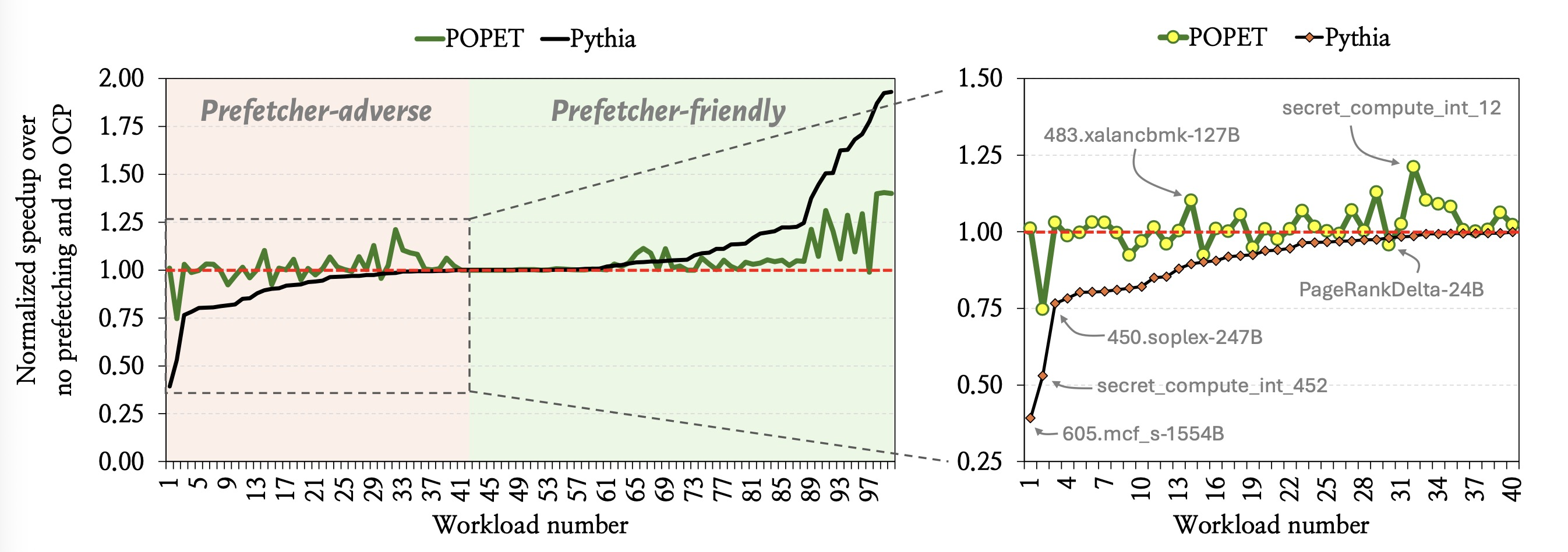
POPET vs. Pythia Performance Line Graph
 | Accuracy | Performance
Pythia | 28.7% | -10.5%
POPET | 84.1% | +10.3%

Slide 53
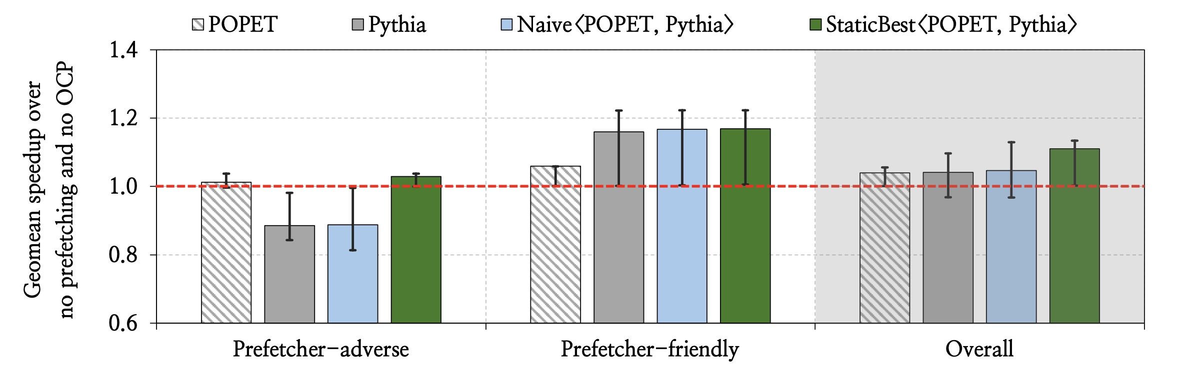
Athena Performance Headroom

Slide 54
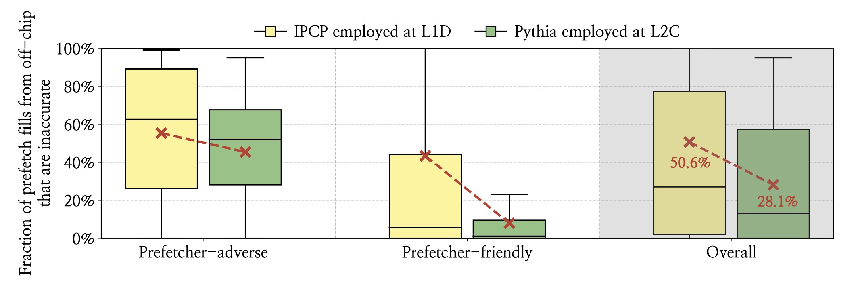
Off-Chip Prefetch Fills are not Always Inaccurate

Slide 55
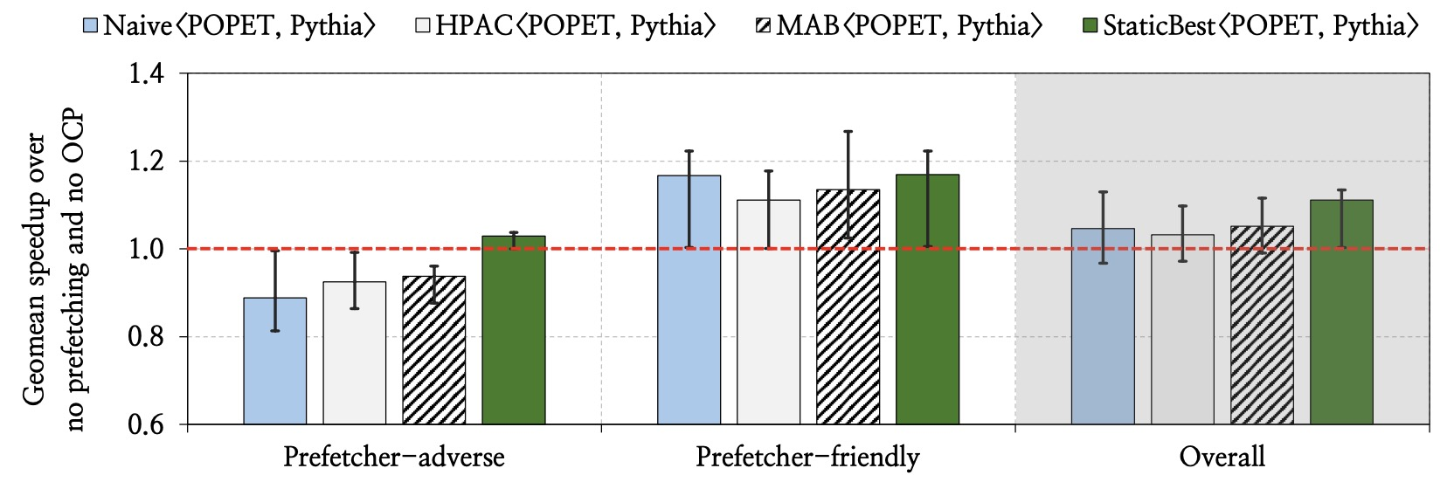
Prior Works Leave Performance Potential Behind

Slide 56
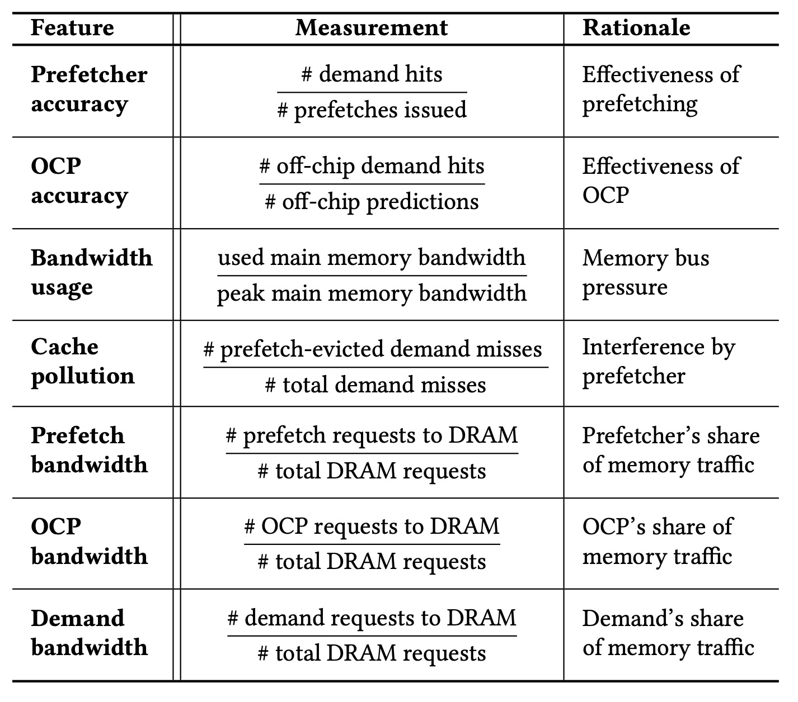
Candidate Features Considered

Slide 57
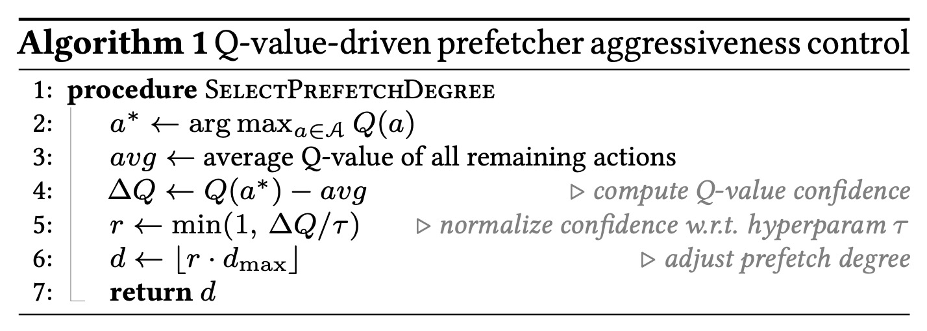
Q-Value-Driven
Prefetcher Aggressiveness Control

Slide 58
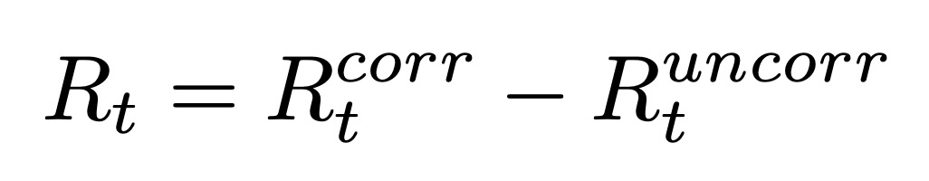
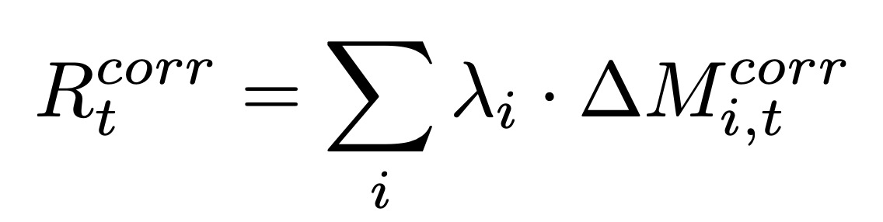
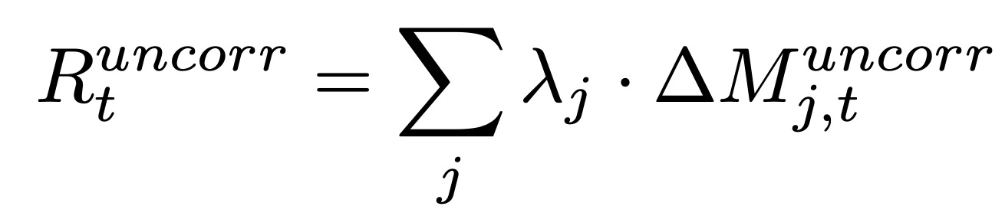
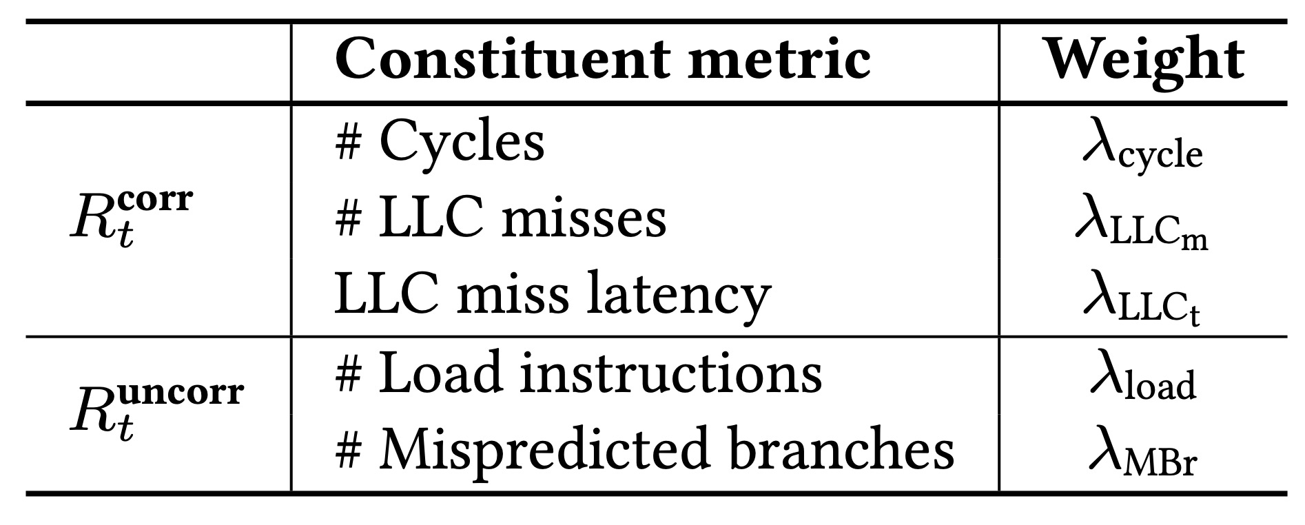
Reward Framework

Slide 59
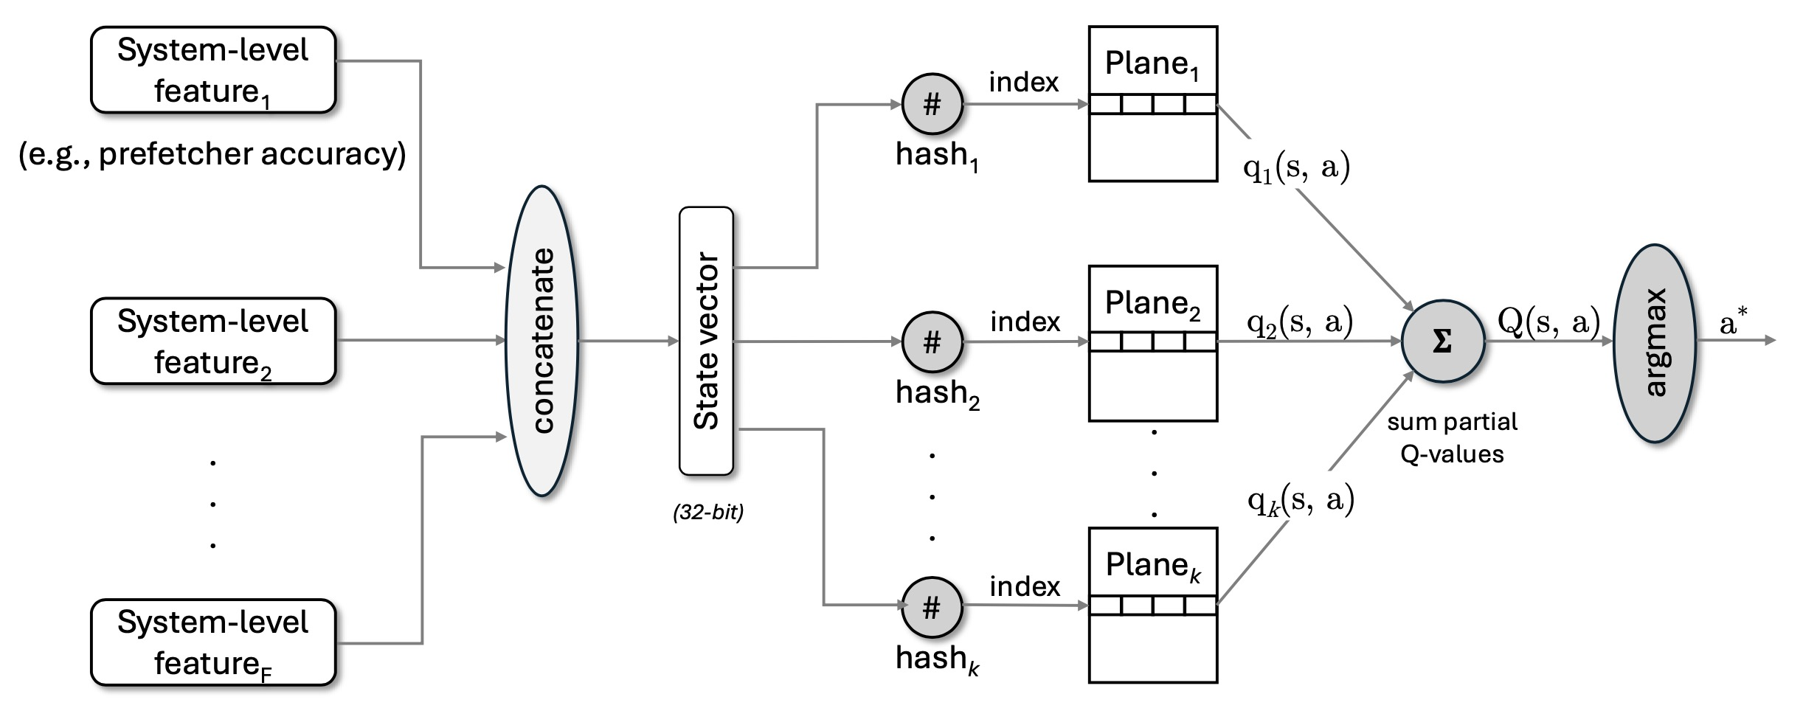
Q-Value Retrieval from QVStore

Slide 60
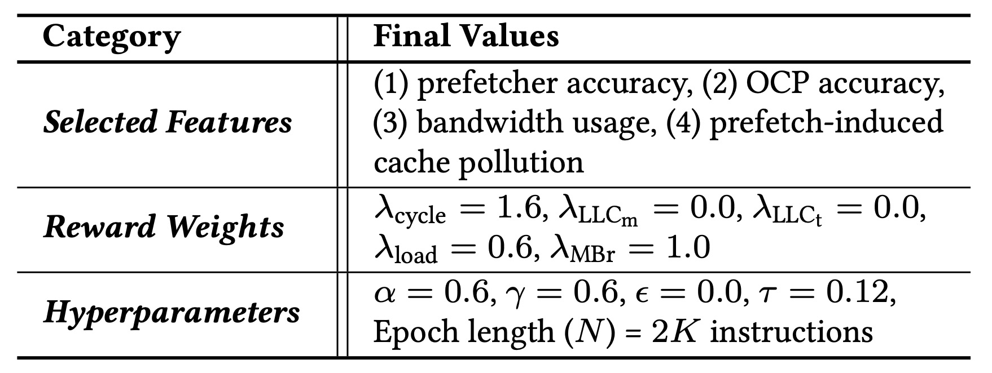
Final Configuration of Athena

Slide 61
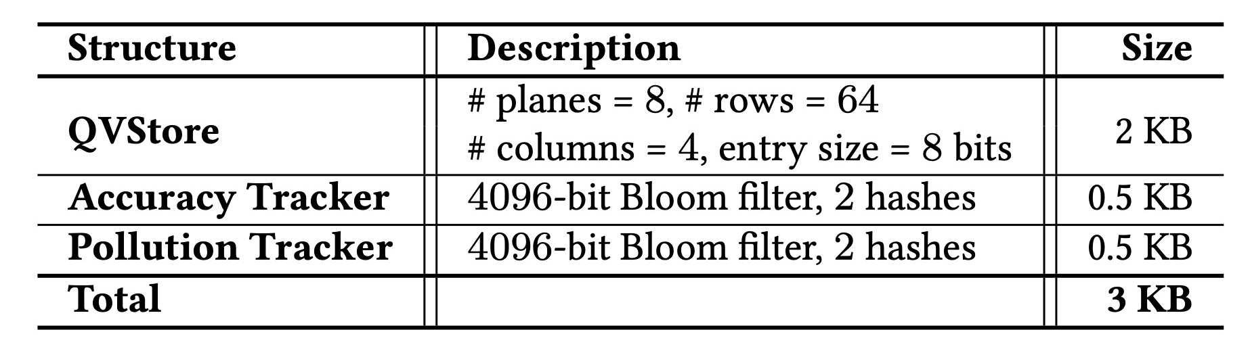
Storage Overhead of Athena

Slide 62
Why is Athena’s Latency Overhead Minimal?
2000 instructions
Epoch_{k}
Epoch_{k+1}
Epoch_{k+2}
Epoch_{k+3}
Latency of
Q-Value updates
<<
Latency to
execute an epoch

Slide 63
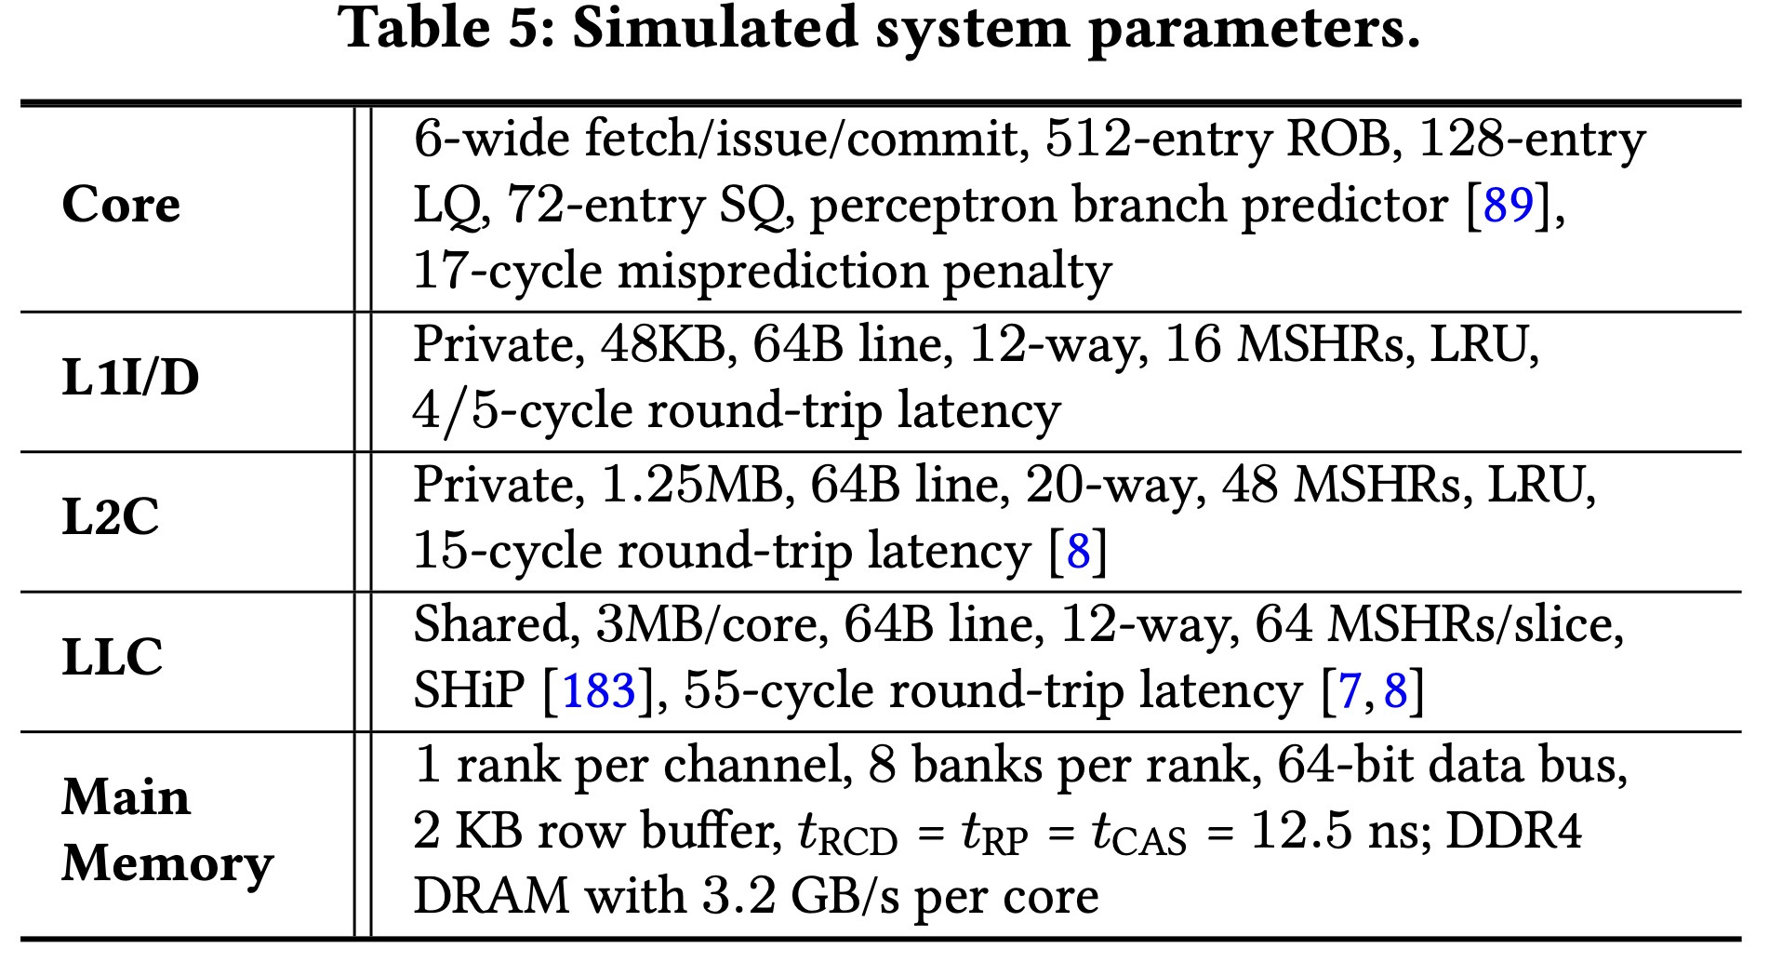
Evaluated System Parameters

Slide 64
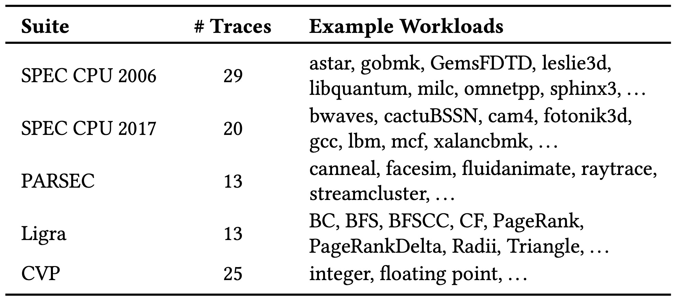
Evaluated Workloads

Slide 65
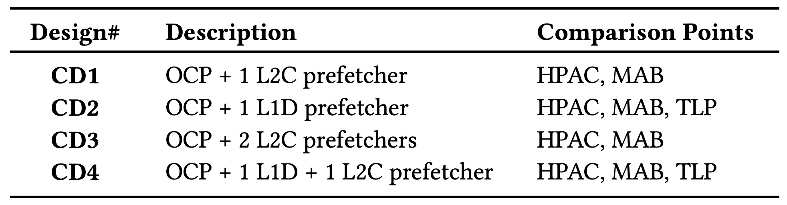
Evaluated Cache Designs

Slide 66
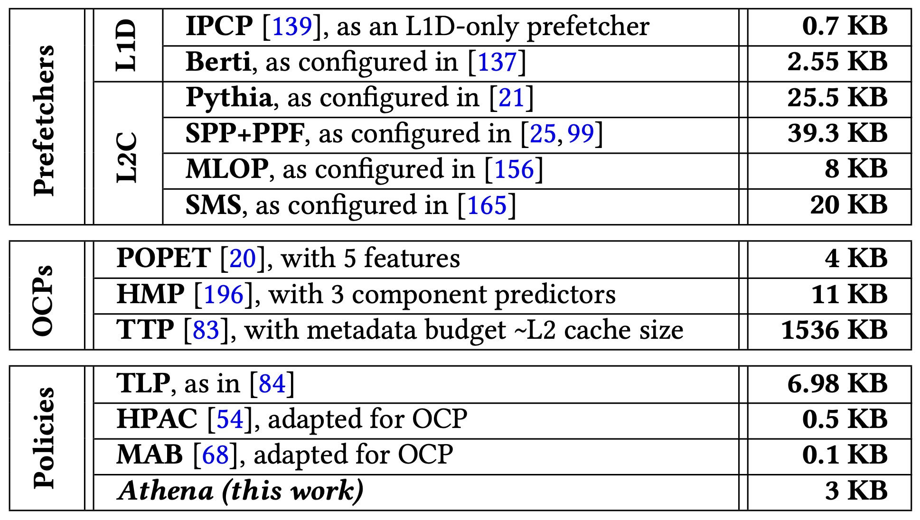
Storage Overhead Comparison

Slide 67
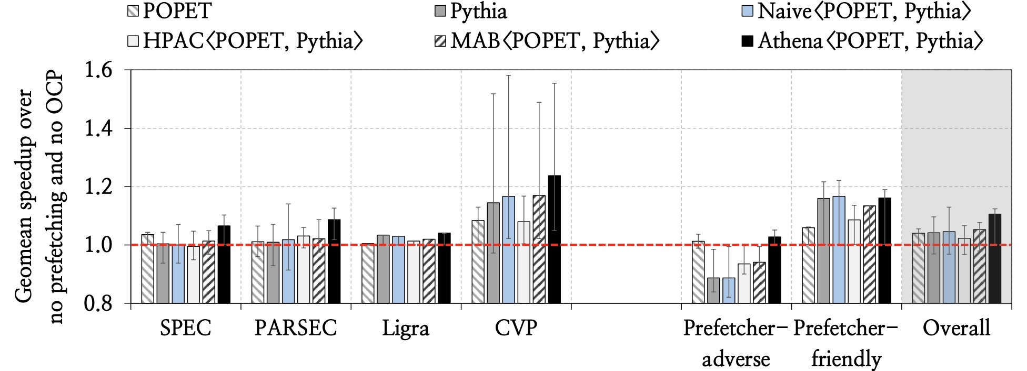
Speedup in CD1

Slide 68
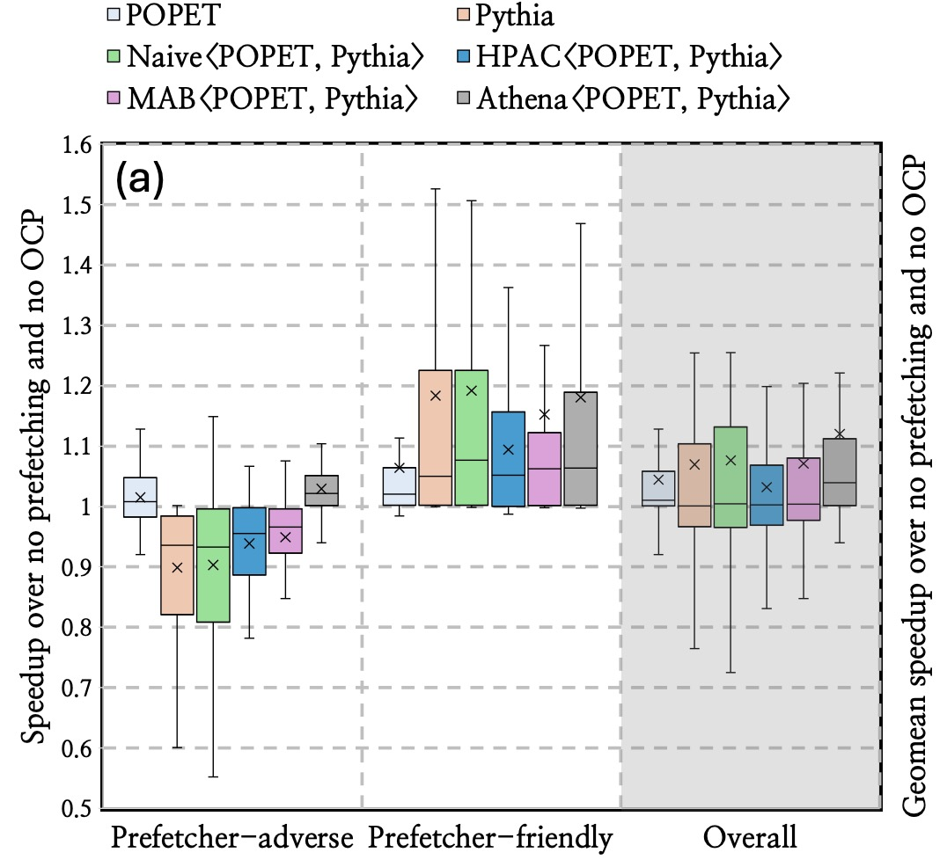
CD1 Speedup – Deepdive

Slide 69
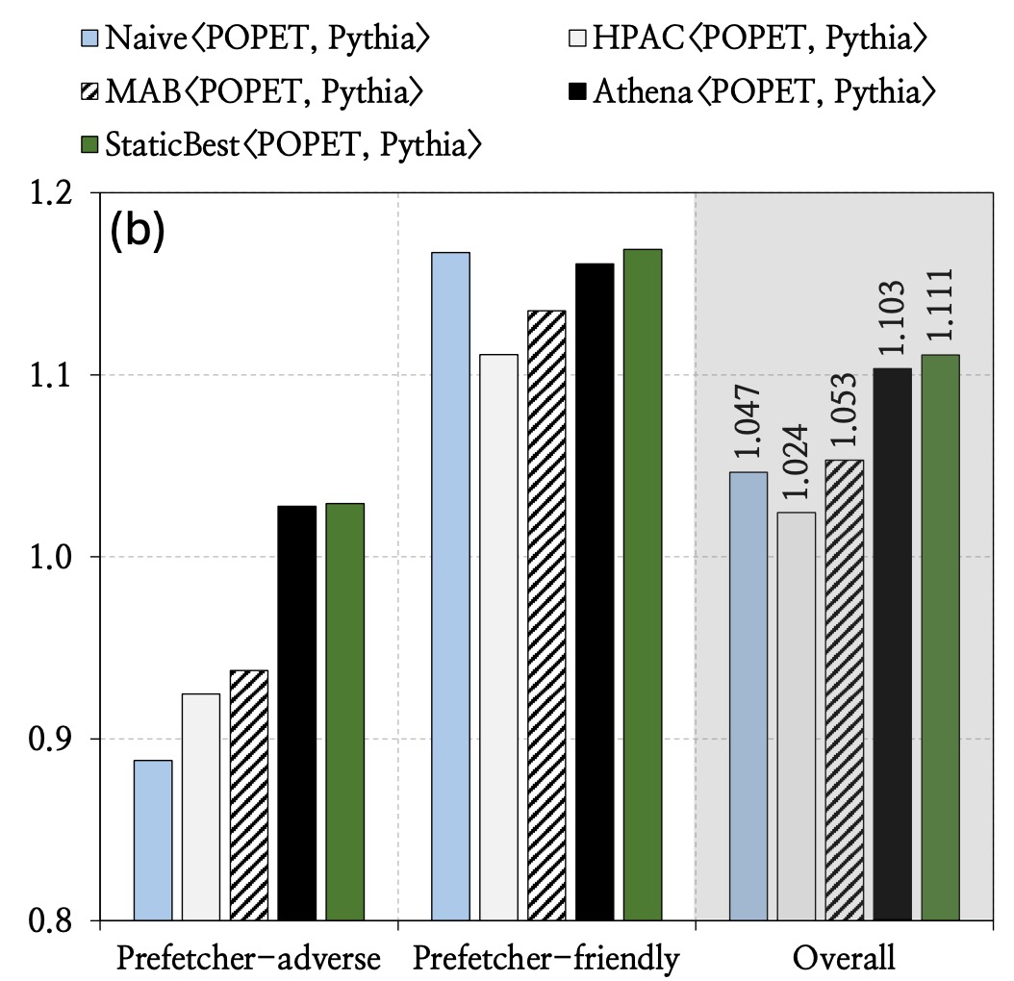
CD1 Speedup – Compared to StaticBest

Slide 70
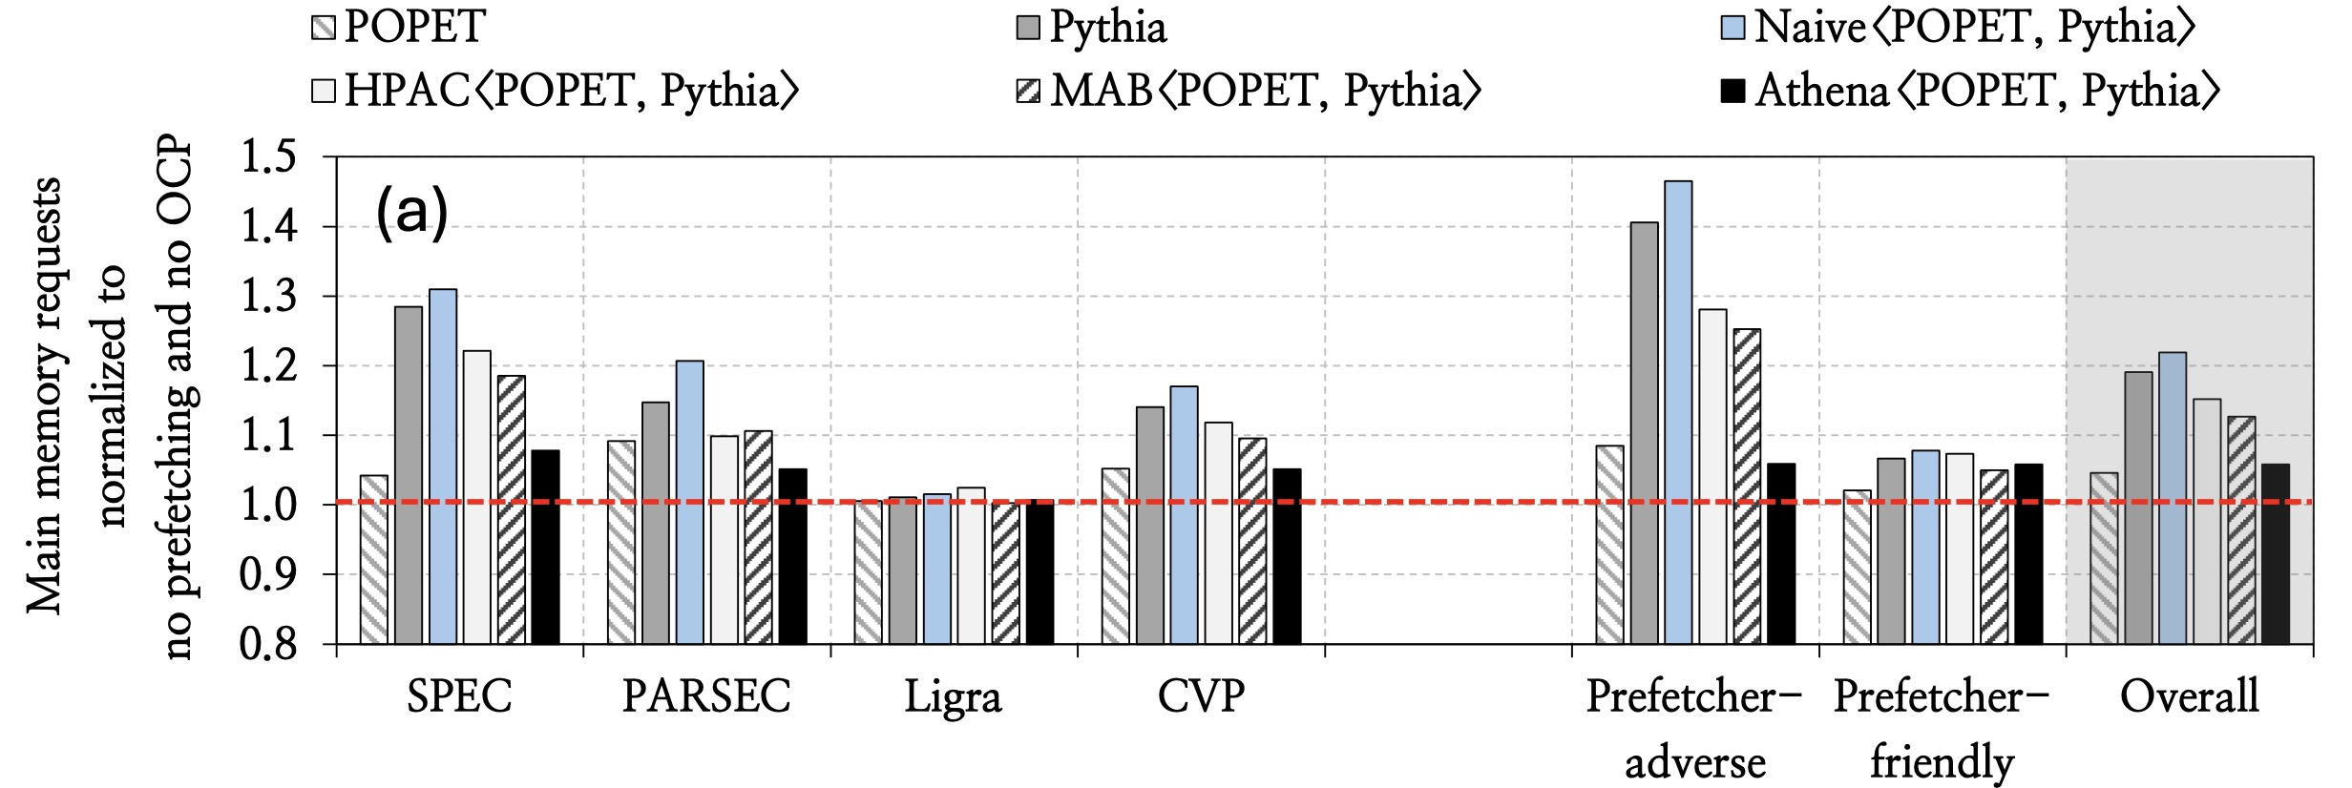
CD1 – Impact on Main Memory Requests

Slide 71
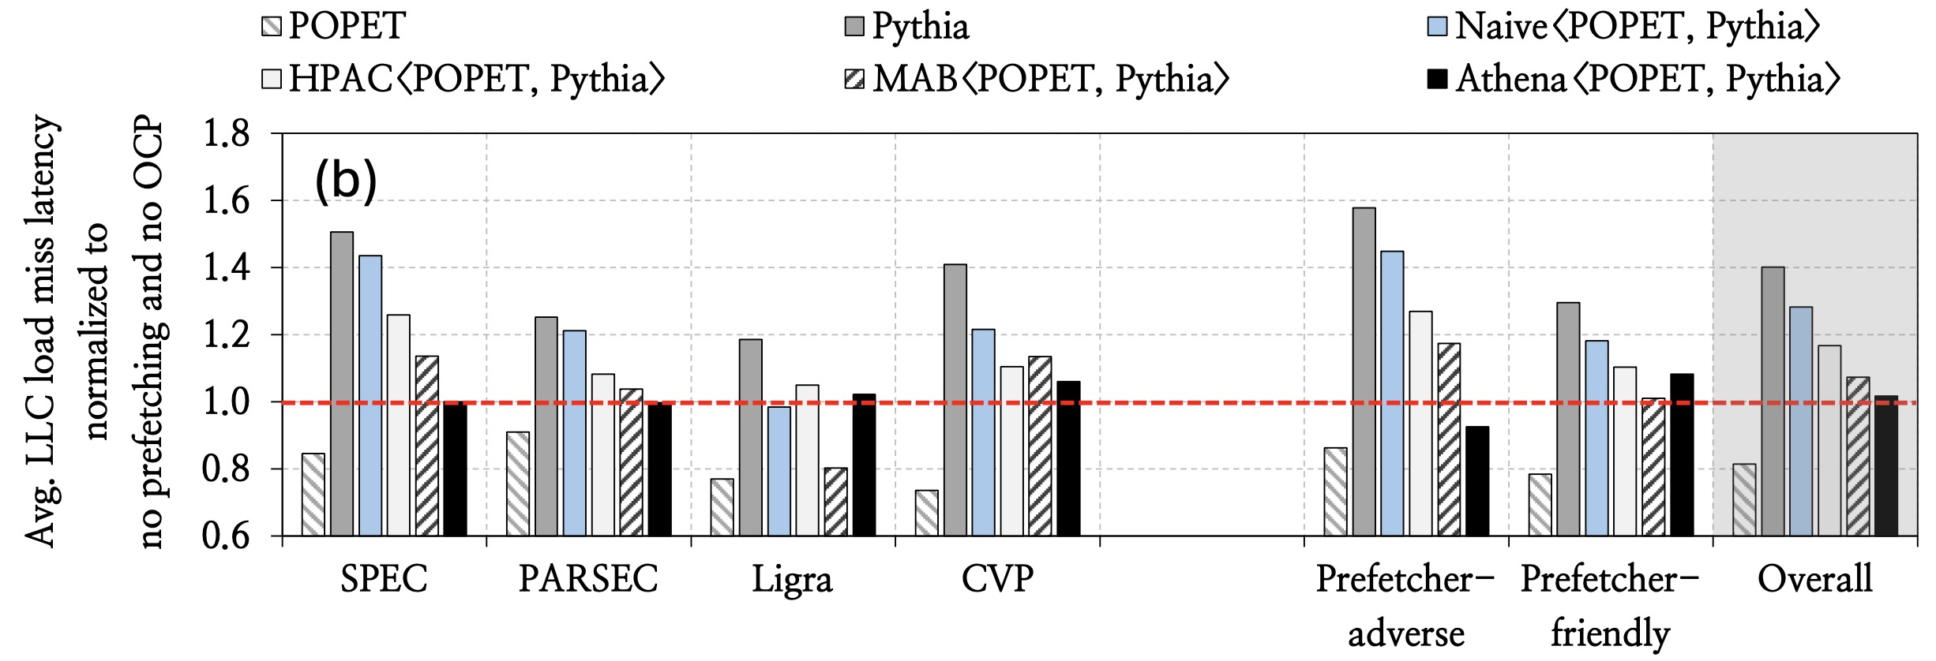
CD1 – Impact on LLC Load Miss Latency

Slide 72
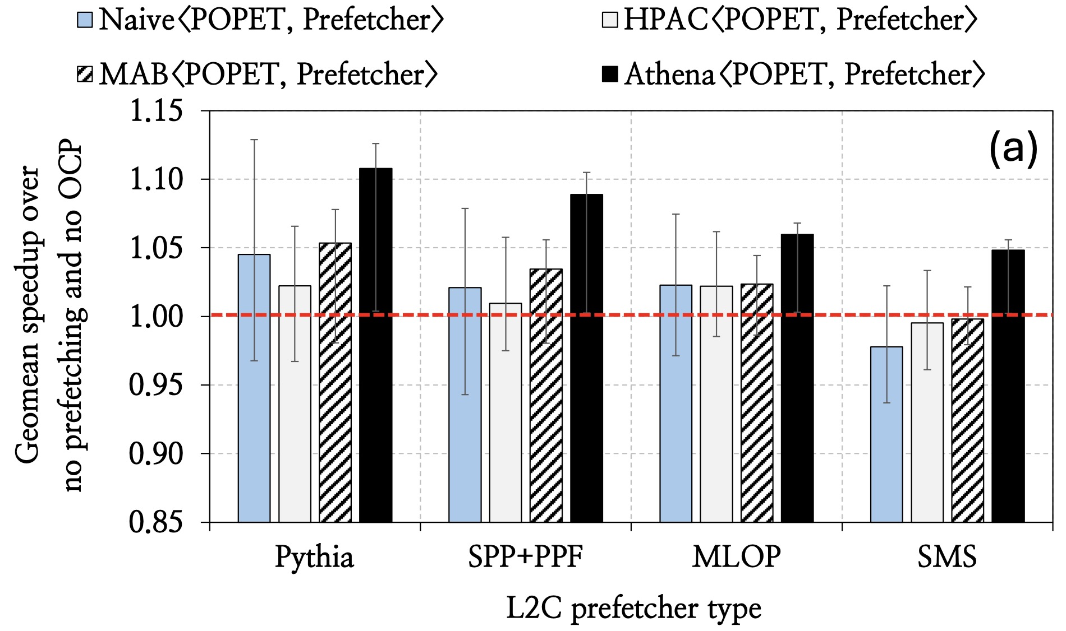
CD1 – Sensitivity to L2C Prefetcher Type

Slide 73
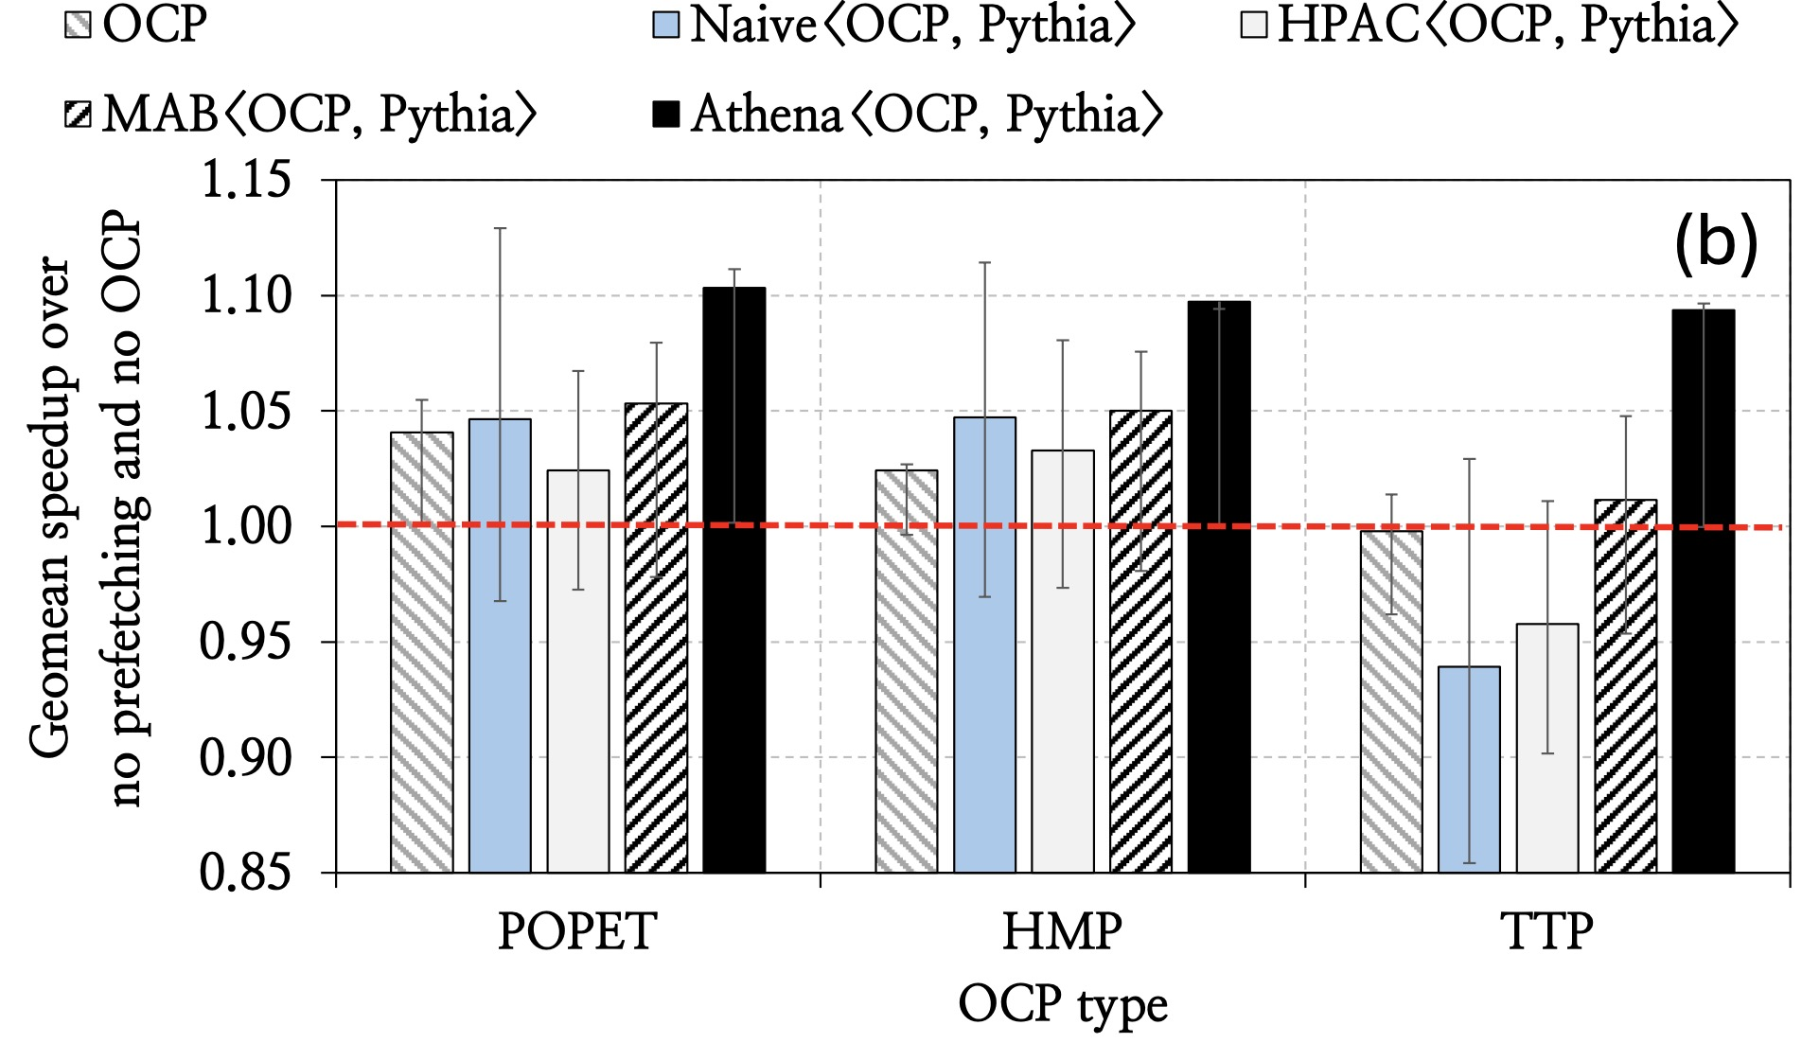
CD1 – Sensitivity to OCP Type

Slide 74
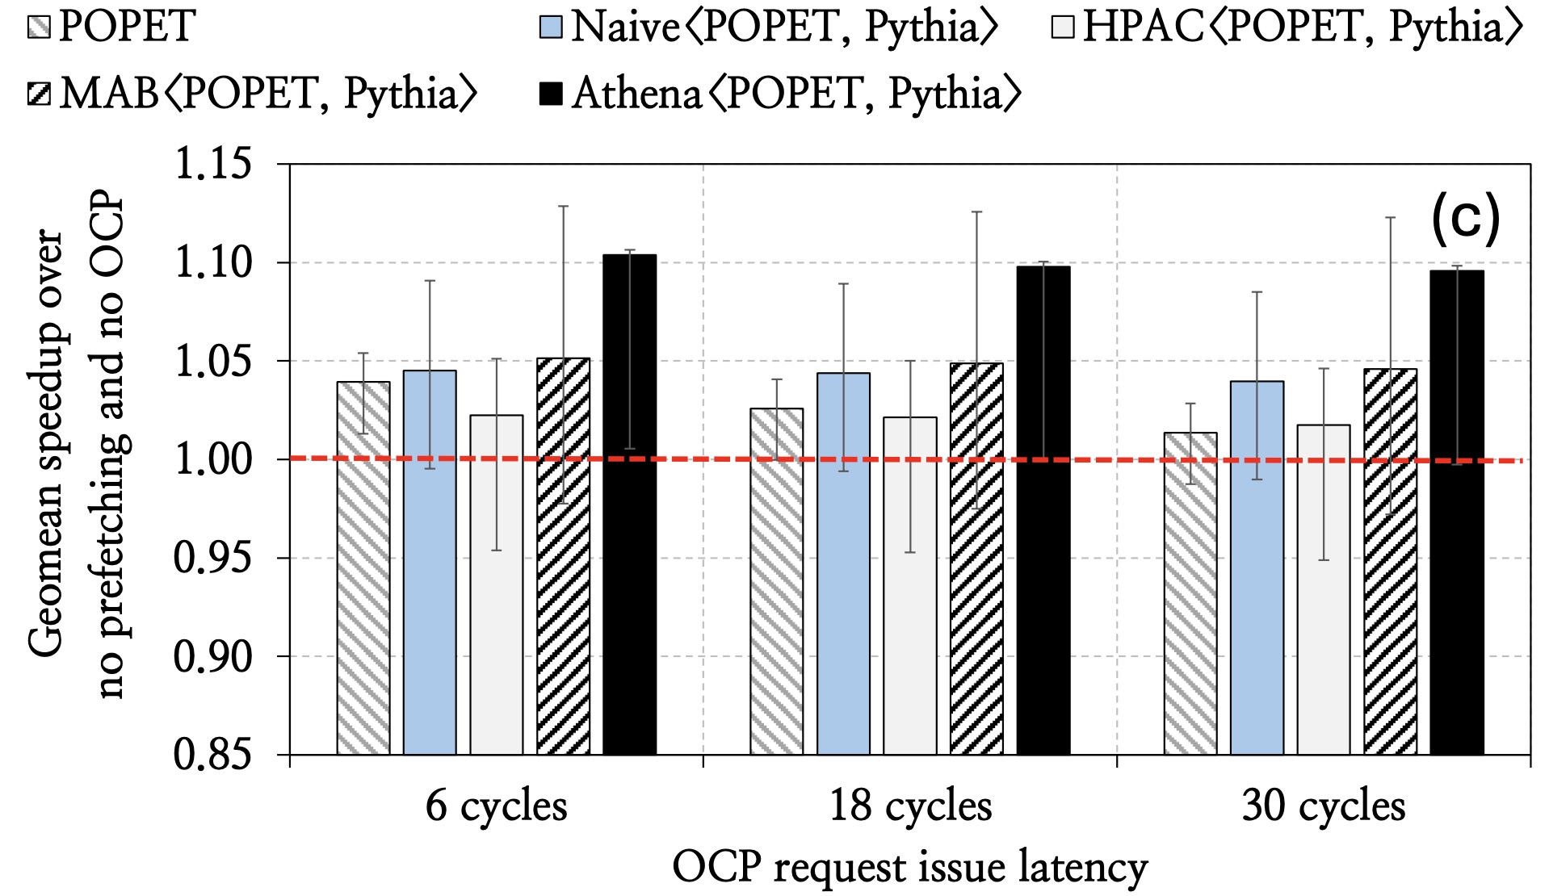
CD1 – Sensitivity to OCP Request Issue Latency

Slide 75
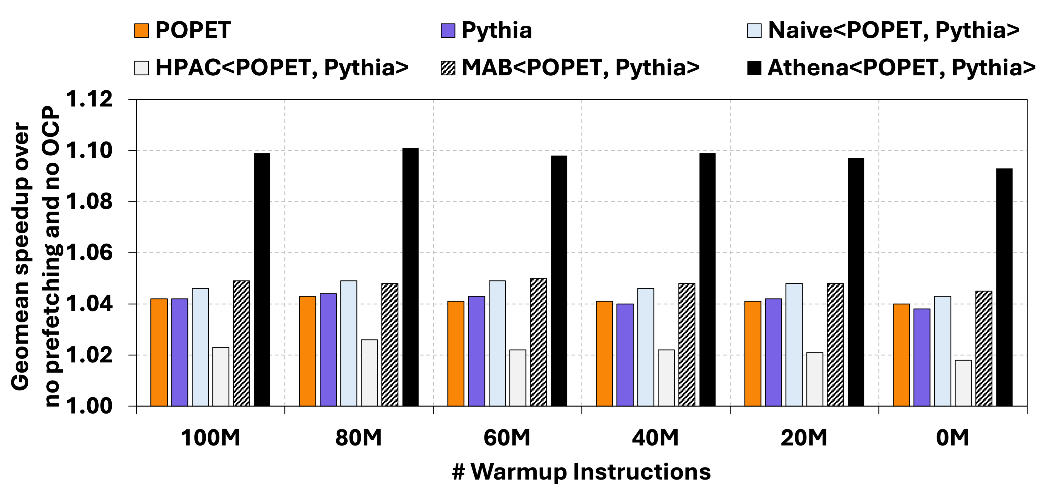
CD1 – Sensitivity to Warmup Length

Slide 76
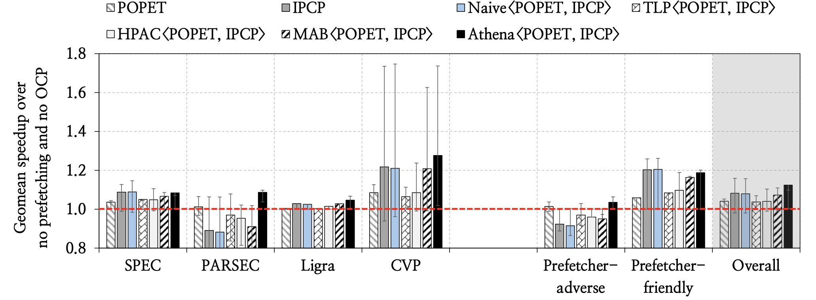
Speedup in CD2

Slide 77
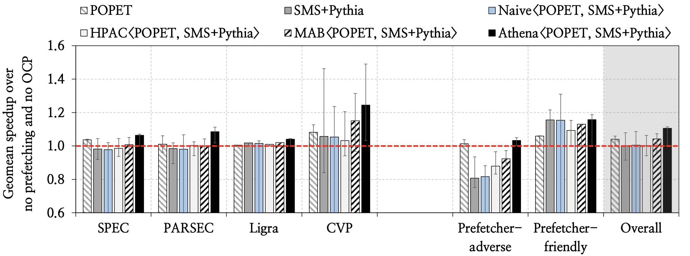
Speedup in CD3

Slide 78
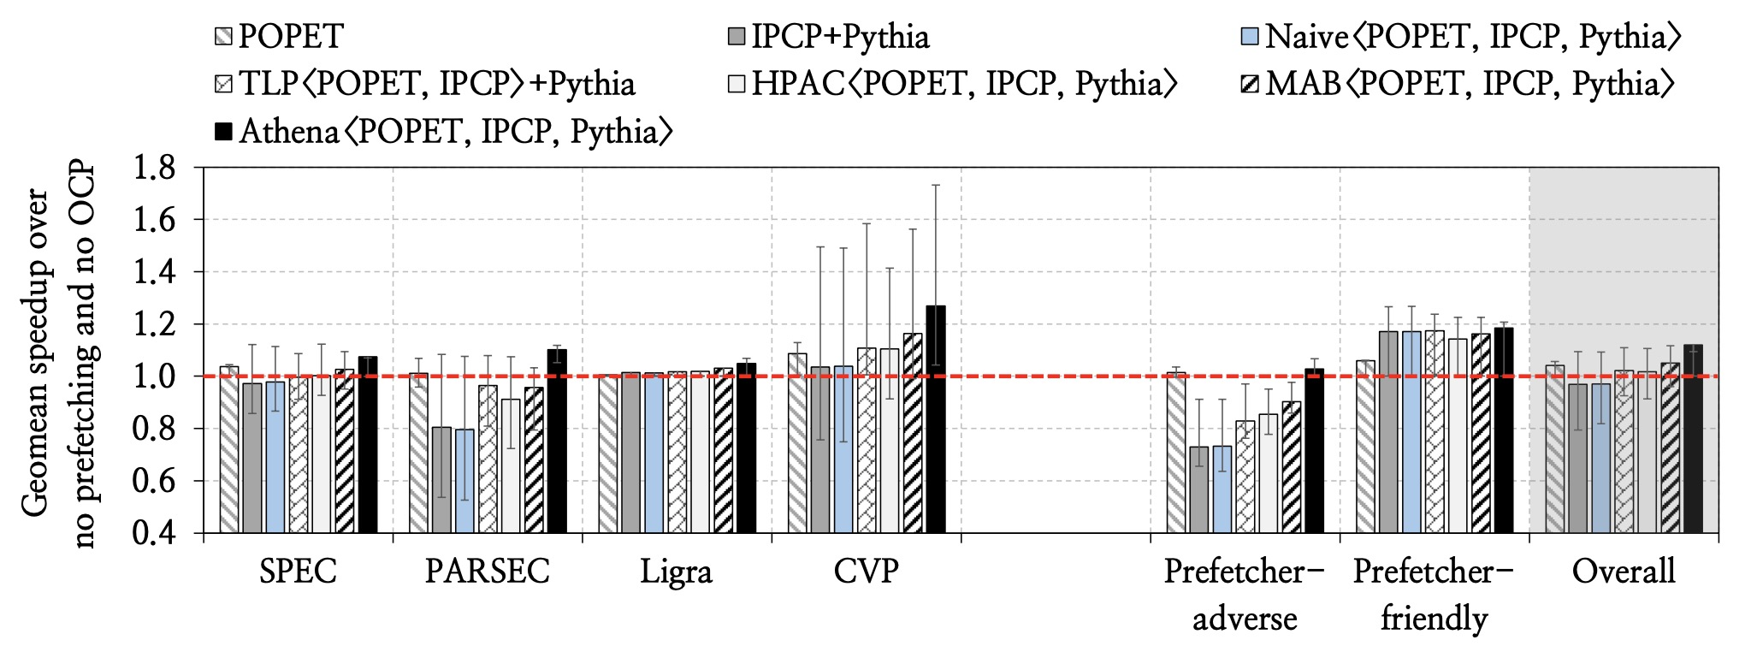
Speedup in CD4

Slide 79
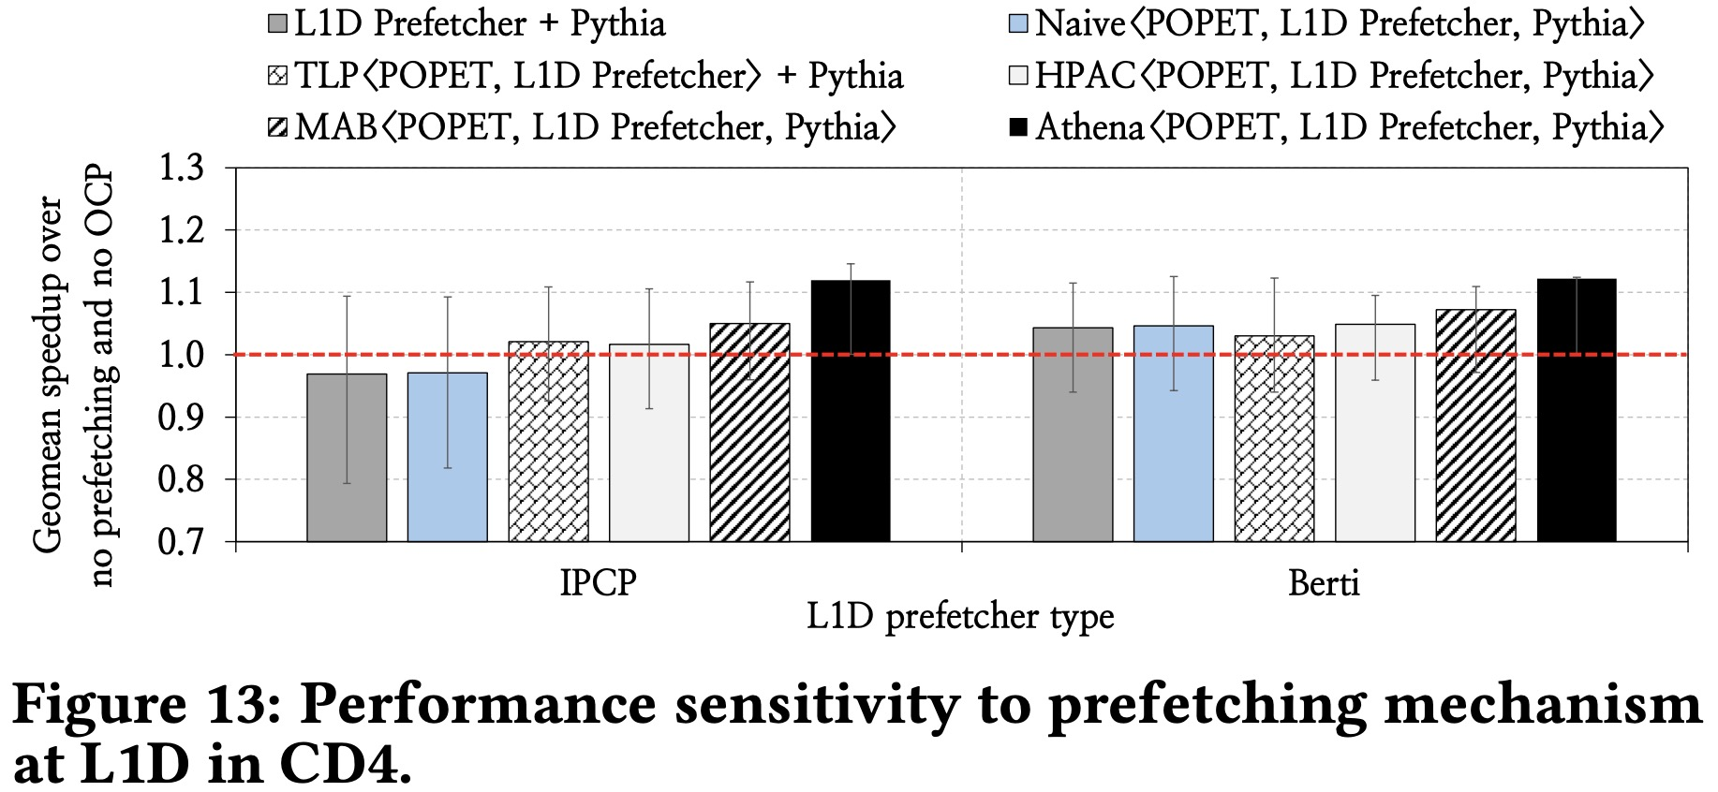
CD4 – Sensitivity to L1D Prefetcher Type

Slide 80
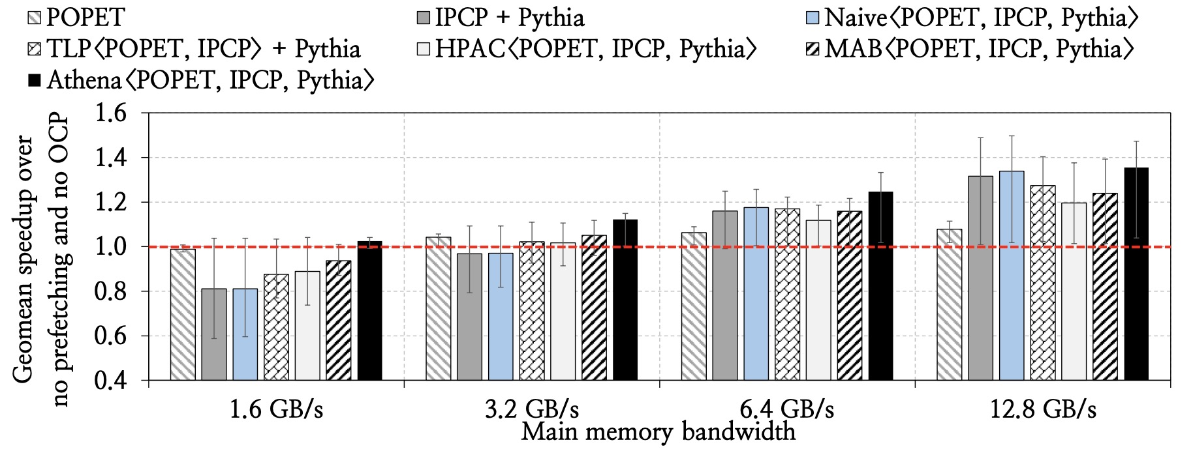
CD4 – Sensitivity to Main Memory Bandwidth

Slide 81
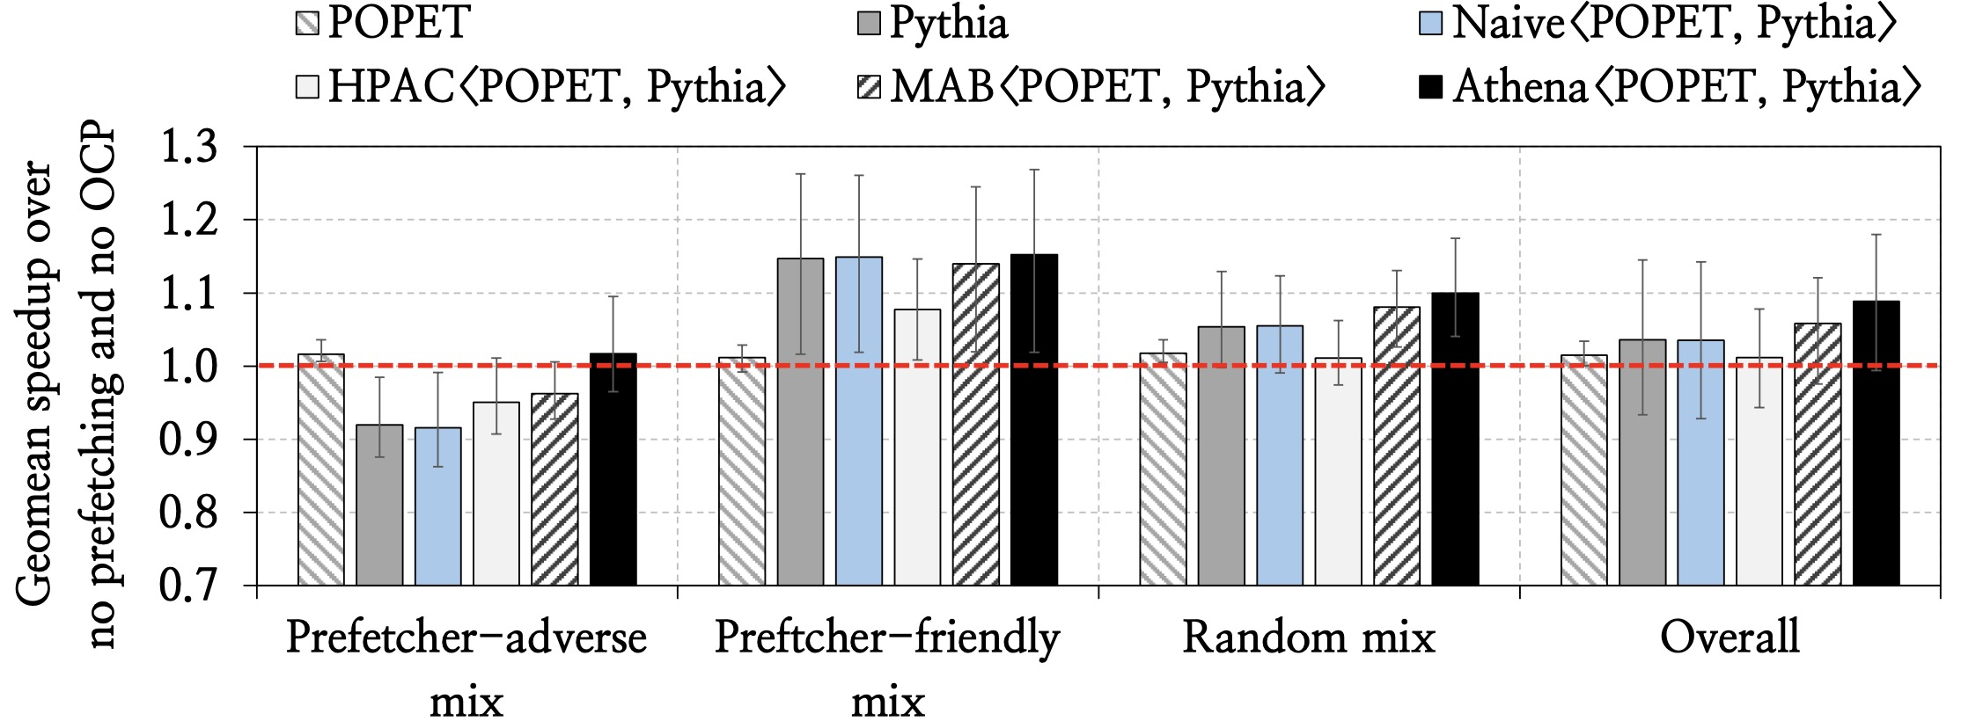
Four-Core Evaluation Results

Slide 82
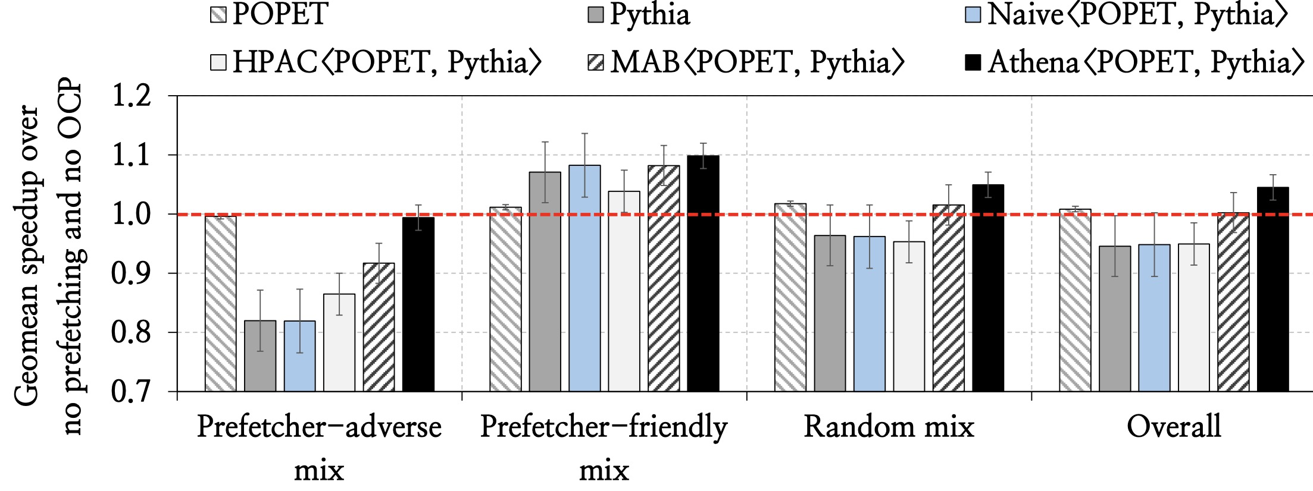
Eight-Core Evaluation Results

Slide 83
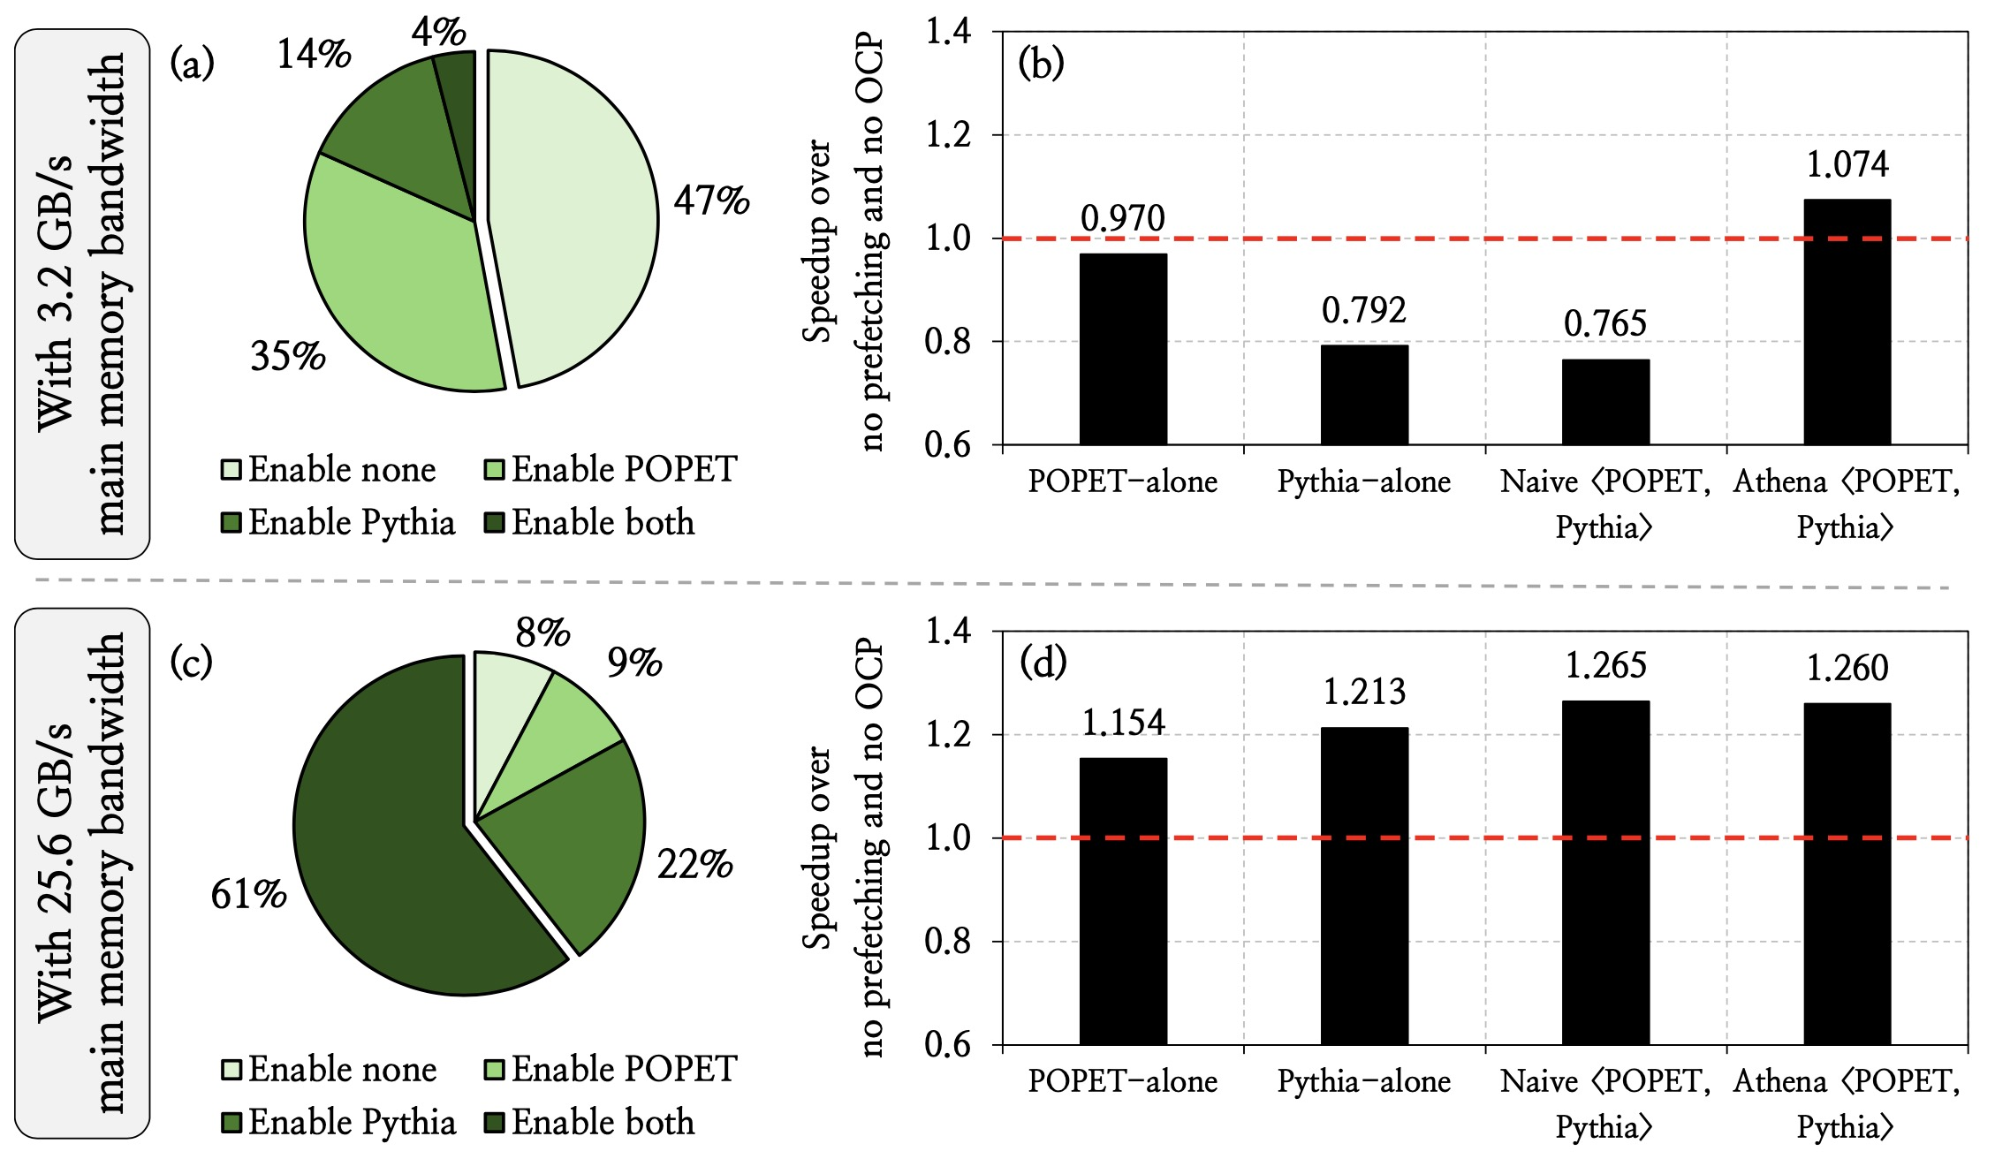
Understanding Athena using a Case Study

Slide 84
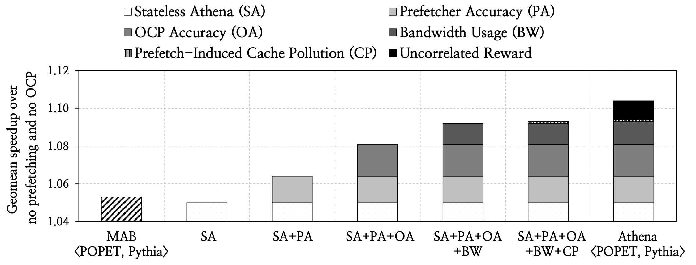
Athena Ablation Study

Slide 85
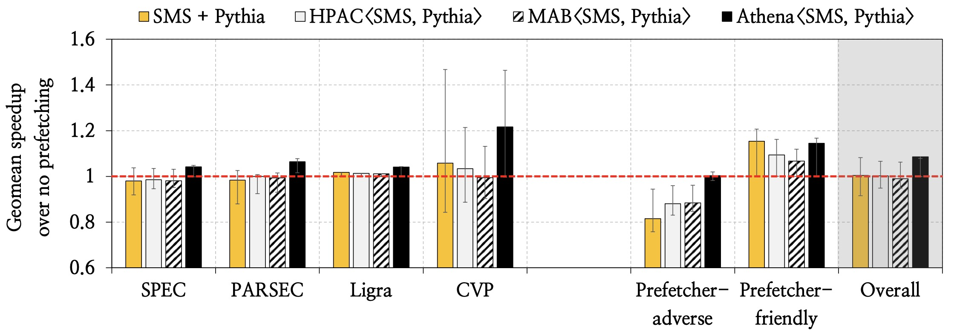
Athena for Prefetcher-Only Management

Slide 86
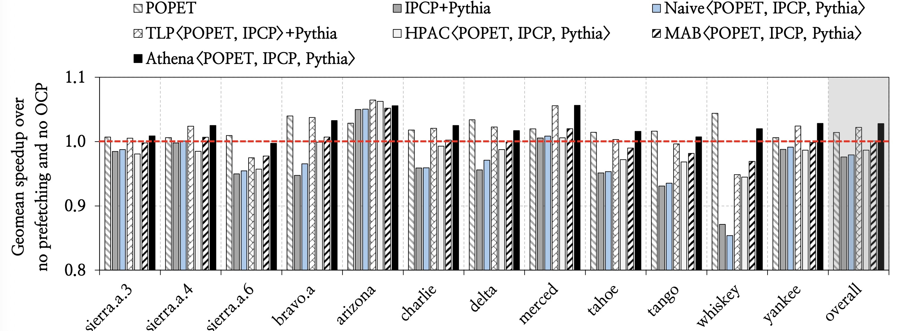
Athena on Unseen Workloads
Across 359 Google datacenter workload traces
released in DPC4

Slide 87
Old Slides

Slide 88
Automated Design Space Exploration
Feature 2
Feature 1
Feature N
4 Final Features
Prefetcher accuracy, OCP accuracy, bandwidth usage, and prefetch-induced cache pollution

Slide 89
Athena: Detailed Design
State
Q-Value
Table
Q-Value
Table
QVStore
+
Action
Notes:
Banner
Describe
: no com
Q-Value Storage
(QVStore), whose purpose is to store the Q-values of state-
action pairs encountered during Athena’s online operation.
plicated /…
Q-Value Storage
(QVStore), whose purpose is to store the Q-values of state-
action pairs encountered during Athena’s online operation.

Slide 90
Athena: Detailed Design
State
Q-Value
Table
Q-Value
Table
QVStore
+
Athena adopts a lightweight and hardware-friendly
tabular organization for storing Q-values, tailored for
low-latency access and online updates
Action
Notes:
Banner
Describe
: no complicated /…

Slide 91
Putting it all Together
Plane₁
Feature₁
#
index
hash₁
q₁(s, a)
Plane₂
q₂(s, a)
Feature₂
index
𝚺
Q(s, a)
a*
concatenate
#
argmax
State vector
hash₂
.
.
.
.
.
.
sum partial
Q-values
.
.
.
(32-bit)
q_{k}(s, a)
Plane_{k}
Feature_{F}
#
index
hash_{k}
Notes:
For a given state-action pair, Athena retrieves its correspond-
ing Q-value from the partitioned QVStore in three stages, as
shown in Figure 6. First, Athena constructs the state vector
by concatenating all feature values. Second, Athena applies k
distinct hash functions to the state vector, each producing an
index to a plane to retrieve the corresponding partial Q-value
in parallel. Third, Athena computes the final Q-value by sum-
ming the partial Q-values across all planes. At the end of each
epoch, Athena updates the Q-value using the SARSA update
rule (see §3), applying the update independently to each plane.

